Slide 1
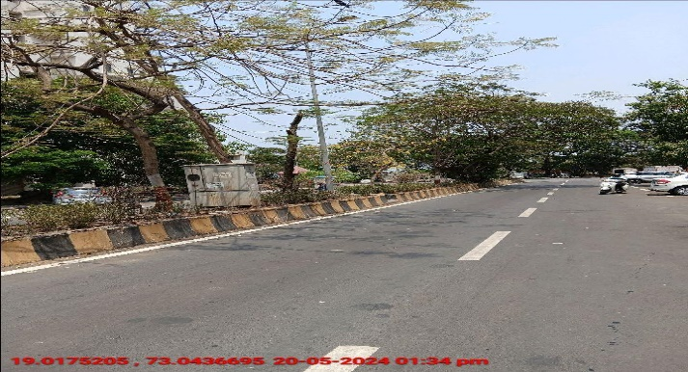
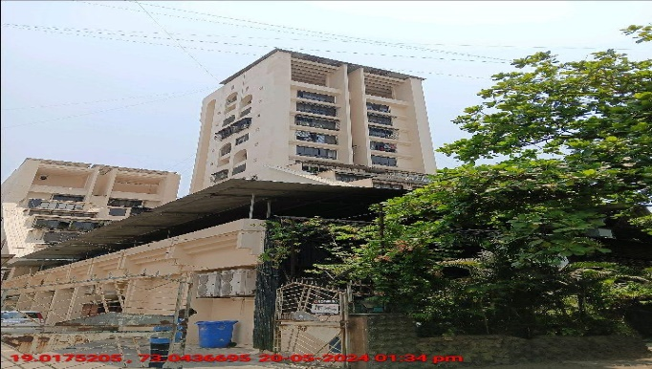
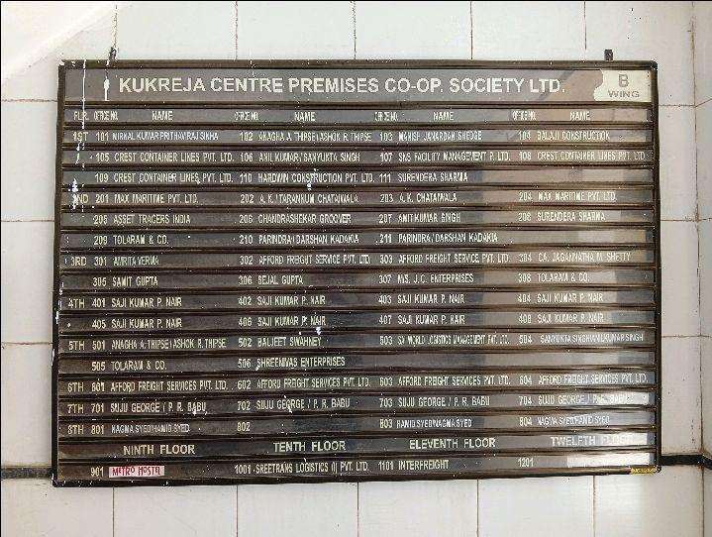
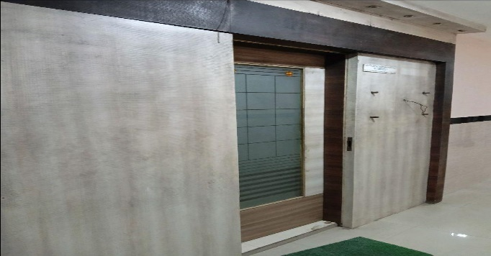
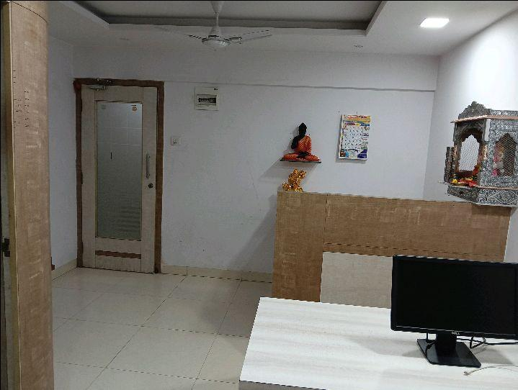
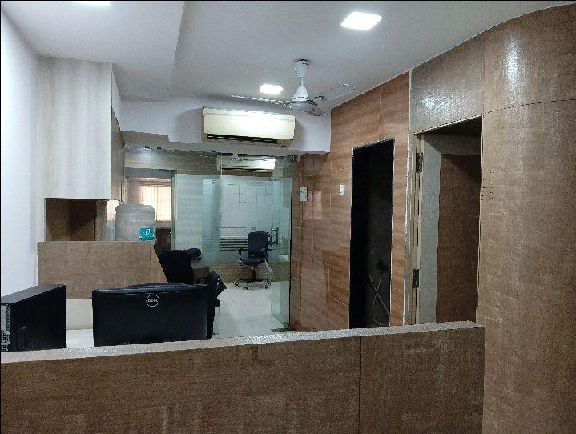
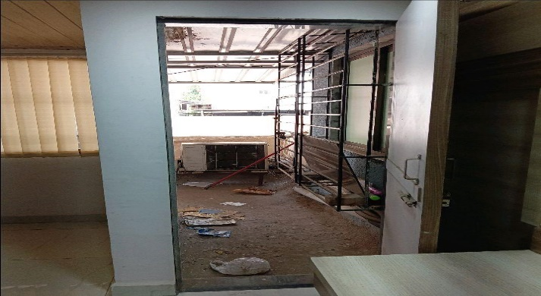
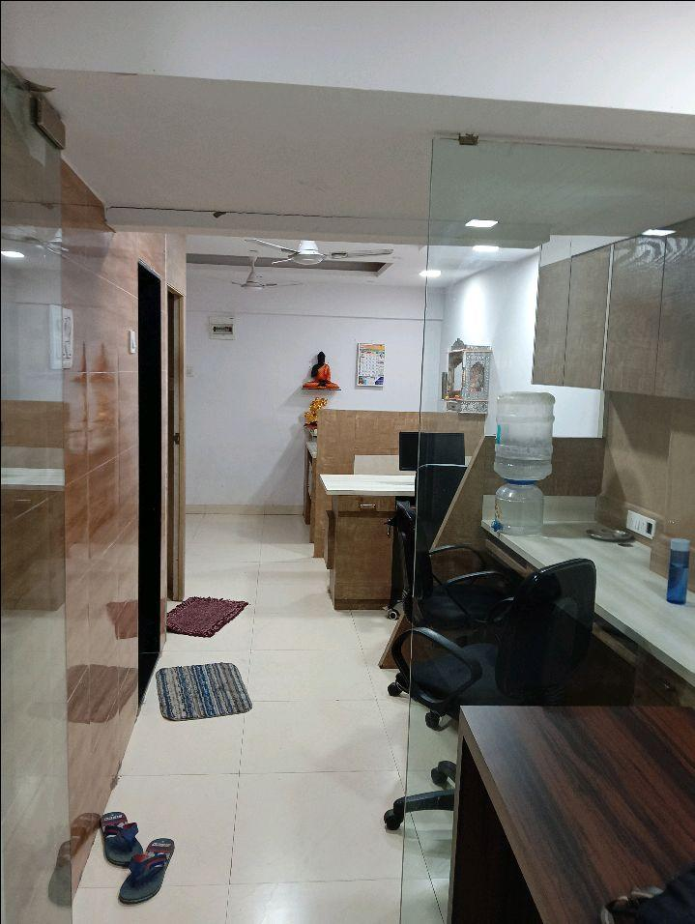
V.S.JADON & CO VALUERS LLP
PHOTOGRAPHS OF PROPERTY OF CUSTOMER HARDWIN CONSTRUCTION PVT LTD
VSJCVNM-AXIS-RTL-MAY24-05264 Page 1

Slide 2
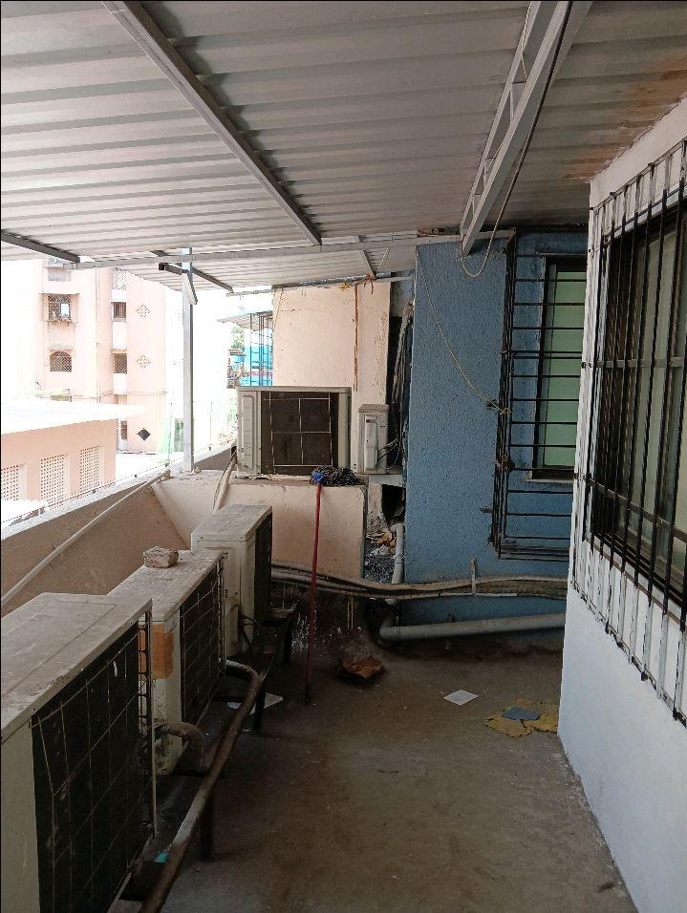
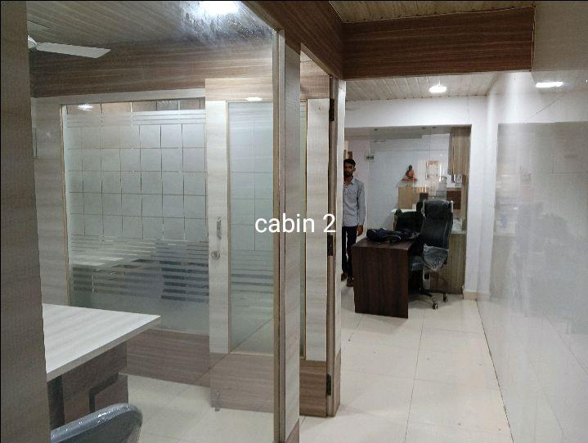
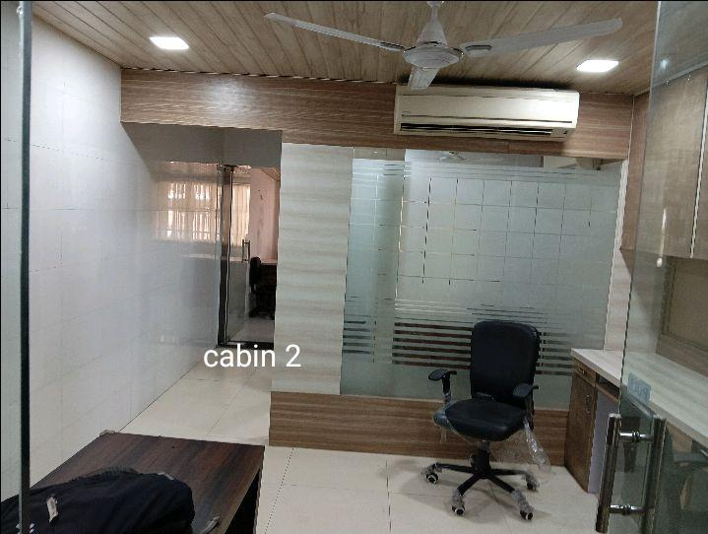
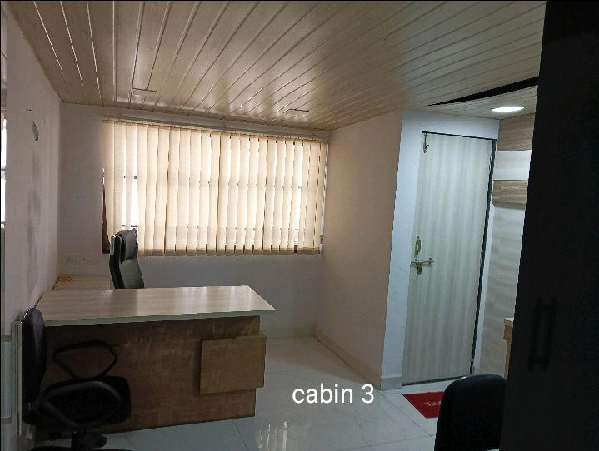
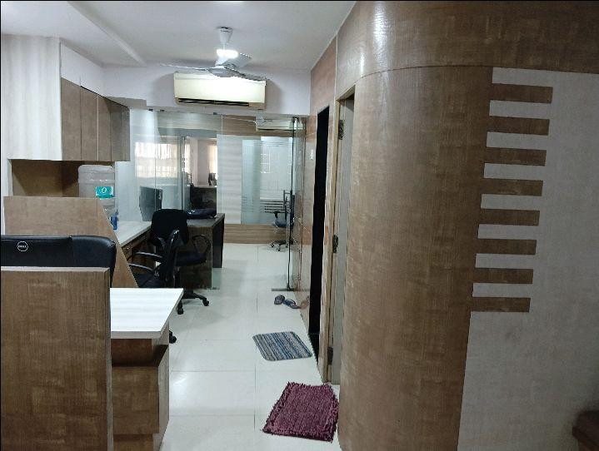

V.S.JADON & CO VALUERS LLP
PHOTOGRAPHS OF PROPERTY OF CUSTOMER HARDWIN CONSTRUCTION PVT LTD
VSJCVNM-AXIS-RTL-MAY24-05264 Page 2

Slide 3
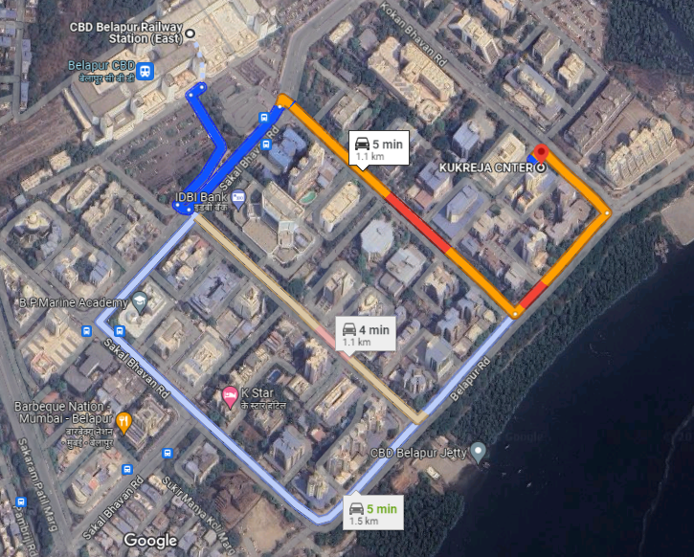
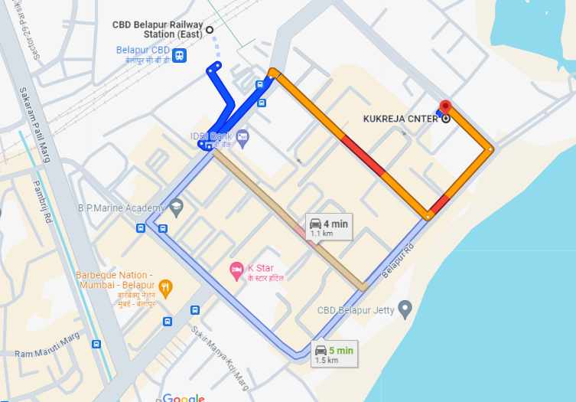
V.S.JADON & CO VALUERS LLP
PHOTOGRAPHS OF PROPERTY OF CUSTOMER HARDWIN CONSTRUCTION PVT LTD
GOOGLE MAP :
VSJCVNM-AXIS-RTL-MAY24-05264 Page 3

Slide 4
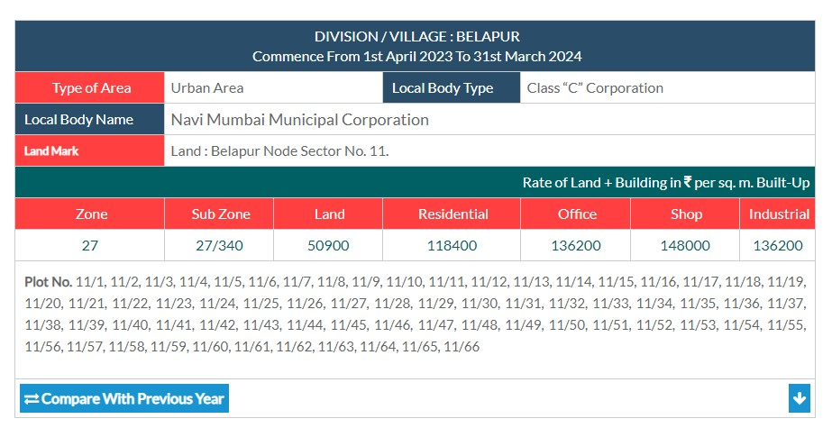
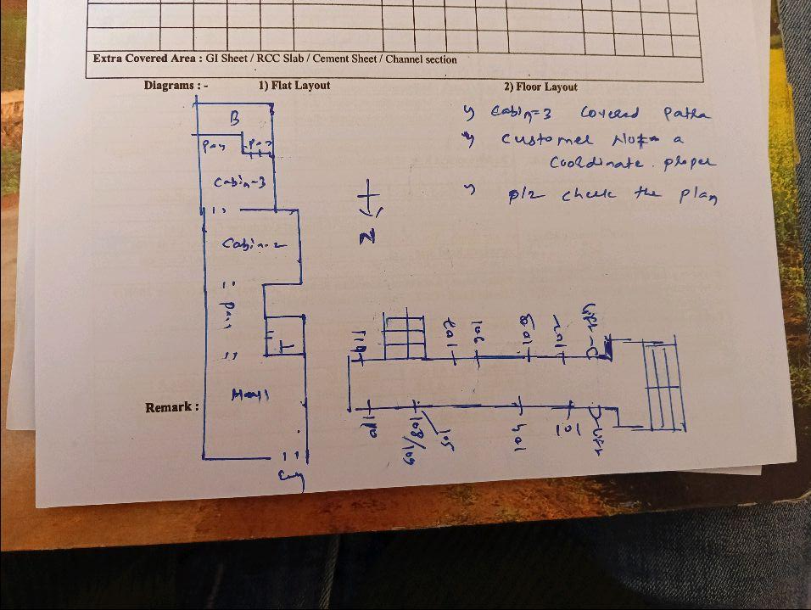
V.S.JADON & CO VALUERS LLP
PHOTOGRAPHS OF PROPERTY OF CUSTOMER HARDWIN CONSTRUCTION PVT LTD
Govt. Rate :
VSJCVNM-AXIS-RTL-MAY24-05264 Page 4

