Slide 1
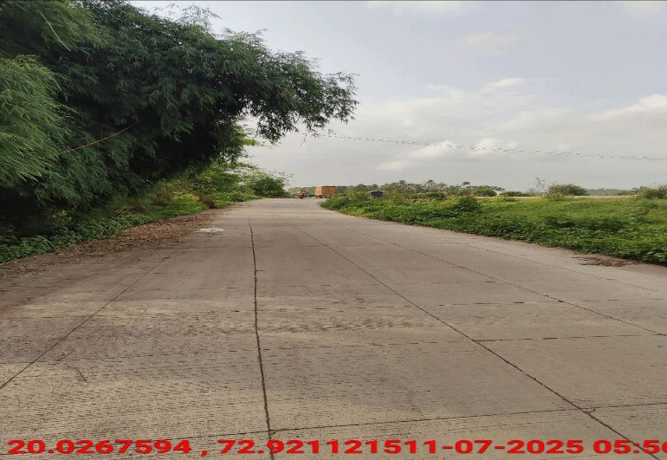
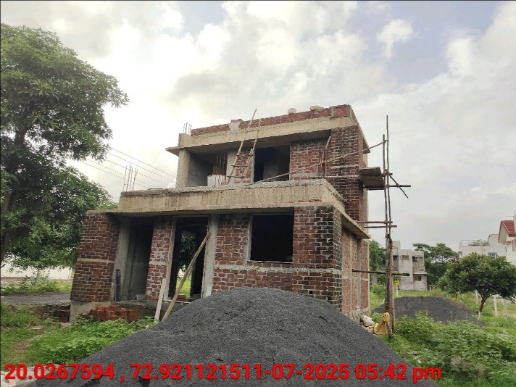
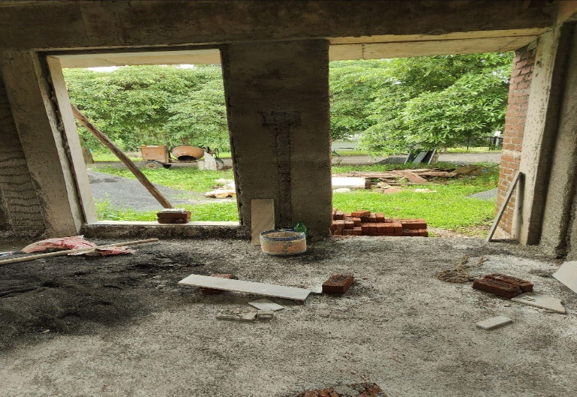
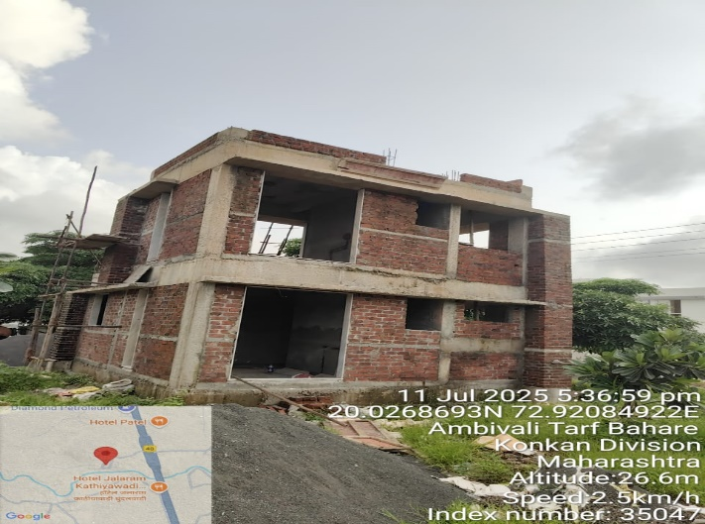
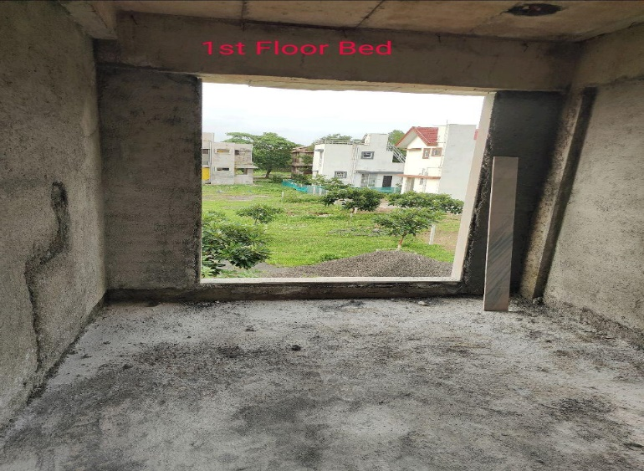
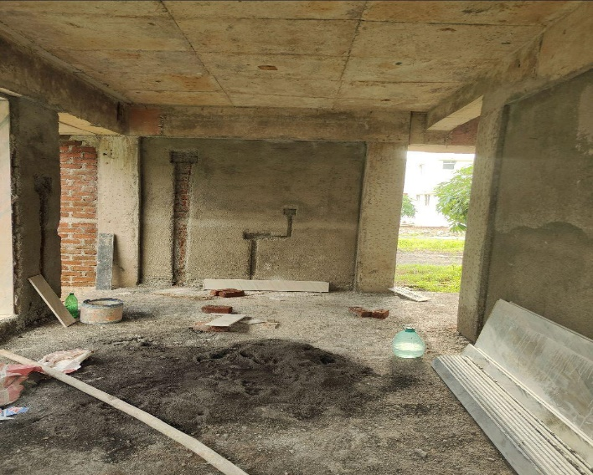
V.S.JADON & CO VALUERS LLP
PHOTOGRAPHS OF PROPERTY OF CUSTOMER Shweta Sachin Singh
VSJCVNM-RBL-RTL-JUL25-12779 Page 6

Slide 2
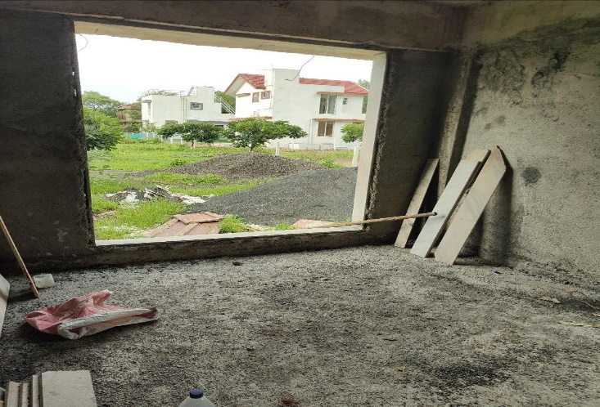
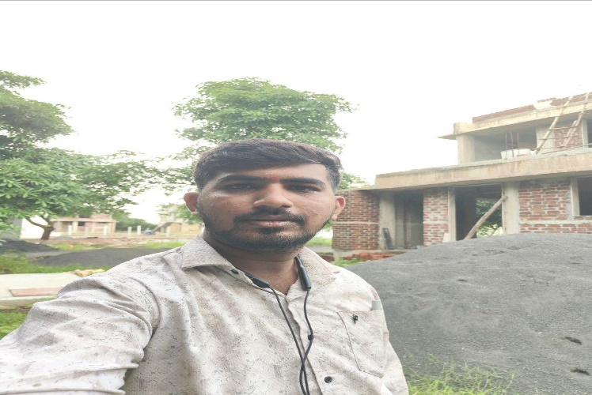
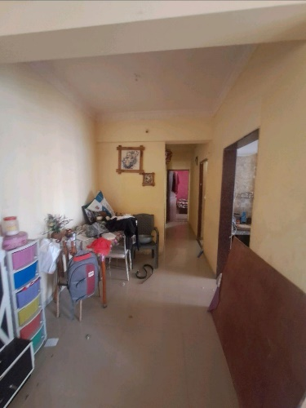
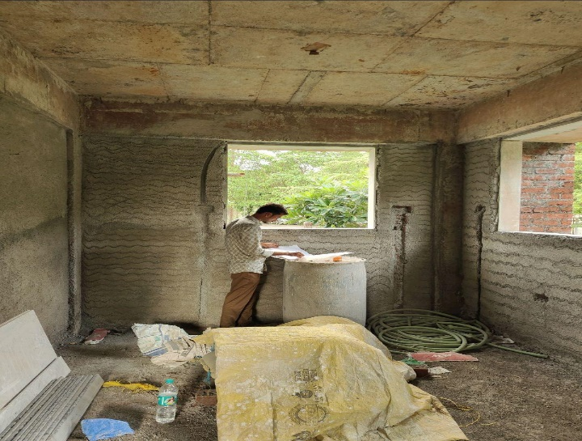
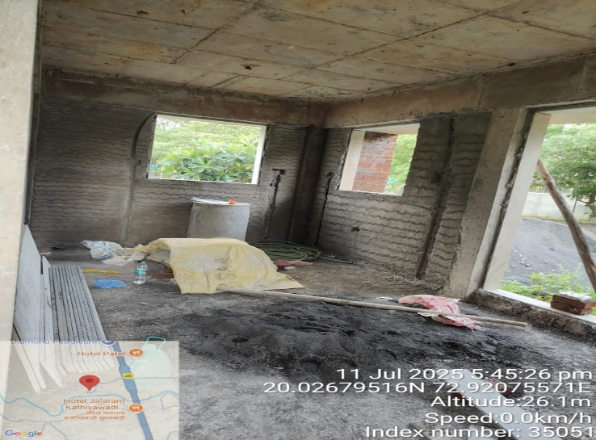
V.S.JADON & CO VALUERS LLP
PHOTOGRAPHS OF PROPERTY OF CUSTOMER Shweta Sachin Singh
VSJCVNM-RBL-RTL-JUL25-12779 Page 7

Slide 3
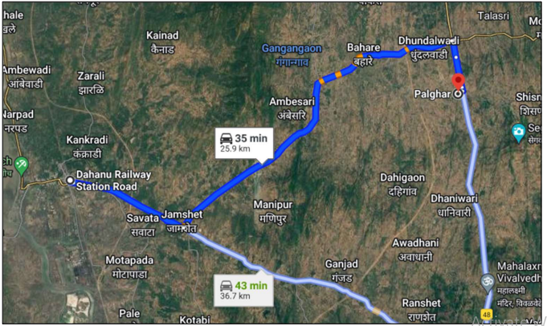
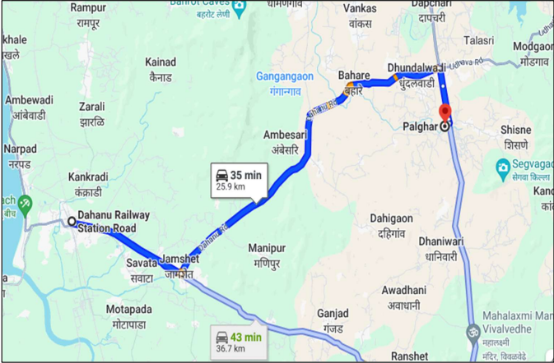
V.S.JADON & CO VALUERS LLP
PHOTOGRAPHS OF PROPERTY OF CUSTOMER : Shweta Sachin Singh
Google Map
VSJCVNM-RBL-RTL-JUL25-12779 Page 8

Slide 4
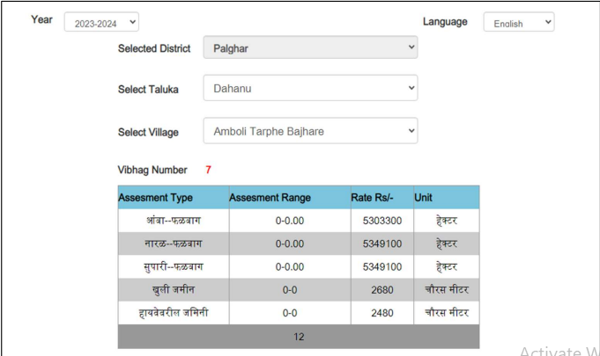
V.S.JADON & CO VALUERS LLP
PHOTOGRAPHS OF PROPERTY OF CUSTOMER Shweta Sachin Singh
Gov Rate
VSJCVNM-RBL-RTL-JUL25-12779 Page 10

