Slide 1
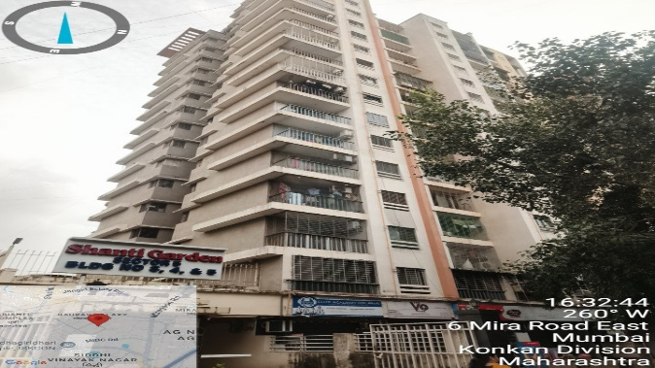
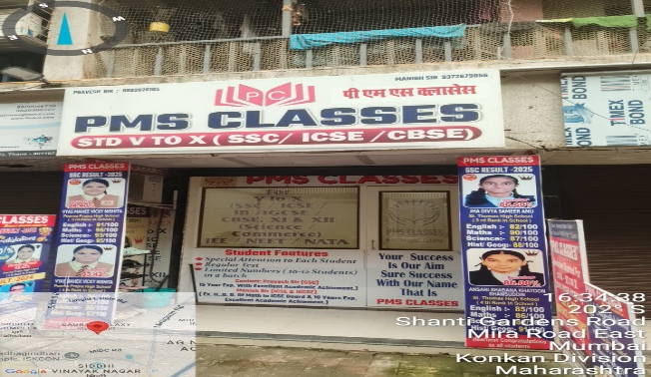
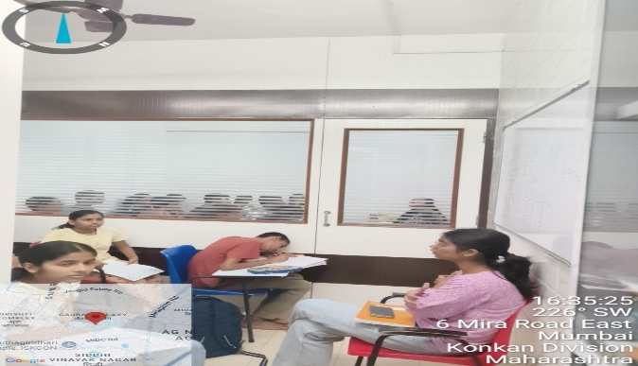
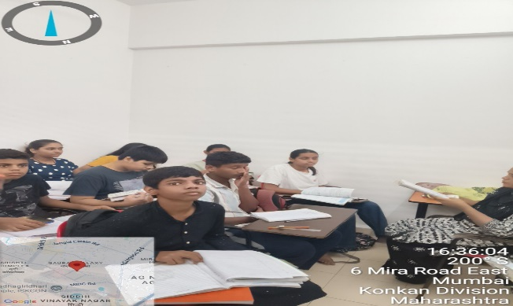
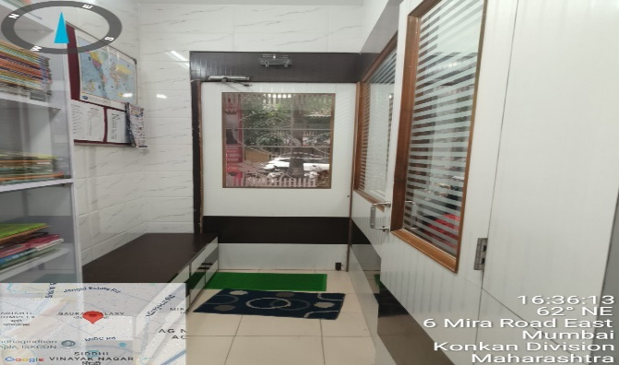
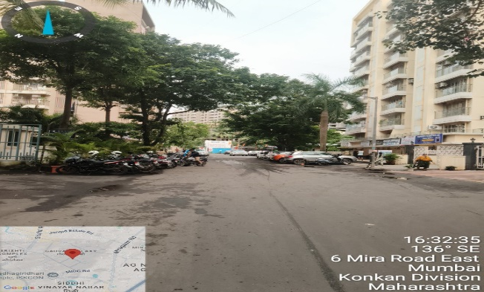

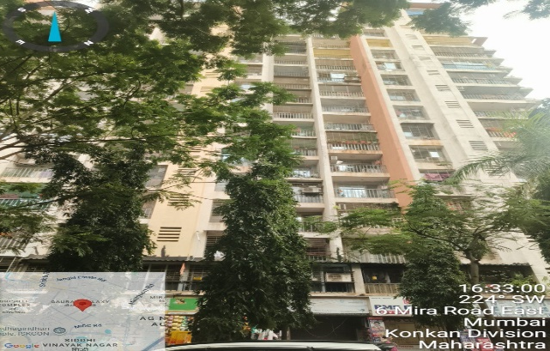
V.S.JADON & CO VALUERS LLP
Property Photographs :Mr. Manish Mishrav.
VSJCVNM-AXIS-RTL-JUL25-13067
1

Slide 2
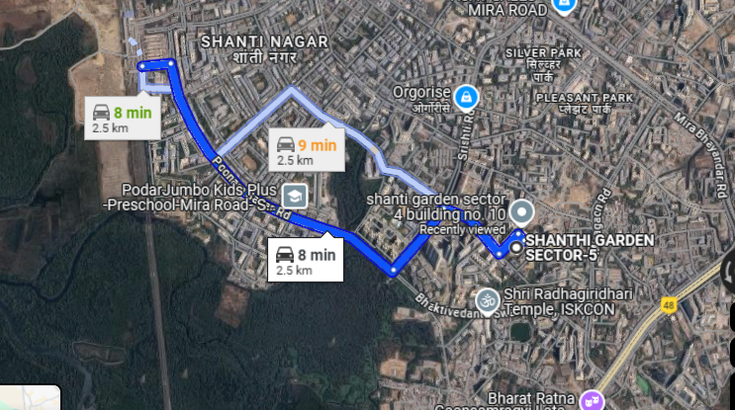
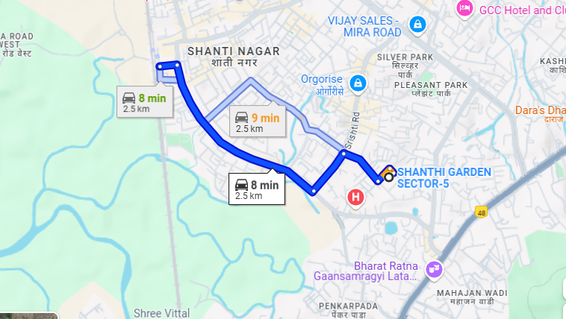
V.S.JADON & CO VALUERS LLP
Google Maps :Mr. Manish Mishra.
VSJCVNM-AXIS-RTL-JUL25-13067
3

Slide 3
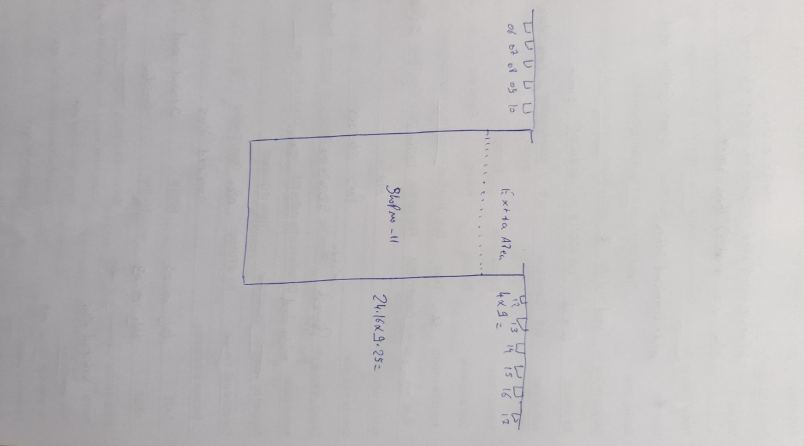
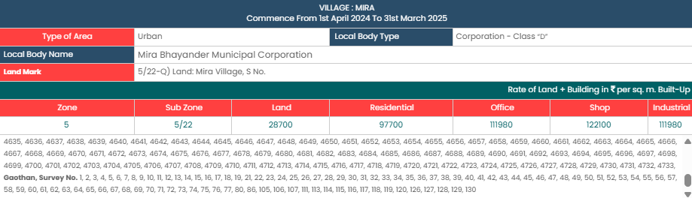
V.S.JADON & CO VALUERS LLP
Layout :Mr. Manish Mishra.
VSJCVNM-AXIS-RTL-JUL25-13067
4

