Slide 1
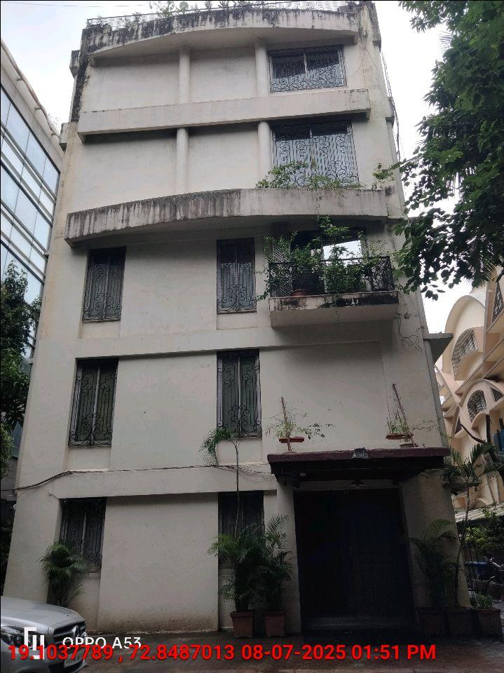
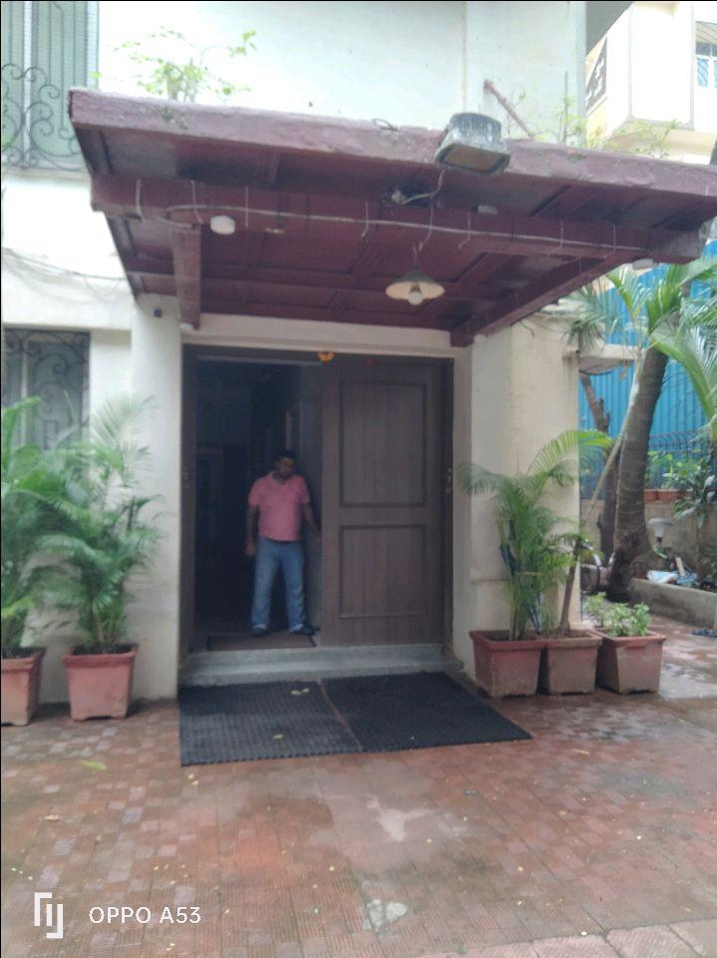
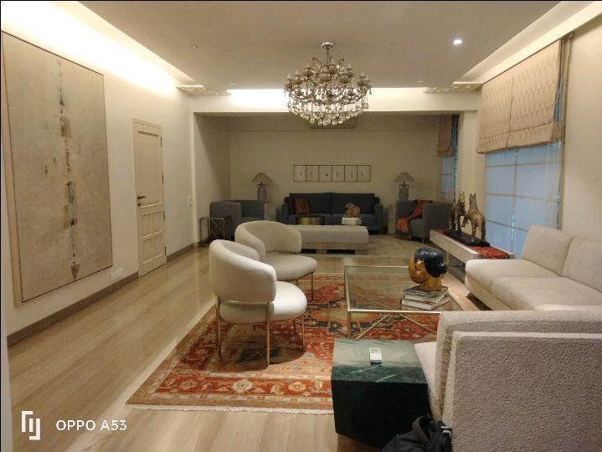
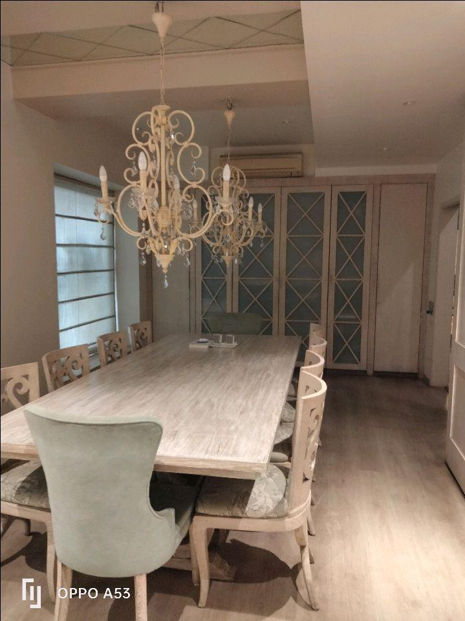
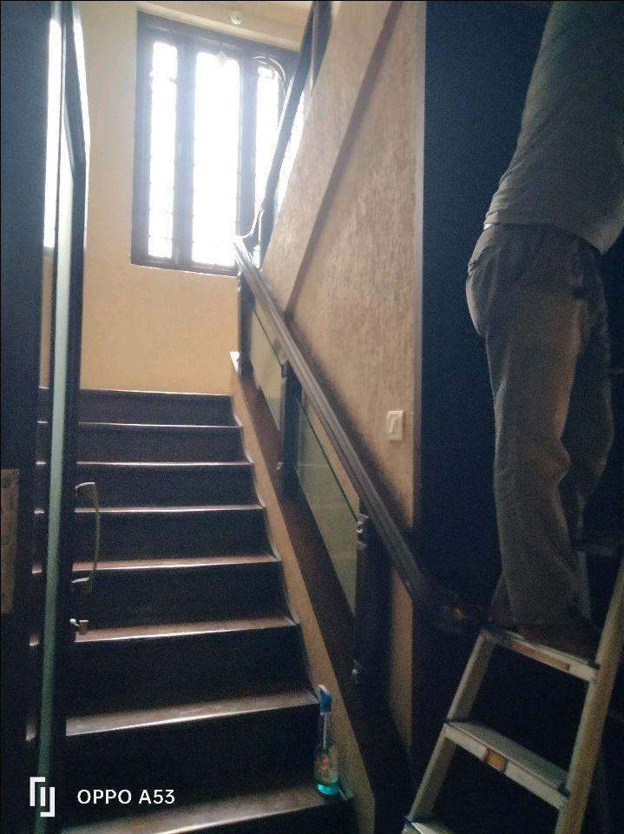
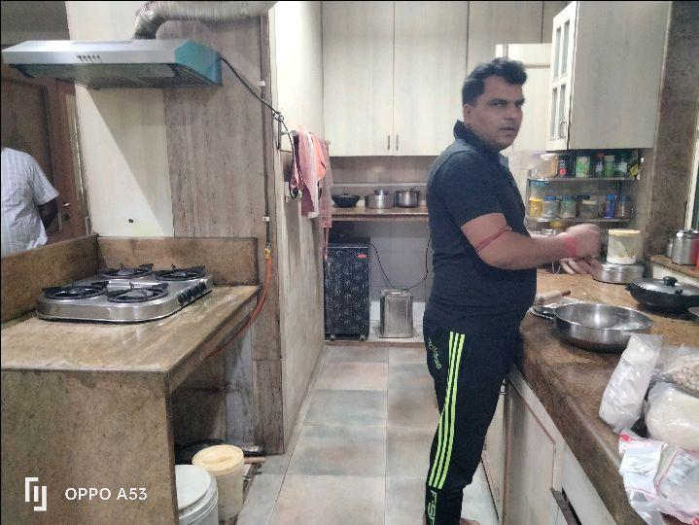
V.S.JADON & CO VALUERS LLP
PHOTOGRAPHS OF PROPERTY OF CUSTOMER: SHALINI GOENKA
VSJCVNM-RBL-RTL-JUL25-13114 Page 1

Slide 2
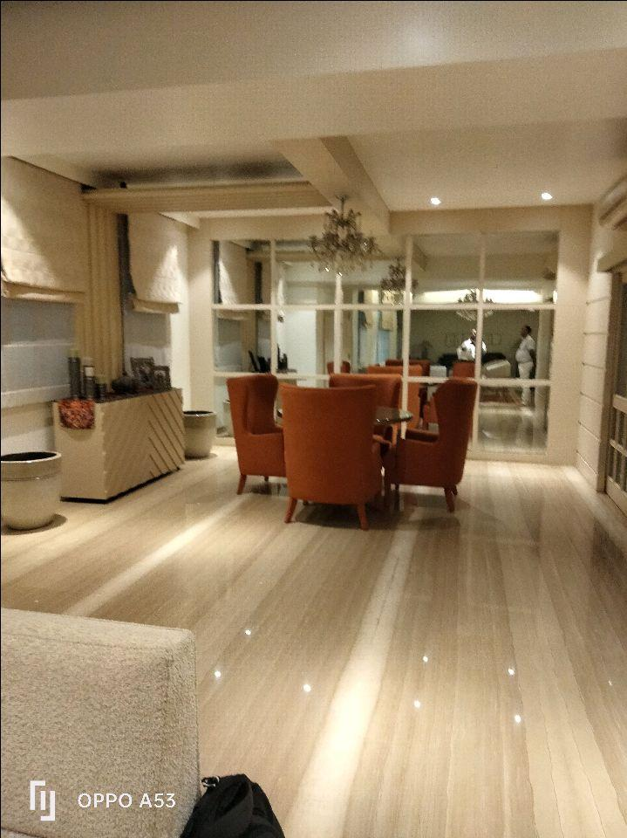
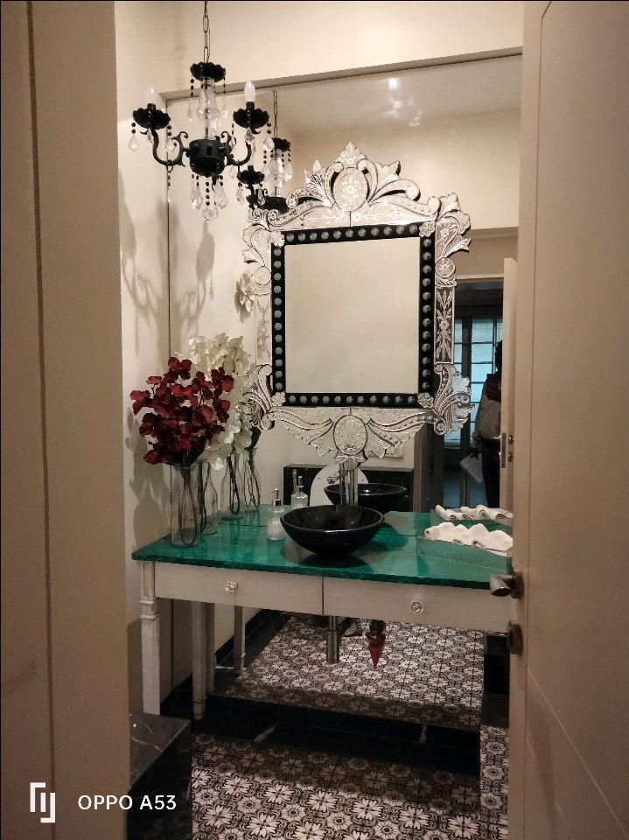
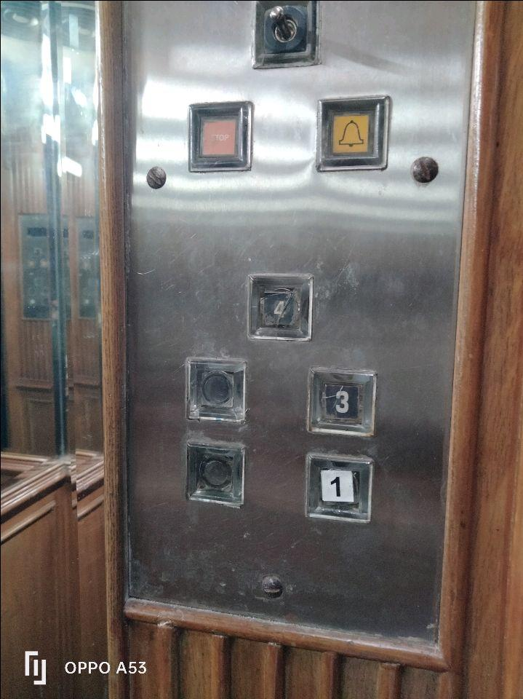
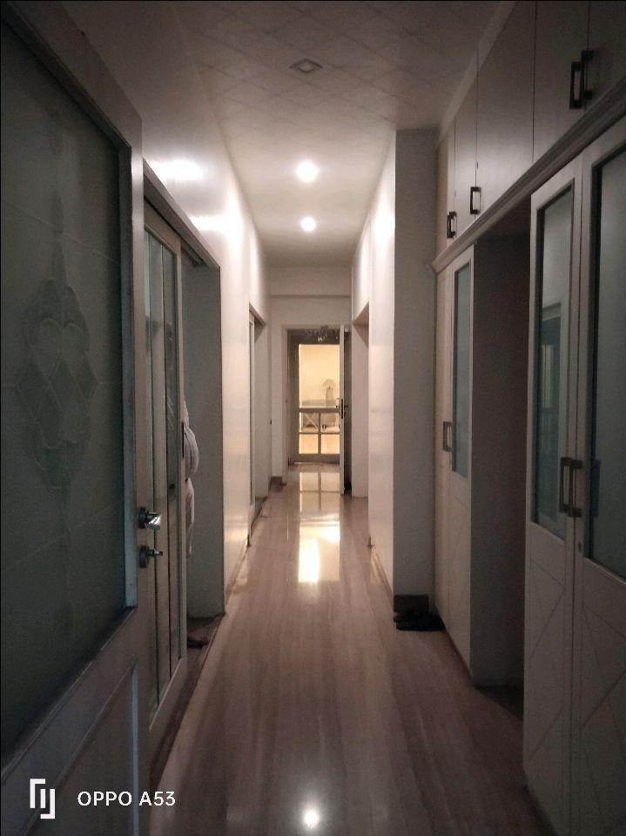
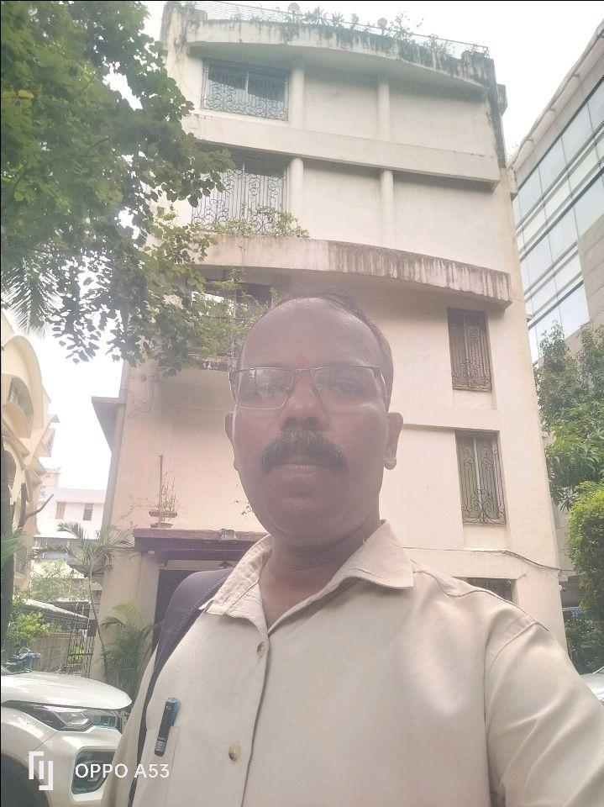
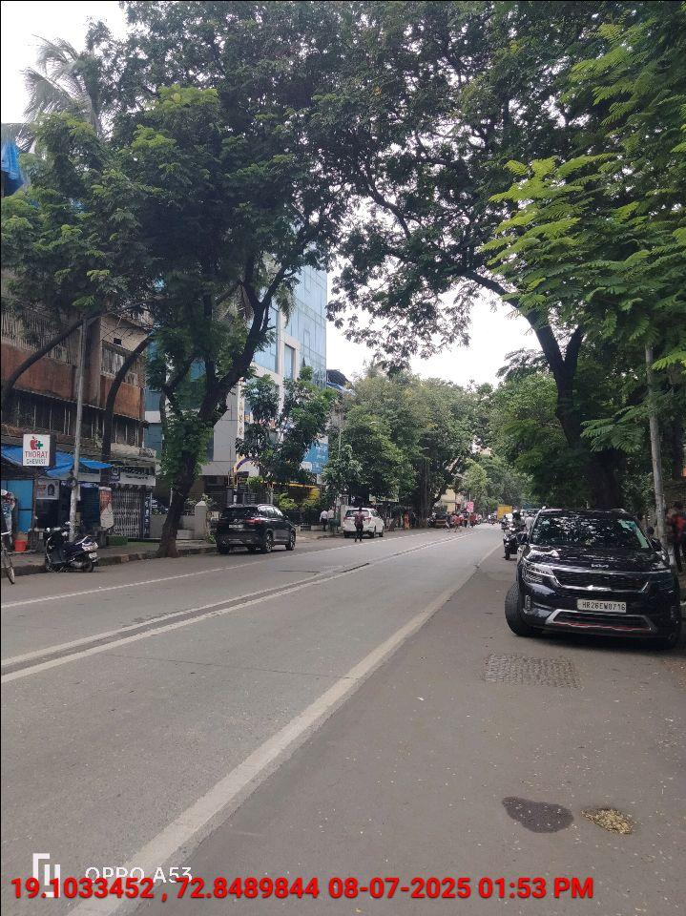
V.S.JADON & CO VALUERS LLP
PHOTOGRAPHS OF PROPERTY OF CUSTOMER: SHALINI GOENKA
VSJCVNM-RBL-RTL-JUL25-13114 Page 1

Slide 3
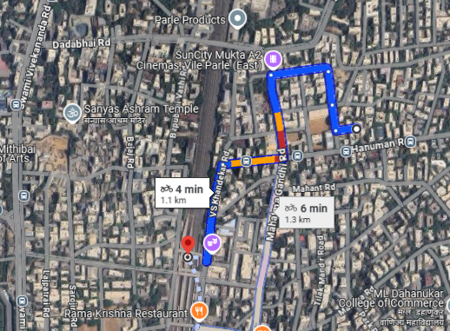
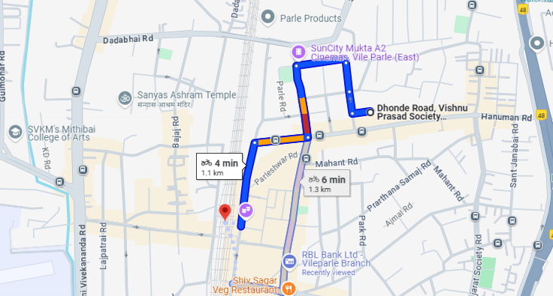
V.S.JADON & CO VALUERS LLP
PHOTOGRAPHS OF PROPERTY OF CUSTOMER: SHALINI GOENKA
VSJCVNM-RBL-RTL-JUL25-13114 Page 3

