Slide 1
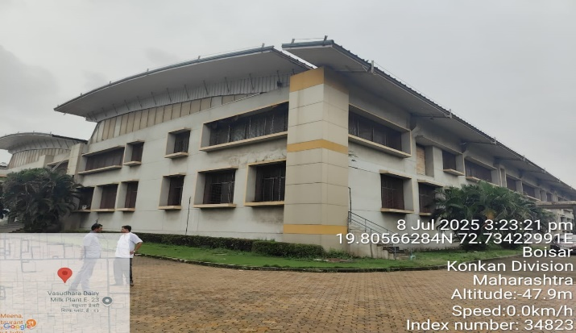
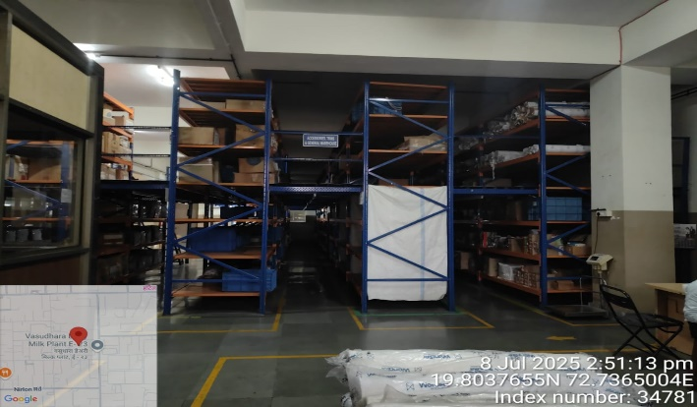
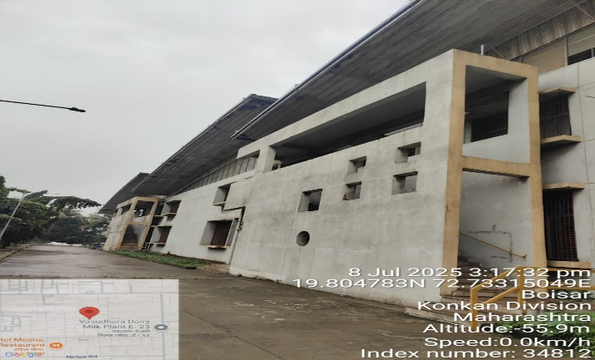
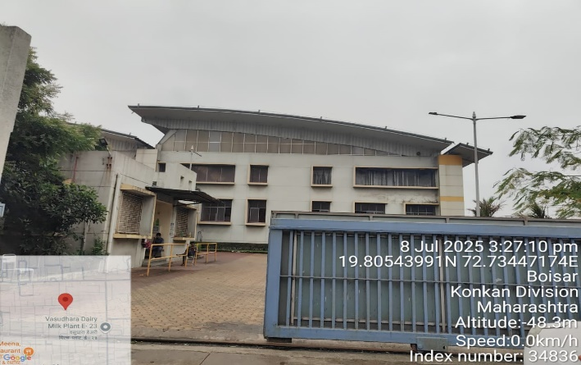
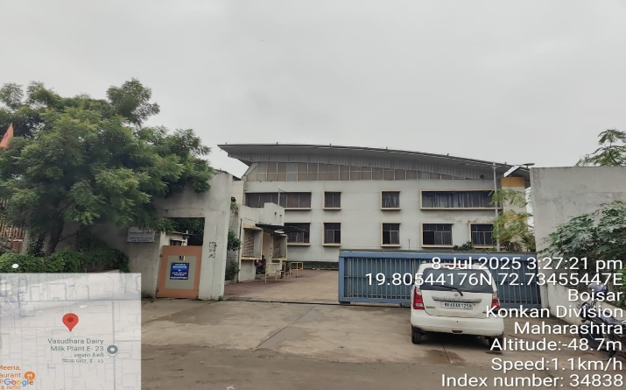
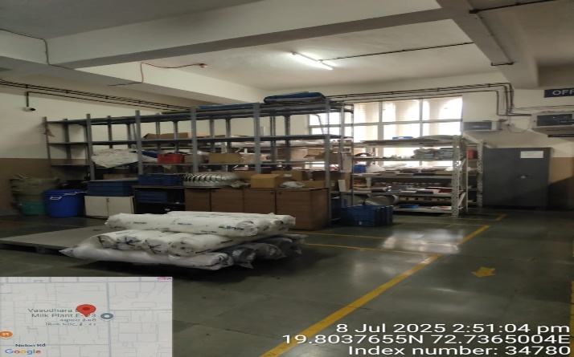
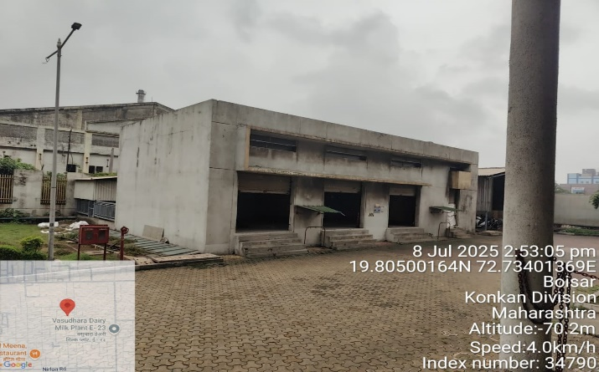
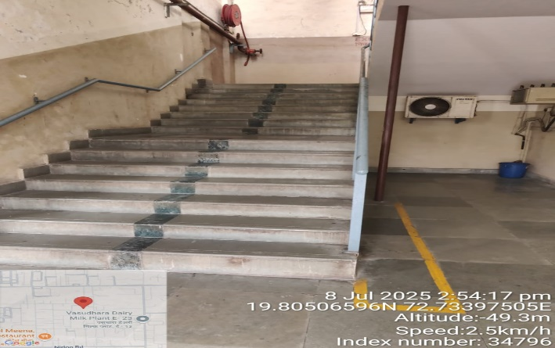
V.S.JADON & CO VALUERS LLP
Site Photo
PHOTOGRAPHS OF PROPERTY OF CUSTOMER: DARSHAN CREATION PVT LTD
VSJCVNM-AXIS-RTL-JUL25-13175 Page 1

Slide 2
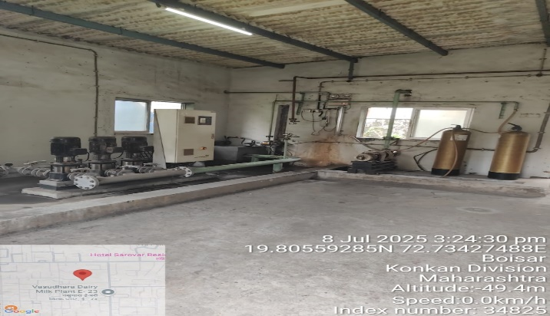
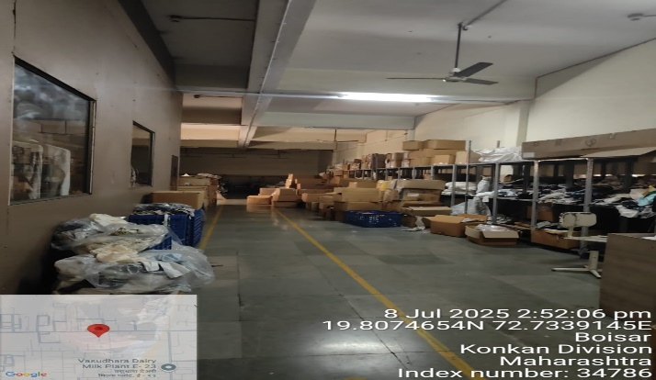
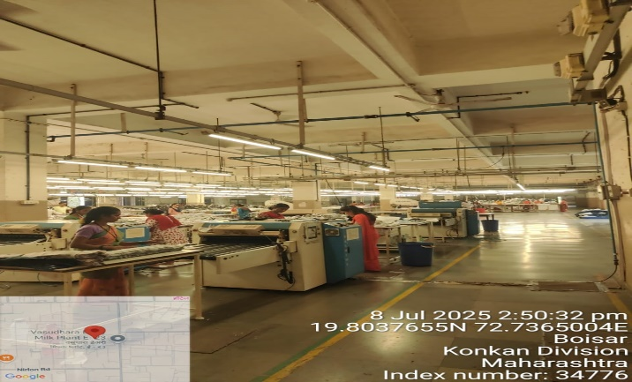
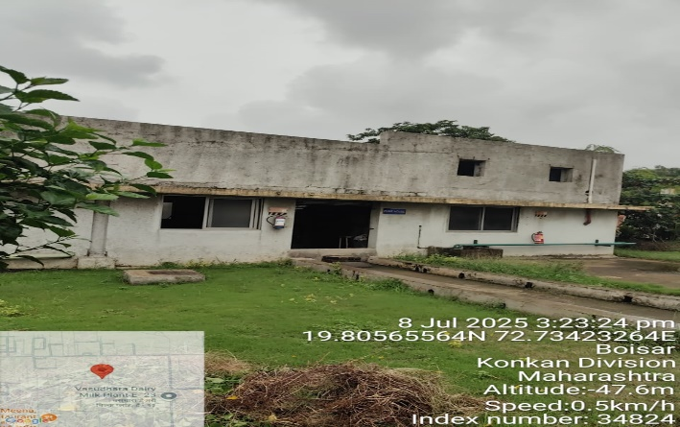
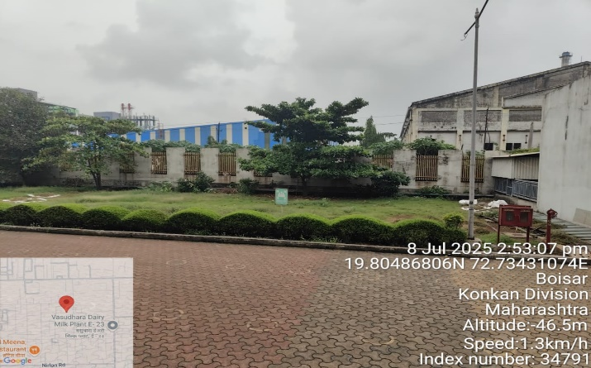
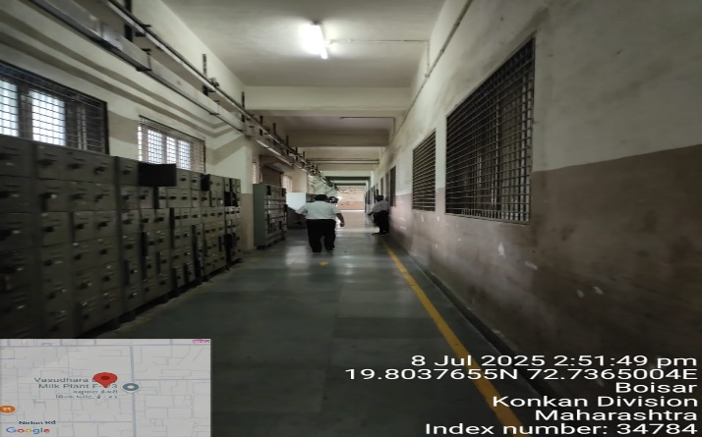
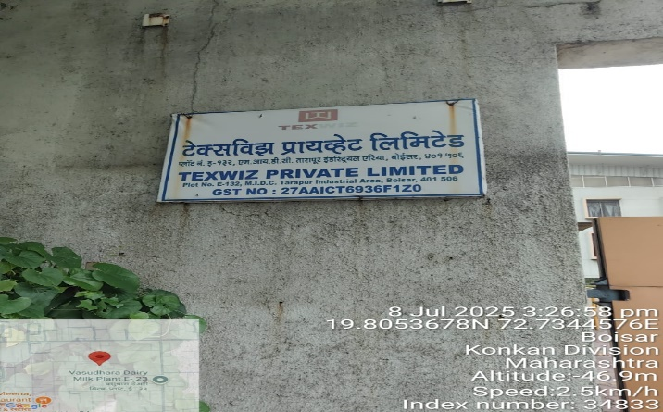
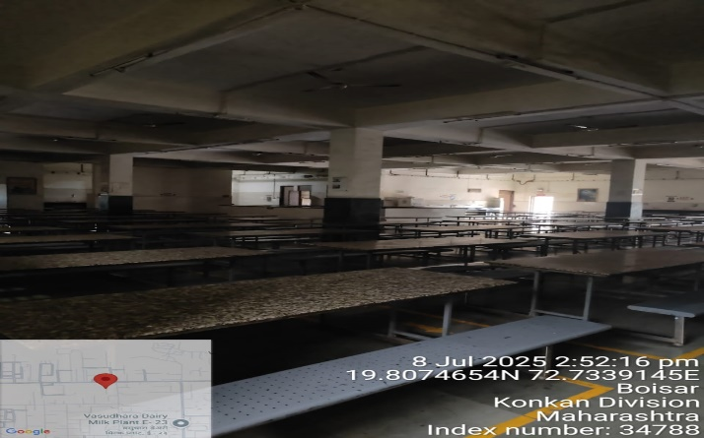
V.S.JADON & CO VALUERS LLP
Site Photo
PHOTOGRAPHS OF PROPERTY OF CUSTOMER: DARSHAN CREATION PVT LTD
VSJCVNM-AXIS-RTL-JUL25-13175 Page 2

Slide 3
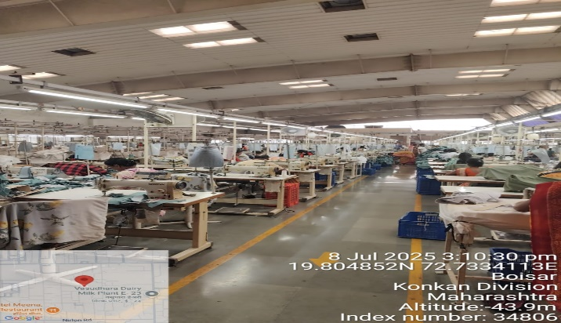
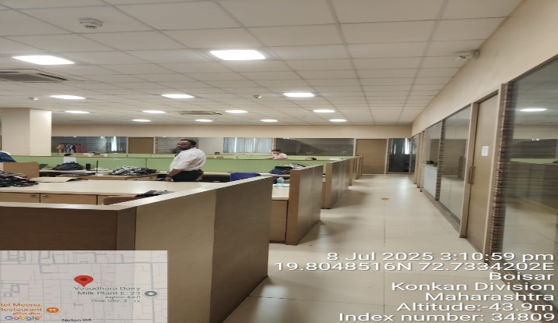
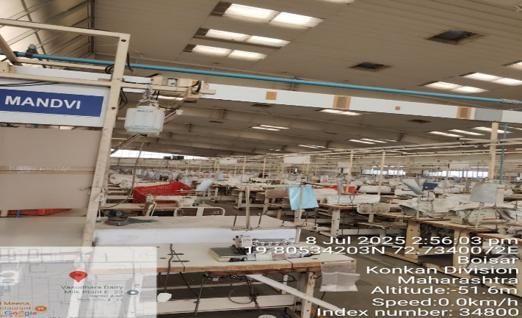
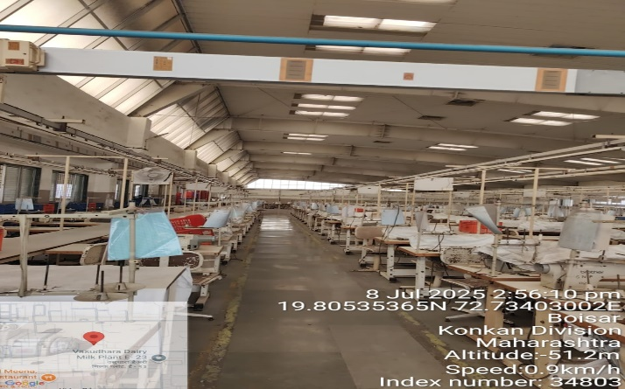
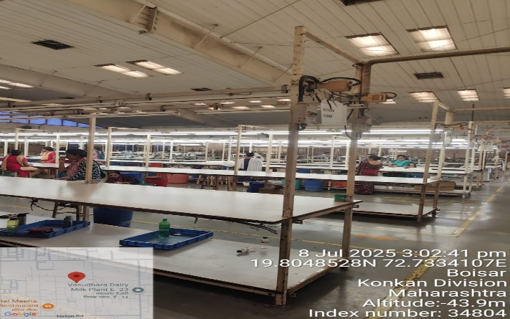
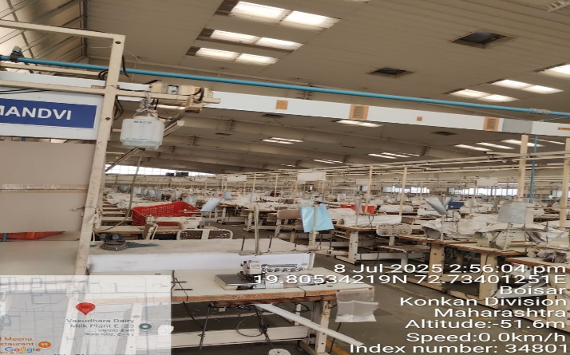
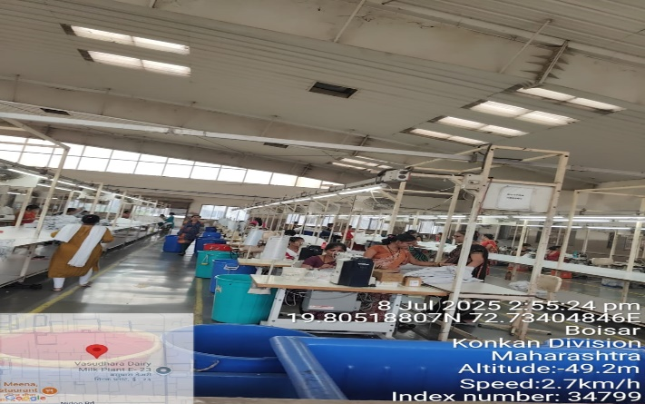
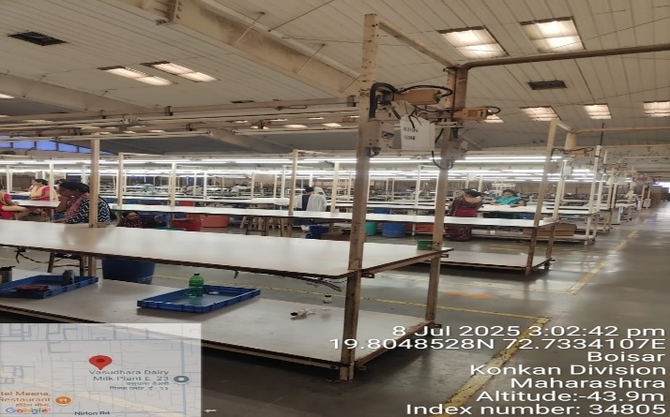
V.S.JADON & CO VALUERS LLP
Site Photo
PHOTOGRAPHS OF PROPERTY OF CUSTOMER: DARSHAN CREATION PVT LTD
VSJCVNM-AXIS-RTL-JUL25-13175 Page 3

Slide 4
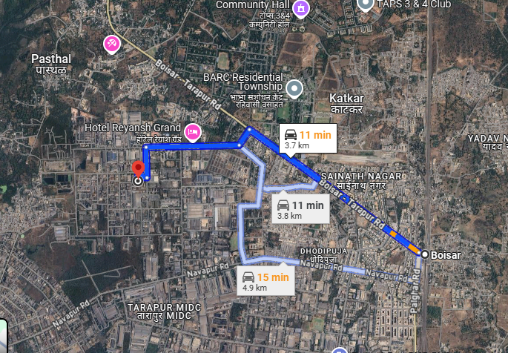
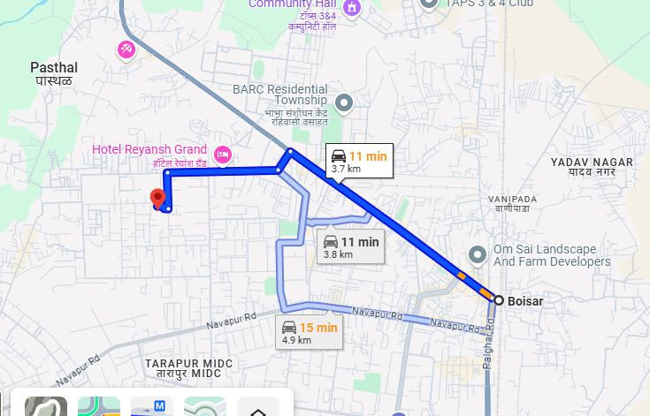
V.S.JADON & CO VALUERS LLP
PHOTOGRAPHS OF PROPERTY OF CUSTOMER: DARSHAN CREATION PVT LTD
Google Maps :
VSJCVNM-AXIS-RTL-JUL25-13175 Page 4

Slide 5
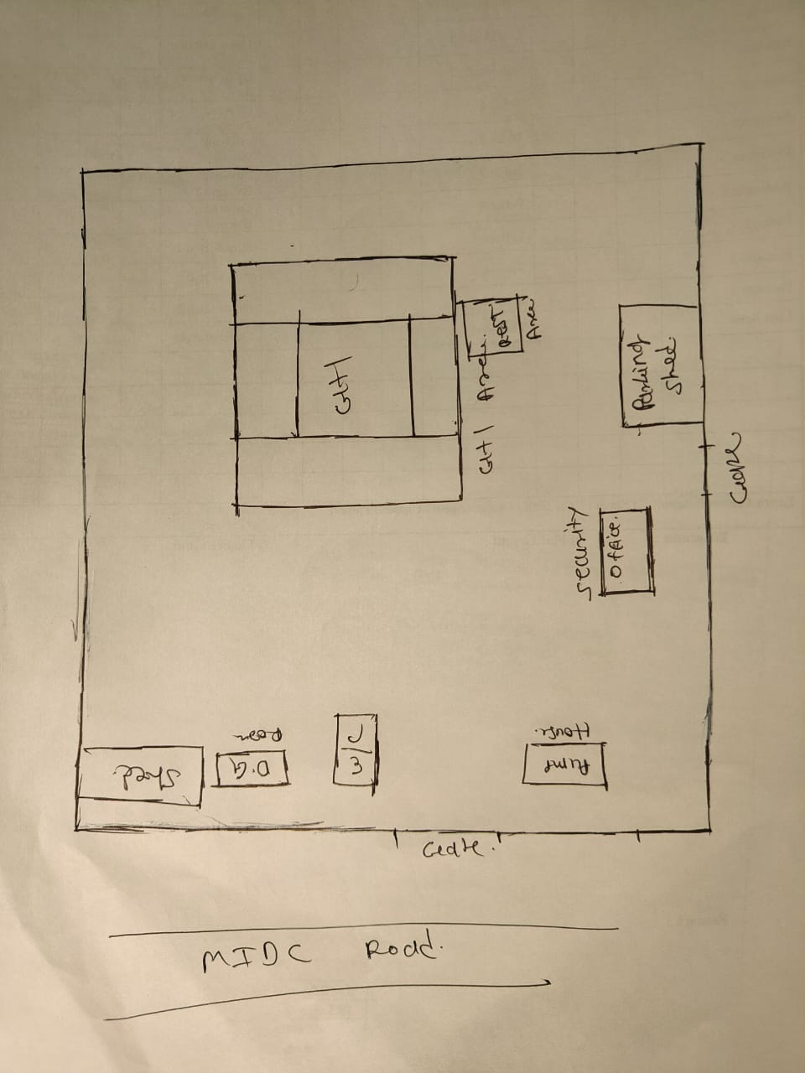
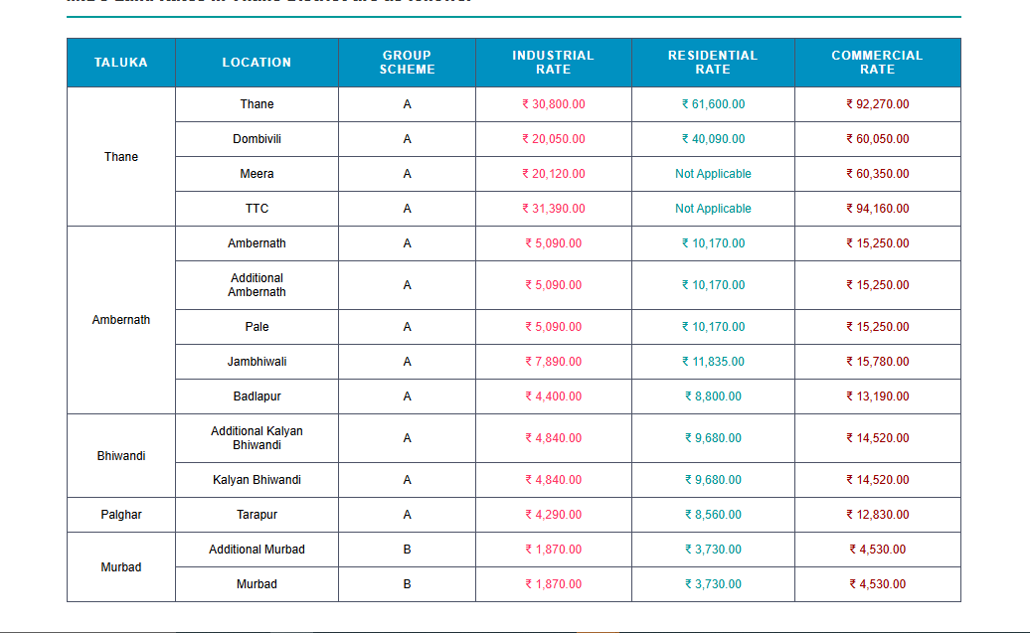
V.S.JADON & CO VALUERS LLP
PHOTOGRAPHS OF PROPERTY OF CUSTOMER: DARSHAN CREATION PVT LTD
Site Layout :
VSJCVNM-AXIS-RTL-JUN25-13175 Page 5

