Slide 1
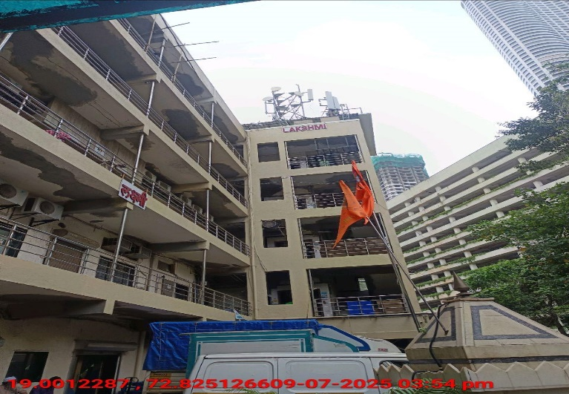
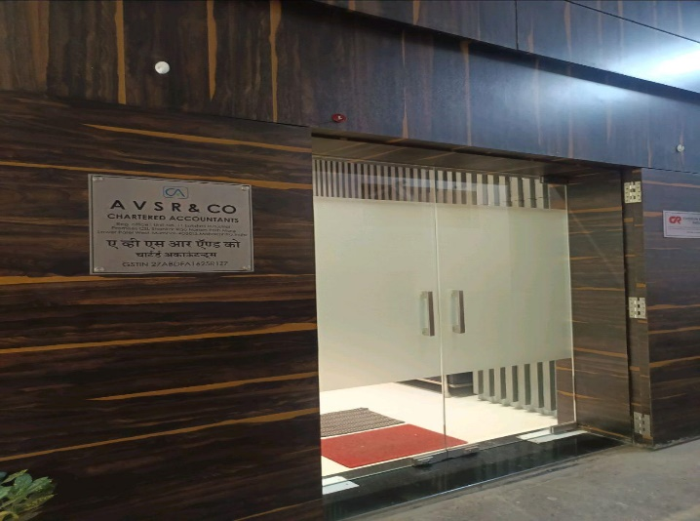
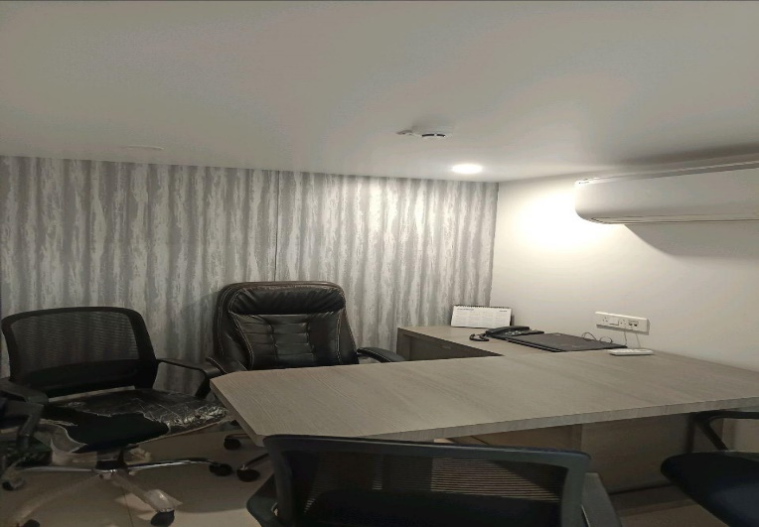
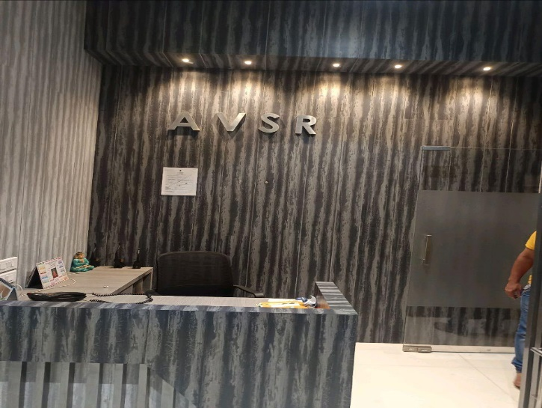
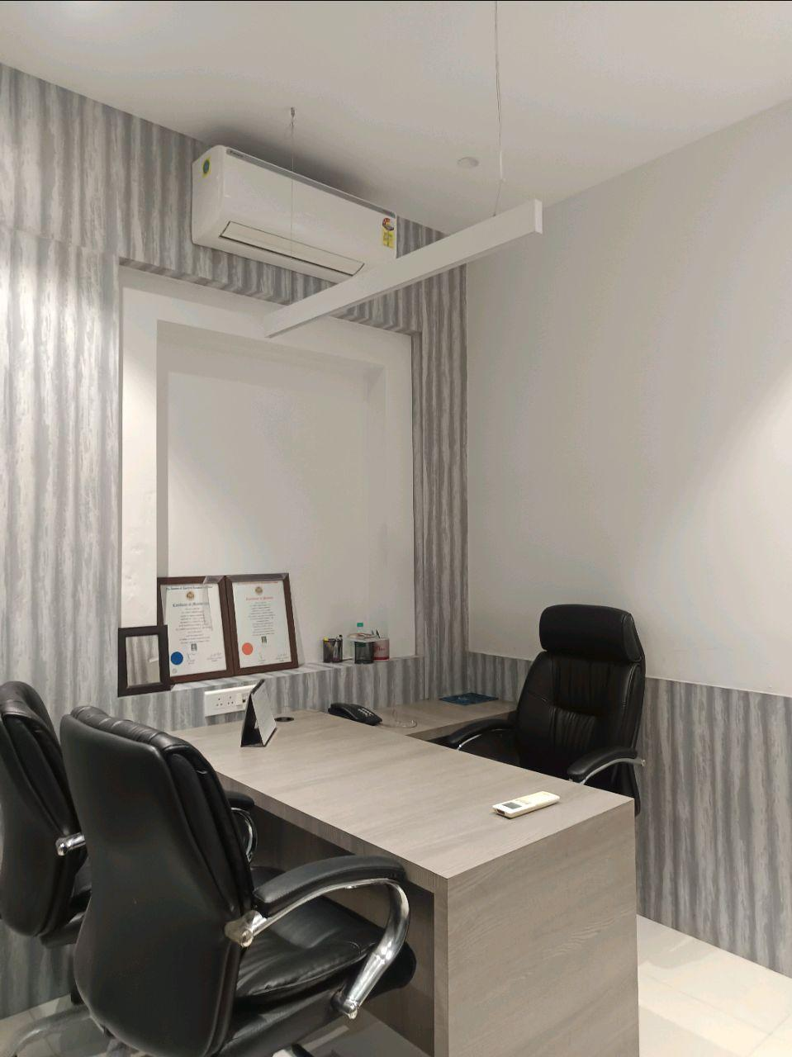
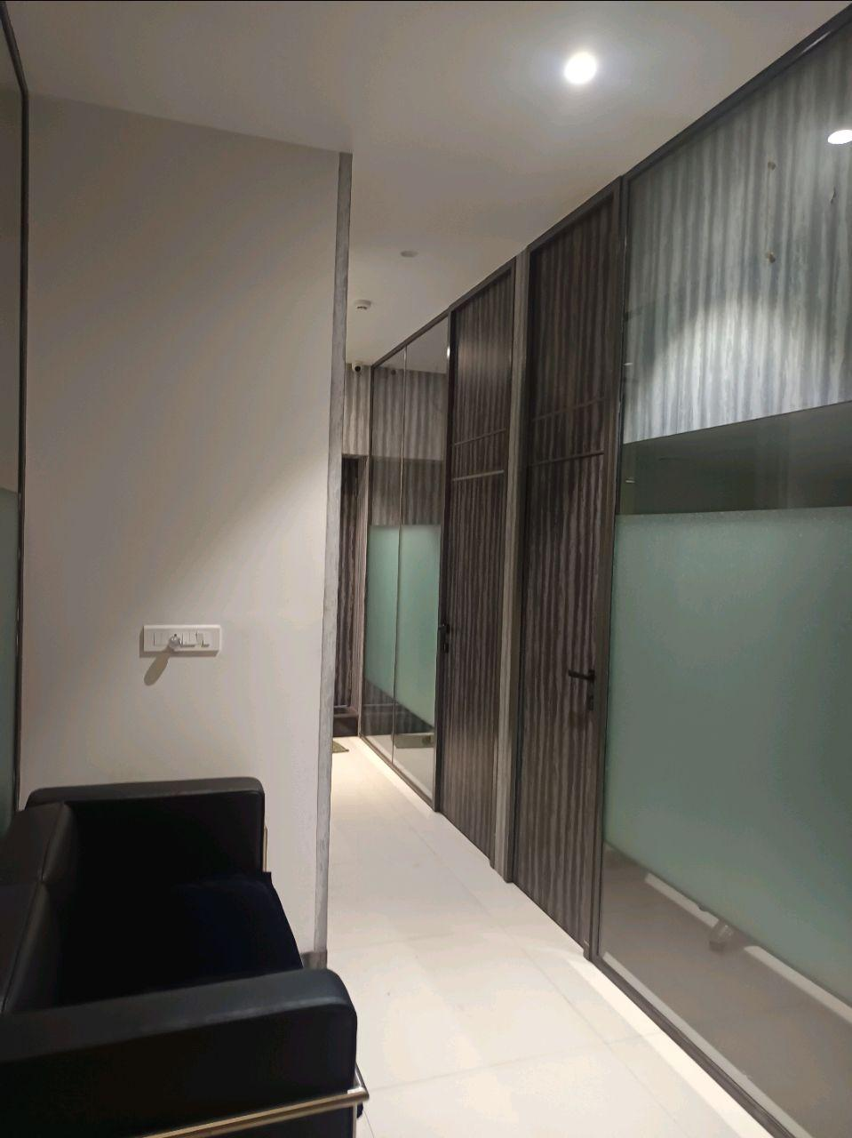
V.S.JADON & CO VALUERS LLP
PHOTOGRAPHS OF PROPERTY OF CUSTOMER A V S R AND CO
VSJCVNM-AXIS-RTL-JUL25-13204
Page 1

Slide 2
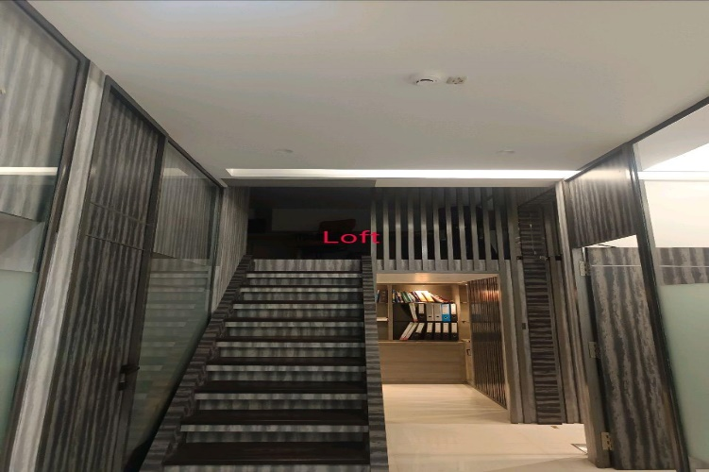
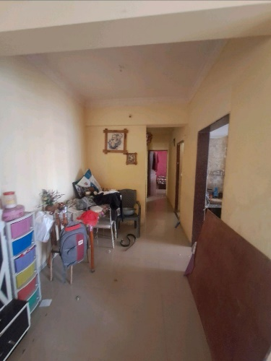
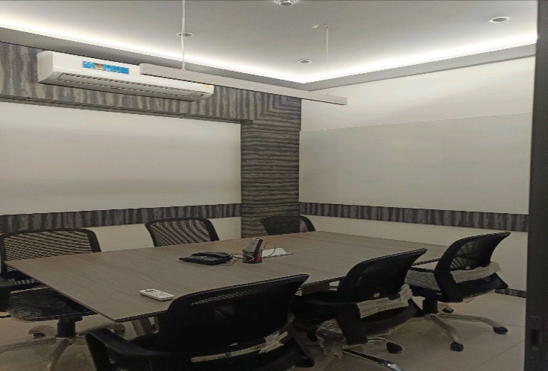
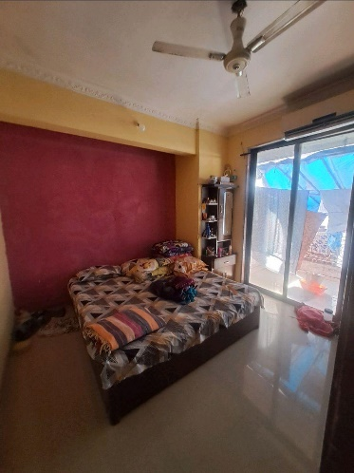
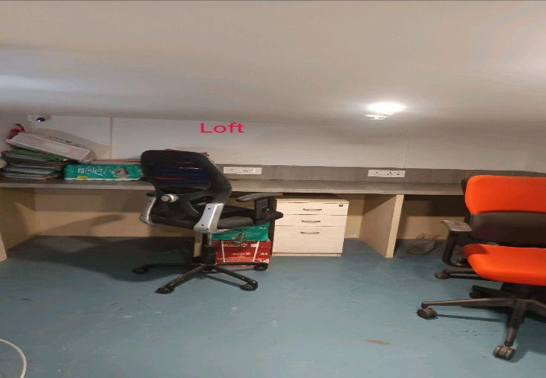
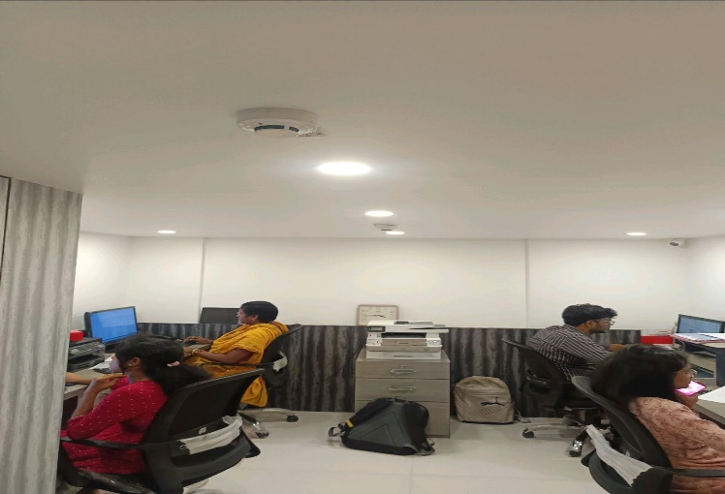
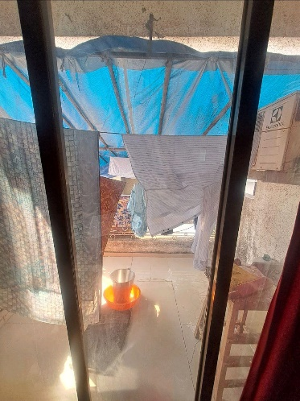

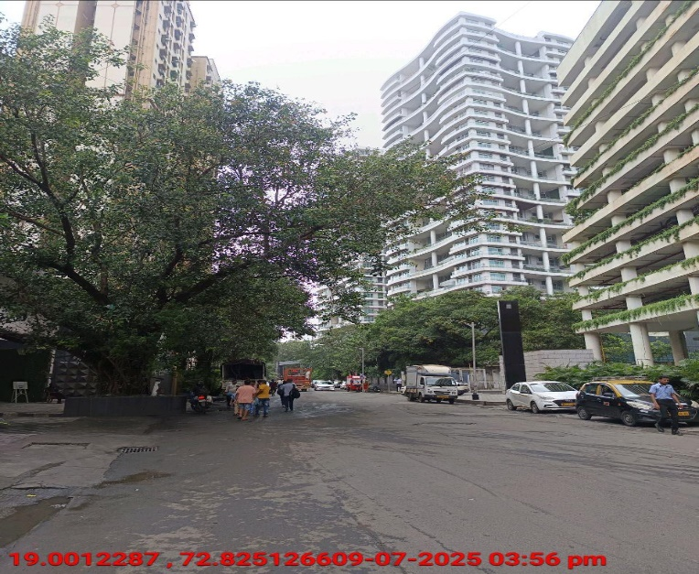
V.S.JADON & CO VALUERS LLP
PHOTOGRAPHS OF PROPERTY OF CUSTOMER A V S R AND CO
VSJCVNM-AXIS-RTL-JUL25-13204
Page 1

Slide 3
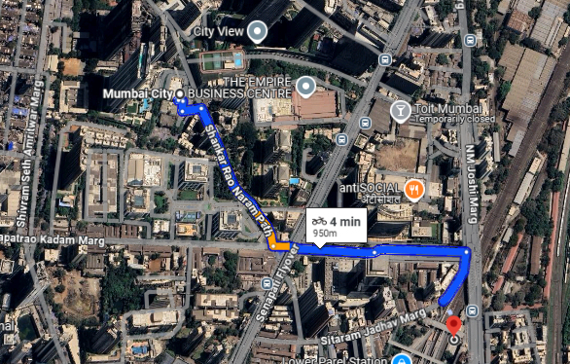
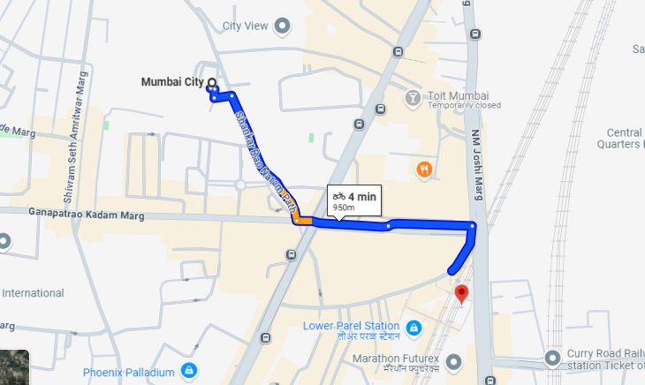
V.S.JADON & CO VALUERS LLP
PHOTOGRAPHS OF PROPERTY OF CUSTOMER : A V S R AND CO
Google Map
VSJCVNM-AXIS-RTL-JUL25-13204
Page 3

Slide 4
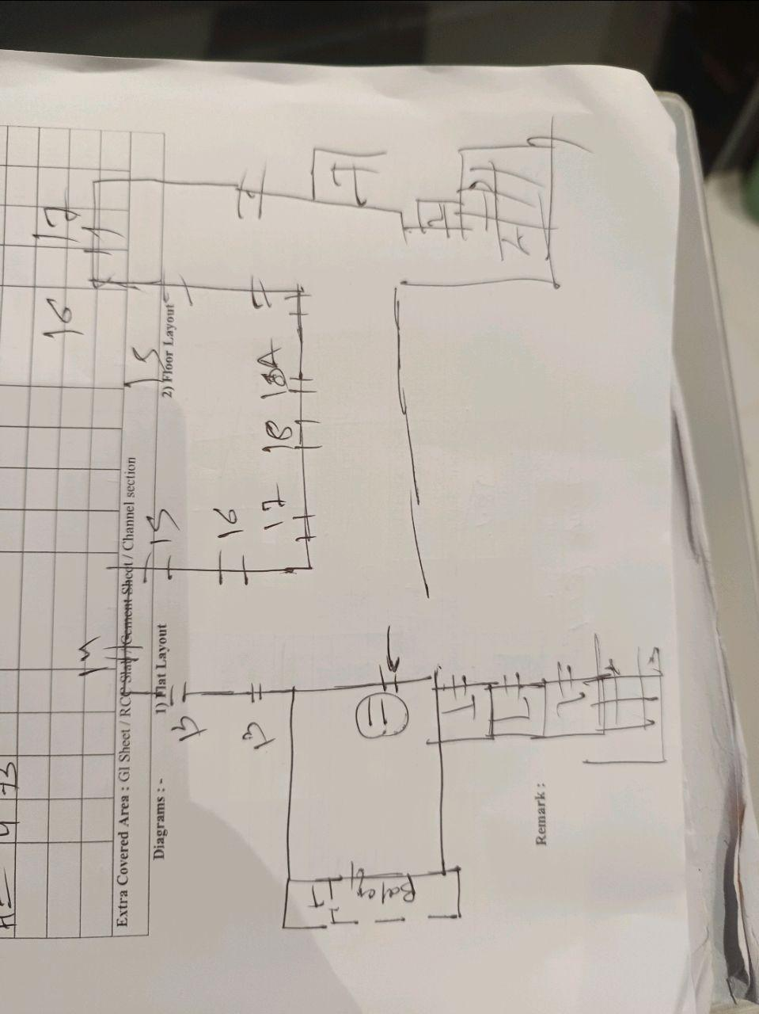
V.S.JADON & CO VALUERS LLP
PHOTOGRAPHS OF PROPERTY OF CUSTOMER: A V S R AND CO
Site Layout
VSJCVNM-AXIS-RTL-JUL25-13204
Page 4

Slide 5
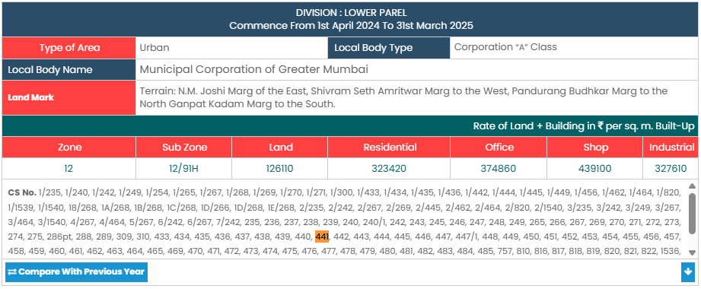
V.S.JADON & CO VALUERS LLP
PHOTOGRAPHS OF PROPERTY OF CUSTOMER A V S R AND CO
Gov Rate
VSJCVNM-AXIS-RTL-JUL25-13204
Page 5

