Slide 1
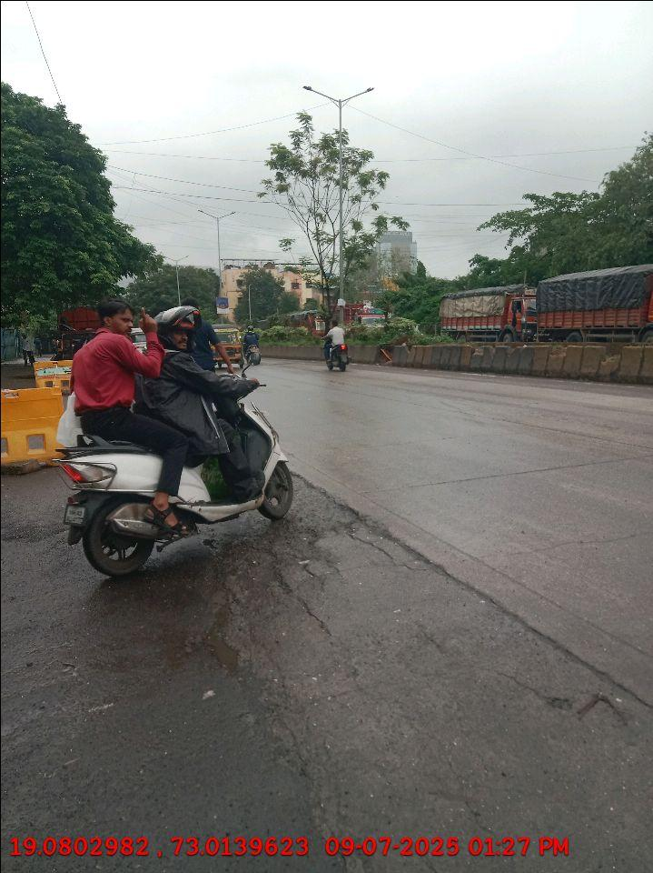
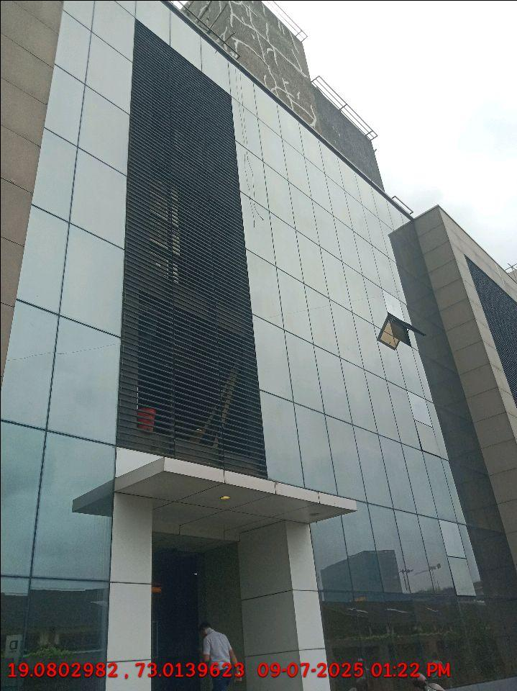
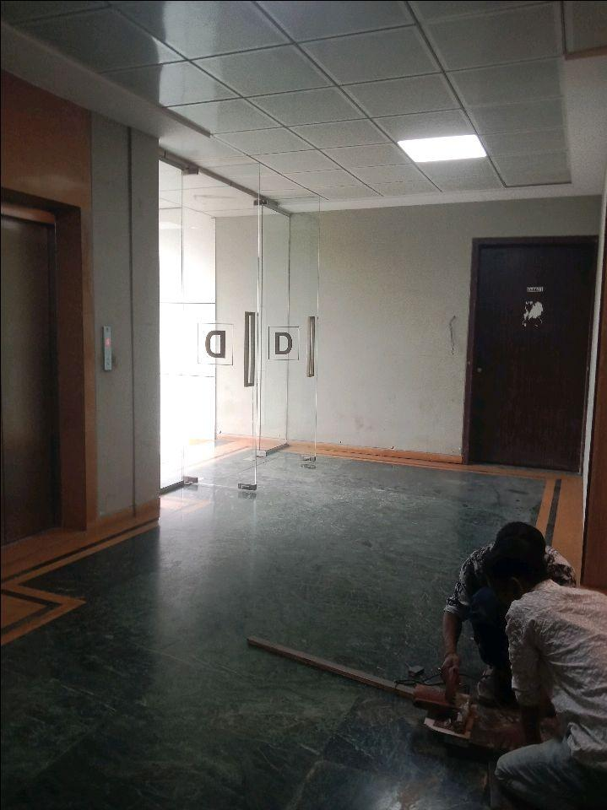
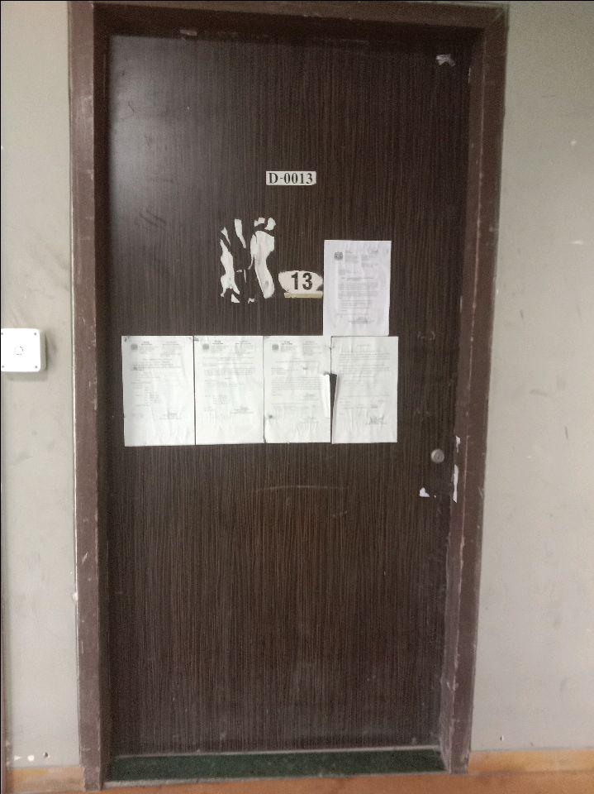
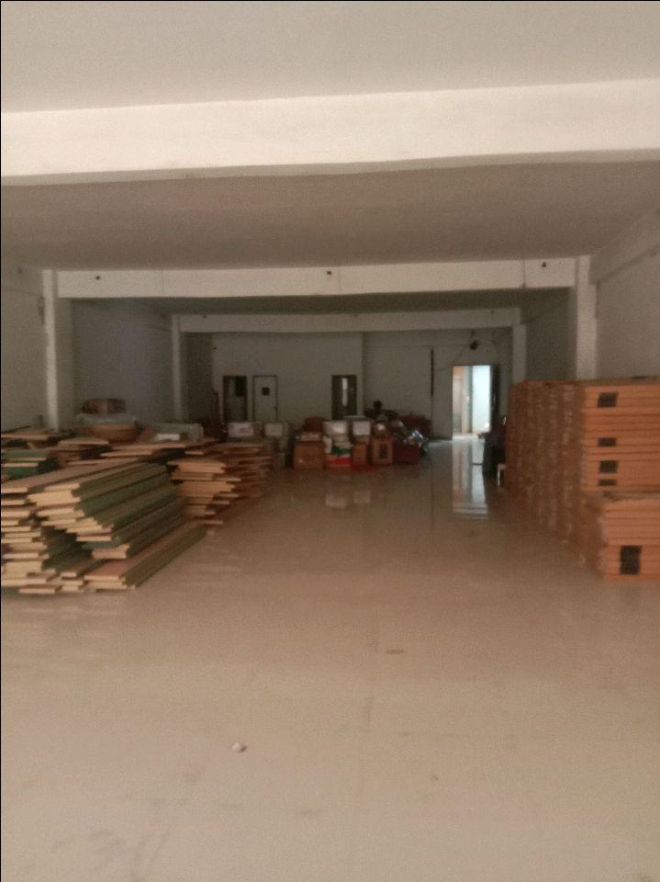
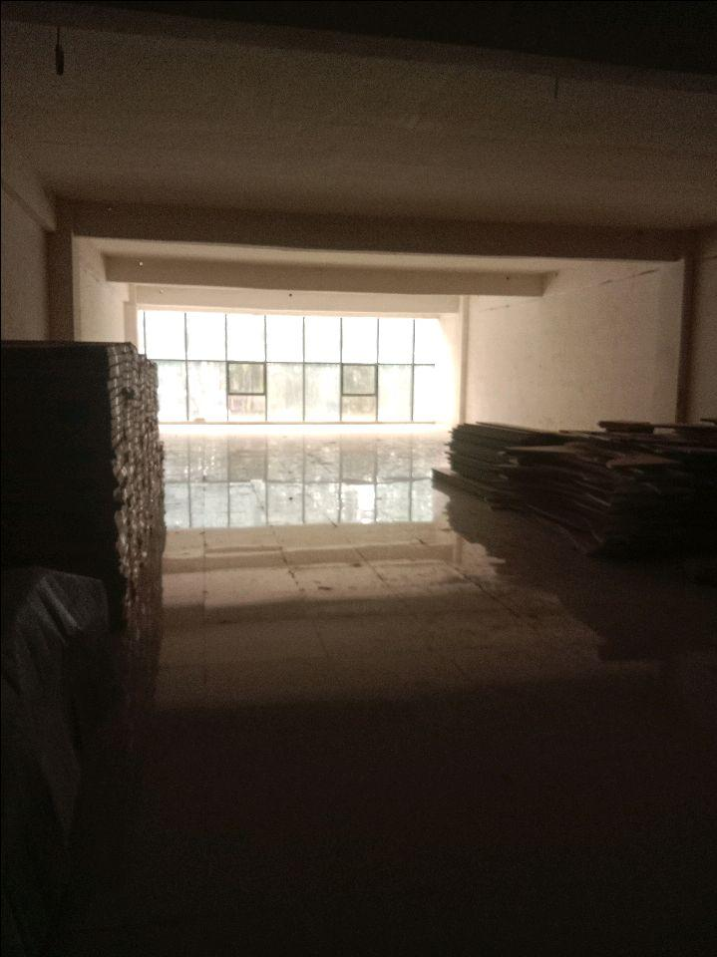
V.S.JADON & CO VALUERS LLP
Site Photo
PHOTOGRAPHS OF PROPERTY OF CUSTOMER:
VSJCVNM-RBL-RTL-JULY 25-13890 Page 5

Slide 2
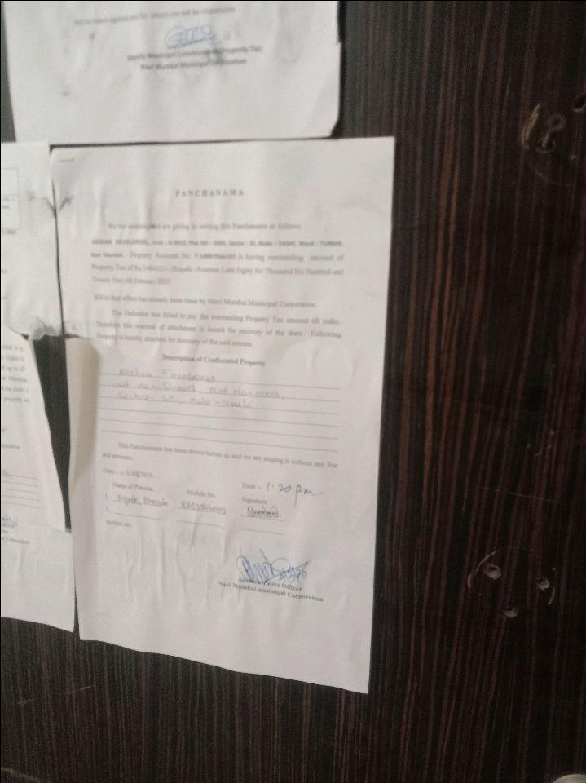
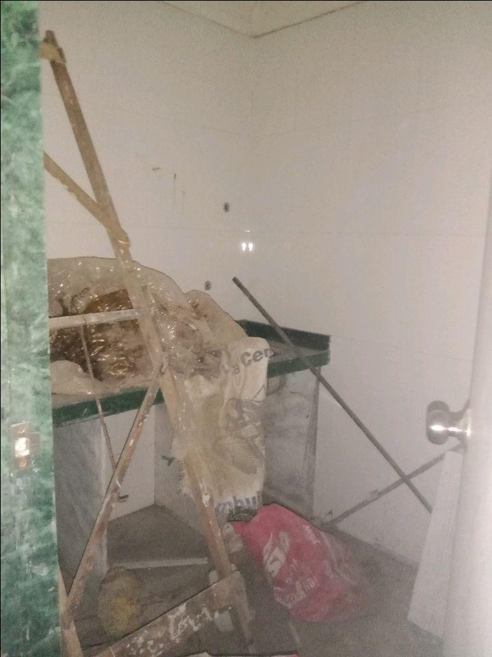

V.S.JADON & CO VALUERS LLP
Site Photo
VSJCVNM-RBL-RTL-JULY 25-13890 Page 6

Slide 3
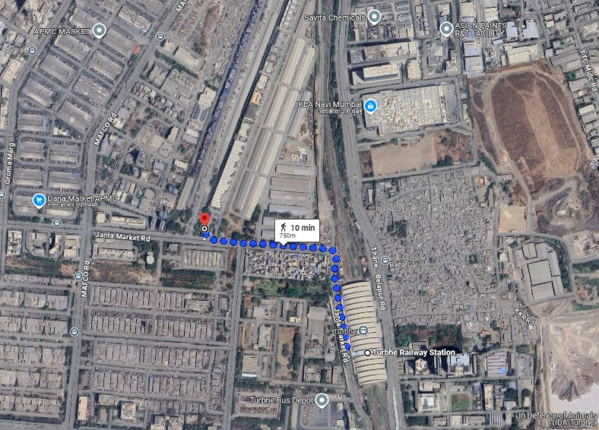
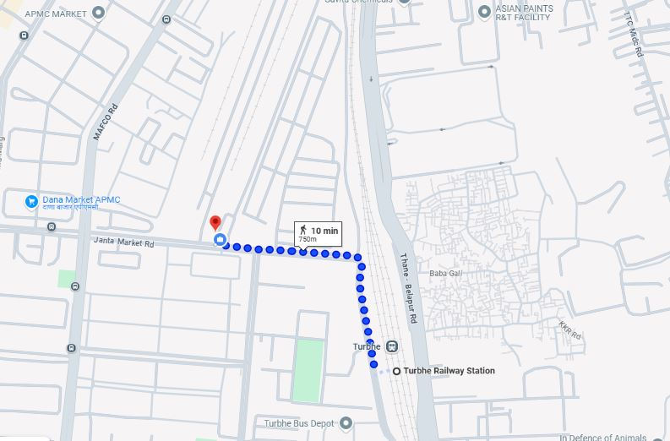
V.S.JADON & CO VALUERS LLP
PHOTOGRAPHS OF PROPERTY OF CUSTOMER:
Google Maps :
VSJCVNM-RBL-RTL-JULY 25-13890 Page 6

Slide 4
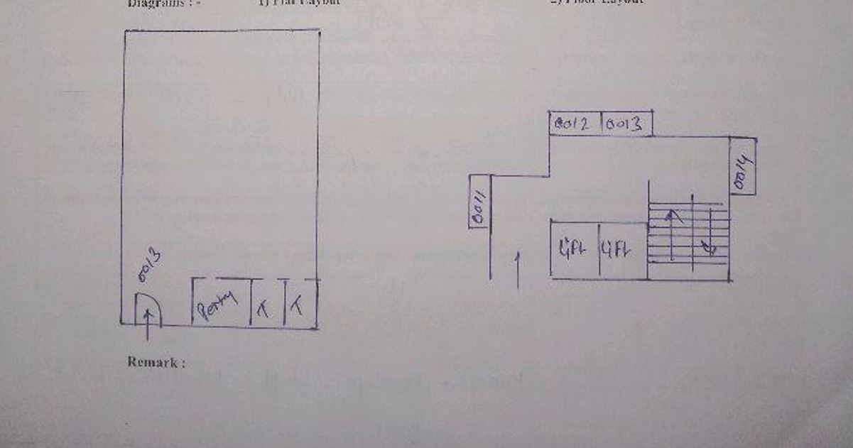
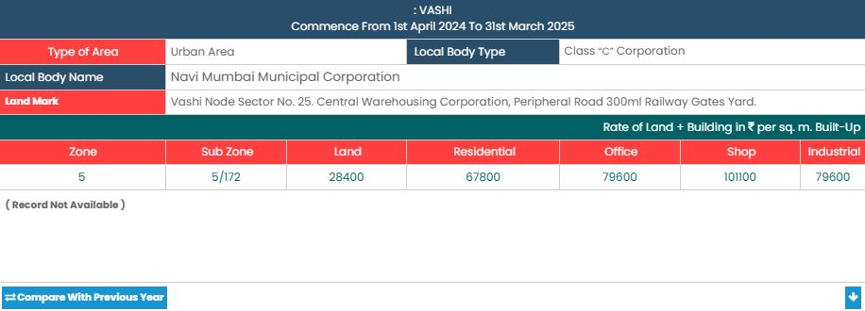
V.S.JADON & CO VALUERS LLP
PHOTOGRAPHS OF PROPERTY OF CUSTOMER:
Site Layout :
VSJCVNM-RBL-RTL-JULY 25-13890 Page 7

