Slide 1
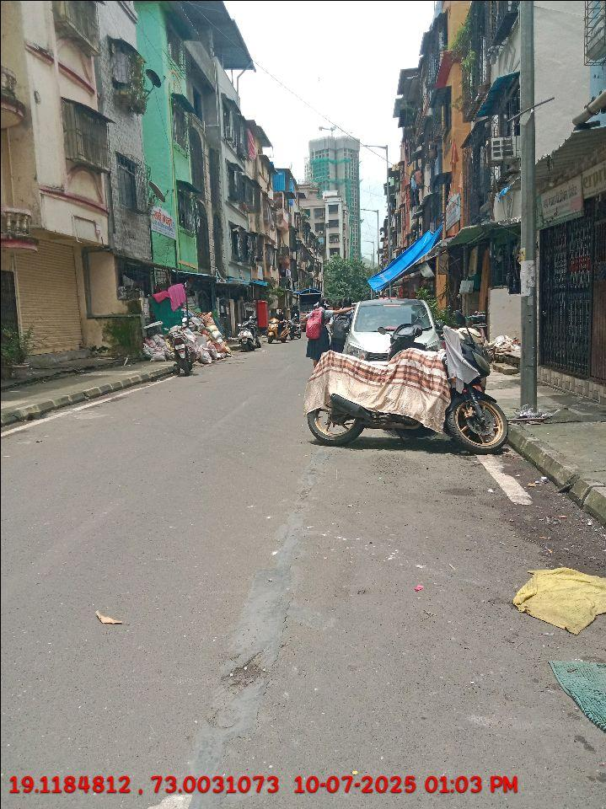
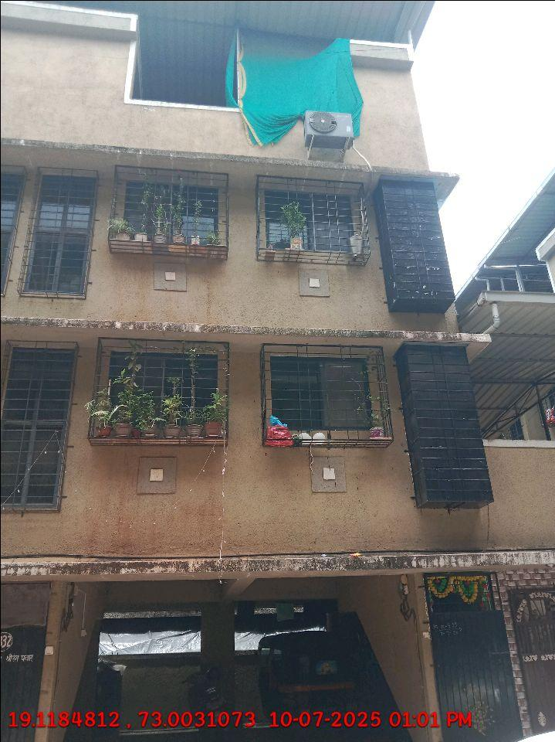
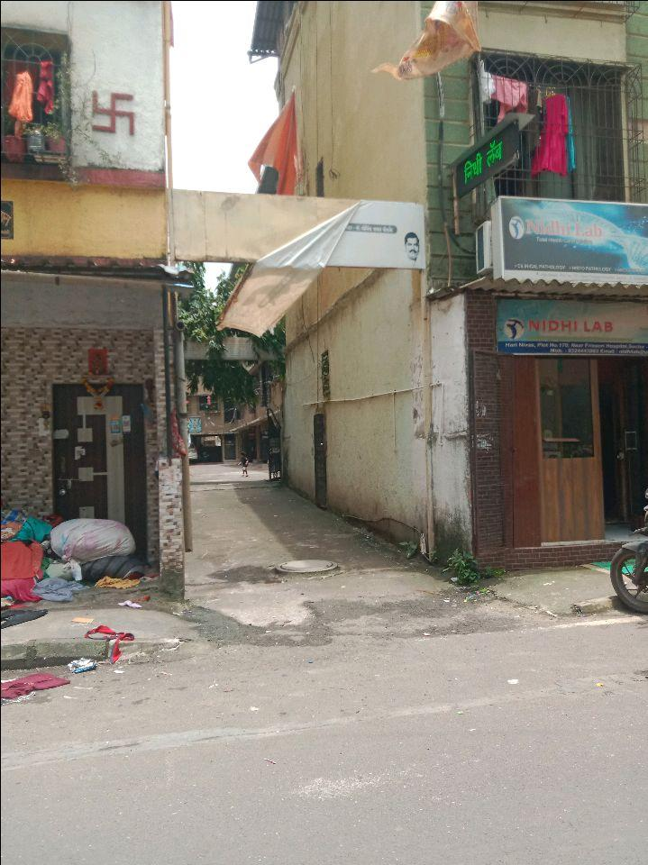
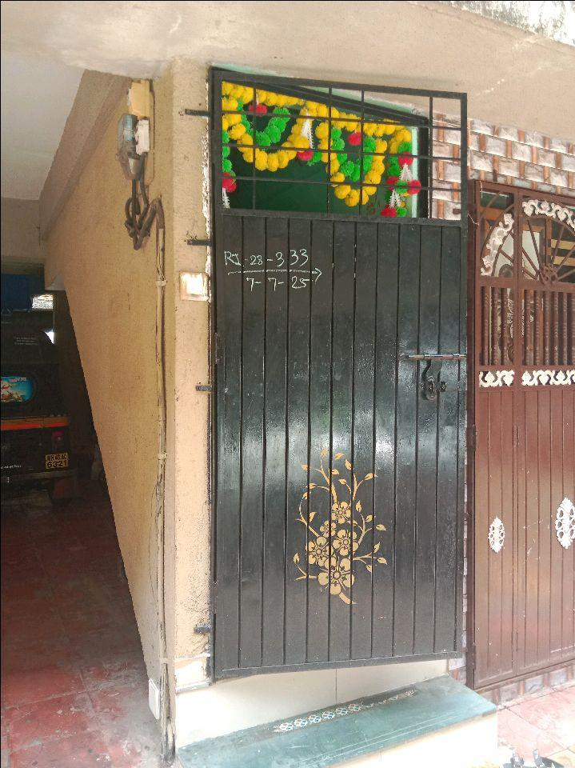
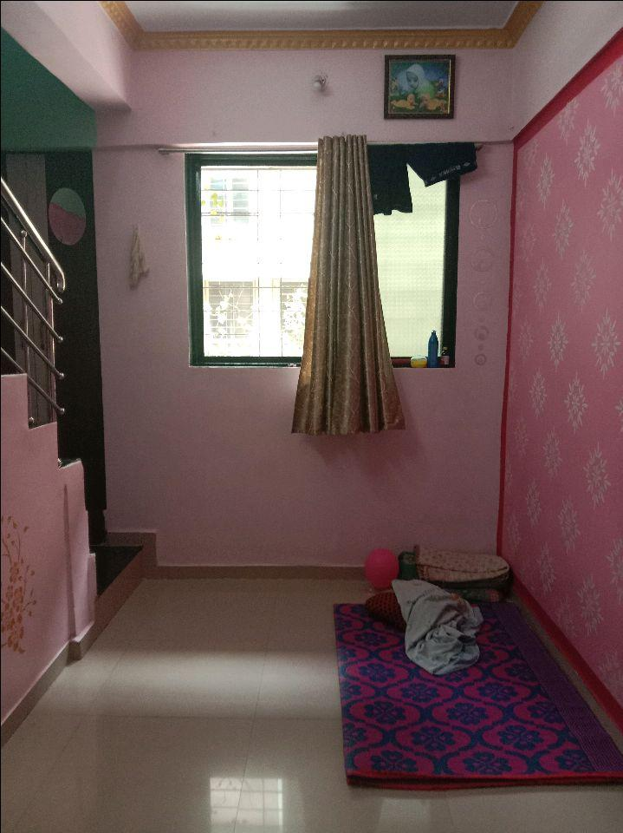
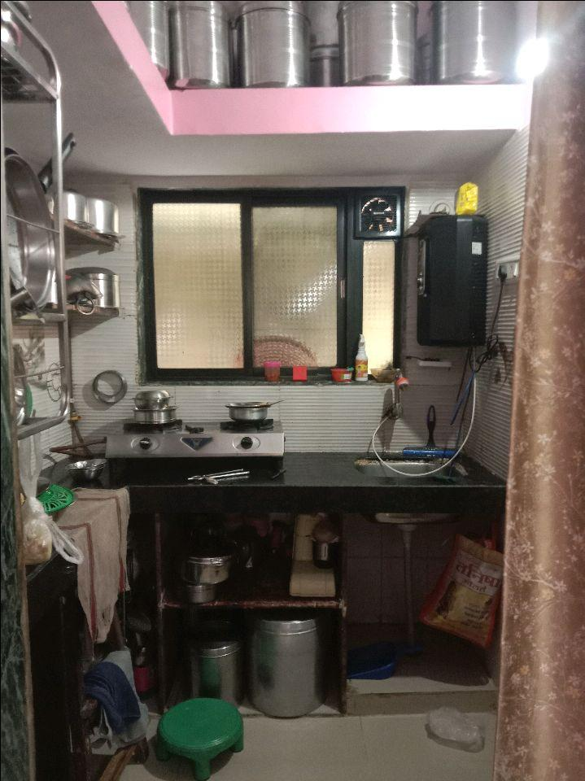
V.S.JADON & CO VALUERS LLP
PHOTOGRAPHS OF PROPERTY OF CUSTOMER: GOVIND BODKE
Site Photo
VSJCVNM-PNB-RTL-FEB25-35387 Page 1

Slide 2
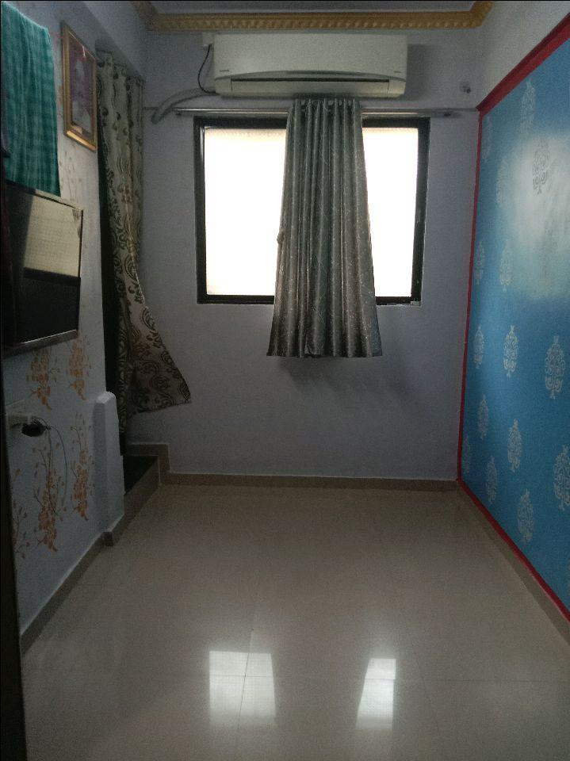
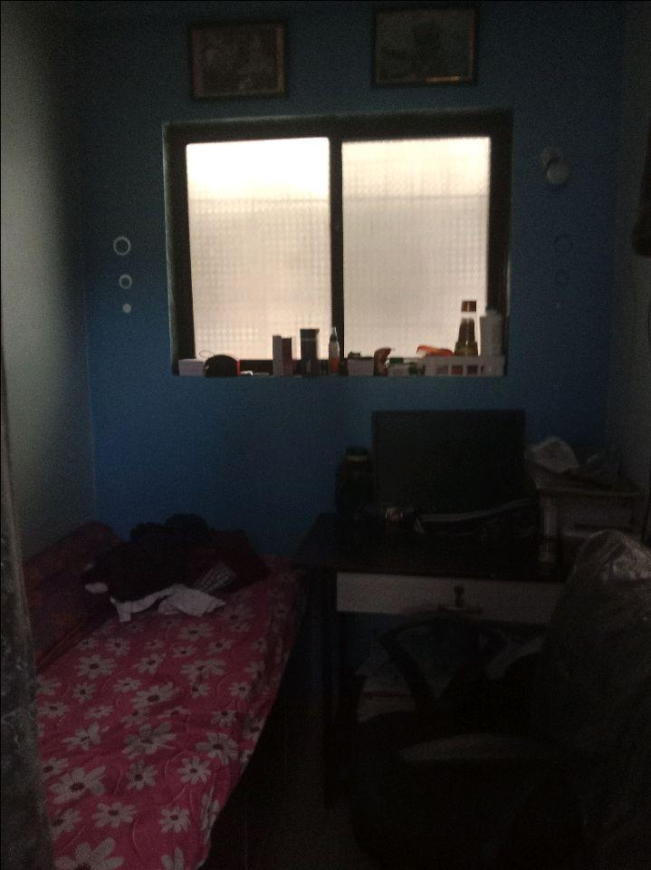
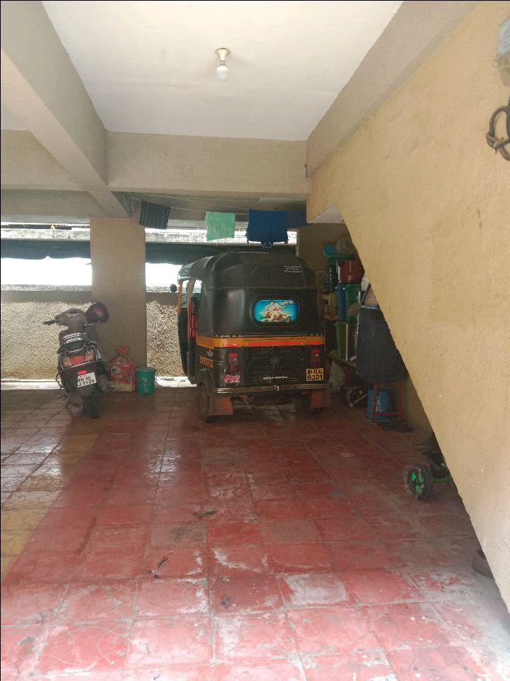
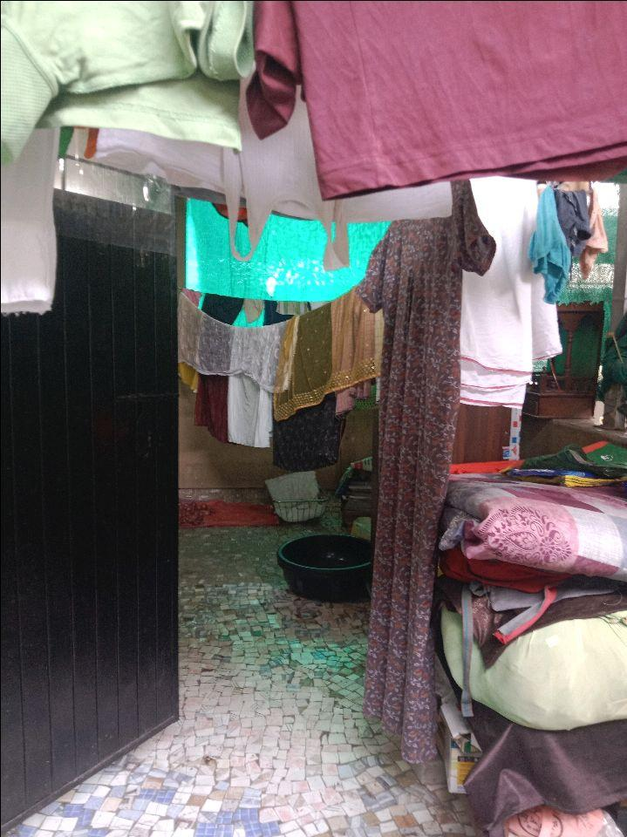
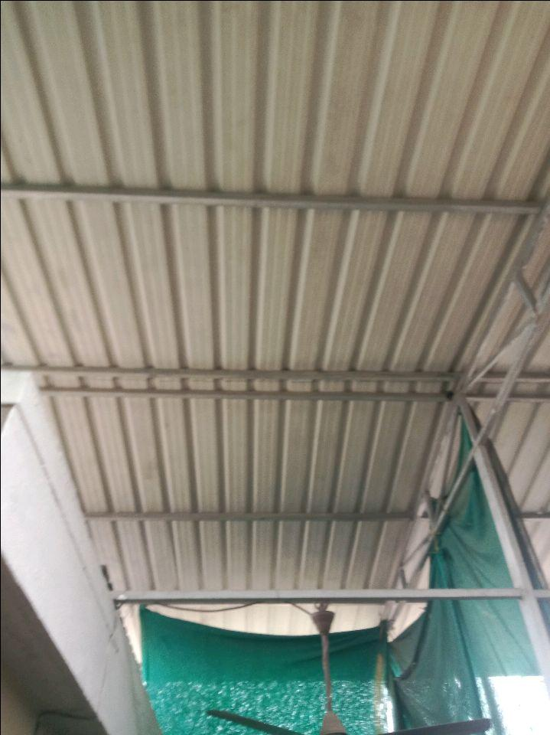

V.S.JADON & CO VALUERS LLP
Site Photo
VSJCVNM-PNB-RTL-FEB25-35387 Page 2

Slide 3
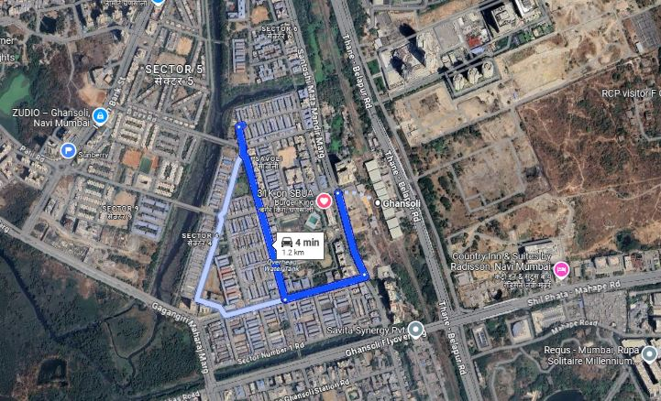
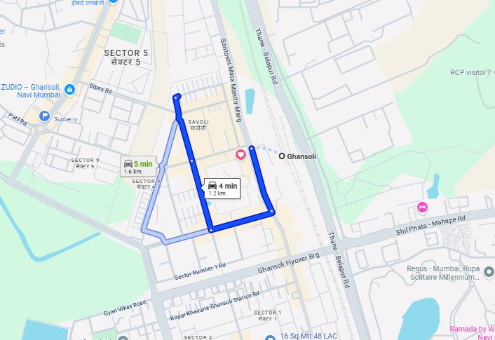
V.S.JADON & CO VALUERS LLP
PHOTOGRAPHS OF PROPERTY OF CUSTOMER: GOVIND BODKE
Google Maps :
VSJCVNM-PNB-RTL-FEB25-35387 Page 3

Slide 4
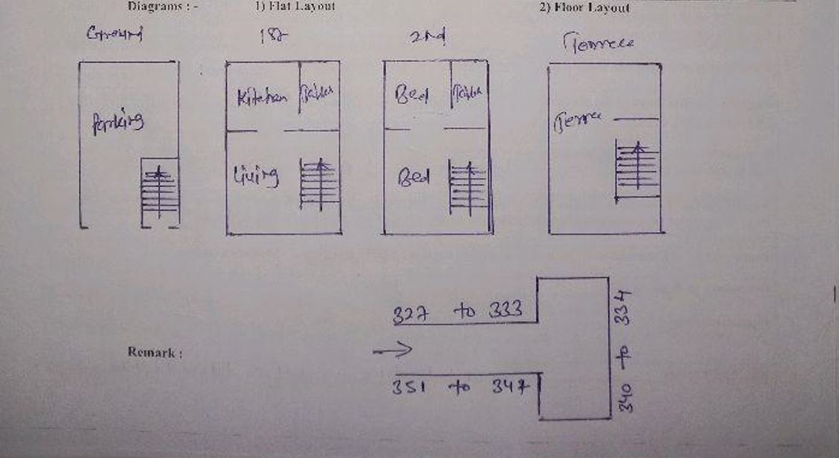
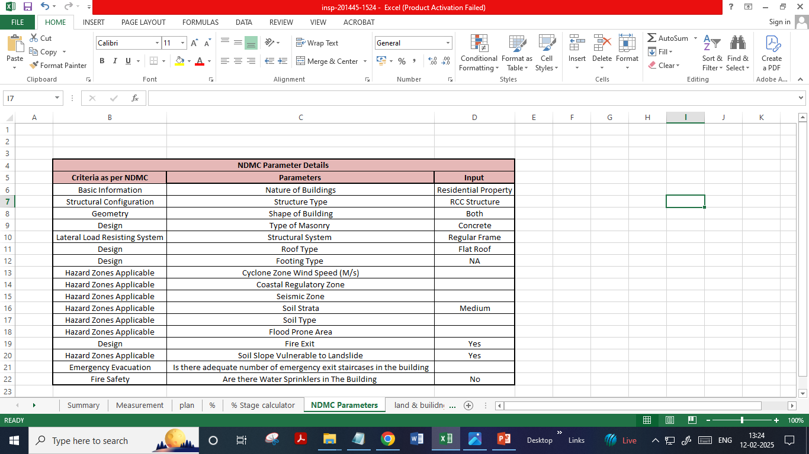
V.S.JADON & CO VALUERS LLP
PHOTOGRAPHS OF PROPERTY OF CUSTOMER: GOVIND BODKE
Construction percentage & NDMC parameter:
VSJCVNM-PNB-RTL-FEB25-35387 Page 4

