Slide 1
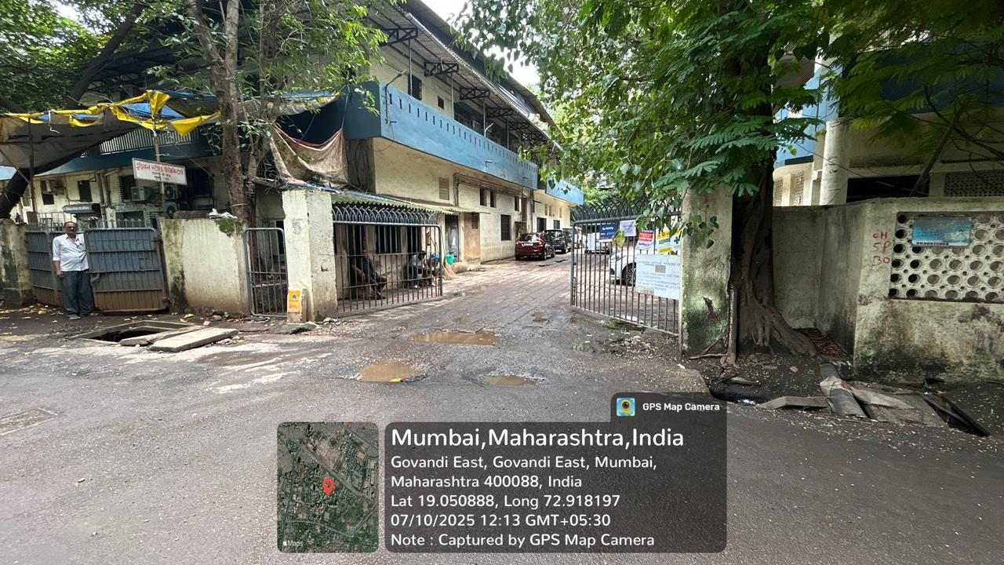
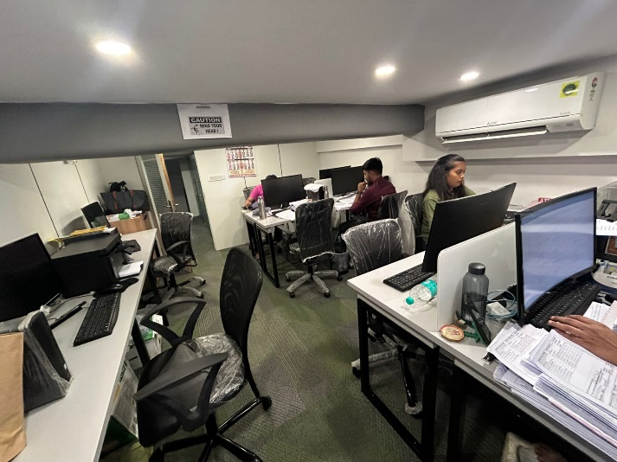
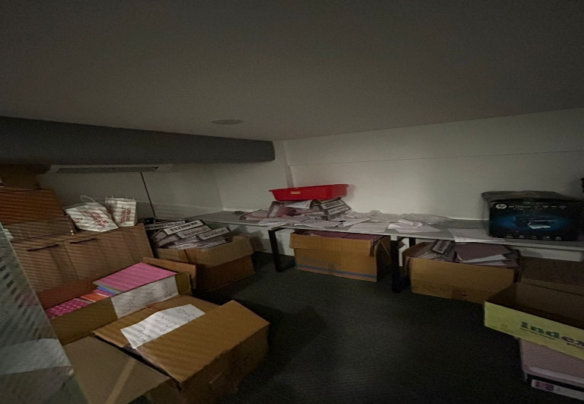
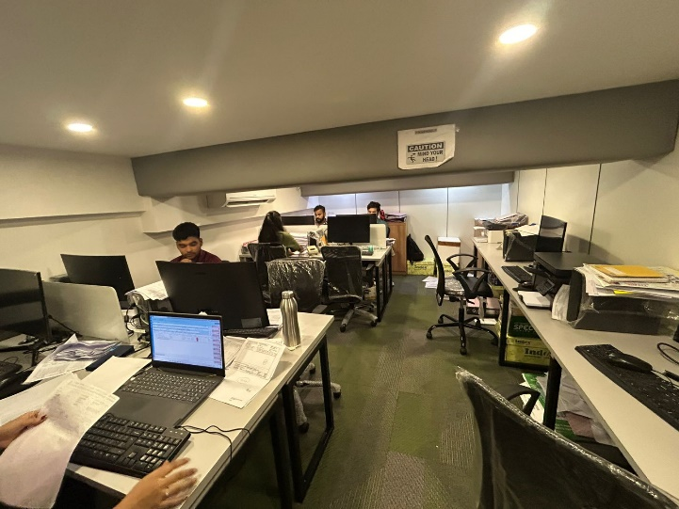
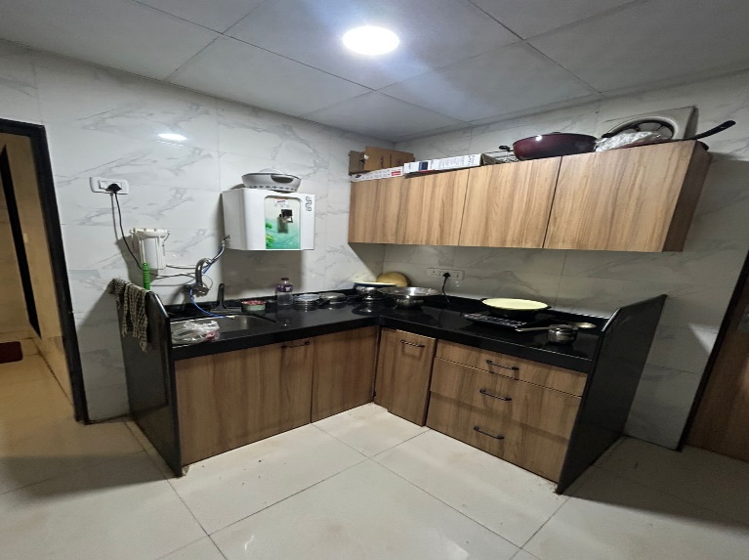
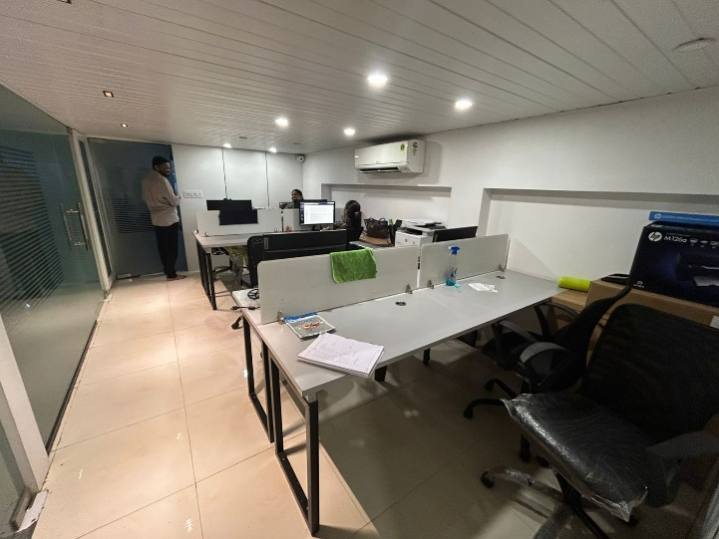
V.S.JADON & CO VALUERS LLP
PHOTOGRAPHS OF PROPERTY OF CUSTOMER : Payal Pharma
VSJCVNM-RBL-RTL-JUL25-14098
Page 1

Slide 2
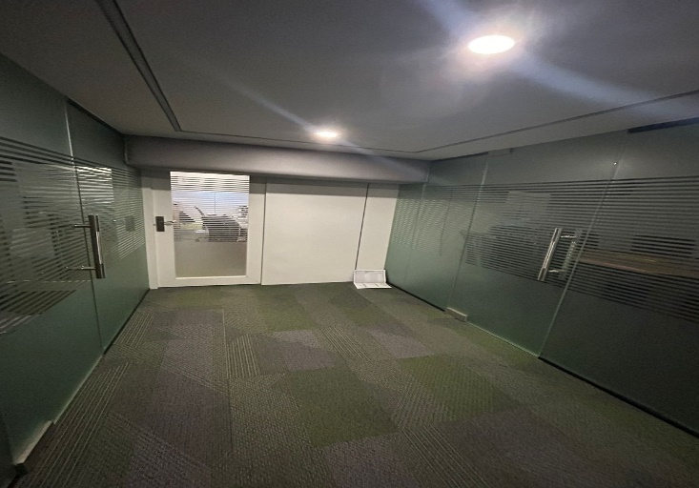
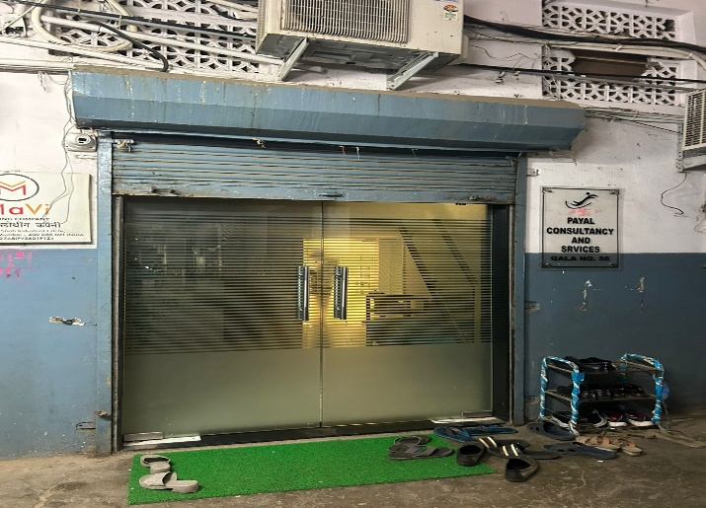
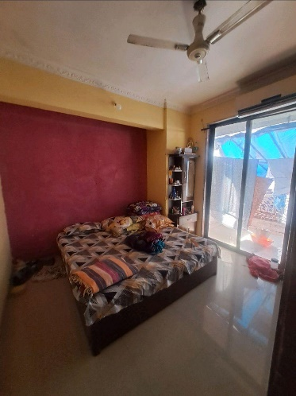
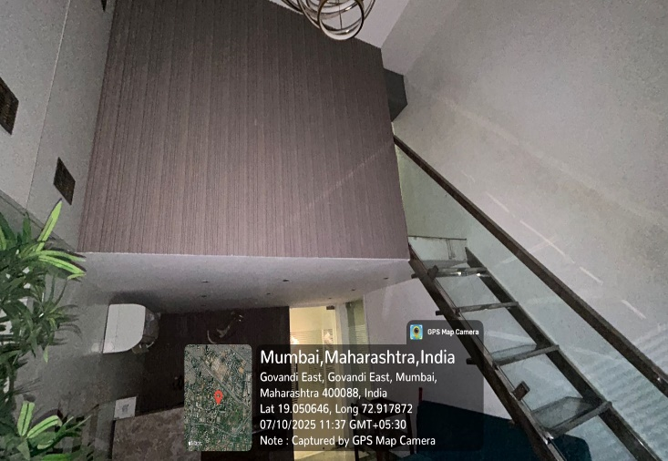
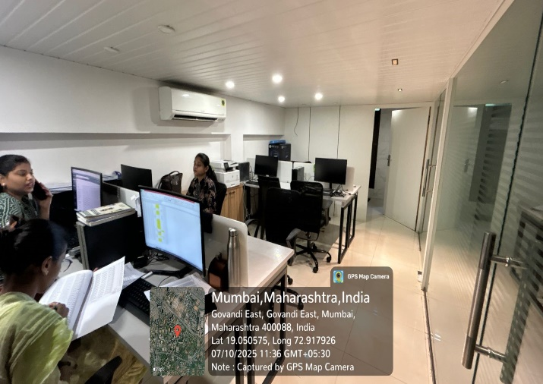

V.S.JADON & CO VALUERS LLP
PHOTOGRAPHS OF PROPERTY OF CUSTOMER : Payal Pharma.
VSJCVNM-RBL-RTL-JUL25-14098
Page 2

Slide 3
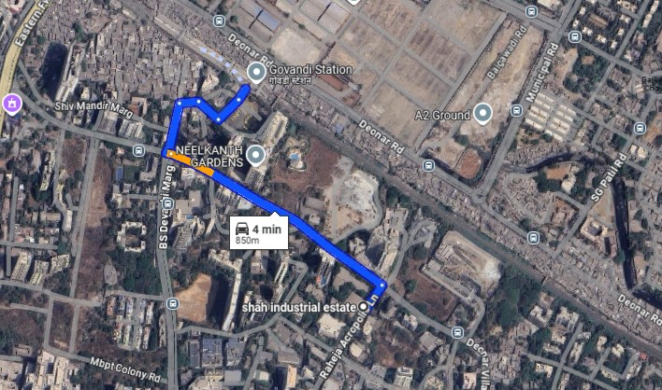
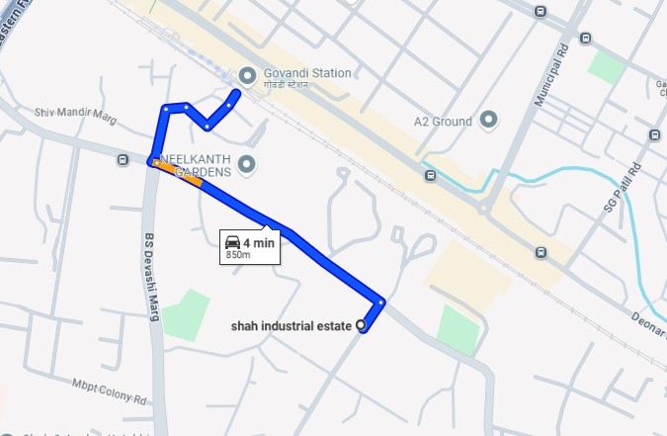
V.S.JADON & CO VALUERS LLP
PHOTOGRAPHS OF PROPERTY OF CUSTOMER : Payal Pharma.
Google Map
VSJCVNM-RBL-RTL-JUL25-14098
Page 3

Slide 4
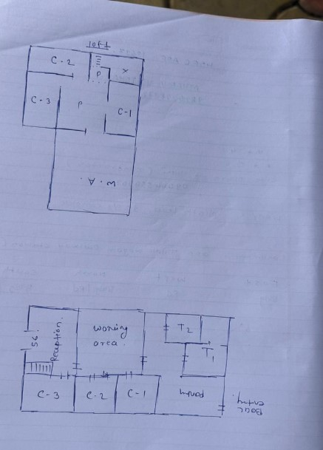
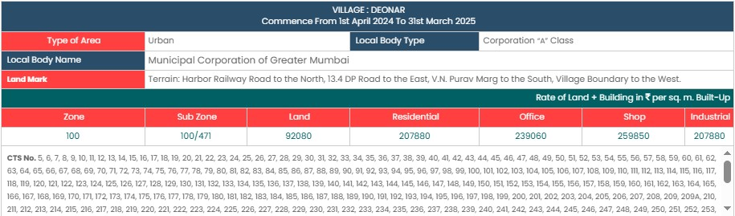
V.S.JADON & CO VALUERS LLP
PHOTOGRAPHS OF PROPERTY OF CUSTOMER: : Payal Pharma.
Site Layout
Govt. Rate
VSJCVNM-RBL-RTL-JUL25-14098
Page 4

