Slide 1
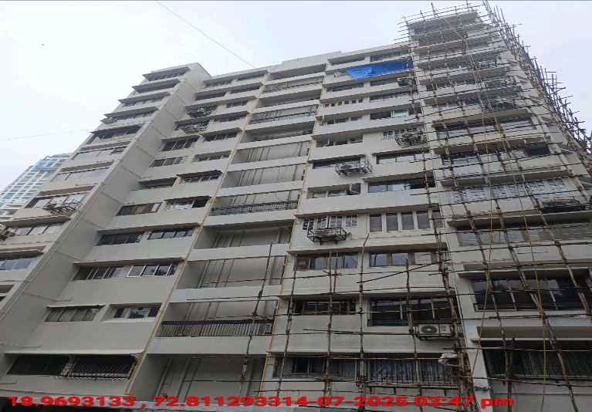
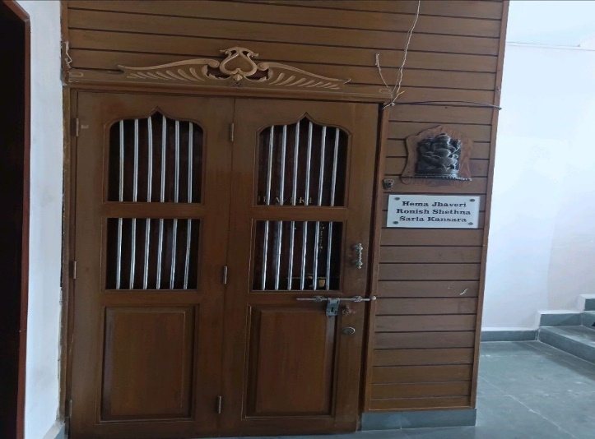
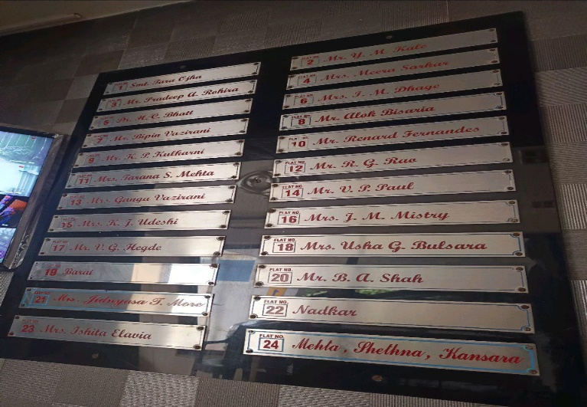
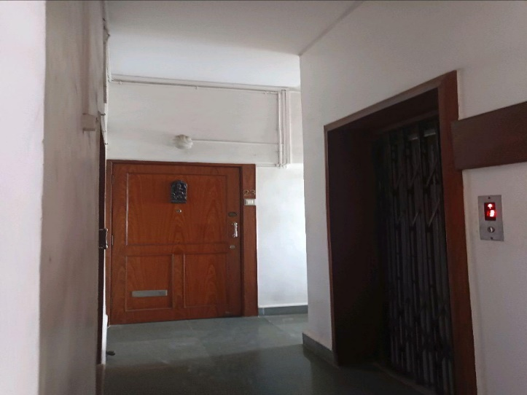
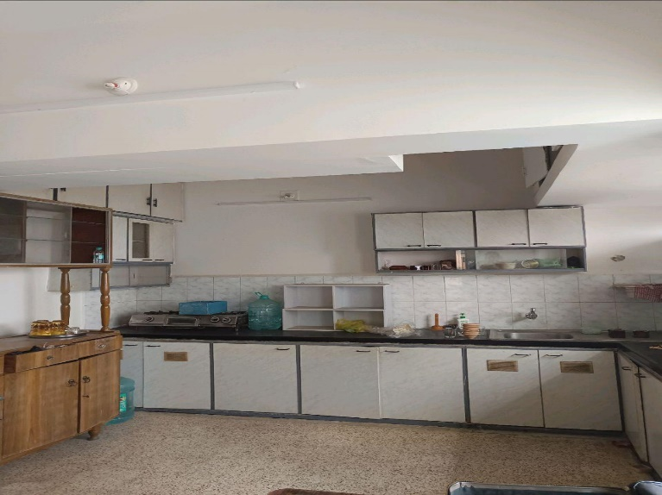
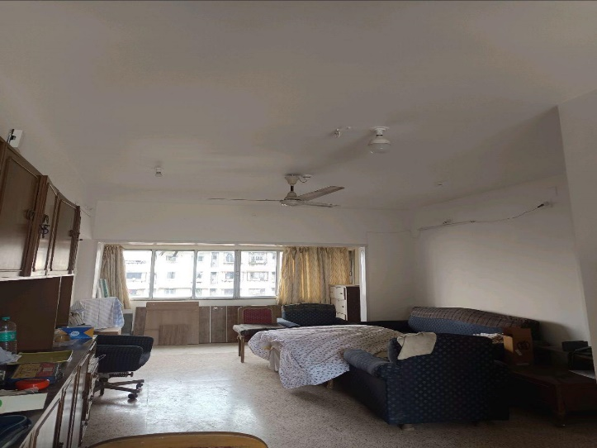
V.S.JADON & CO VALUERS LLP
PHOTOGRAPHS OF PROPERTY OF CUSTOMER : Mrs. Jidnyasa More.
VSJCVNM-RBL-RTL-JUL25-14155
Page 1

Slide 2
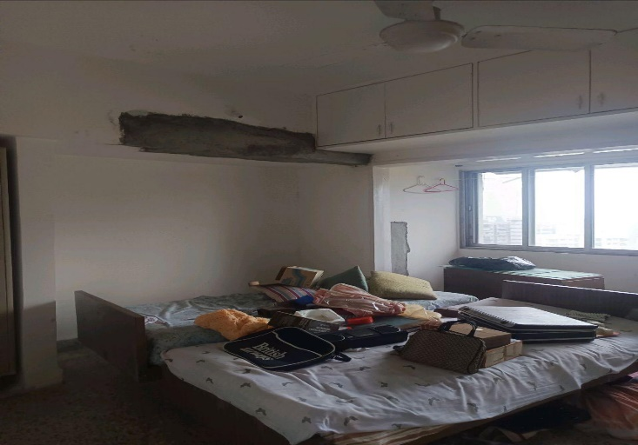
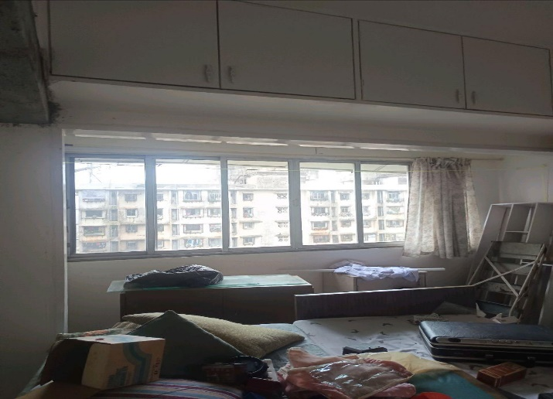
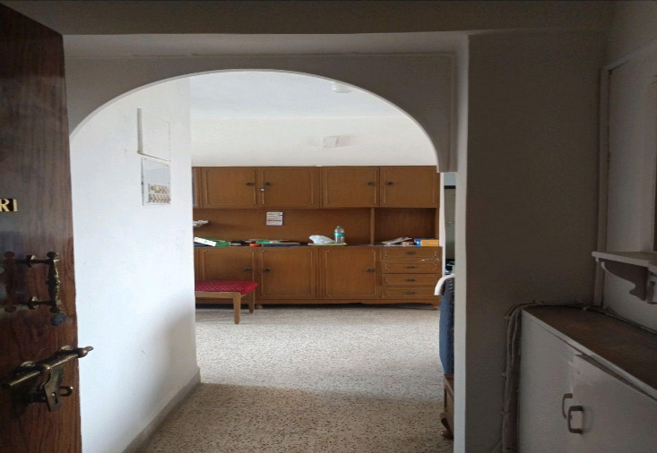
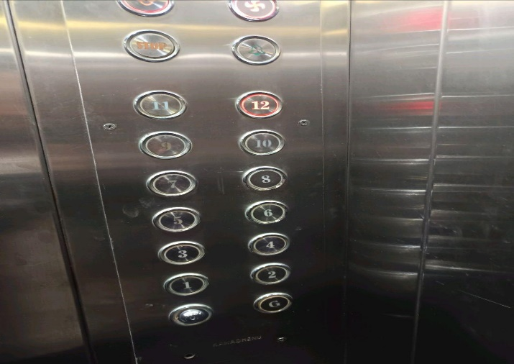
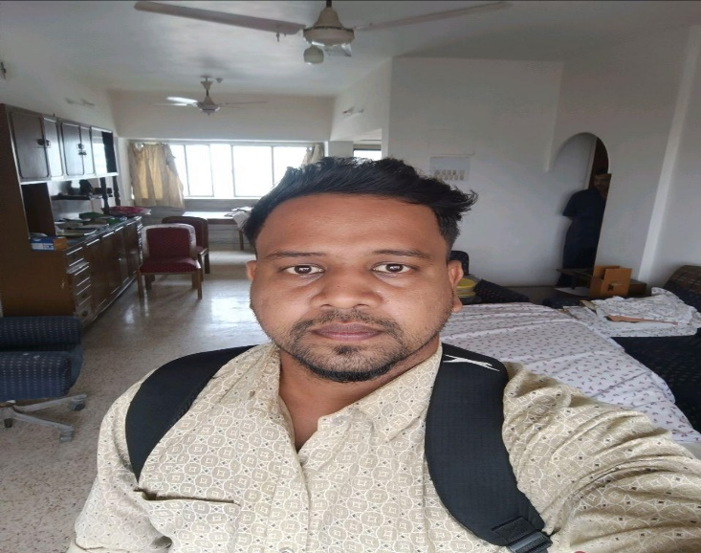
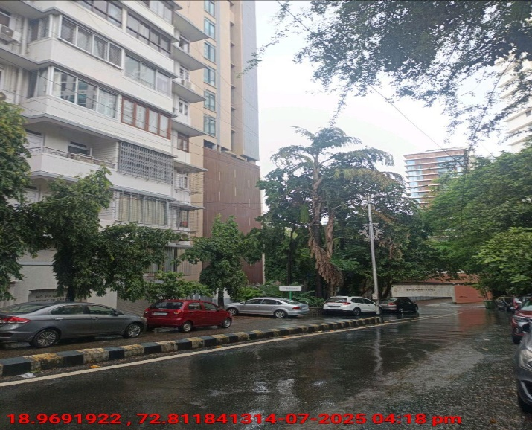
V.S.JADON & CO VALUERS LLP
PHOTOGRAPHS OF PROPERTY OF CUSTOMER :Mrs. Jidnyasa More.
VSJCVNM-RBL-RTL-JUL25-14155
Page 2

Slide 3
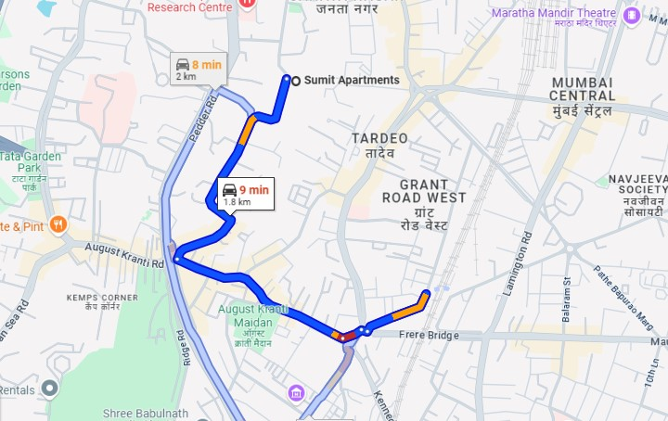
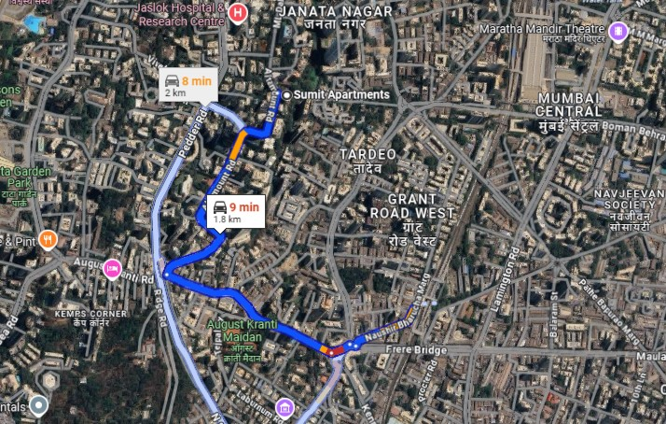
V.S.JADON & CO VALUERS LLP
PHOTOGRAPHS OF PROPERTY OF CUSTOMER :Mrs. Jidnyasa More. Google Map
VSJCVNM-RBL-RTL-JUL25-14155
Page 3

Slide 4
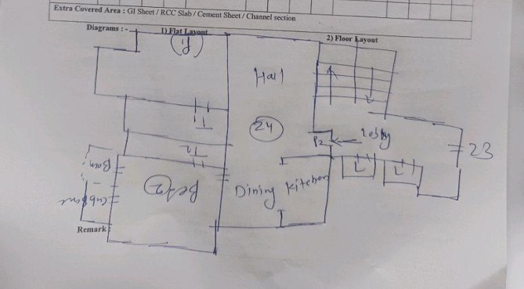
V.S.JADON & CO VALUERS LLP
PHOTOGRAPHS OF PROPERTY OF CUSTOMER: Mrs. Jidnyasa More..
Site Layout
Govt. Rate
VSJCVNM-RBL-RTL-JUL25-14155
Page 4

