Slide 1
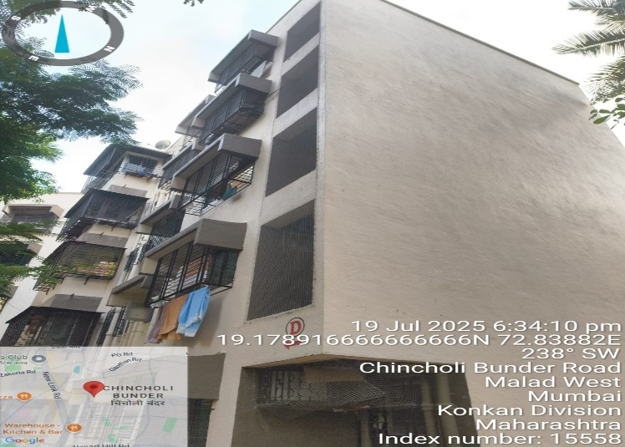
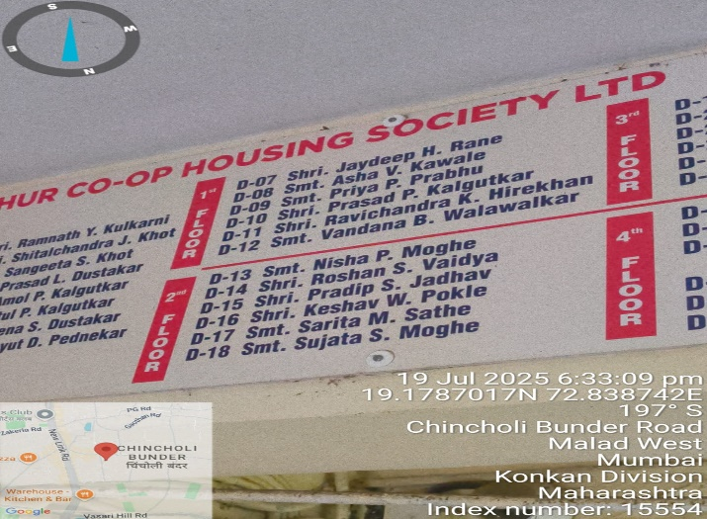
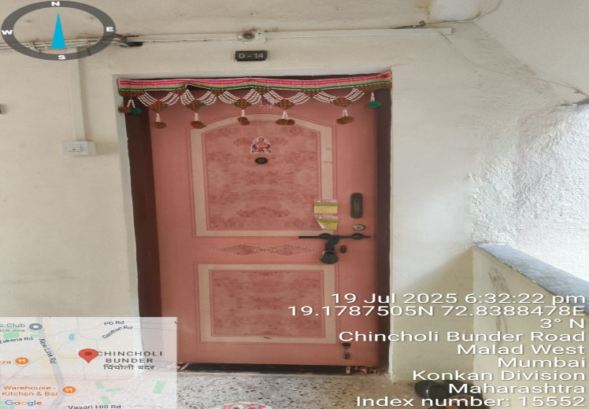
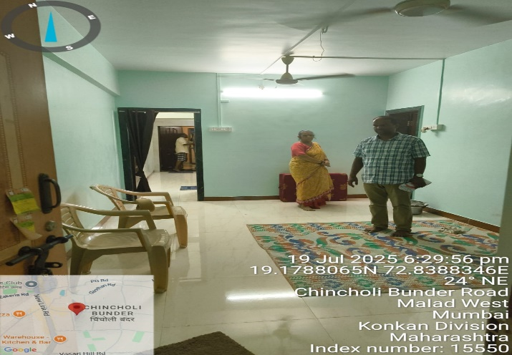
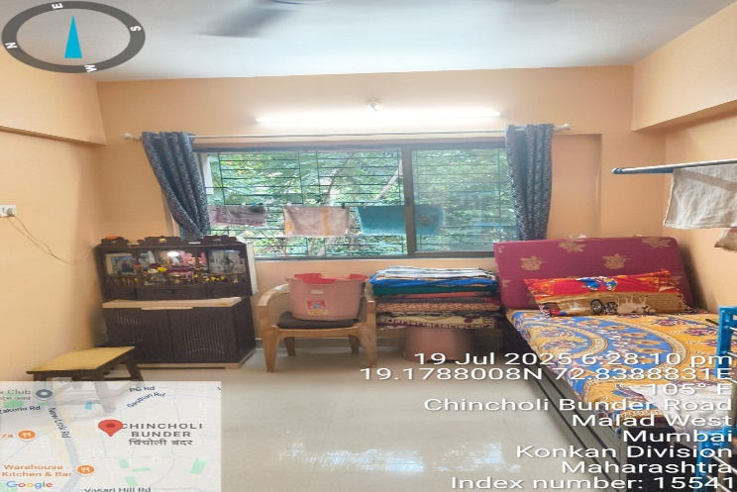
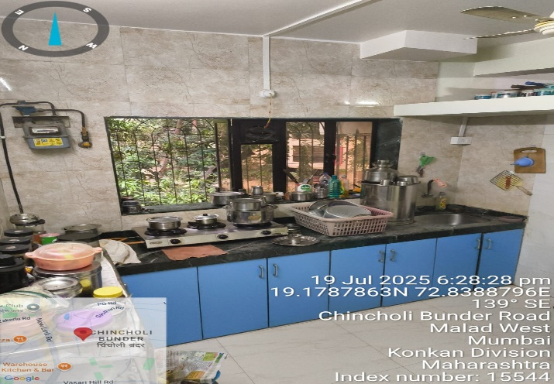
V.S.JADON & CO VALUERS LLP
PHOTOGRAPHS OF PROPERTY OF CUSTOMER: Mr. Roshan Sadanand Vaidya
VSJCVNM-RBL-RTL-JUL25-14717 Page 1

Slide 2
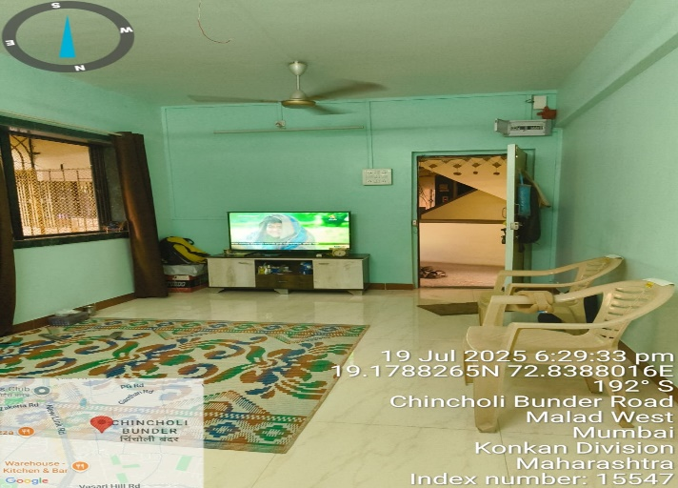
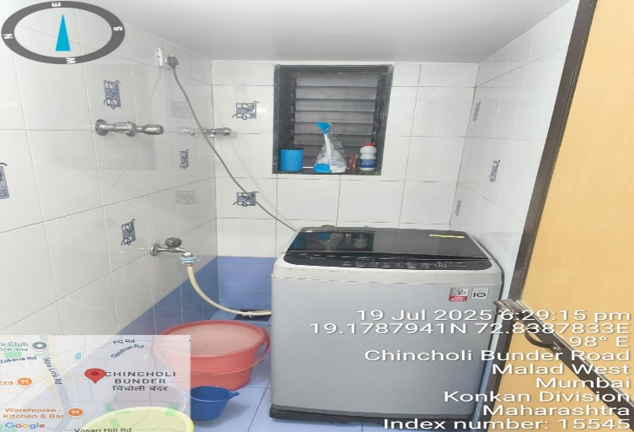
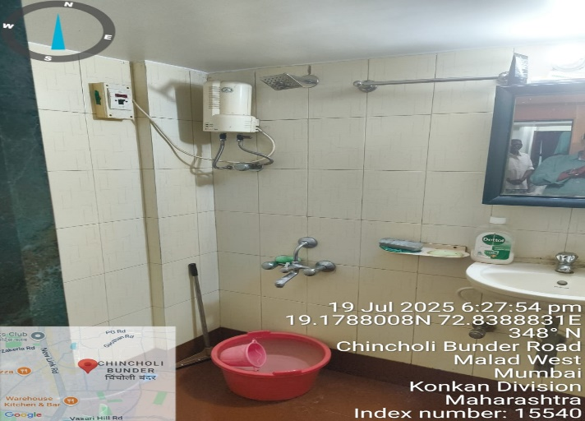
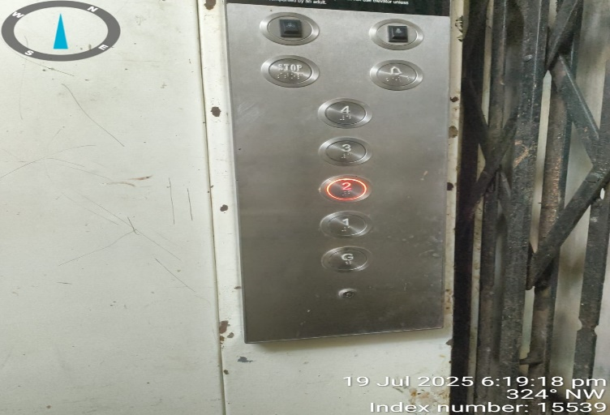
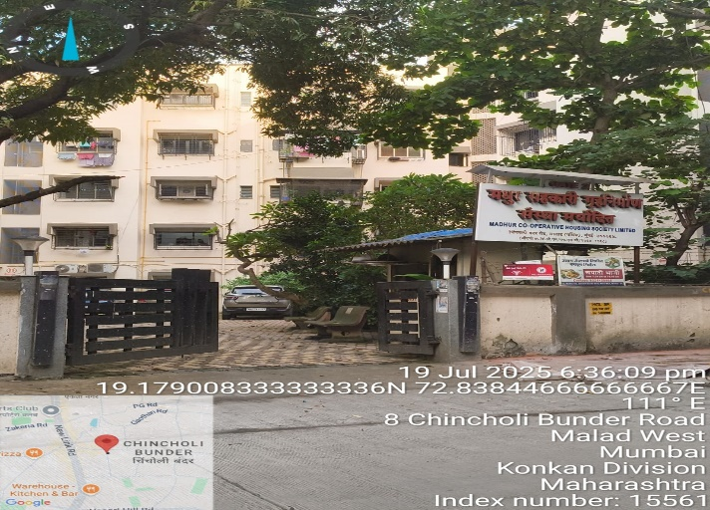
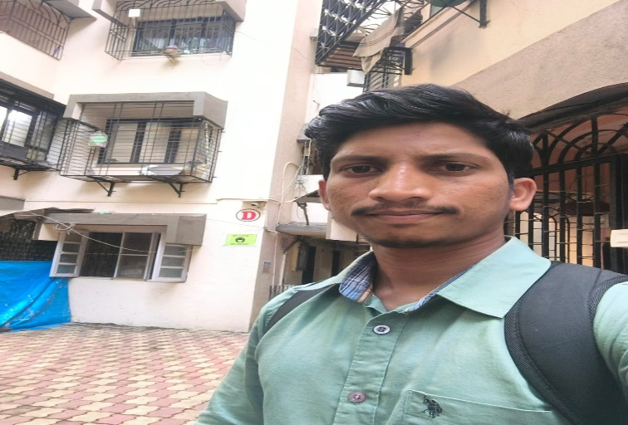
V.S.JADON & CO VALUERS LLP
PHOTOGRAPHS OF PROPERTY OF CUSTOMER: Mr. Roshan Sadanand Vaidya
VSJCVNM-RBL-RTL-JUL25-14717 Page 2

Slide 3
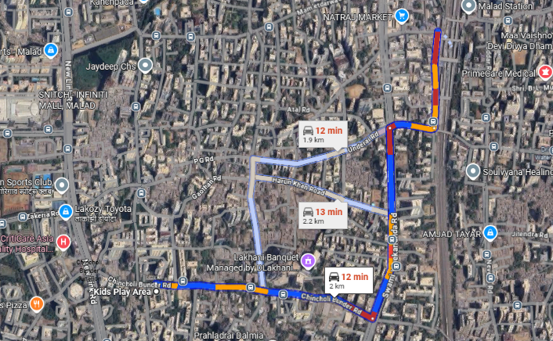
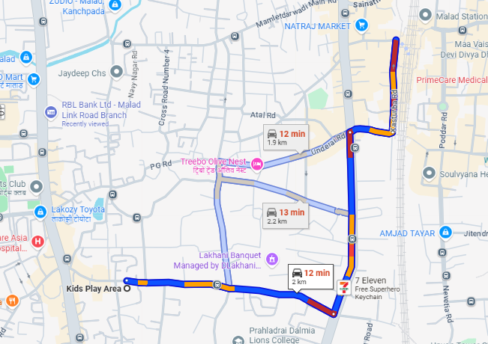
V.S.JADON & CO VALUERS LLP
PHOTOGRAPHS OF PROPERTY OF CUSTOMER: Mr. Roshan Sadanand Vaidya
VSJCVNM-RBL-RTL-JUL25-14717 Page 3

Slide 4
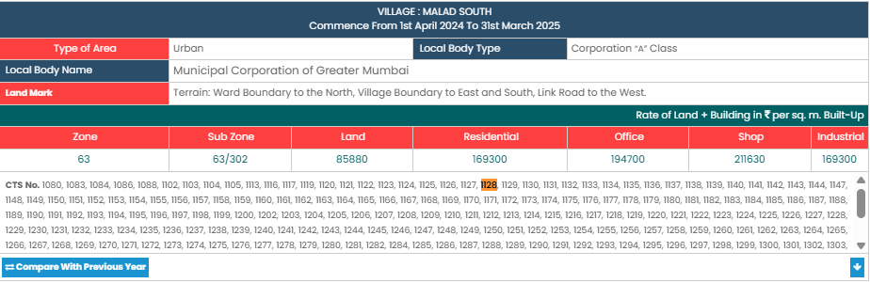
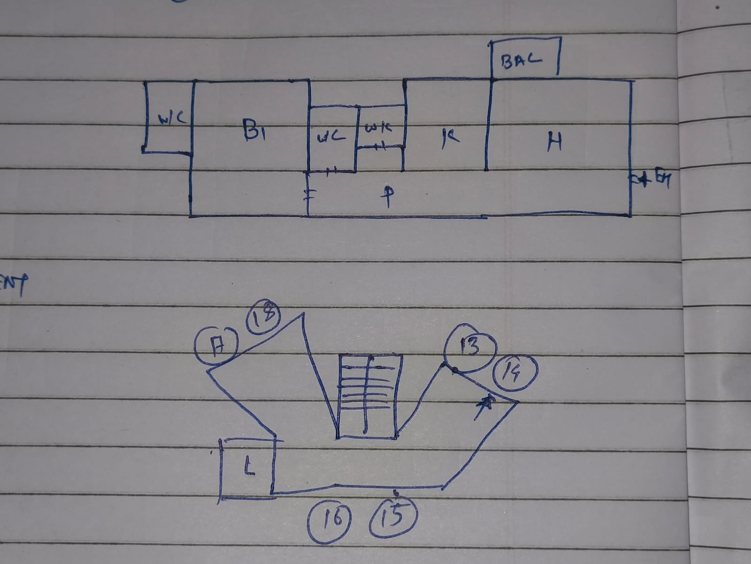
V.S.JADON & CO VALUERS LLP
PHOTOGRAPHS OF PROPERTY OF CUSTOMER: Mr. Roshan Sadanand Vaidya
VSJCVNM-RBL-RTL-JUL25-14717 Page 4

