Slide 1
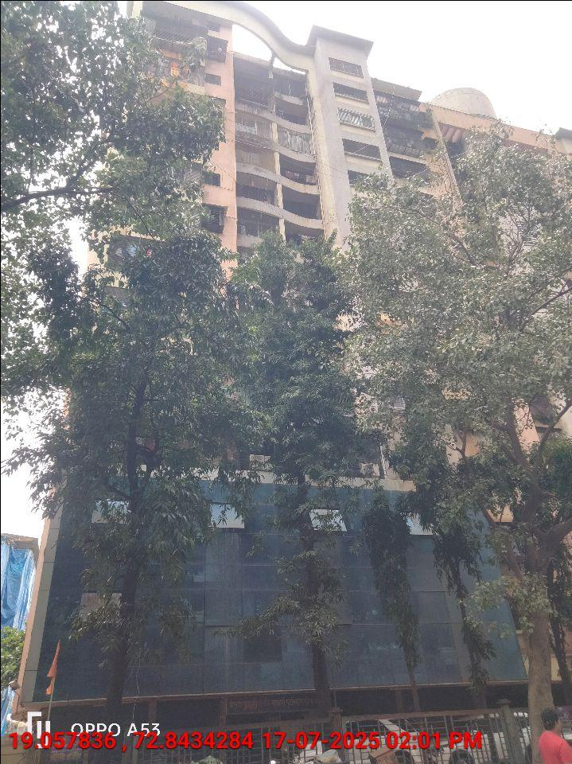
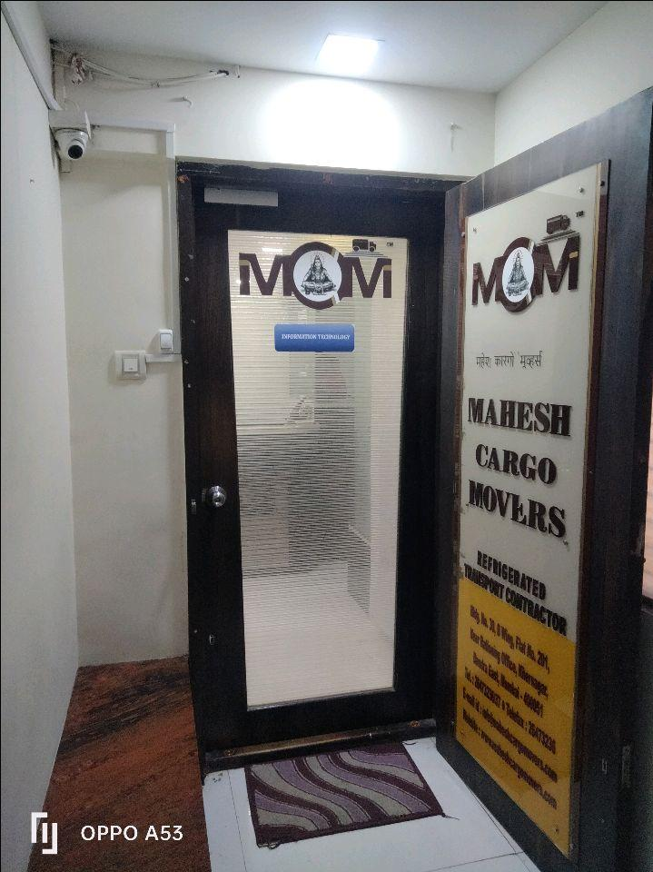
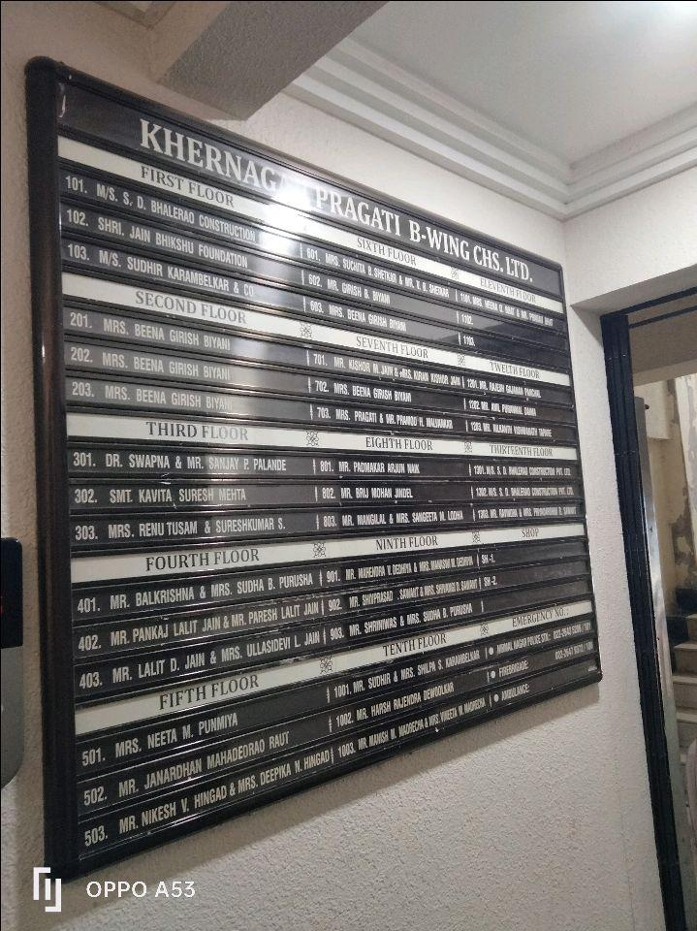
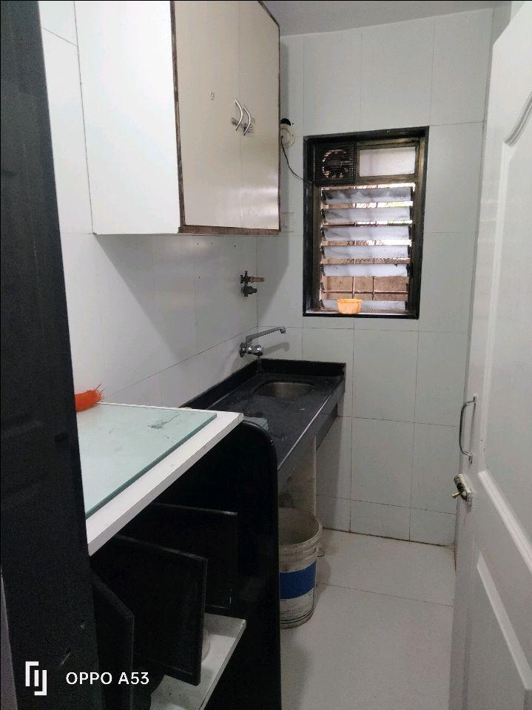
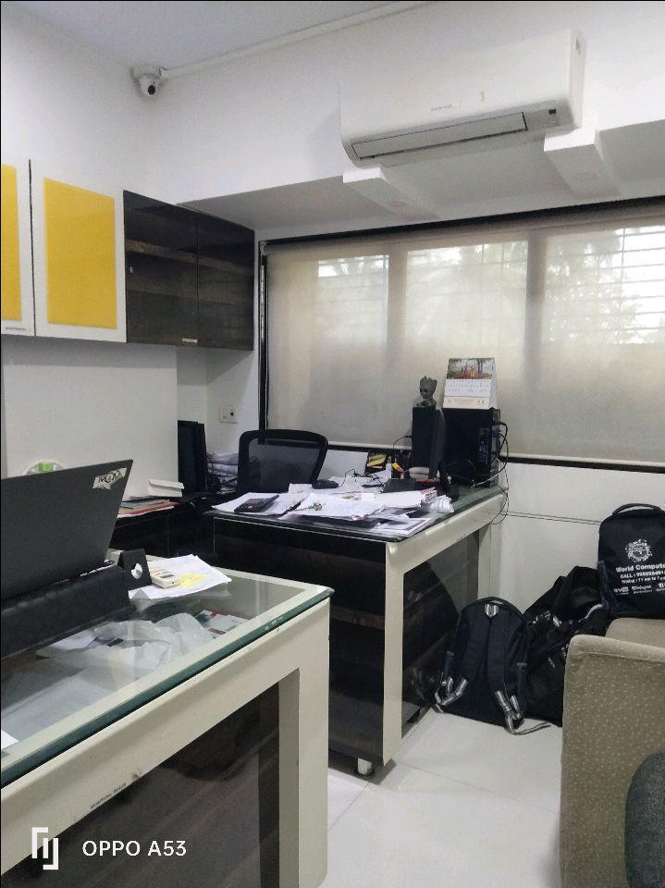
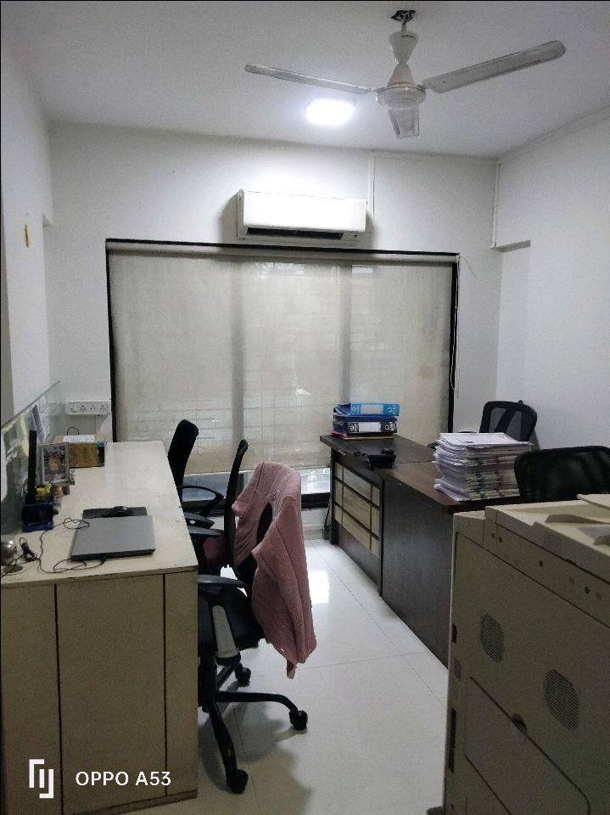
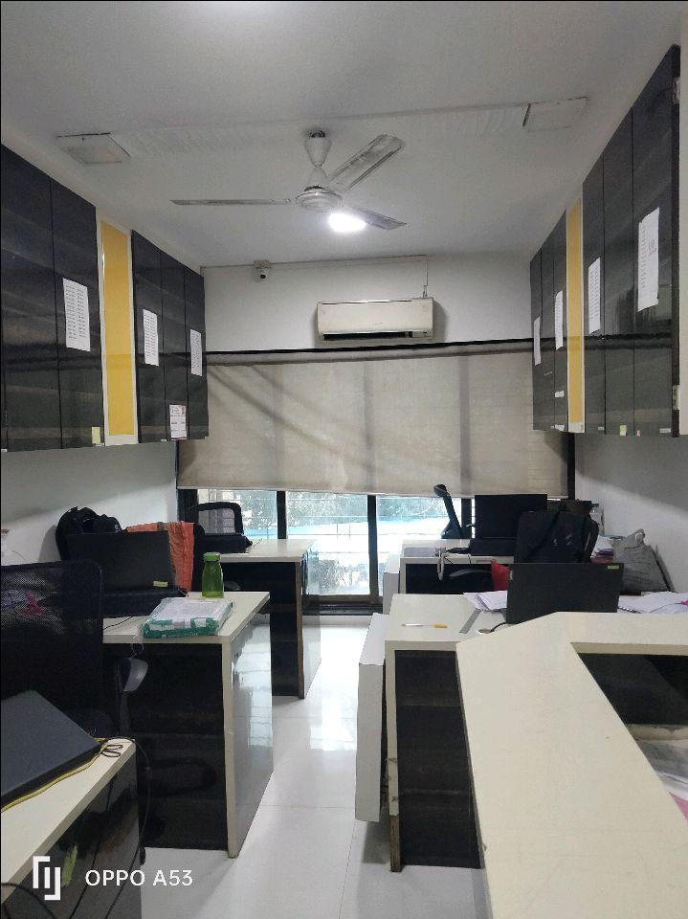
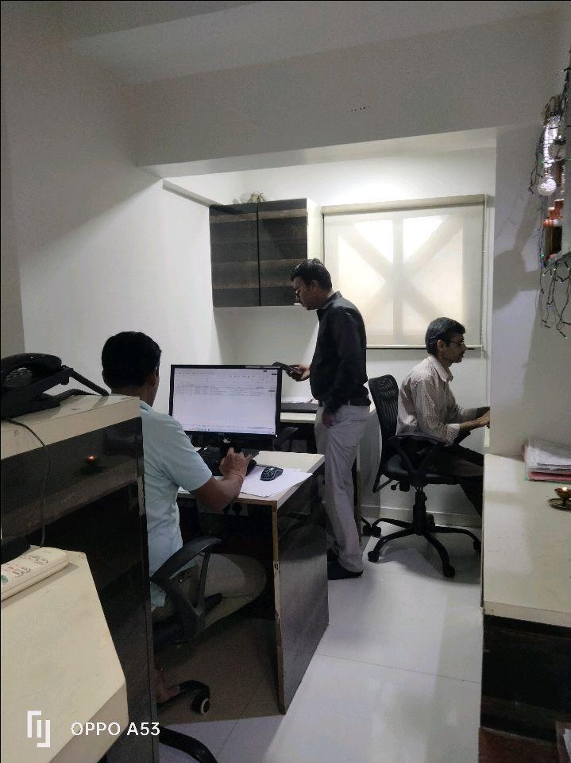
V.S.JADON & CO VALUERS LLP
Site Photo – Office No 201
PHOTOGRAPHS OF PROPERTY OF CUSTOMER: BEENA GIRISH BIYANI
VSJCVNM-AXIS-RTL-JUN25-14501 Page 6

Slide 2
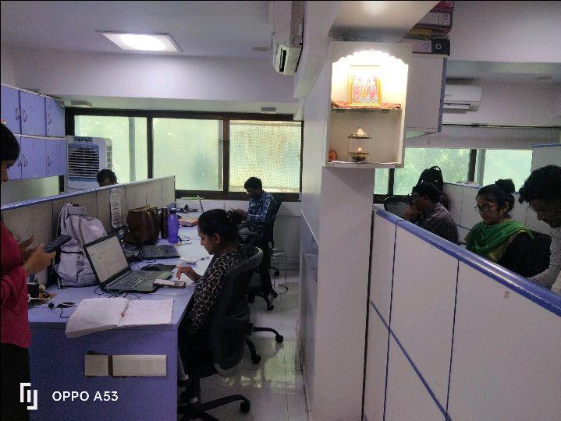
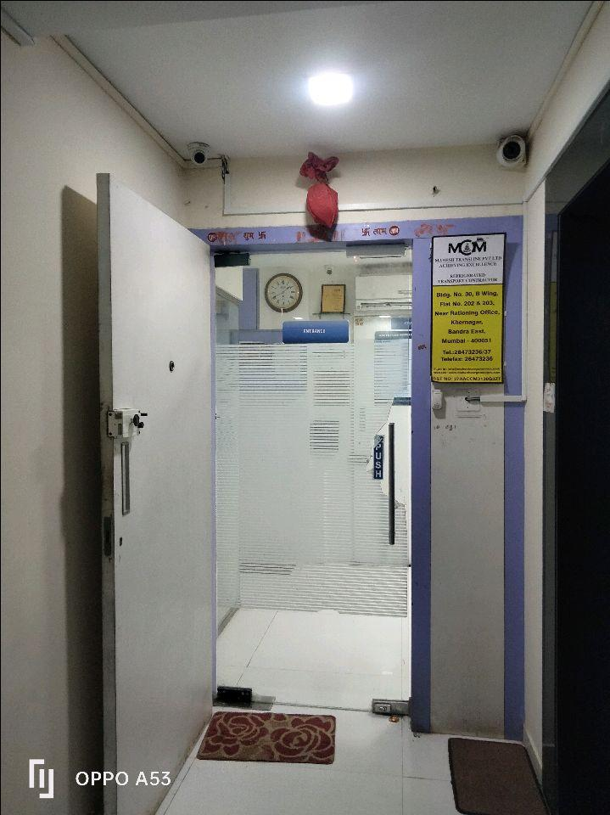
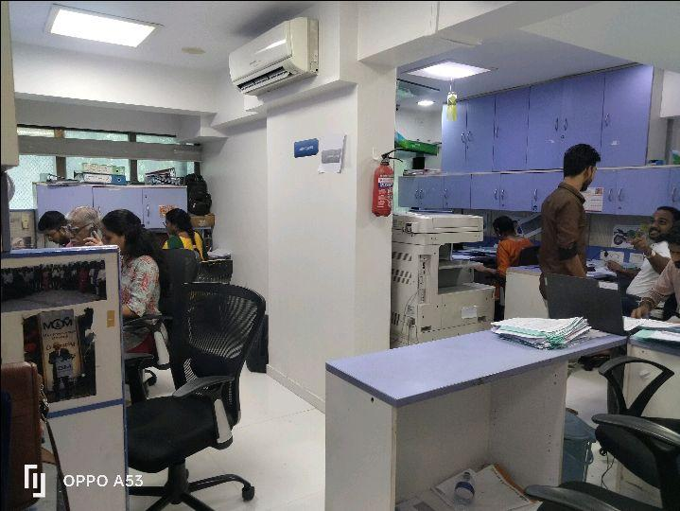
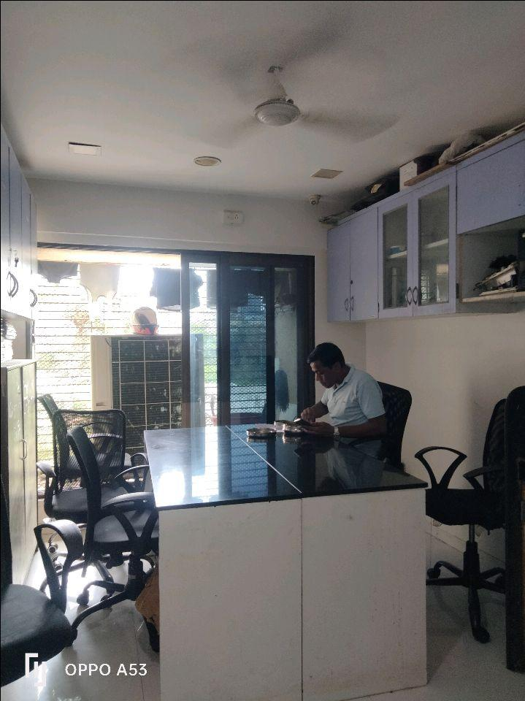
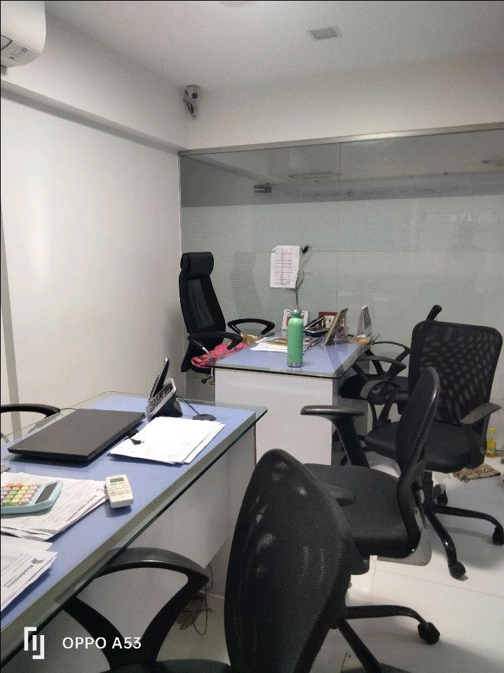
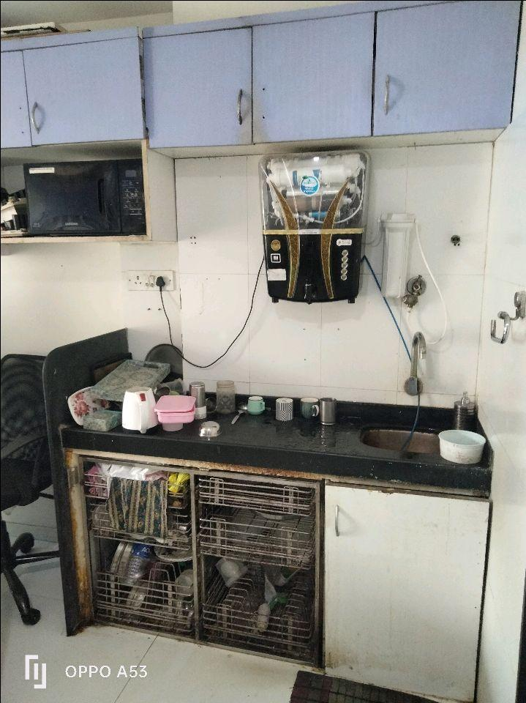
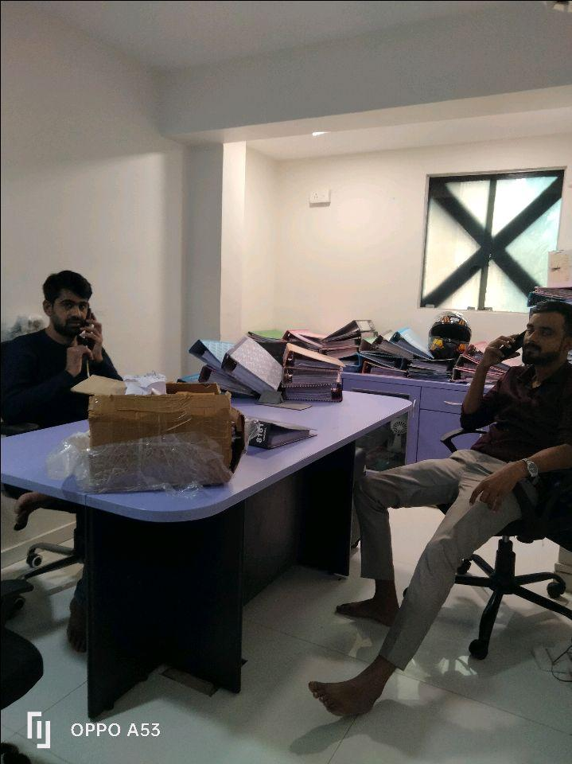
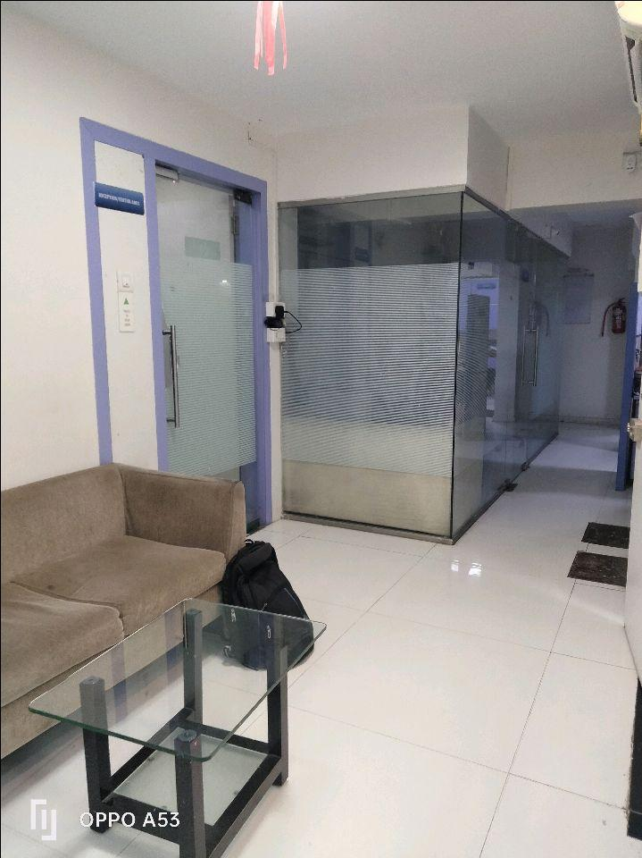
V.S.JADON & CO VALUERS LLP
Site Photo Office No 202 & 203
PHOTOGRAPHS OF PROPERTY OF CUSTOMER: BEENA GIRISH BIYANI
VSJCVNM-AXIS-RTL-JUN25-14501 Page 7

Slide 3
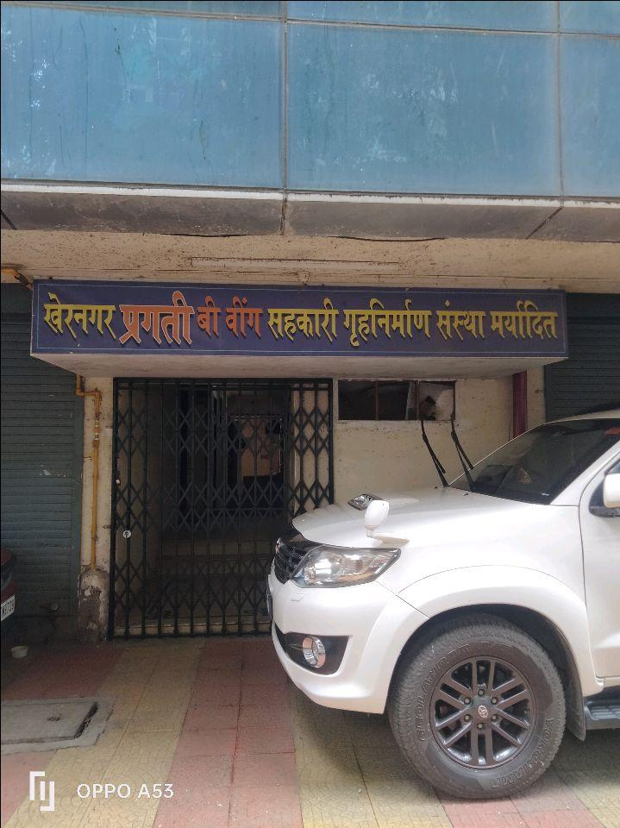
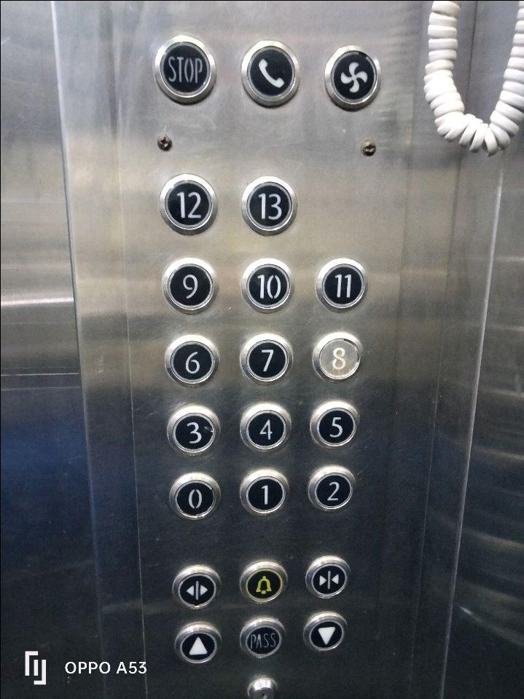
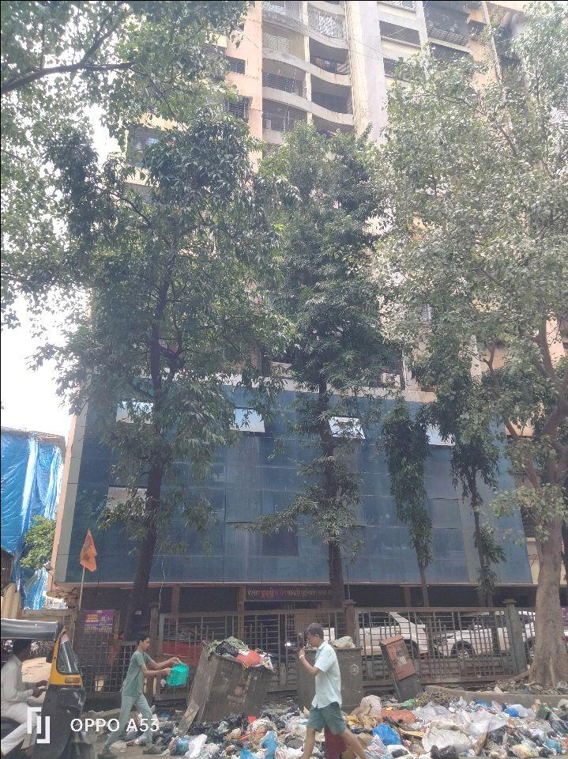

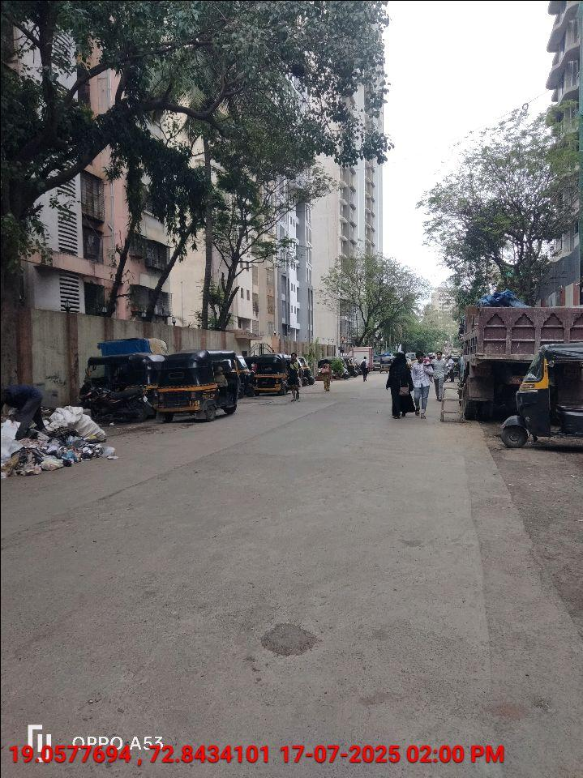
V.S.JADON & CO VALUERS LLP
Site Photo
PHOTOGRAPHS OF PROPERTY OF CUSTOMER: BEENA GIRISH BIYANI
VSJCVNM-AXIS-RTL-JUN25-14501 Page 8

Slide 4
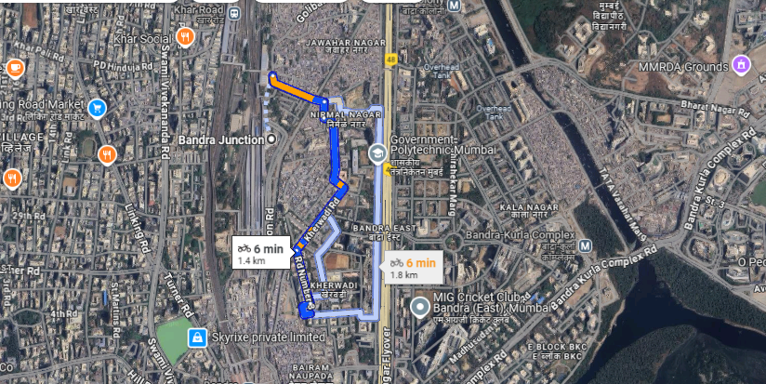
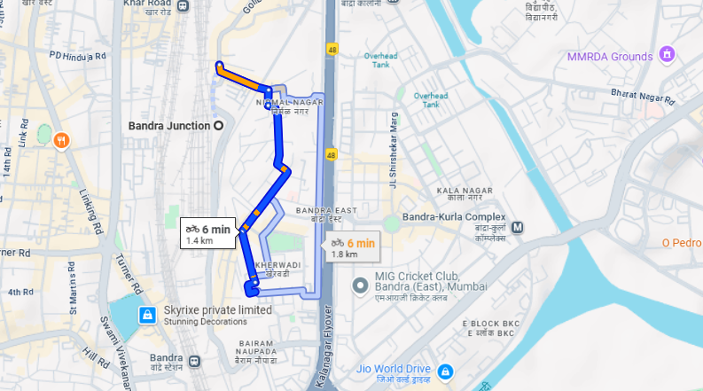
V.S.JADON & CO VALUERS LLP
PHOTOGRAPHS OF PROPERTY OF CUSTOMER BEENA GIRISH BIYANI
Google Maps :
VSJCVNM-AXIS-RTL-JUN25-14501 Page 9

Slide 5
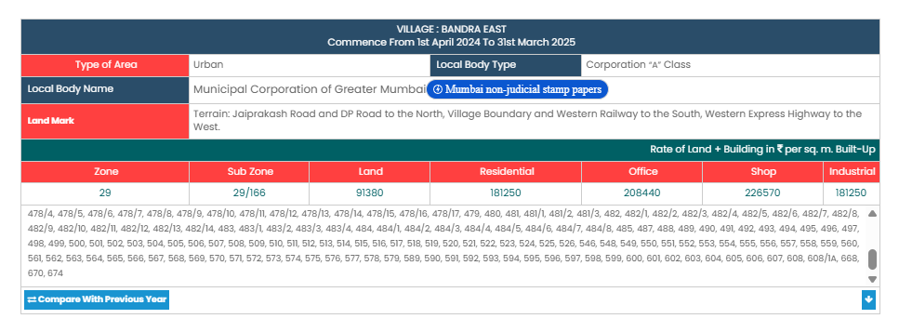
V.S.JADON & CO VALUERS LLP
PHOTOGRAPHS OF PROPERTY OF CUSTOMER: BEENA GIRISH BIYANI
Gov Rate:
VSJCVNM-AXIS-RTL-JUN25-14501 Page 9

Slide 6
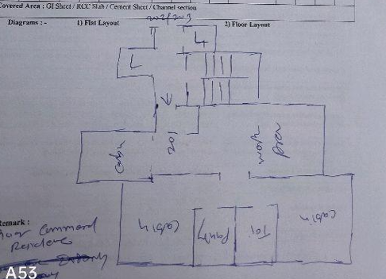
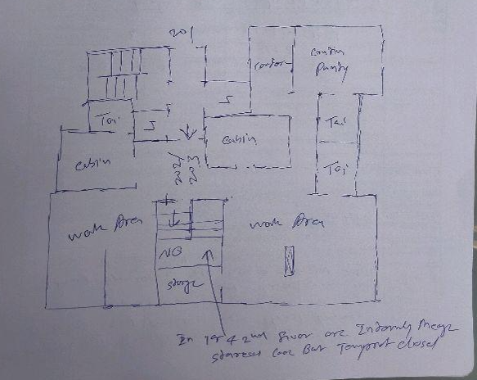
V.S.JADON & CO VALUERS LLP
PHOTOGRAPHS OF PROPERTY OF CUSTOMER: BEENA GIRISH BIYANI
Site Layout :
VSJCVNM-AXIS-RTL-JUN25-14501 Page 10

