Slide 1
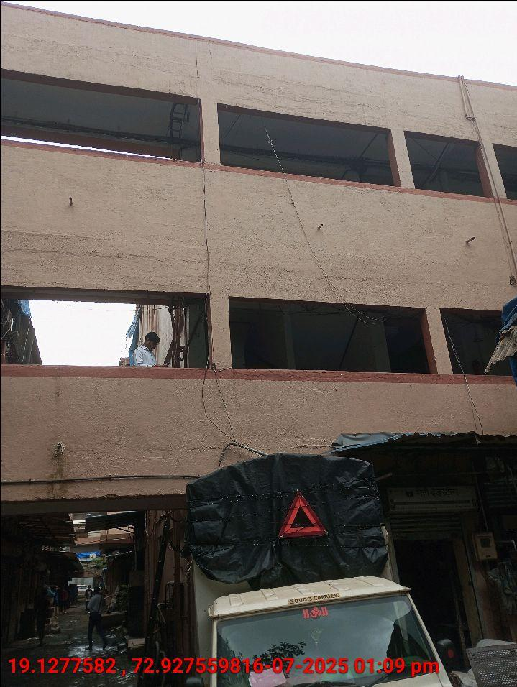
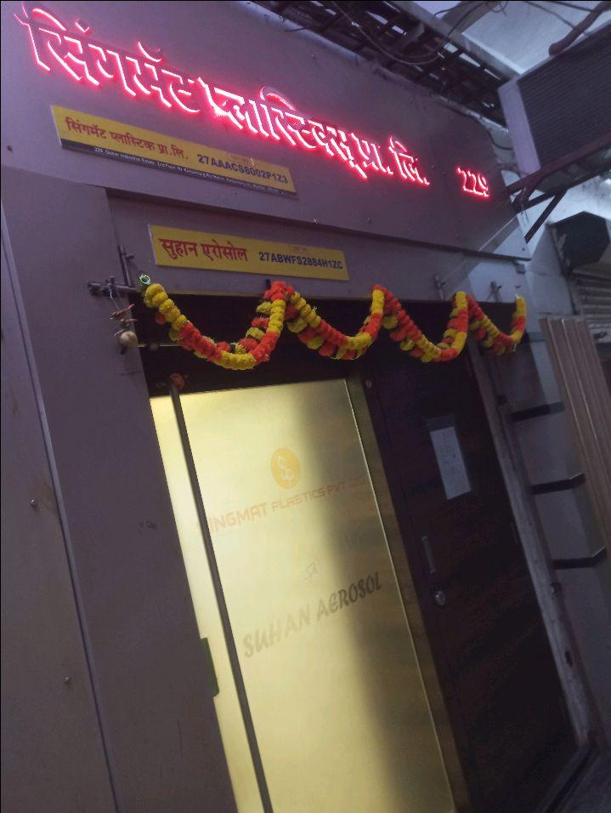
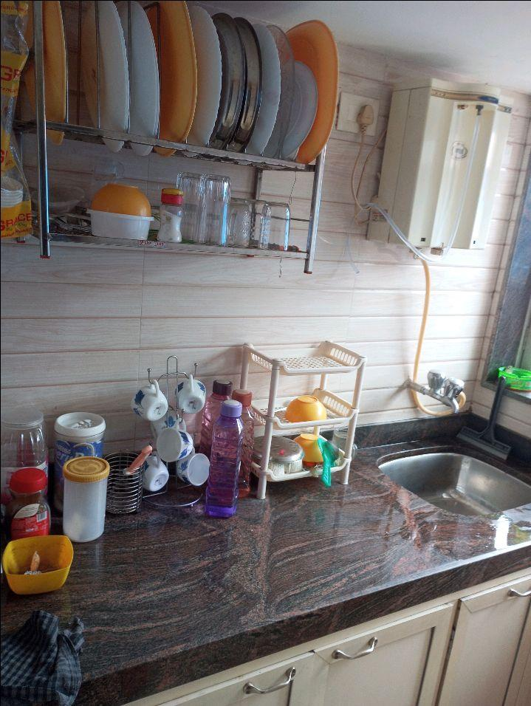
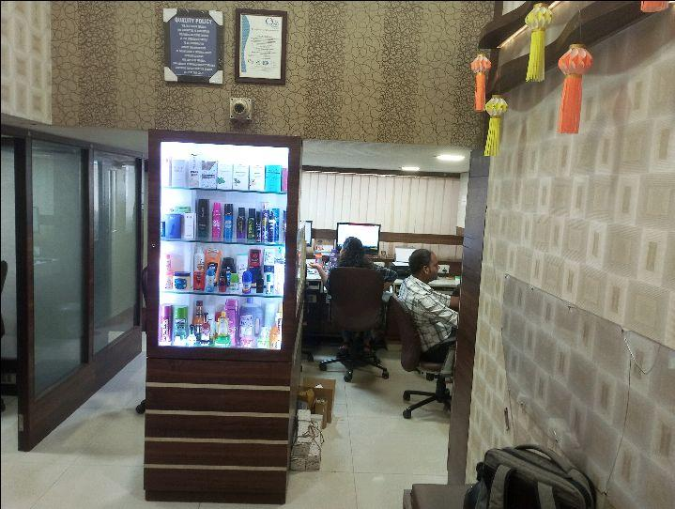
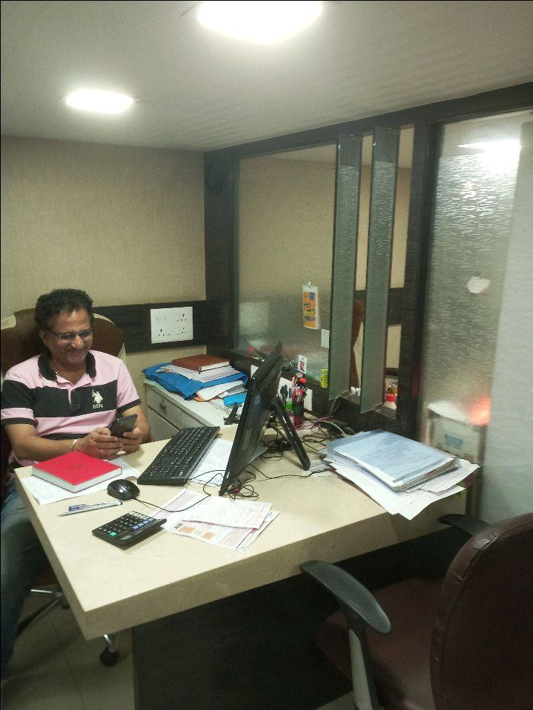
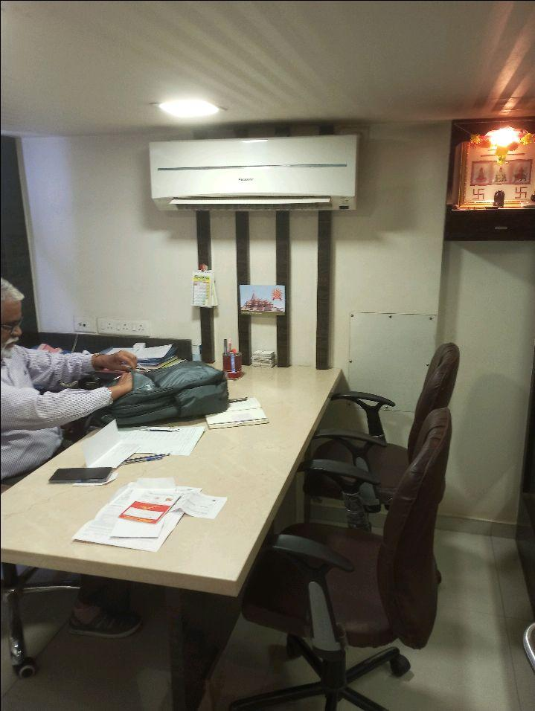
V.S.JADON & CO VALUERS LLP
PHOTOGRAPHS OF PROPERTY OF CUSTOMER : Suhan Aerosol.
VSJCVNM-AXIS-RTL-JUL25-14547
Page 1

Slide 2
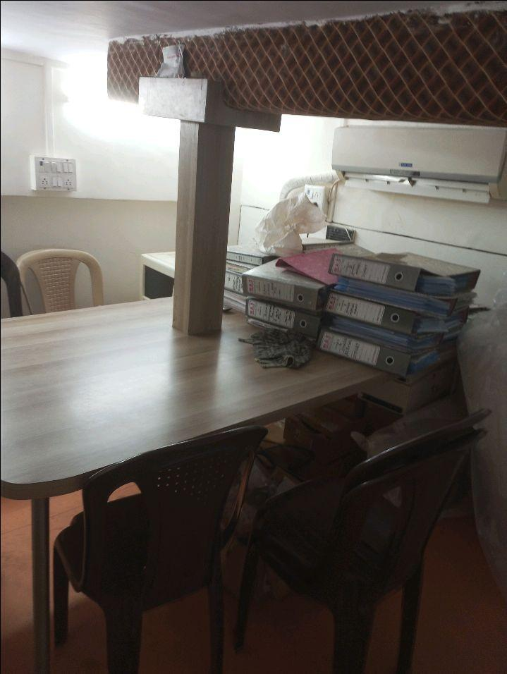
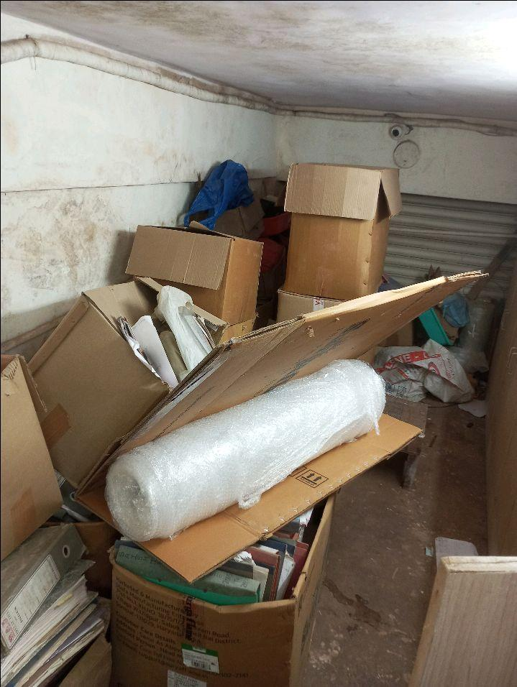
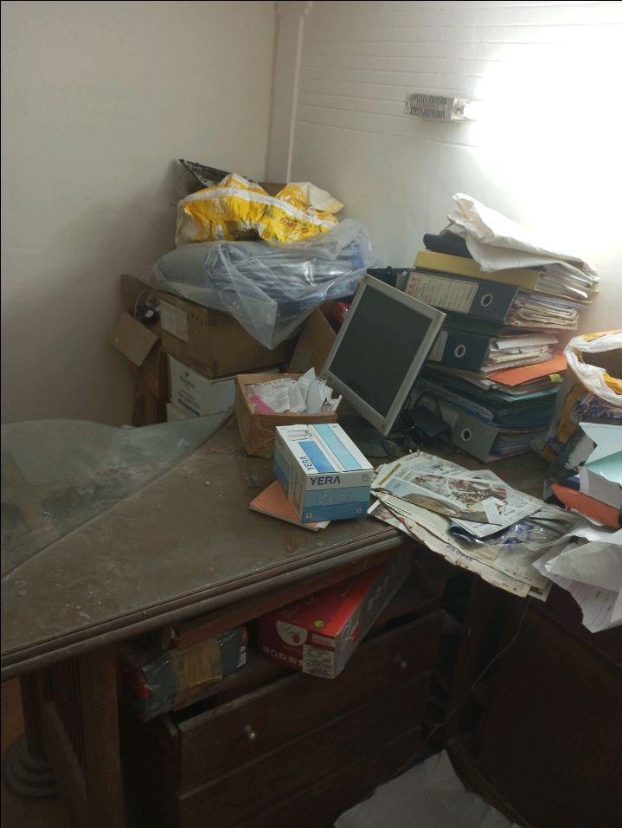
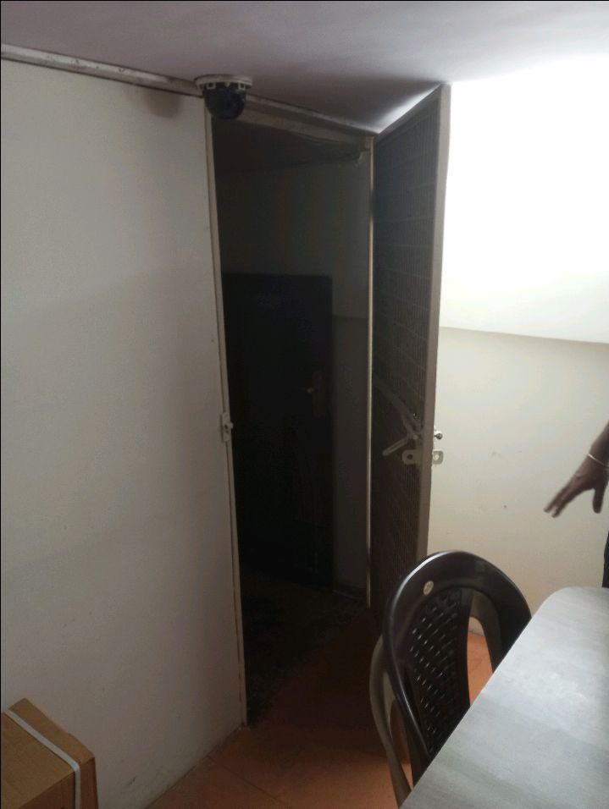
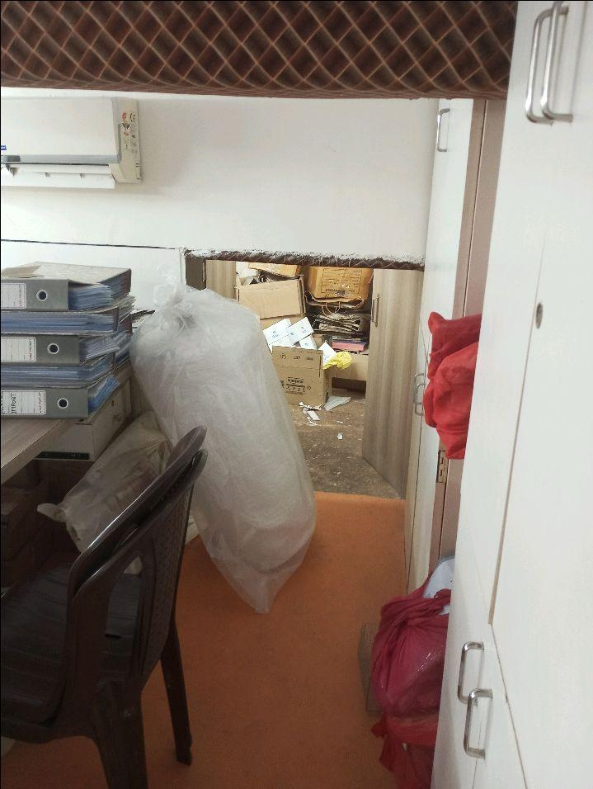
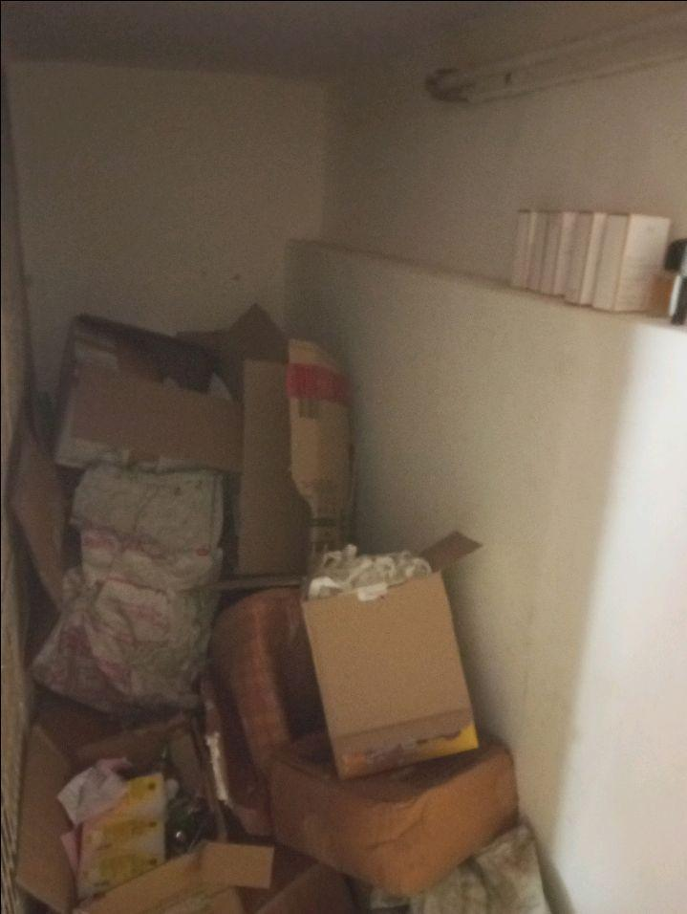
V.S.JADON & CO VALUERS LLP
PHOTOGRAPHS OF PROPERTY OF CUSTOMER : Suhan Aerosol.
VSJCVNM-AXIS-RTL-JUL25-14547
Page 2

Slide 3
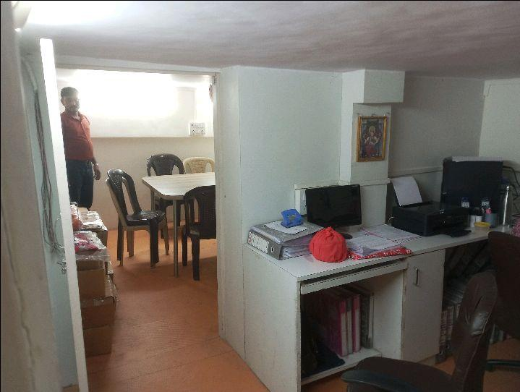
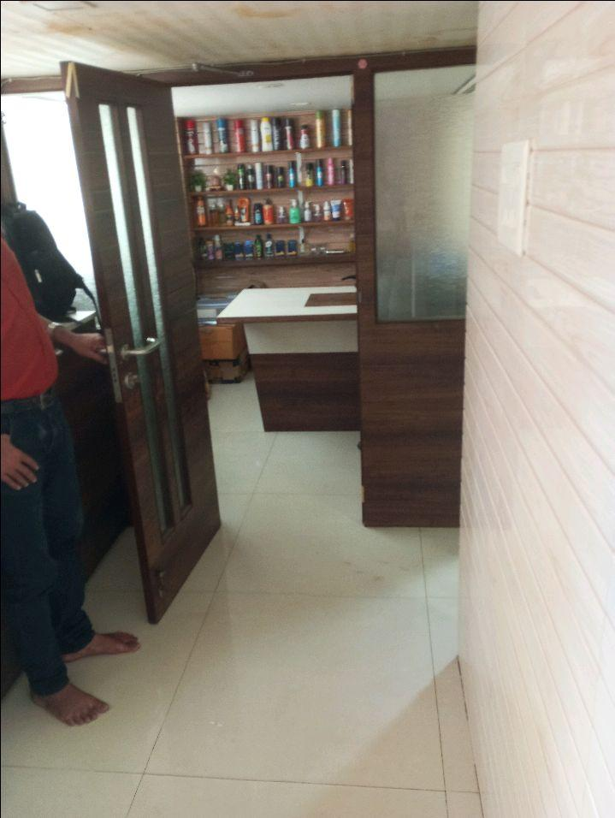
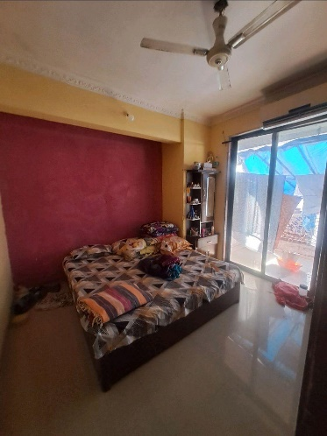
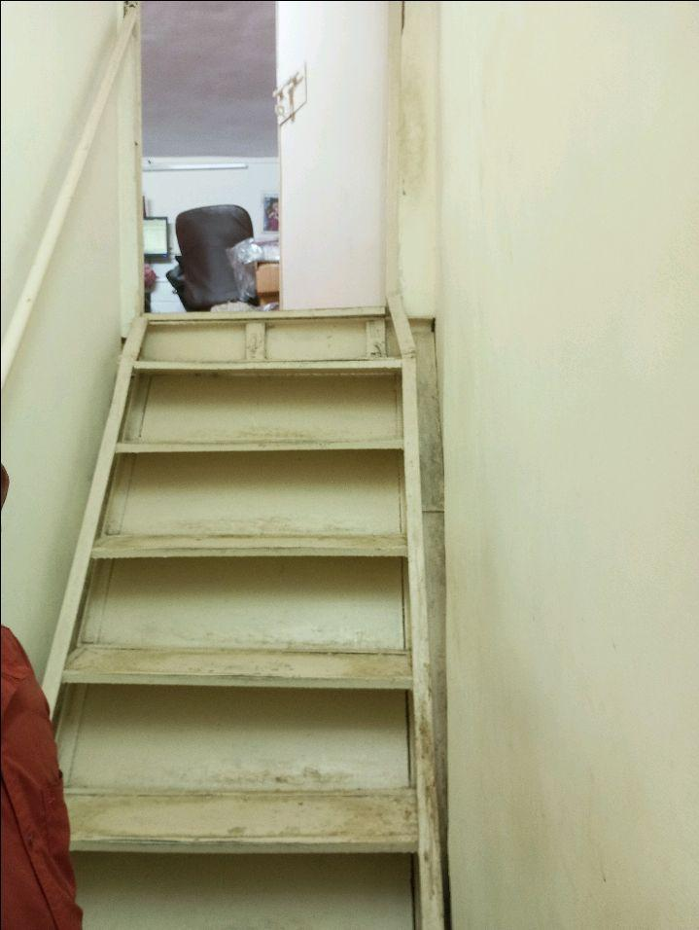

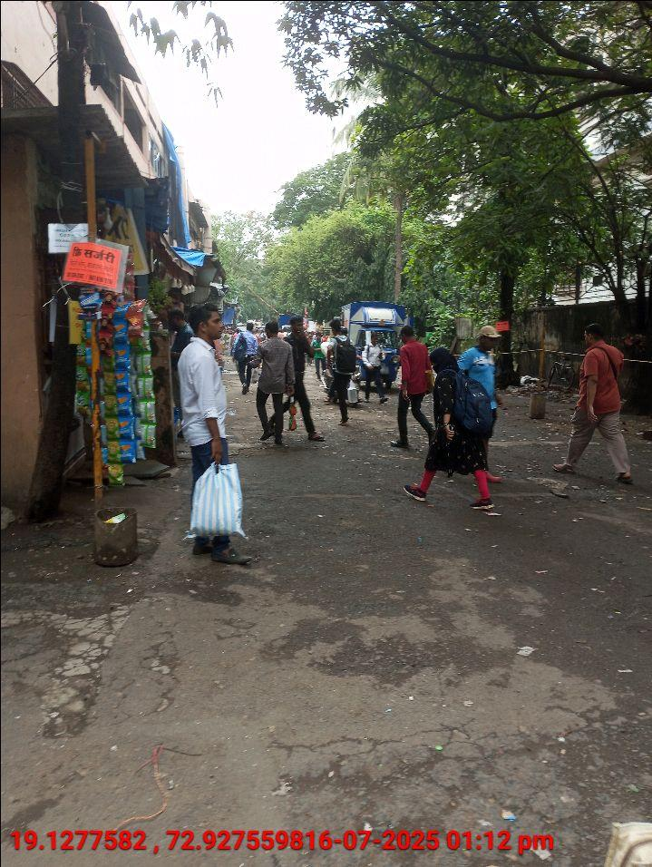
V.S.JADON & CO VALUERS LLP
PHOTOGRAPHS OF PROPERTY OF CUSTOMER : Suhan Aerosol.
VSJCVNM-AXIS-RTL-JUL25-14547
Page 3

Slide 4
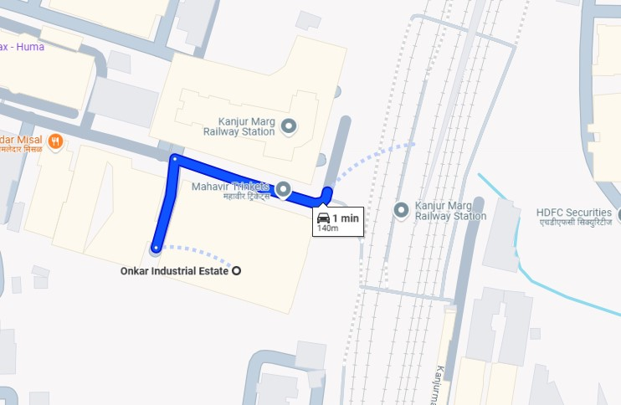
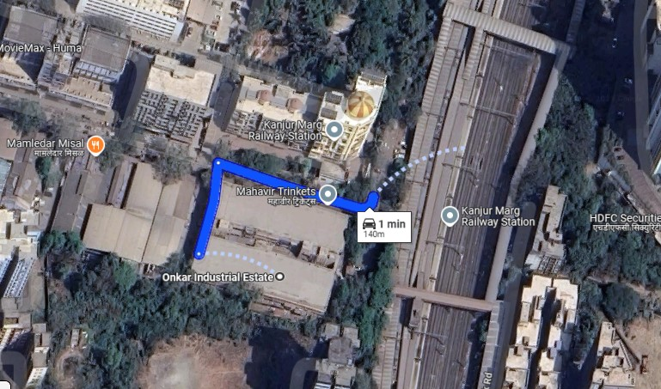
V.S.JADON & CO VALUERS LLP
PHOTOGRAPHS OF PROPERTY OF CUSTOMER: Suhan Aerosol.
Google Map
VSJCVNM-AXIS-RTL-JUL25-14547
Page 4

Slide 5
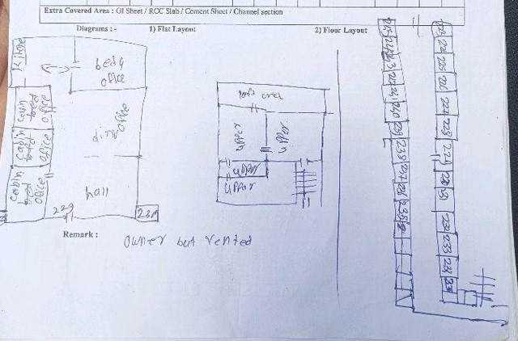
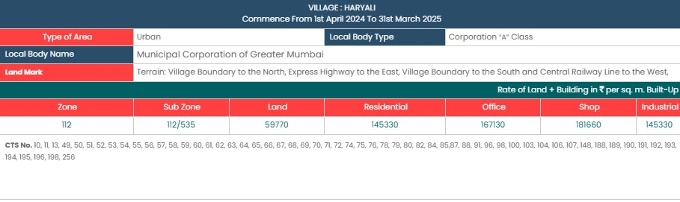
V.S.JADON & CO VALUERS LLP
PHOTOGRAPHS OF PROPERTY OF CUSTOMER:Suhan Aerosol.
Site Layout
Govt. Rate
VSJCVNM-AXIS-RTL-JUL25-14547
Page 5

