Slide 1

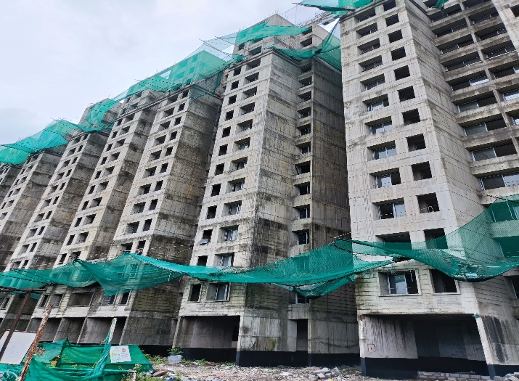
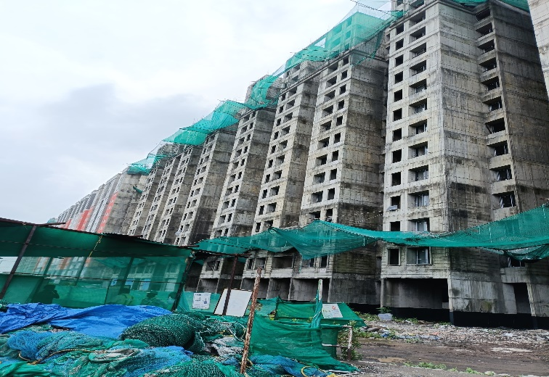
V.S.JADON & CO VALUERS LLP
PHOTOGRAPHS OF PROPERTY OF CUSTOMER: Sudhir Mahajan
VSJCVNM-RBL-RTL-JUL25-14572 Page 6

Slide 2
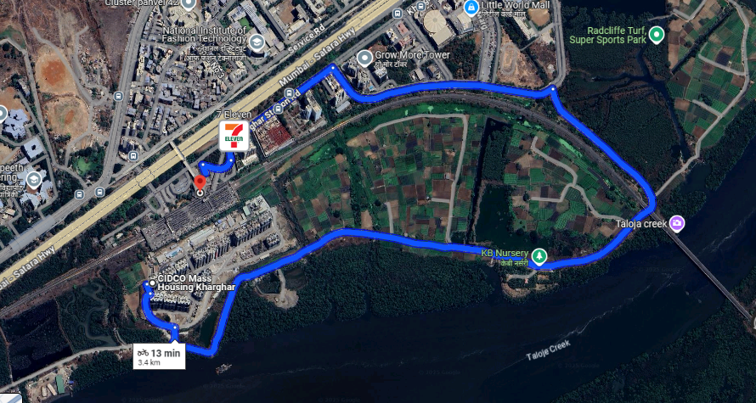
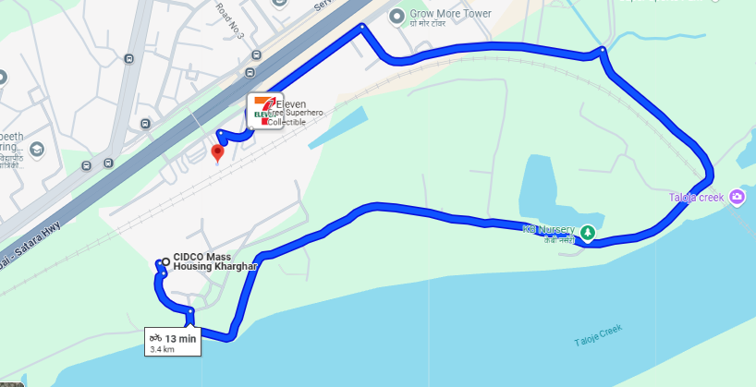
V.S.JADON & CO VALUERS LLP
PHOTOGRAPHS OF PROPERTY OF CUSTOMER: Sudhir Mahajan
Google Map
VSJCVNM-RBL-RTL-JUL25-14572 Page 7

Slide 3
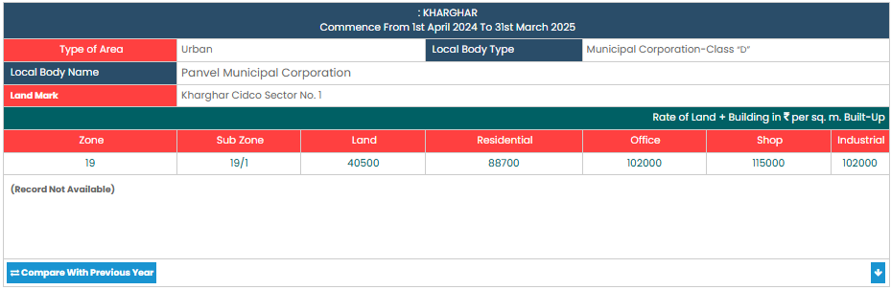
V.S.JADON & CO VALUERS LLP
PHOTOGRAPHS OF PROPERTY OF CUSTOMER: Sudhir Mahajan
Gov Rate
VSJCVNM-RBL-RTL-JUL25-14572 Page 8

