Slide 1
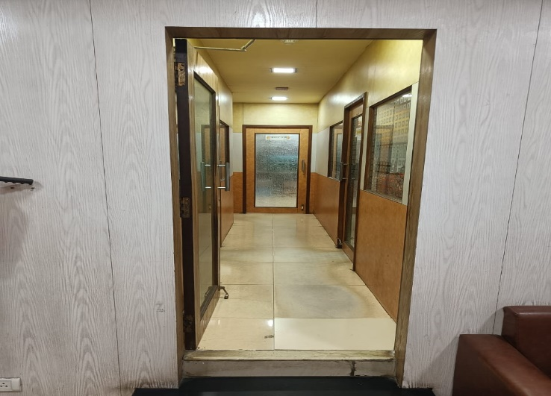
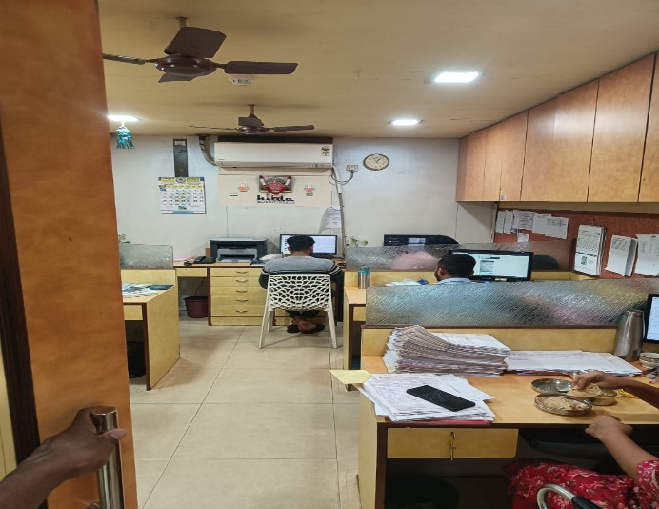
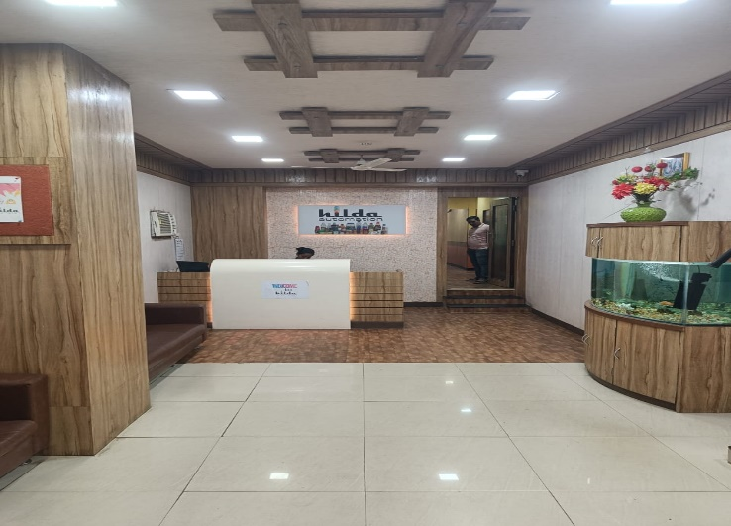
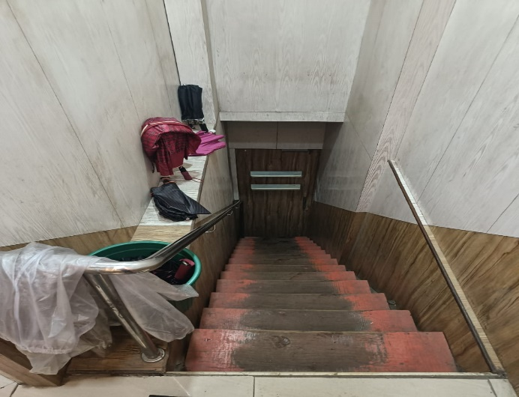
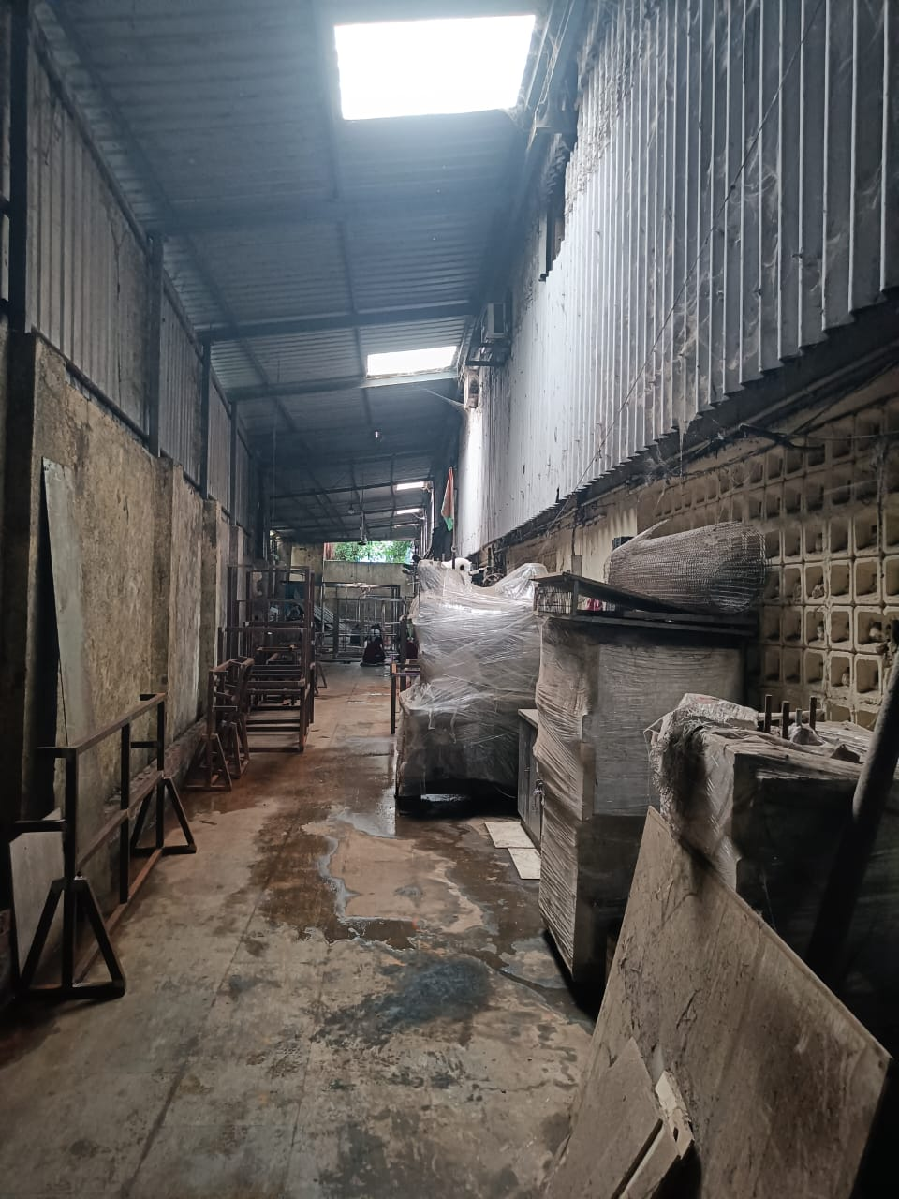
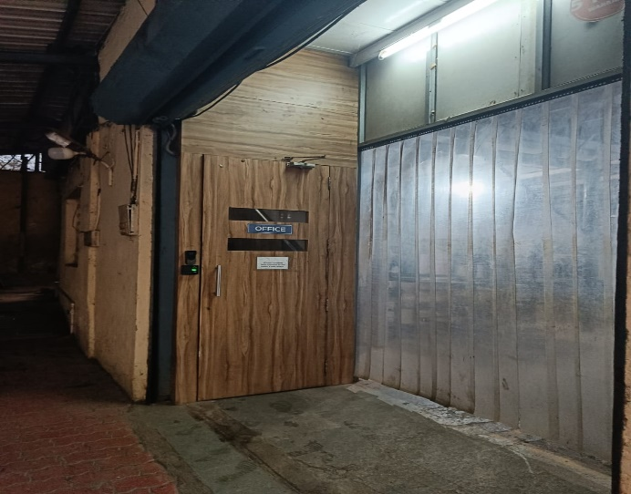
V.S.JADON & CO VALUERS LLP
PHOTOGRAPHS OF PROPERTY OF CUSTOMER : Hilda Automation Pvt Ltd.
VSJCVNM-AXIS-RTL-JUL25-14989
Page 1

Slide 2
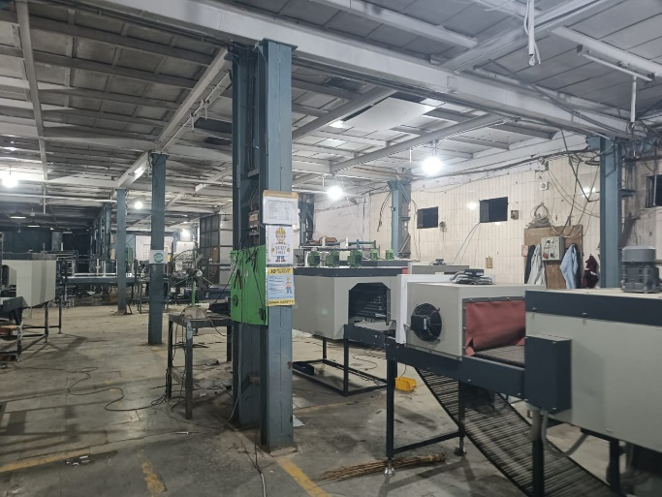
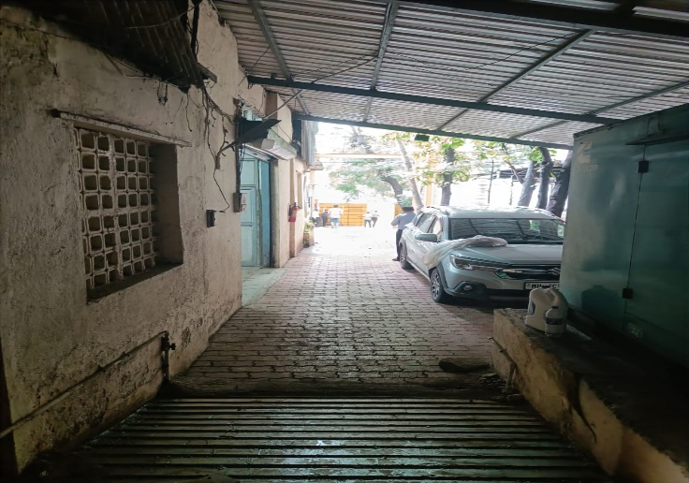
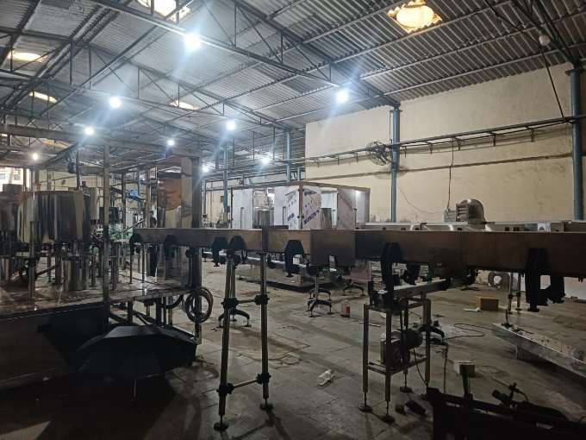
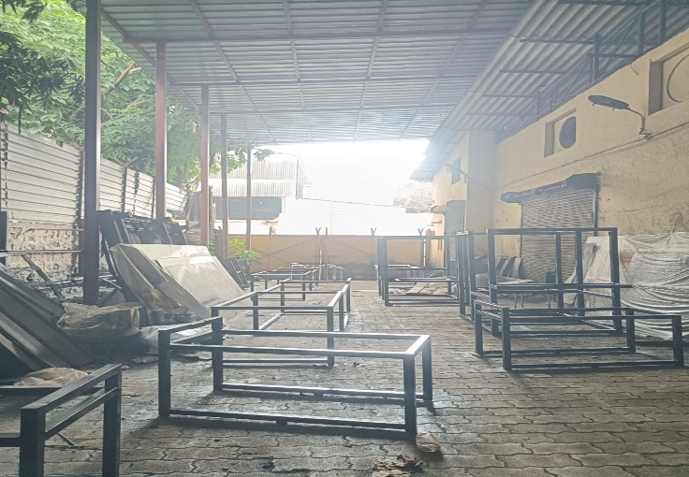
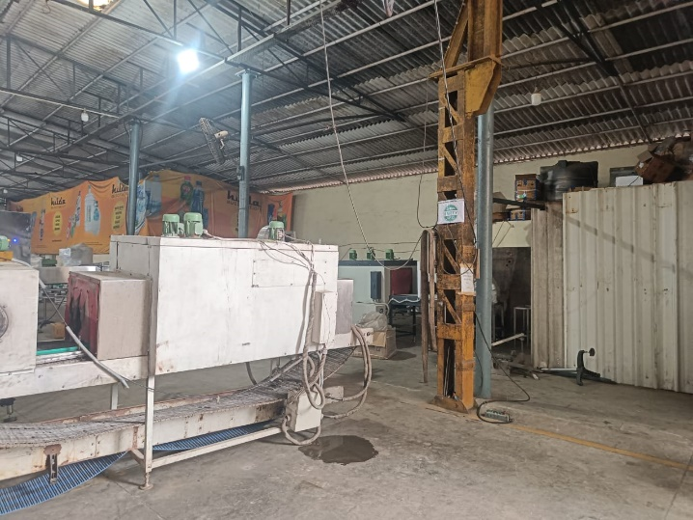
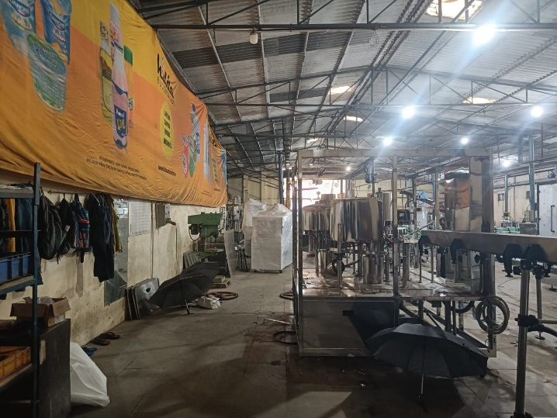
V.S.JADON & CO VALUERS LLP
PHOTOGRAPHS OF PROPERTY OF CUSTOMER Hilda Automation Pvt Ltd.
VSJCVNM-AXIS-RTL-JUL25-14989
Page 2

Slide 3
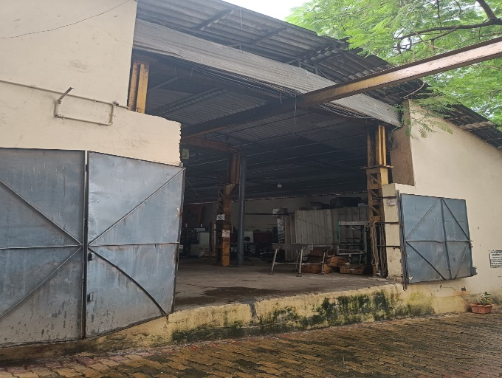
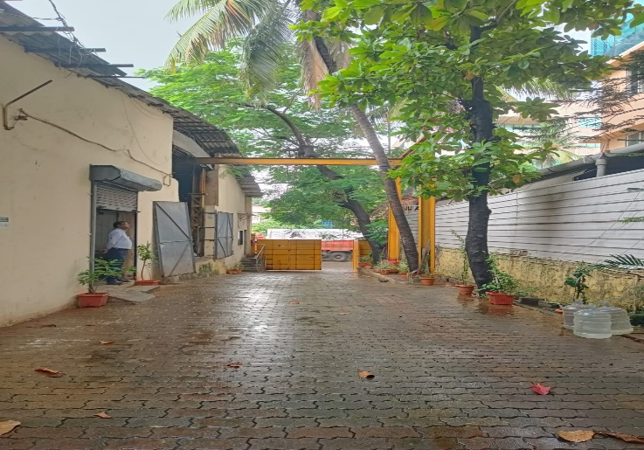
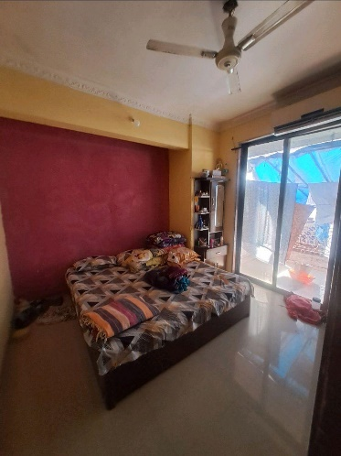
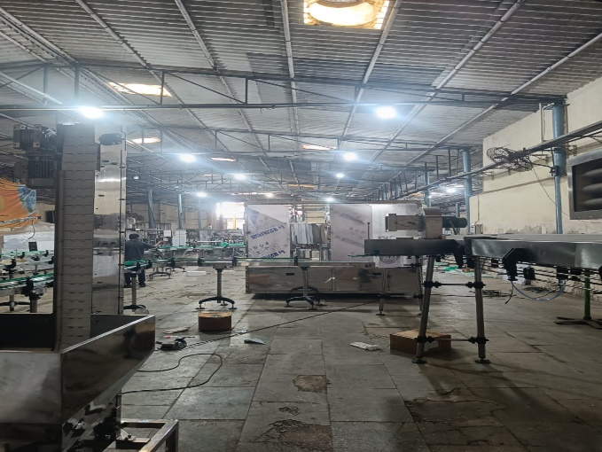
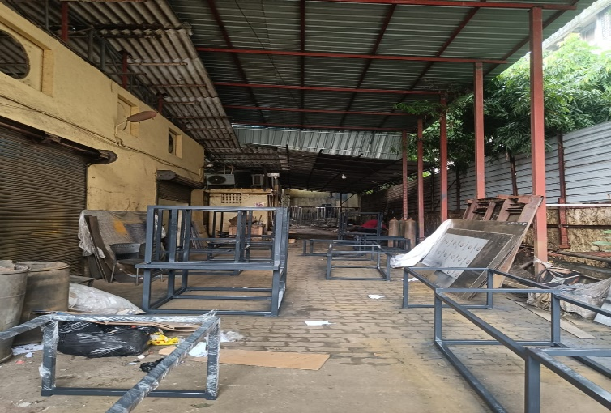

V.S.JADON & CO VALUERS LLP
PHOTOGRAPHS OF PROPERTY OF CUSTOMER : Hilda Automation Pvt Ltd.
VSJCVNM-AXIS-RTL-JUL25-14989
Page 3

Slide 4
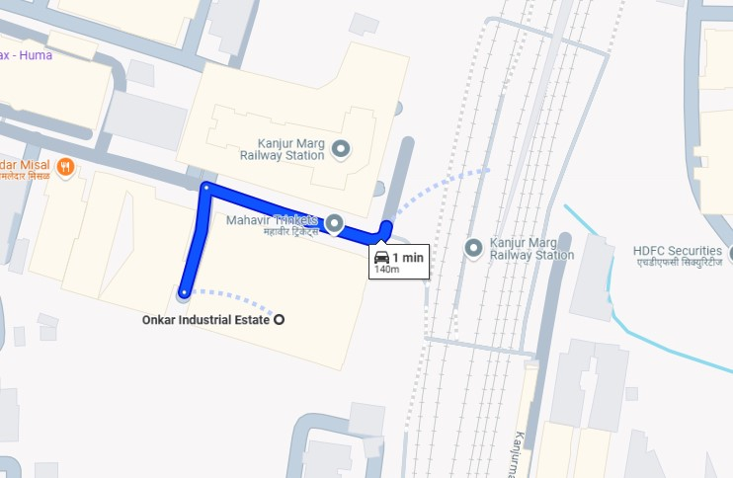
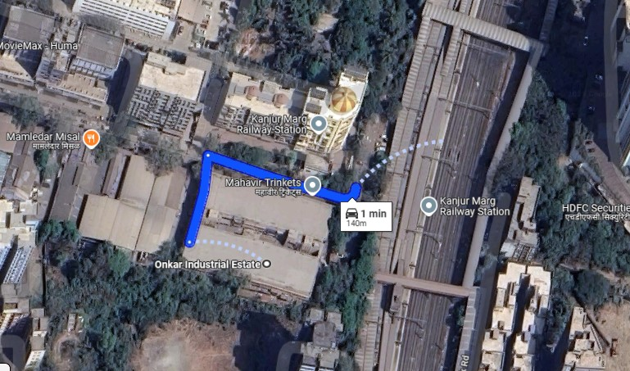
V.S.JADON & CO VALUERS LLP
PHOTOGRAPHS OF PROPERTY OF CUSTOMER :Hilda Automation Pvt Ltd.
Google Map
VSJCVNM-AXIS-RTL-JUL25-14989
Page 4

Slide 5
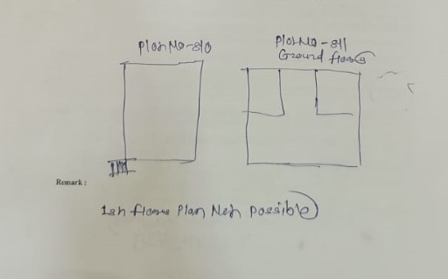
V.S.JADON & CO VALUERS LLP
PHOTOGRAPHS OF PROPERTY OF CUSTOMER: Hilda Automation Pvt Ltd.
Site Layout
Govt. Rate
VSJCVNM-AXIS-RTL-JUL25-14989
Page 5

