Slide 1
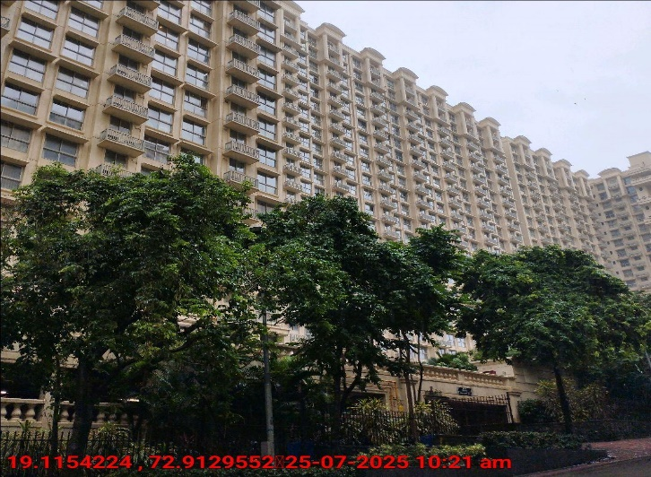
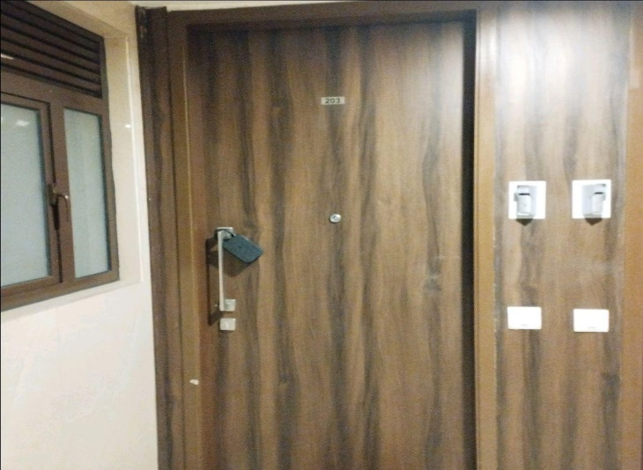
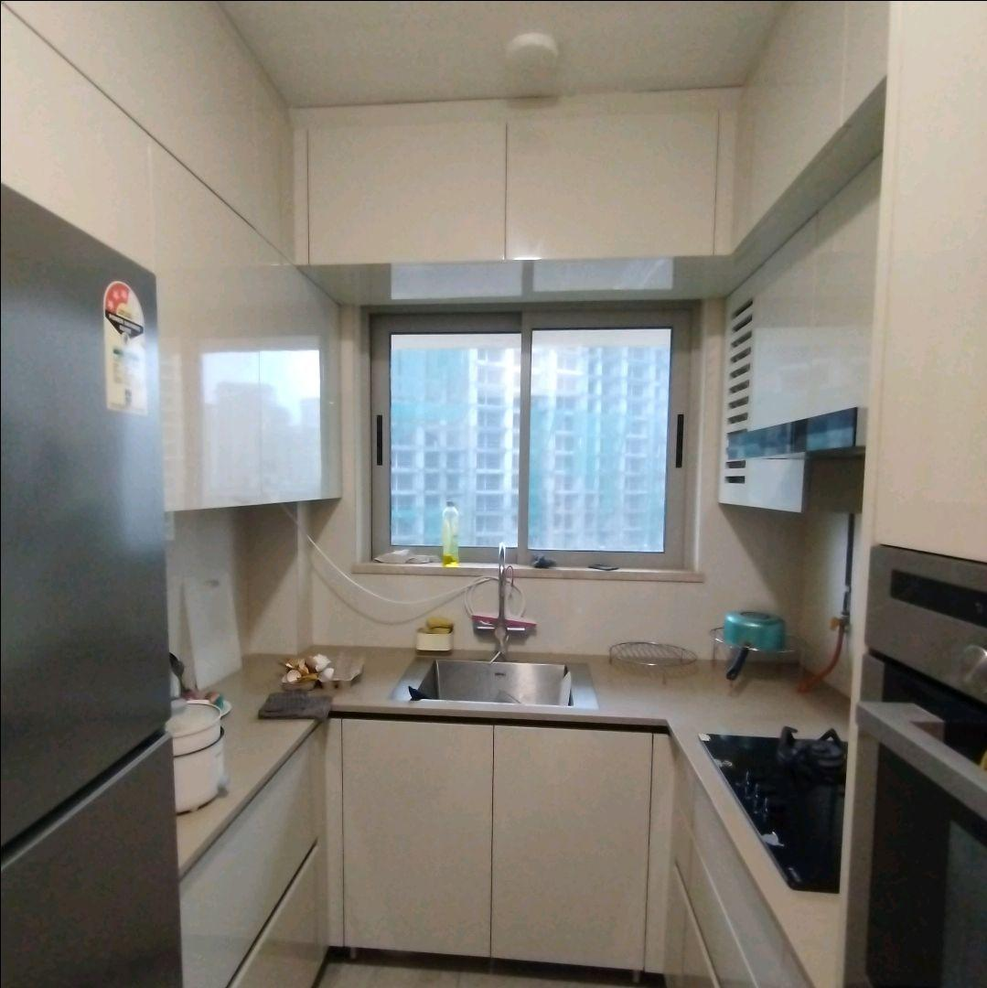
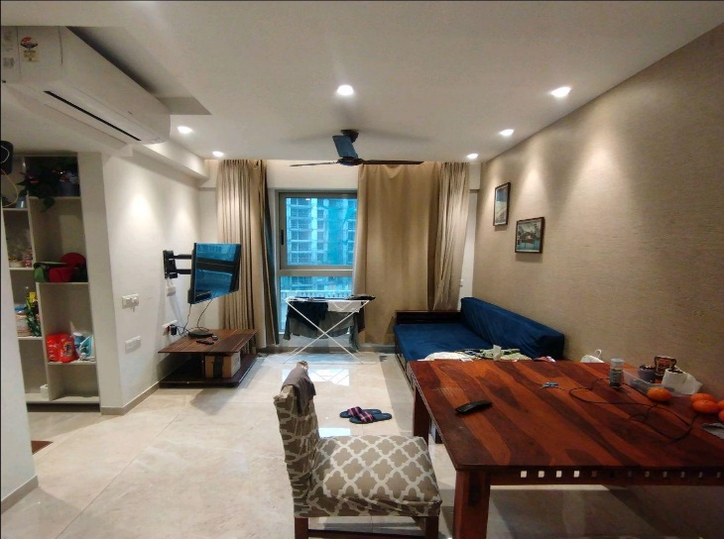
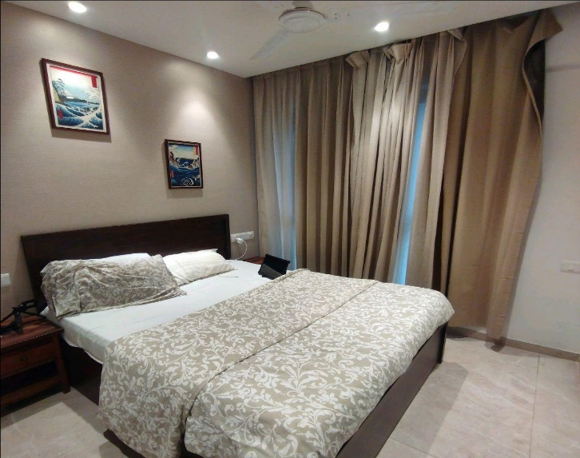
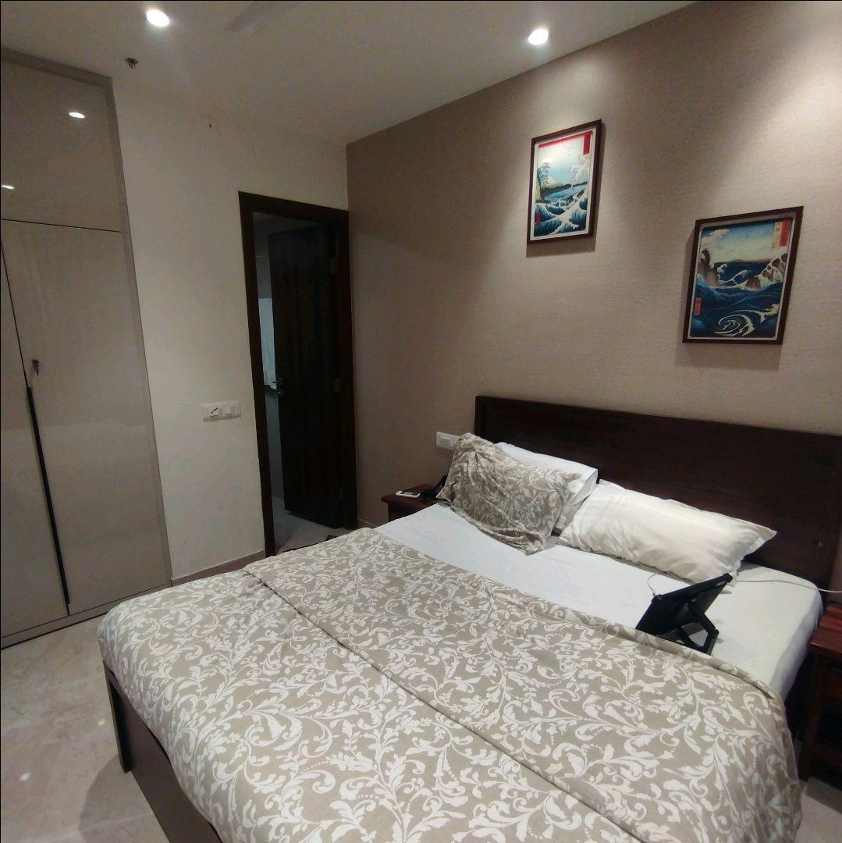
V.S.JADON & CO VALUERS LLP
PHOTOGRAPHS OF PROPERTY OF CUSTOMER Amit Jain
VSJCVNM-RBL-RTL-JUL25-15368
Page 1

Slide 2

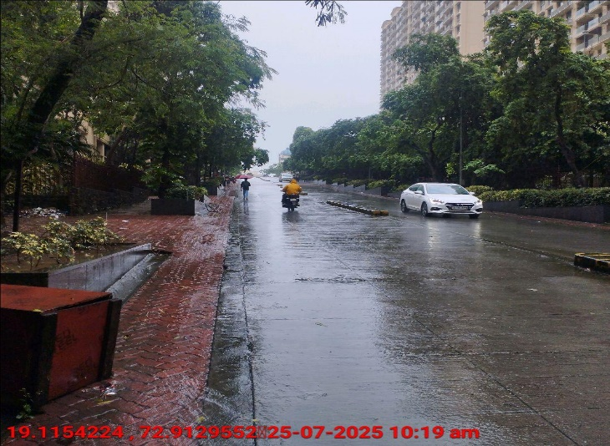
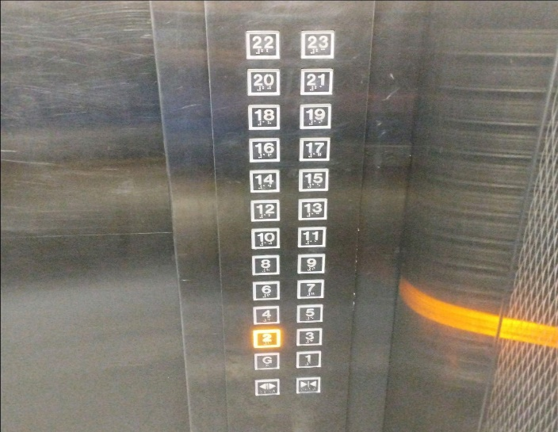
V.S.JADON & CO VALUERS LLP
PHOTOGRAPHS OF PROPERTY OF CUSTOMER Amit Jain
VSJCVNM-RBL-RTL-JUL25-15368
Page 1

Slide 3
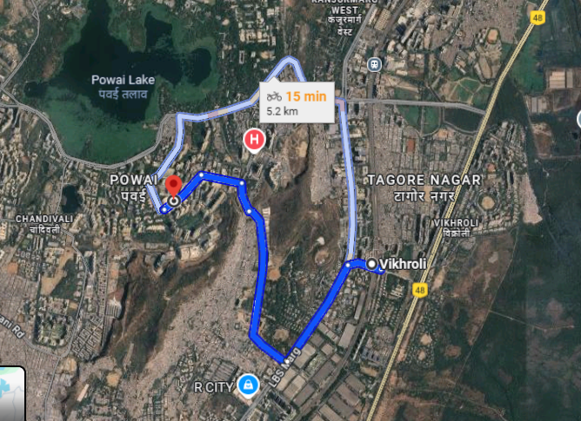
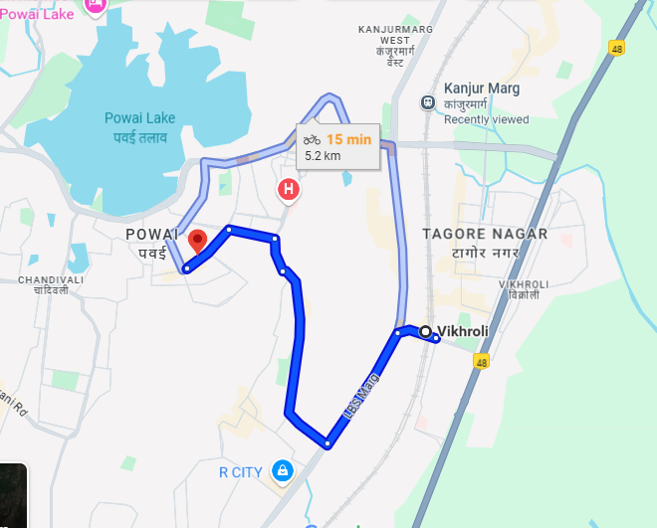
V.S.JADON & CO VALUERS LLP
PHOTOGRAPHS OF PROPERTY OF CUSTOMER : Amit Jain
Google Map
VSJCVNM-RBL-RTL-JUL25-15368
Page 3

Slide 4
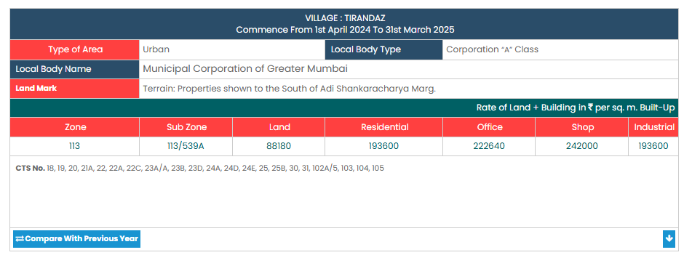
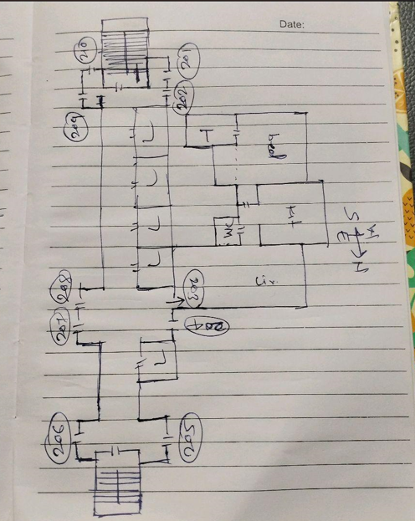
V.S.JADON & CO VALUERS LLP
PHOTOGRAPHS OF PROPERTY OF CUSTOMER Amit Jain
Gov Rate
VSJCVNM-RBL-RTL-JUL25-15368 Page 5

