Slide 1
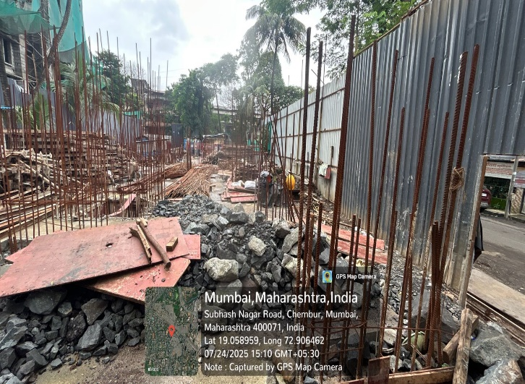
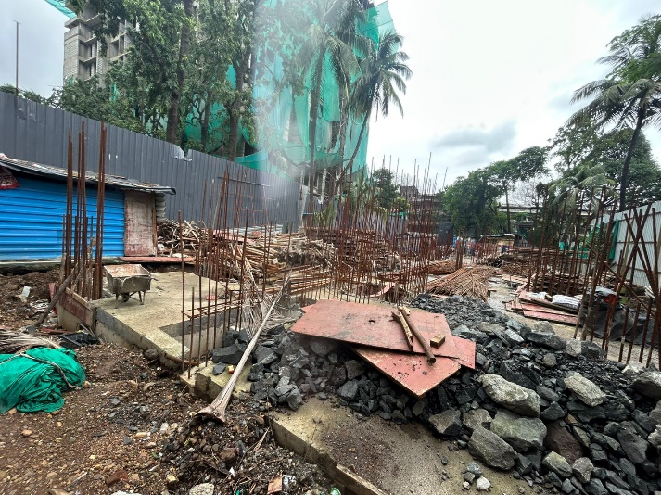
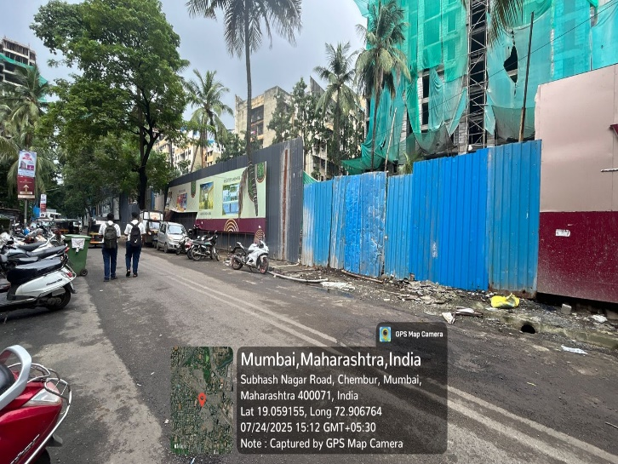

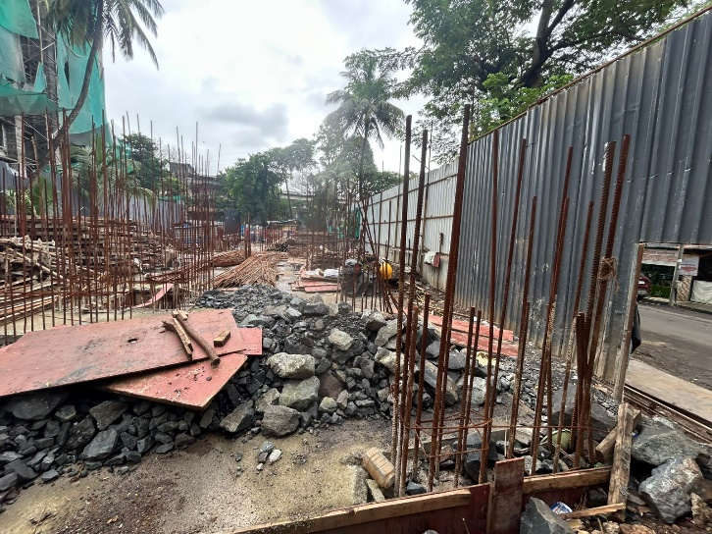
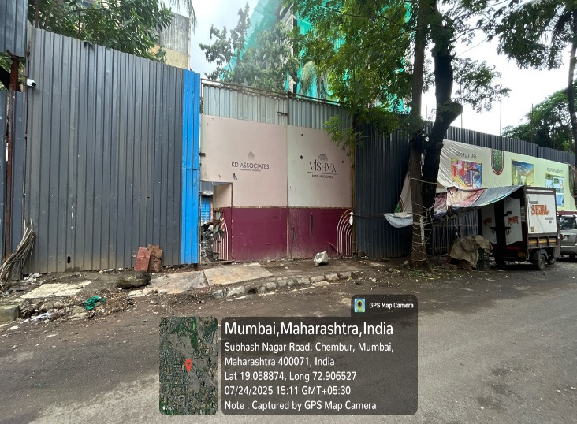
V.S.JADON & CO VALUERS LLP
PHOTOGRAPHS OF PROPERTY OF CUSTOMER GOVIND TALE
VSJCVNM-RBL-RTL-JUL25-15378
Page 1

Slide 2
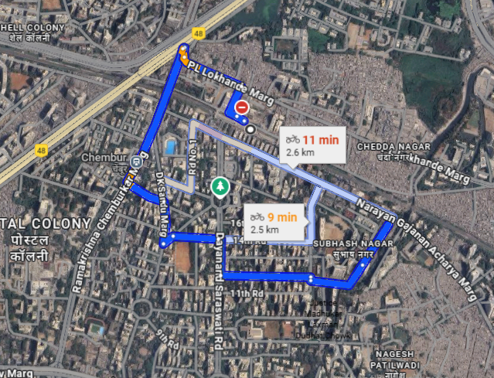
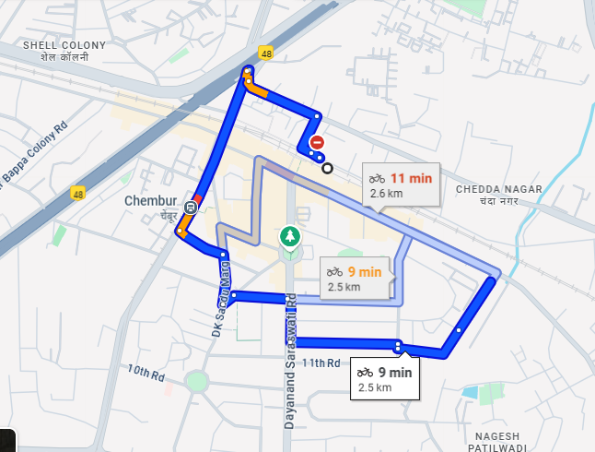
V.S.JADON & CO VALUERS LLP
PHOTOGRAPHS OF PROPERTY OF CUSTOMER : GOVIND TALE
Google Map
VSJCVNM-RBL-RTL-JUL25-15520
Page 3

Slide 3
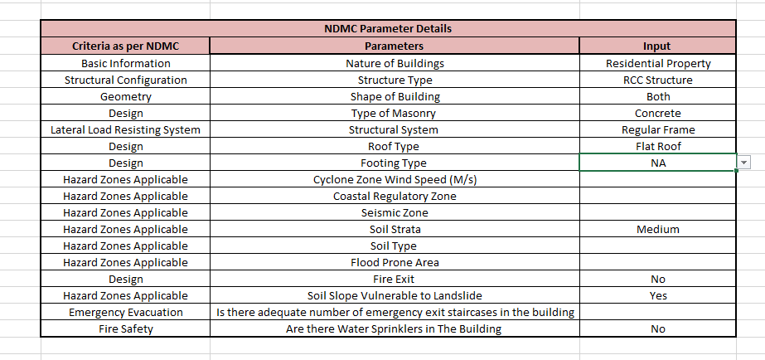
V.S.JADON & CO VALUERS LLP
PHOTOGRAPHS OF PROPERTY OF CUSTOMER GOVIND TALE
VSJCVNM-RBL-RTL-JUL25-15378 Page 5

