Slide 1
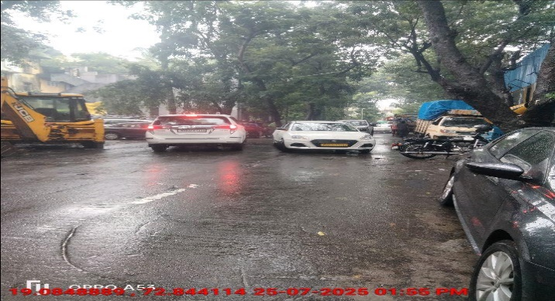
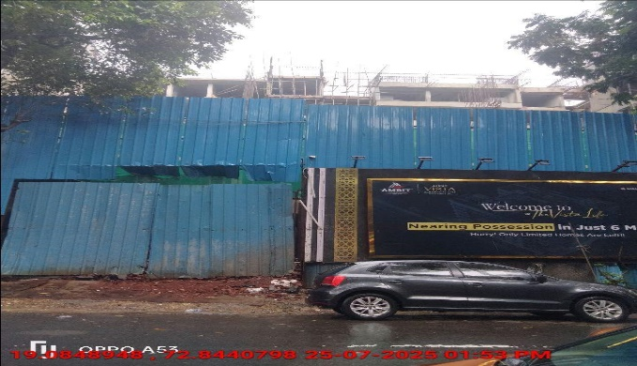
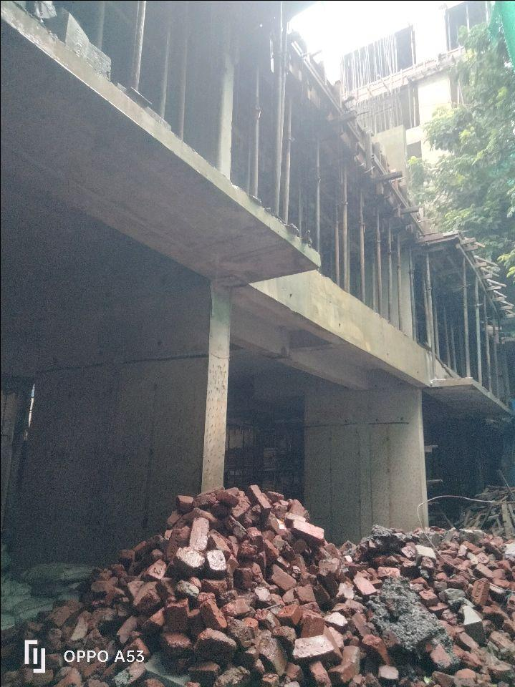
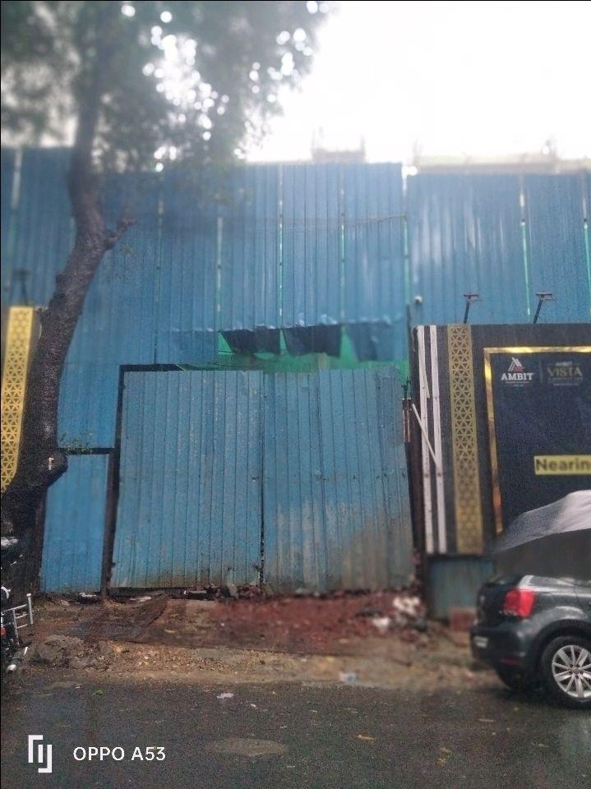
V.S.JADON & CO VALUERS LLP
PHOTOGRAPHS OF PROPERTY OF CUSTOMER MR. UMESH RAJENDRA BHUSHAN
VSJCVNM-RBL-RTL-JUL25-15444 Page 6

Slide 2
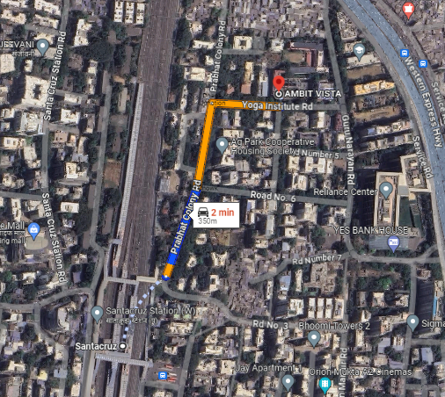
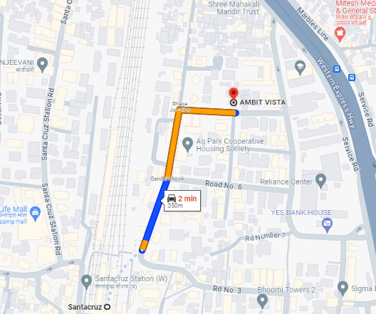
V.S.JADON & CO VALUERS LLP
PHOTOGRAPHS OF PROPERTY OF CUSTOMER MR. UMESH RAJENDRA BHUSHAN
GOOGLE MAP :
VSJCVNM-RBL-RTL-JUL25-15444 Page 6

Slide 3
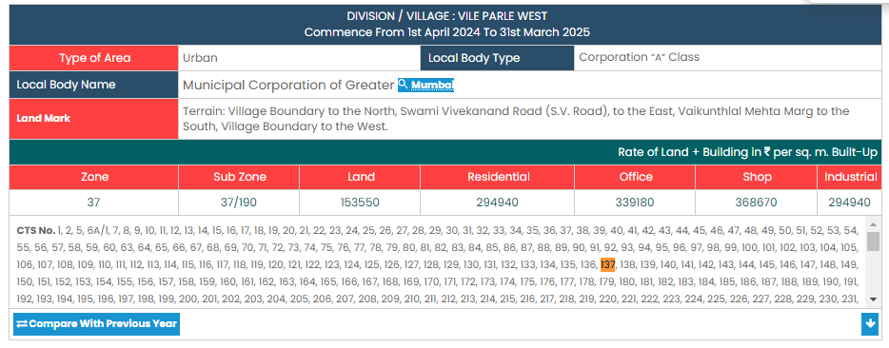
V.S.JADON & CO VALUERS LLP
PHOTOGRAPHS OF PROPERTY OF CUSTOMER MR. UMESH RAJENDRA BHUSHAN
Govt. Rate :
VSJCVNM-RBL-RTL-JUL25-15444 Page 7

