Slide 1
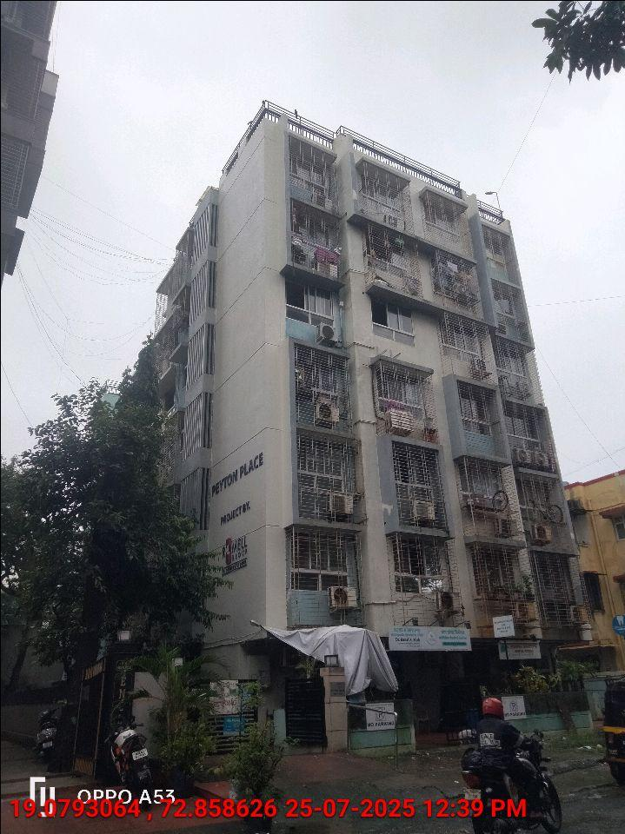
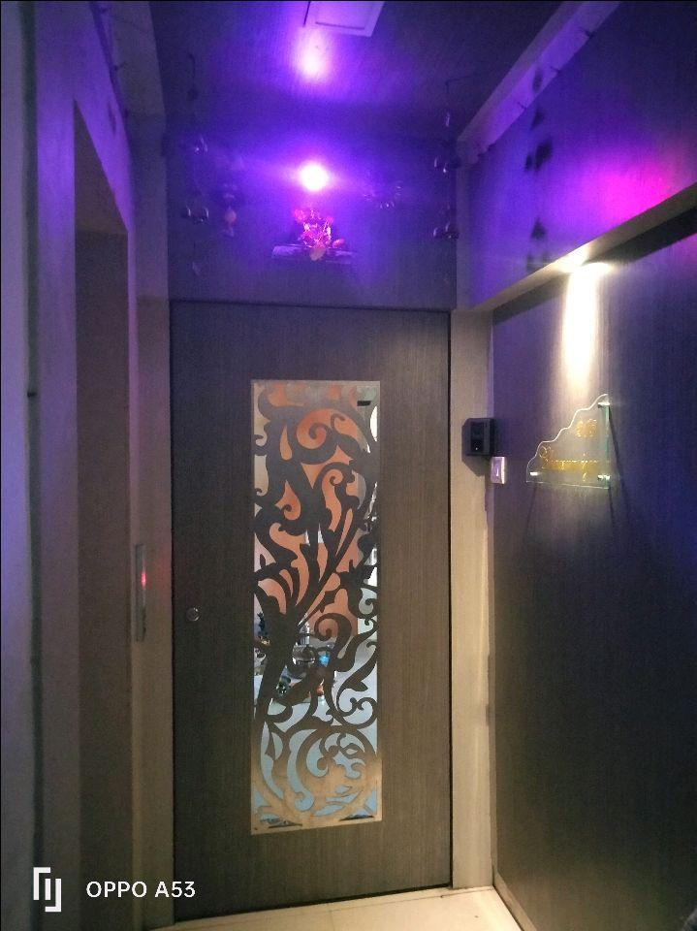
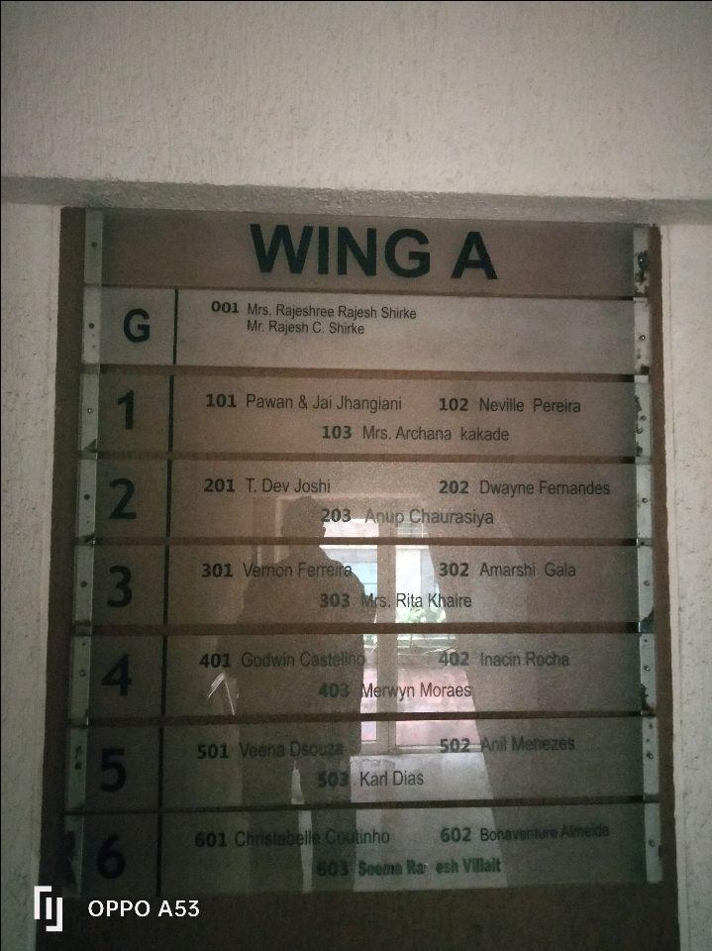
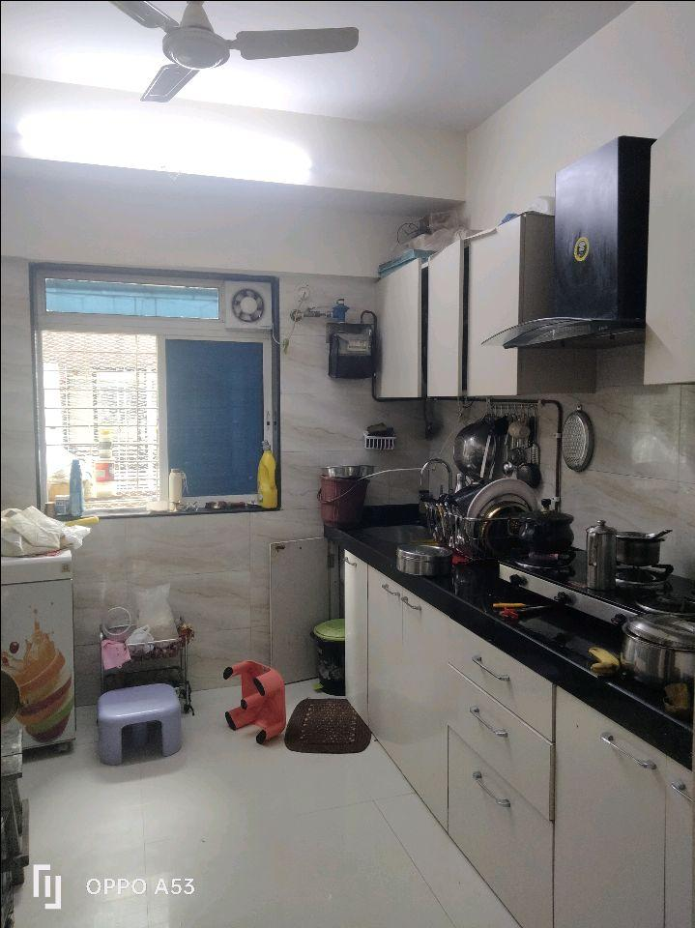
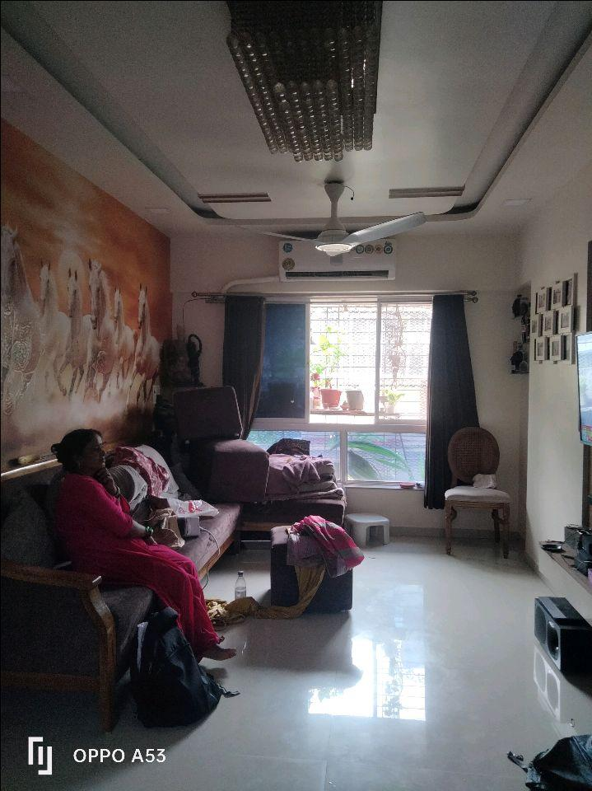
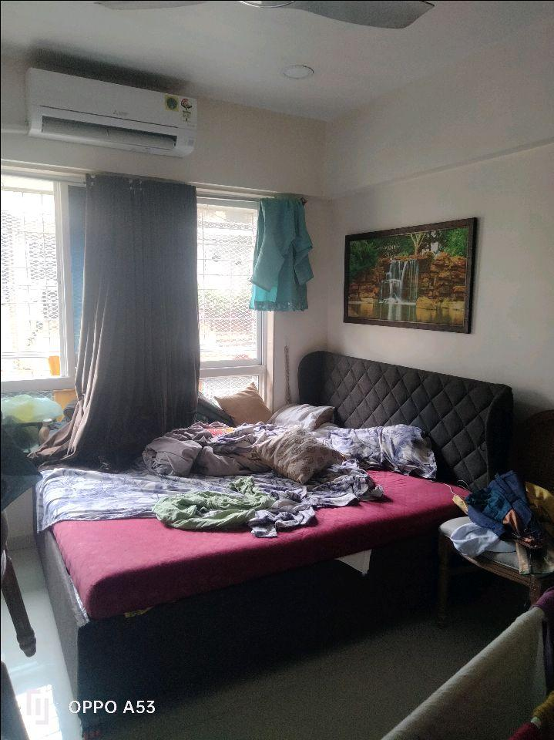
V.S.JADON & CO VALUERS LLP
PHOTOGRAPHS OF PROPERTY OF CUSTOMER ANUP MANDAP DECORATORS
VSJCVNM-RBL-RTL-JUL25-15520
Page 6

Slide 2
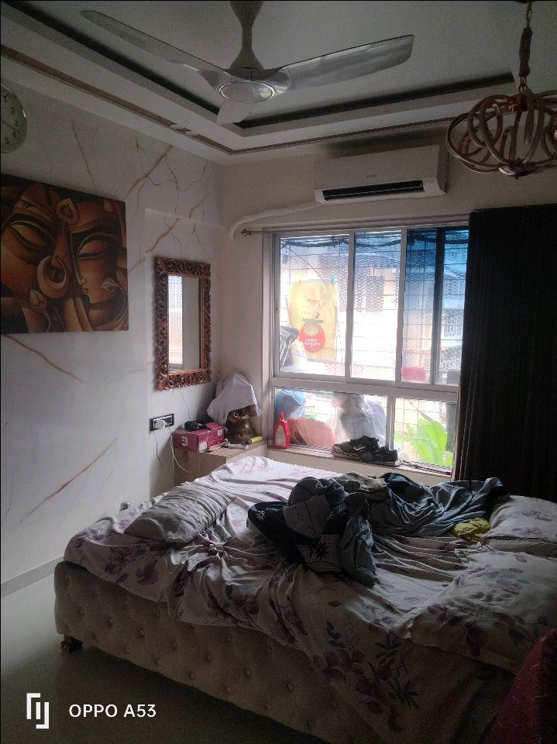
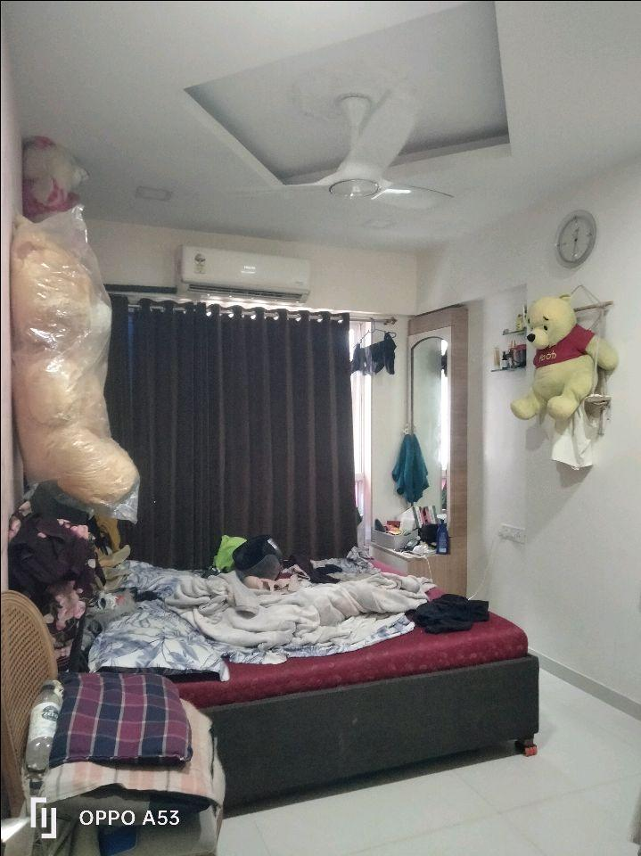

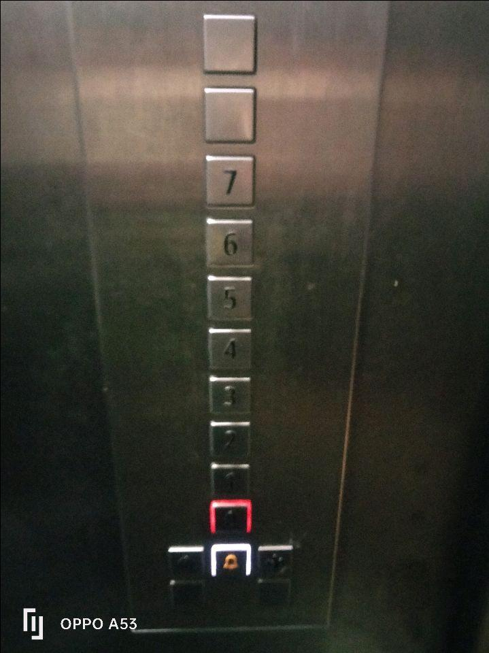
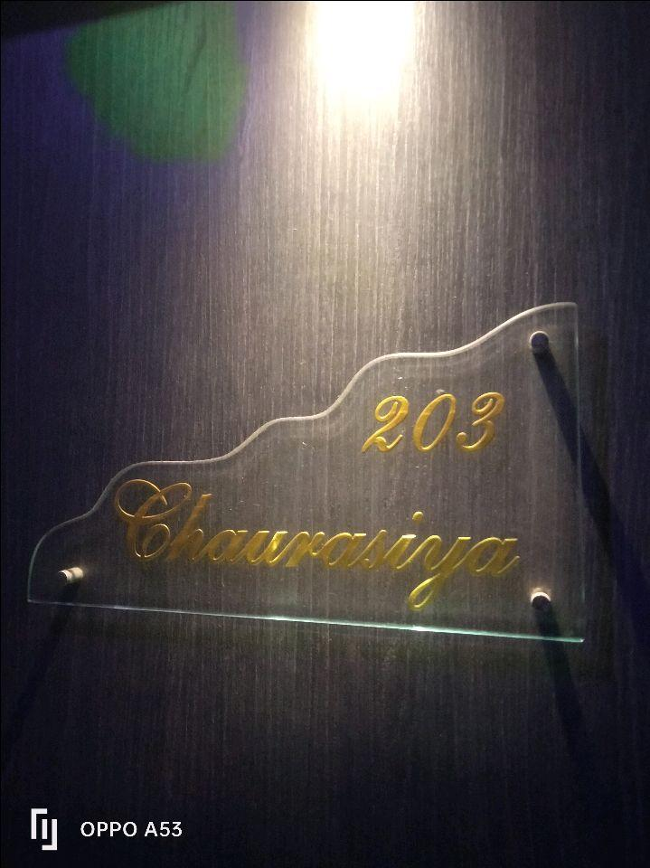
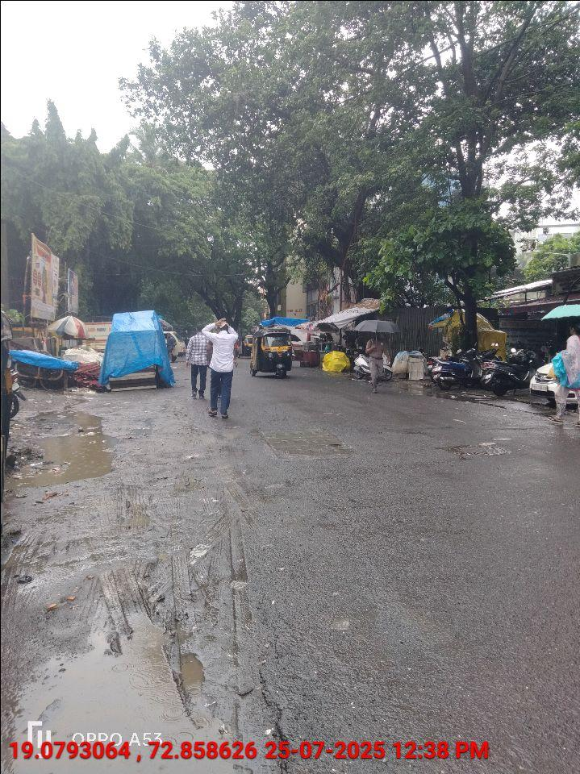
V.S.JADON & CO VALUERS LLP
PHOTOGRAPHS OF PROPERTY OF CUSTOMER ANUP MANDAP DECORATORS
VSJCVNM-RBL-RTL-JUL25-15520
Page 7

Slide 3
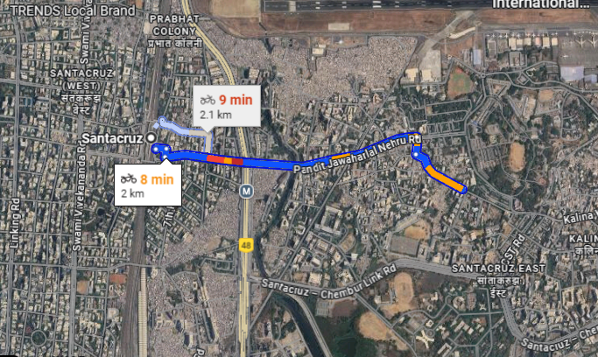
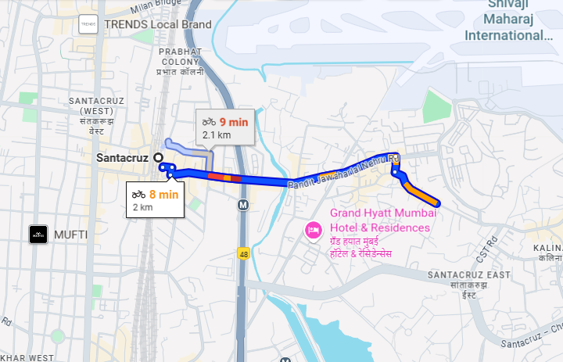
V.S.JADON & CO VALUERS LLP
PHOTOGRAPHS OF PROPERTY OF CUSTOMER : ANUP MANDAP DECORATORS
Google Map
VSJCVNM-RBL-RTL-JUL25-15520
Page 8

Slide 4
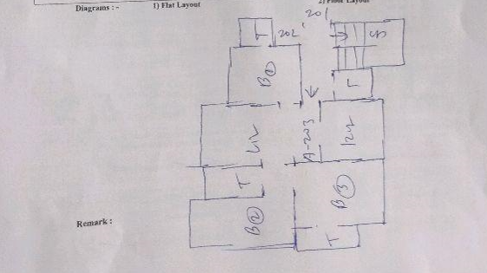
V.S.JADON & CO VALUERS LLP
PHOTOGRAPHS OF PROPERTY OF CUSTOMER ANUP MANDAP DECORATORS
Site Layout:
VSJCVNM-RBL-RTL-JUL25-15520 Page 9

