Slide 1
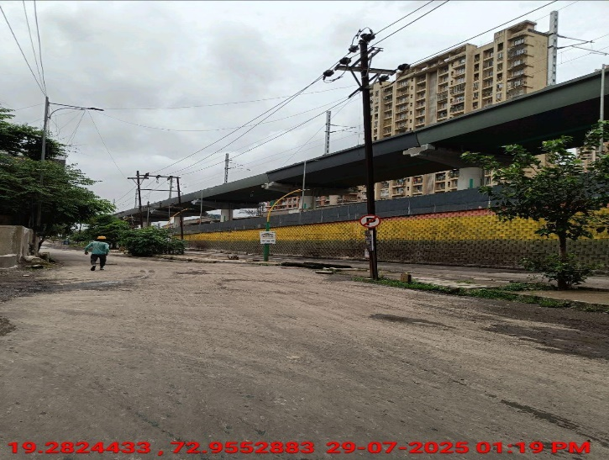
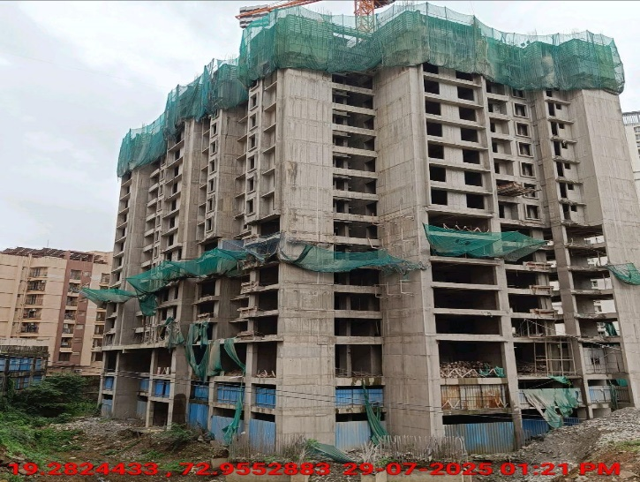
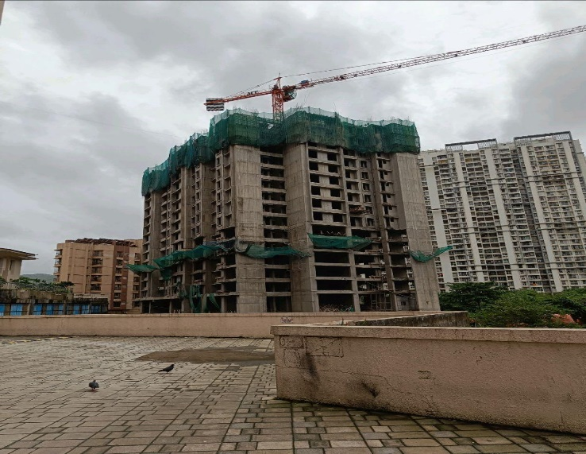
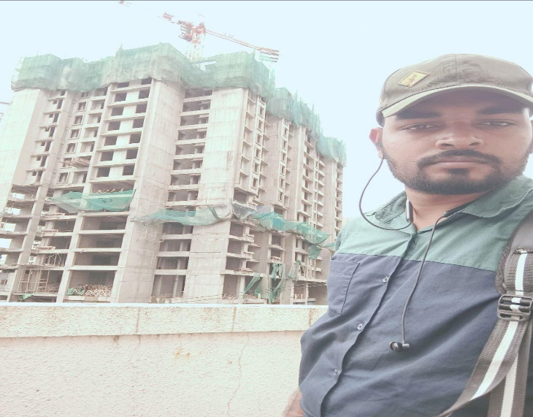
V.S.JADON & CO VALUERS LLP
PHOTOGRAPHS OF PROPERTY OF CUSTOMER: Shirish Salekar
VSJCVNM-RBL-RTL-JUL25-15874 Page 8

Slide 2
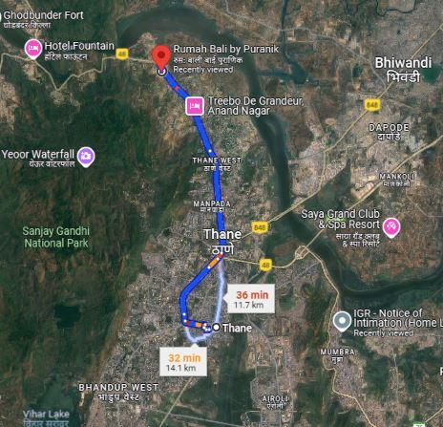
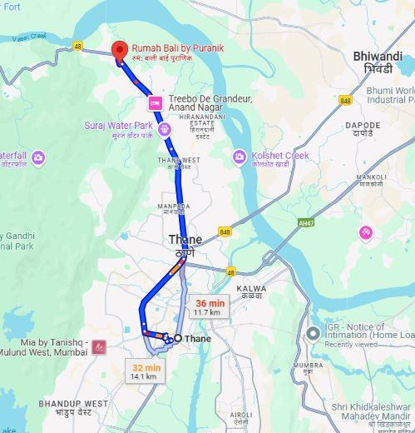
V.S.JADON & CO VALUERS LLP
PHOTOGRAPHS OF PROPERTY OF CUSTOMER: Shirish Salekar
VSJCVNM-RBL-RTL-JUL25-15874 Page 9

Slide 3
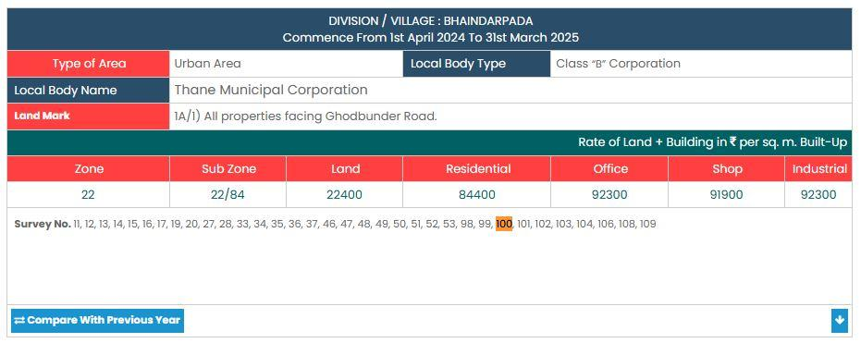
V.S.JADON & CO VALUERS LLP
PHOTOGRAPHS OF PROPERTY OF CUSTOMER: Shirish Salekar
Gov Rate
VSJCVNM-RBL-RTL-JUL25-15874 Page 10

