Slide 1
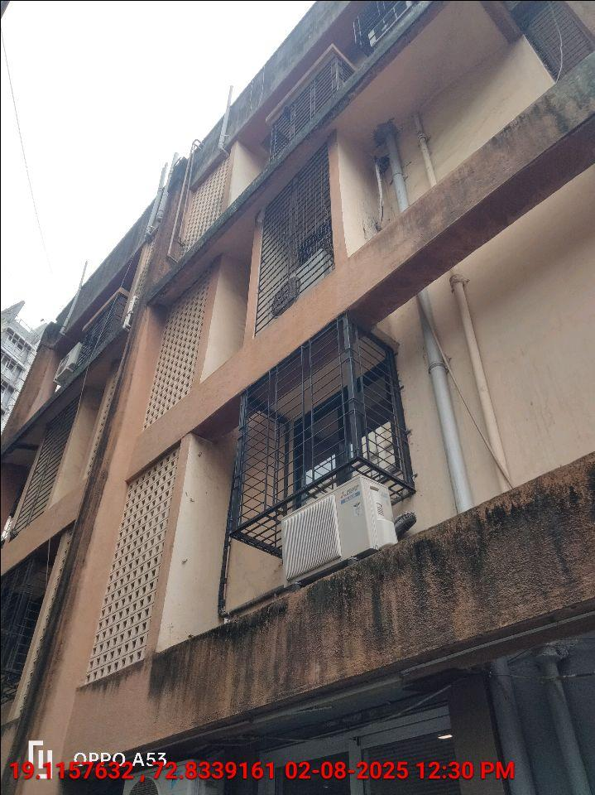
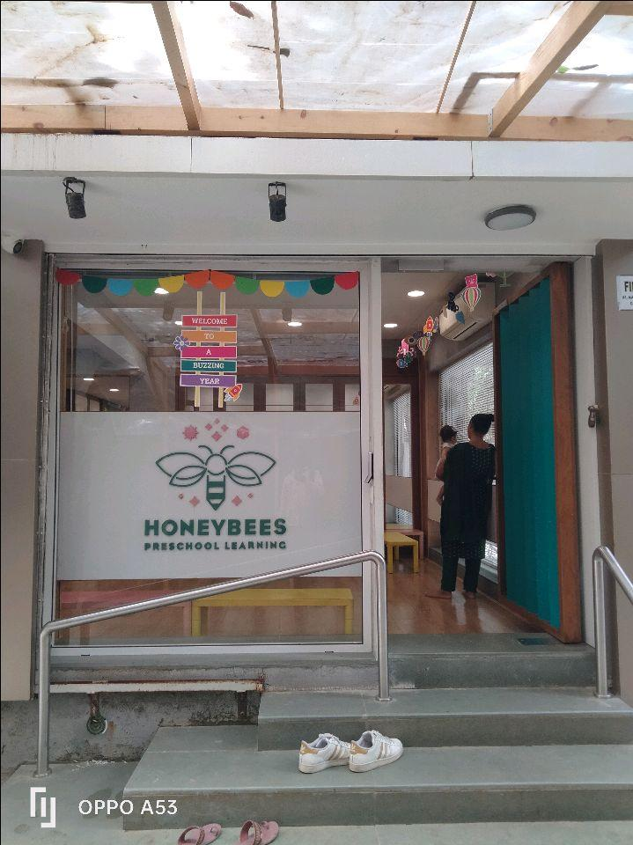
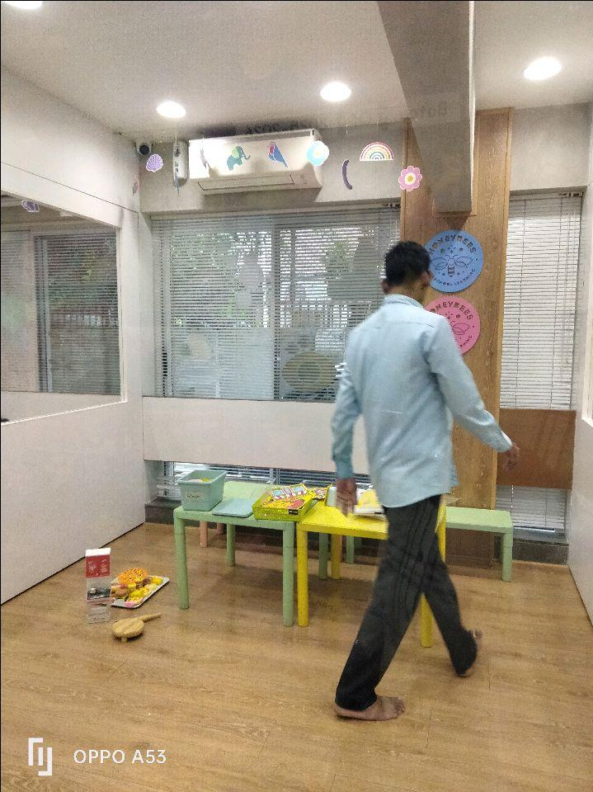
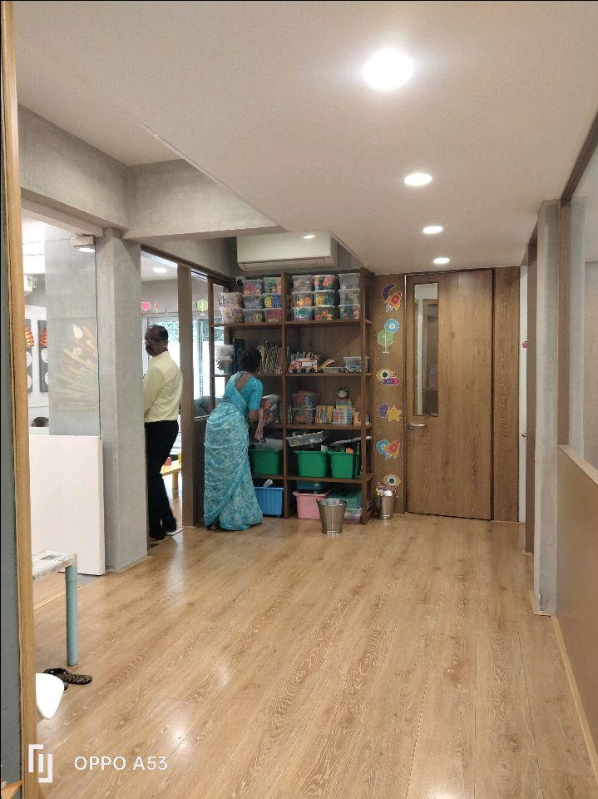
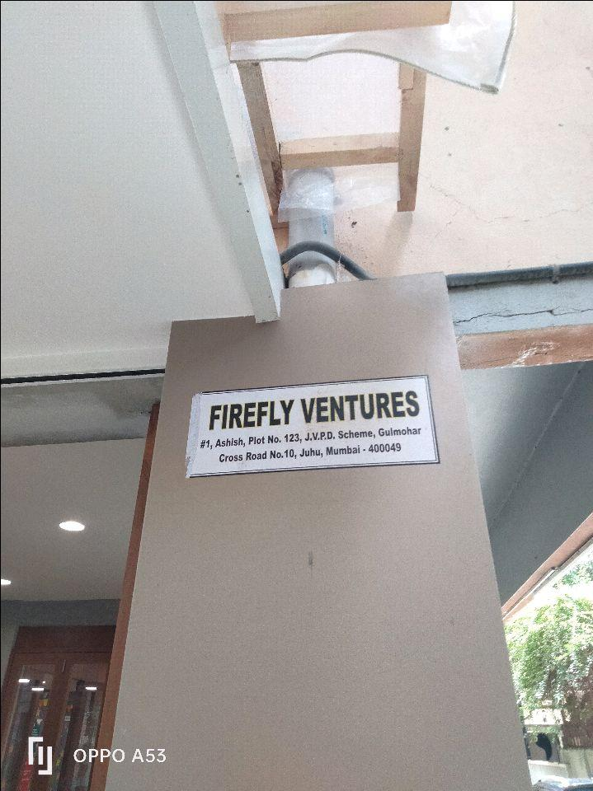
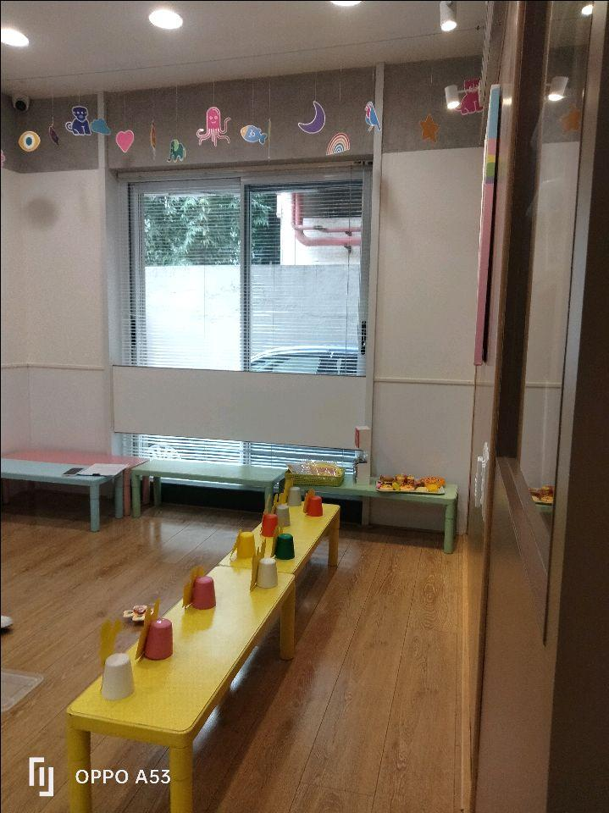
V.S.JADON & CO VALUERS LLP
PHOTOGRAPHS OF PROPERTY OF CUSTOMER RENAISSANCE PHARMACEUTICALS
VSJCVNM-AXIS-RTL-AUG25-16145
Page 6

Slide 2
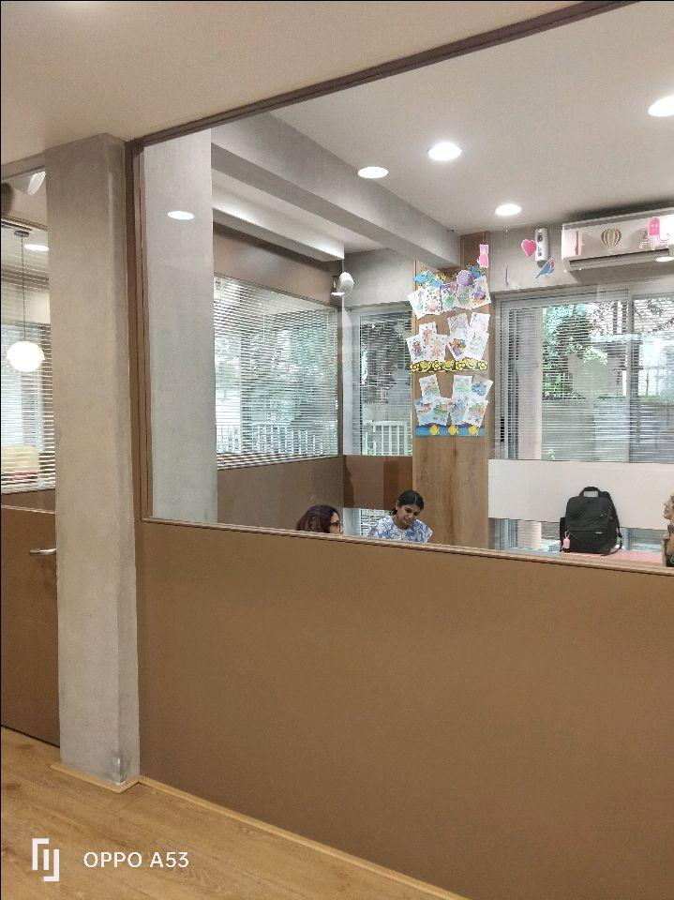
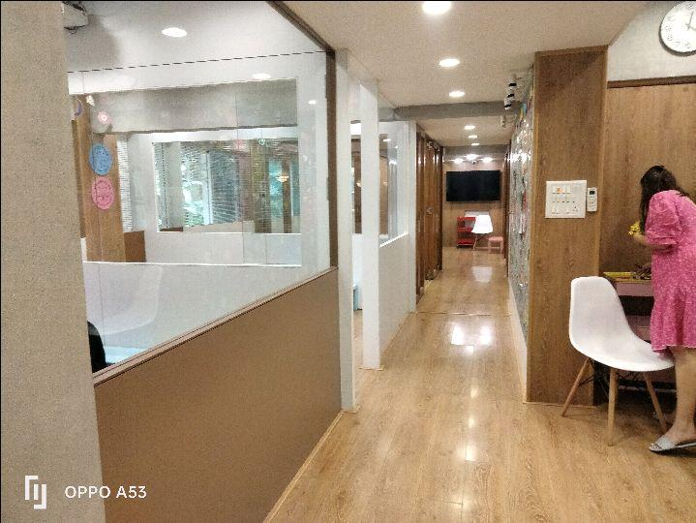

V.S.JADON & CO VALUERS LLP
PHOTOGRAPHS OF PROPERTY OF CUSTOMER RENAISSANCE PHARMACEUTICALS
VSJCVNM-AXIS-RTL-AUG25-16145
Page 7

Slide 3
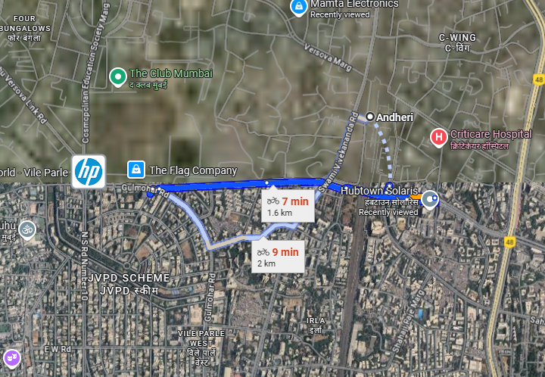
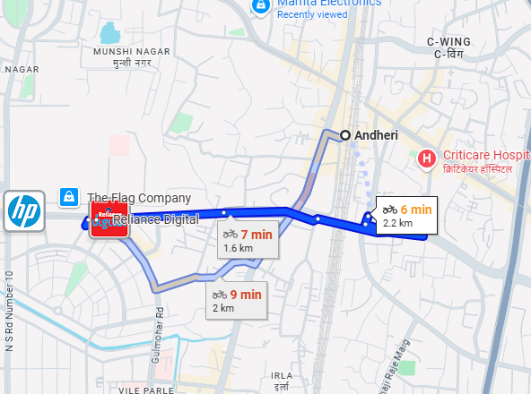
V.S.JADON & CO VALUERS LLP
PHOTOGRAPHS OF PROPERTY OF CUSTOMER : RENAISSANCE PHARMACEUTICALS Google Map
Google Map
VSJCVNM-AXIS-RTL-AUG25-16145 Page 8

Slide 4
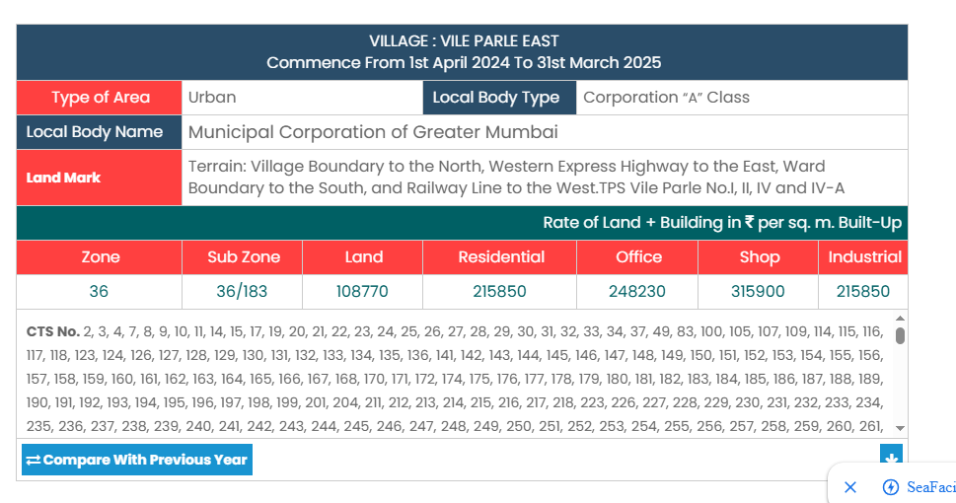
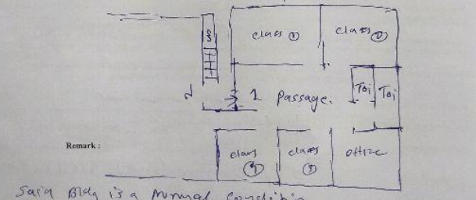
V.S.JADON & CO VALUERS LLP
PHOTOGRAPHS OF PROPERTY OF CUSTOMER JIGNESH ASHWIN KHILANI
Gov Rate & Site Layout
VSJCVNM-AXIS-RTL-AUG25-16145
Page 9

