Slide 1
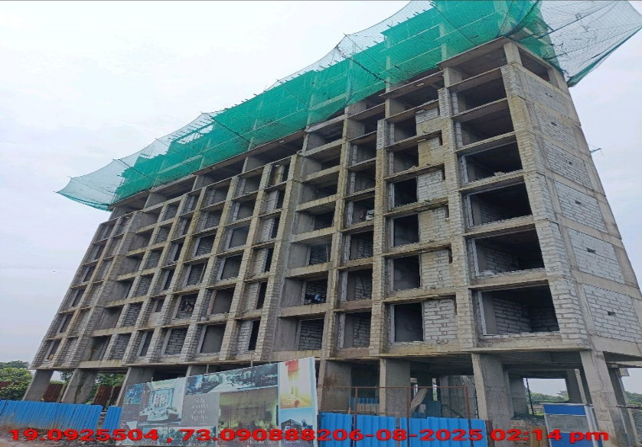
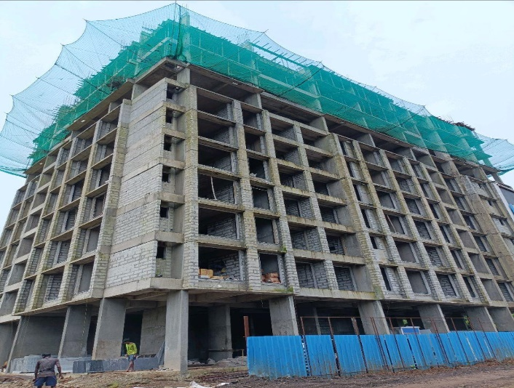
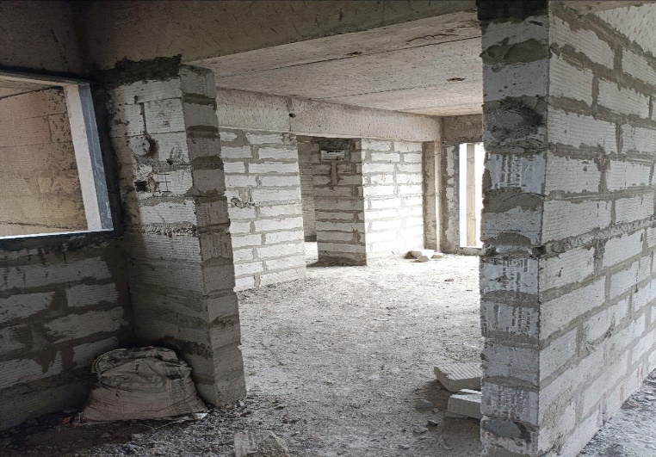
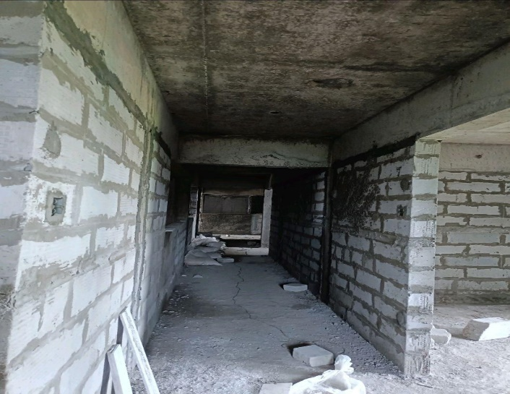
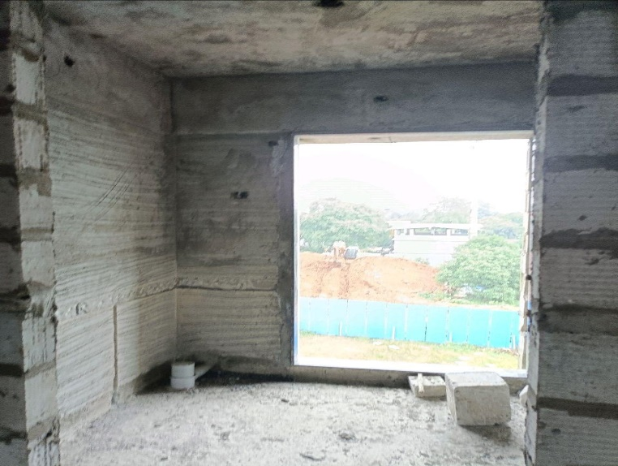
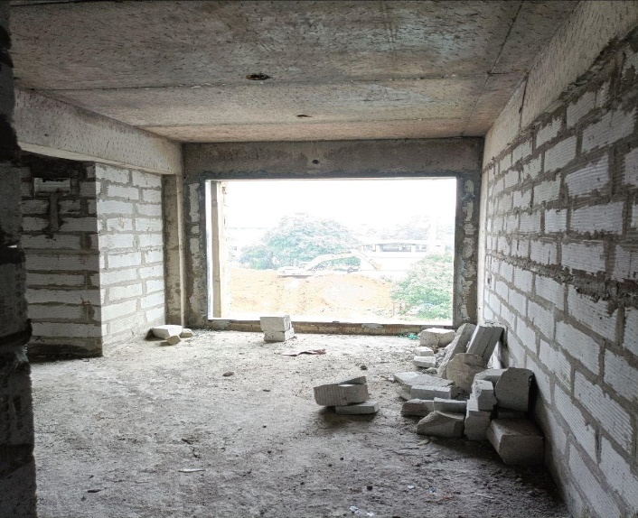
V.S.JADON & CO VALUERS LLP
PHOTOGRAPHS OF PROPERTY OF CUSTOMER : Mr. Gadekar Kishor Kashinathi.
VSJCVNM-PNBHFL-RTL-AUG25-16464
Page 5

Slide 2
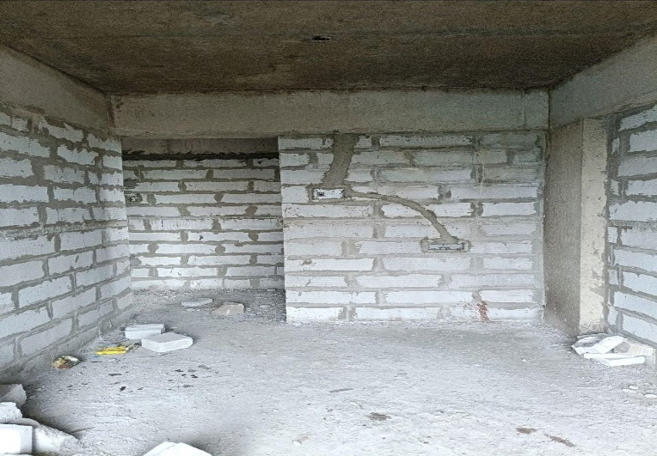
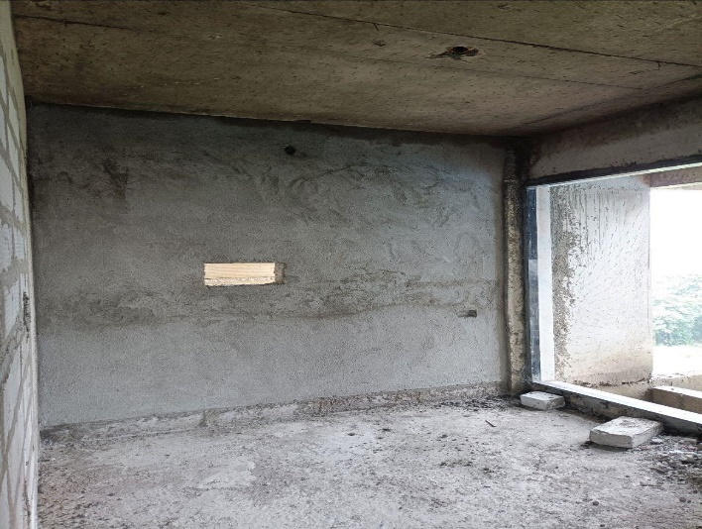
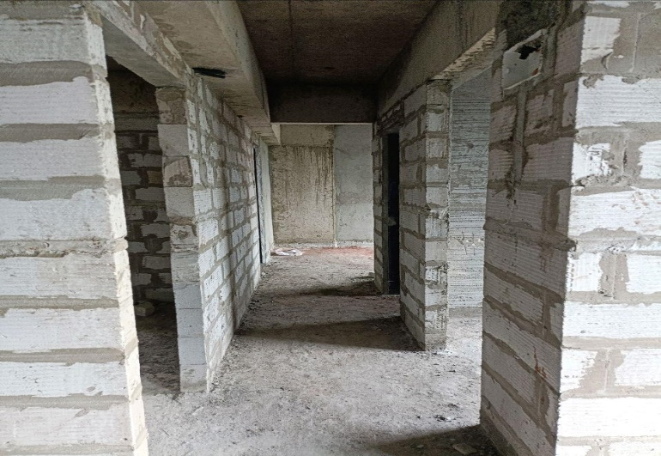
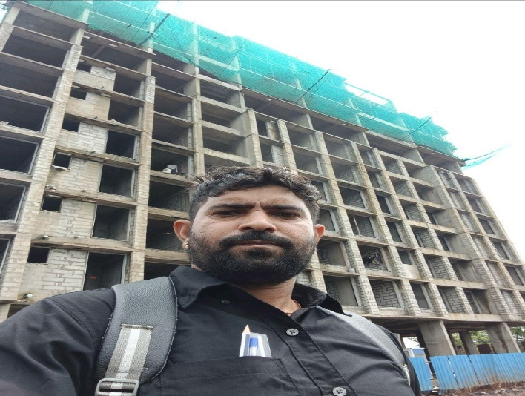
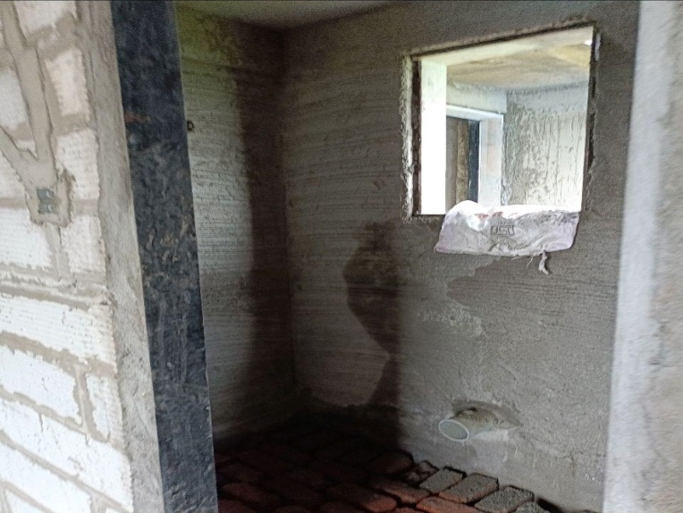
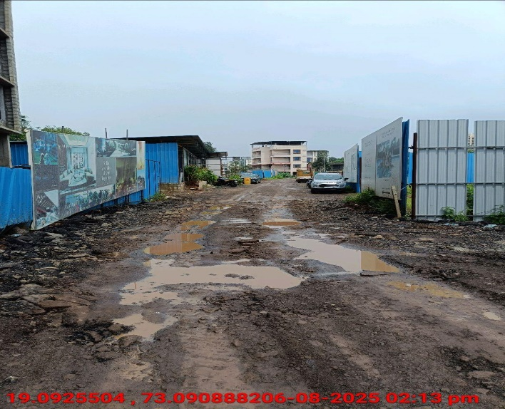
V.S.JADON & CO VALUERS LLP
PHOTOGRAPHS OF PROPERTY OF CUSTOMER : Mr. Gadekar Kishor Kashinathi.
VSJCVNM-PNBHFL-RTL-AUG25-16464
Page 6

Slide 3
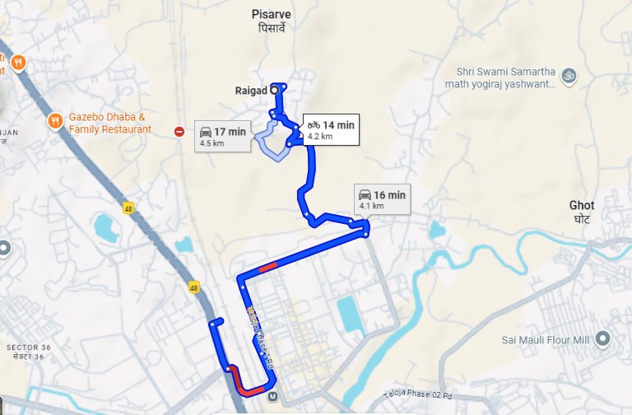
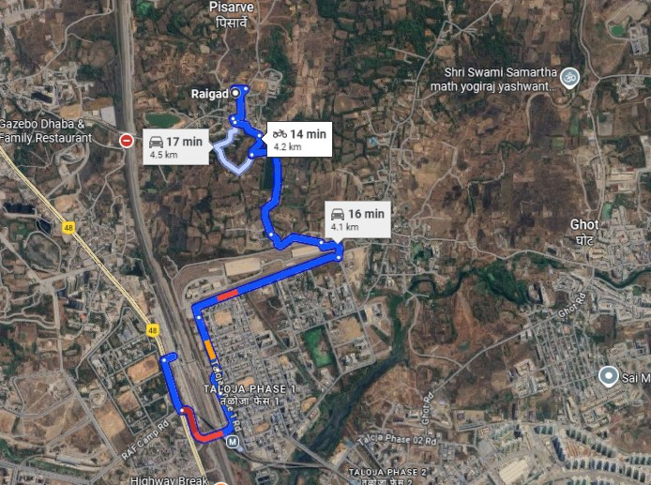
V.S.JADON & CO VALUERS LLP
PHOTOGRAPHS OF PROPERTY OF CUSTOMER : Mr. Gadekar Kishor Kashinathi.
Google Map
VSJCVNM-PNBHFL-RTL-AUG25-16464
Page 7

Slide 4
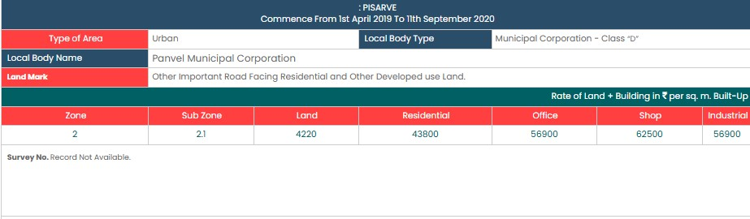
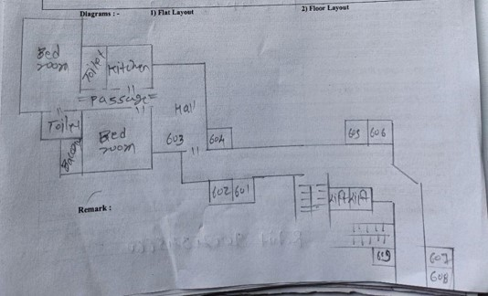
V.S.JADON & CO VALUERS LLP
PHOTOGRAPHS OF PROPERTY OF CUSTOMER: Mr. Gadekar Kishor Kashinathi.
Govt. Rate
Layout Plan
VSJCVNM-PNBHFL-RTL-AUG25-16464
Page 8

Slide 5
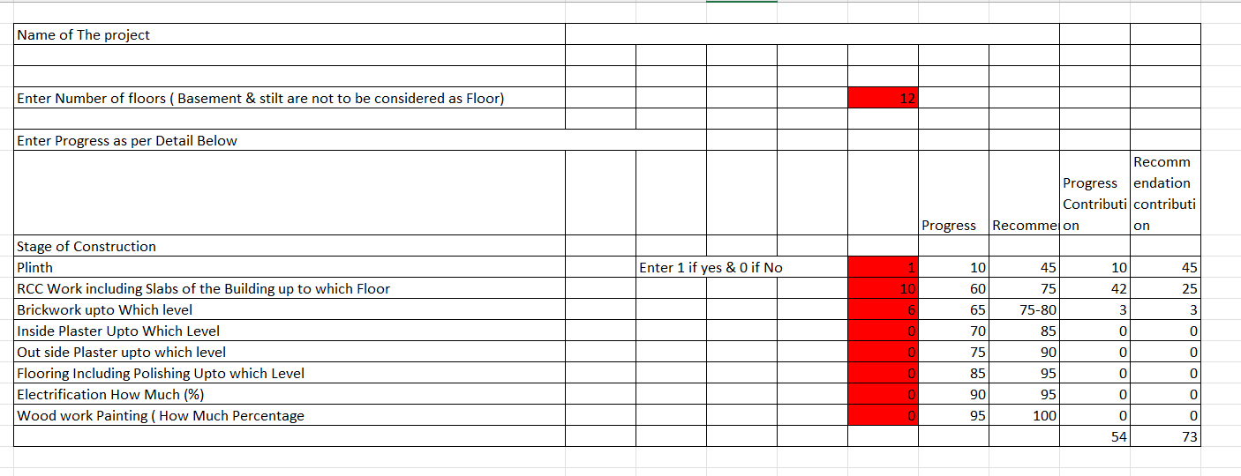
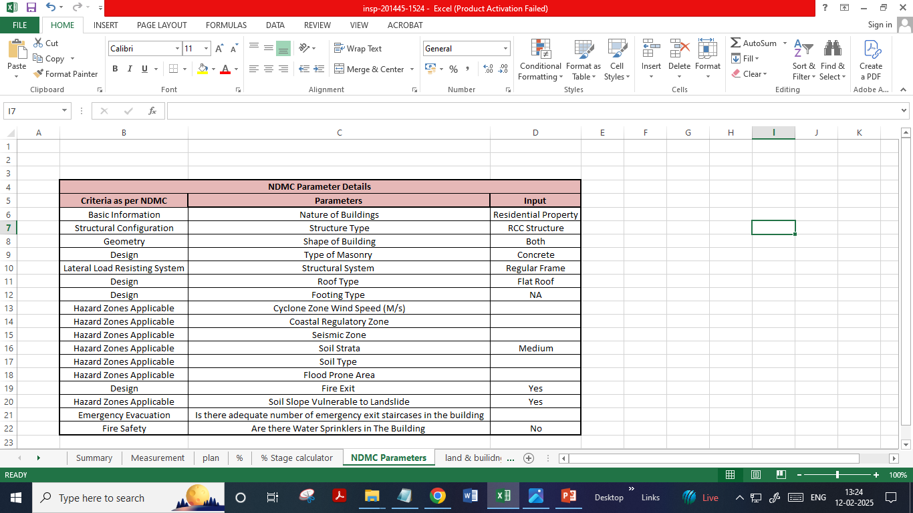
V.S.JADON & CO VALUERS LLP
PHOTOGRAPHS OF PROPERTY OF CUSTOMER: Mr. Gadekar Kishor Kashinathi.
Construction % -
NDMC Parameter
VSJCVNM-PNBHFL-RTL-AUG25-16464
Page 9

