Slide 1
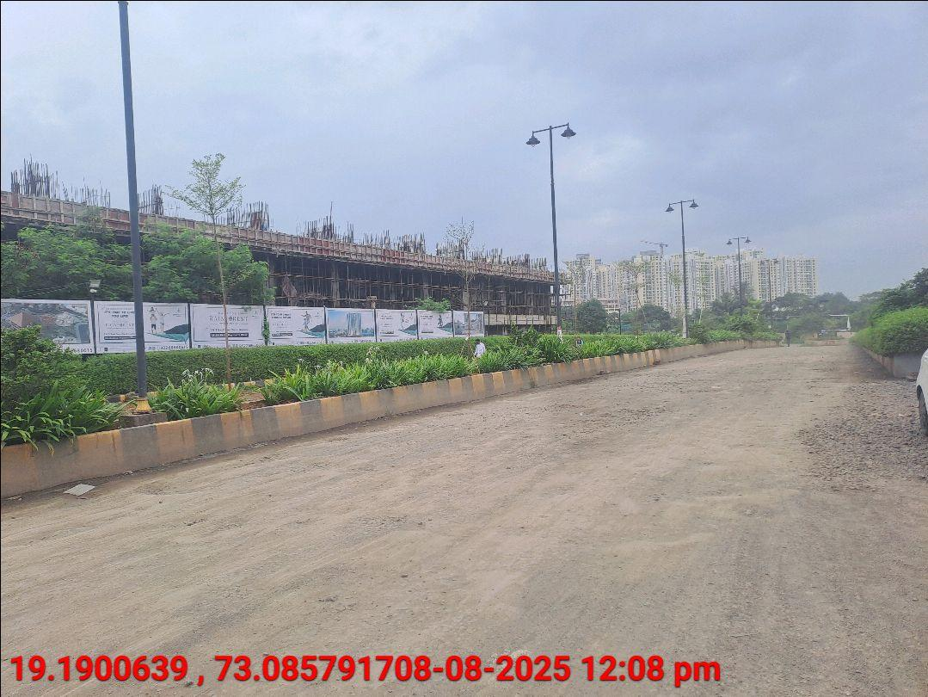
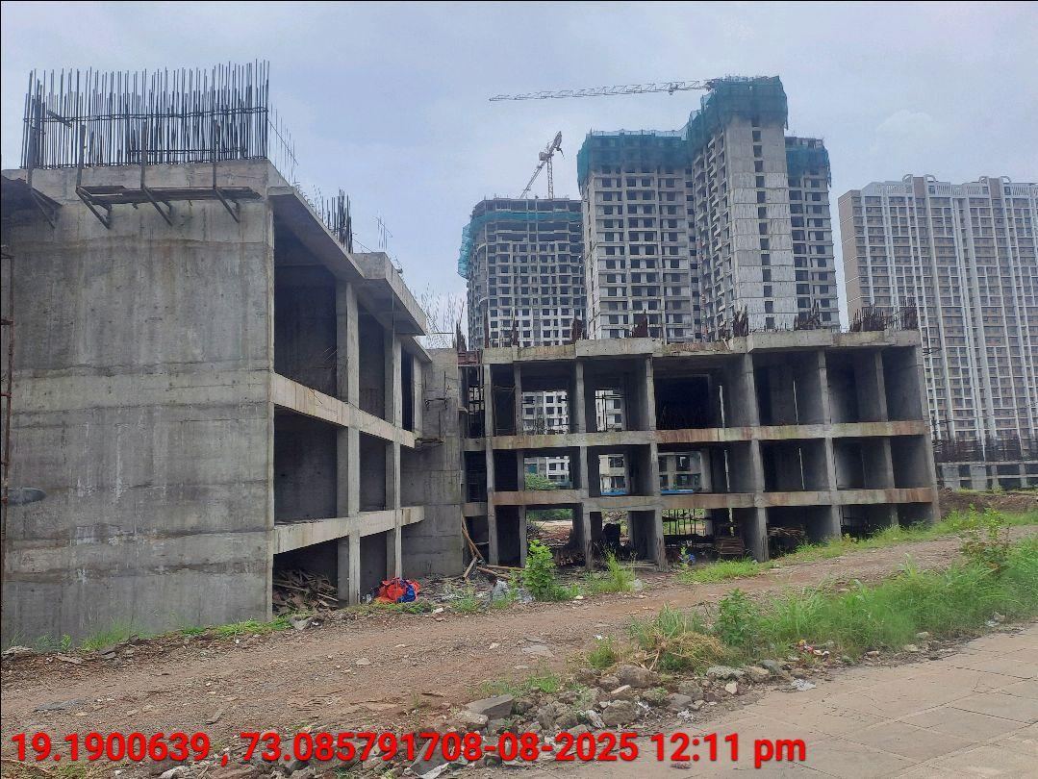
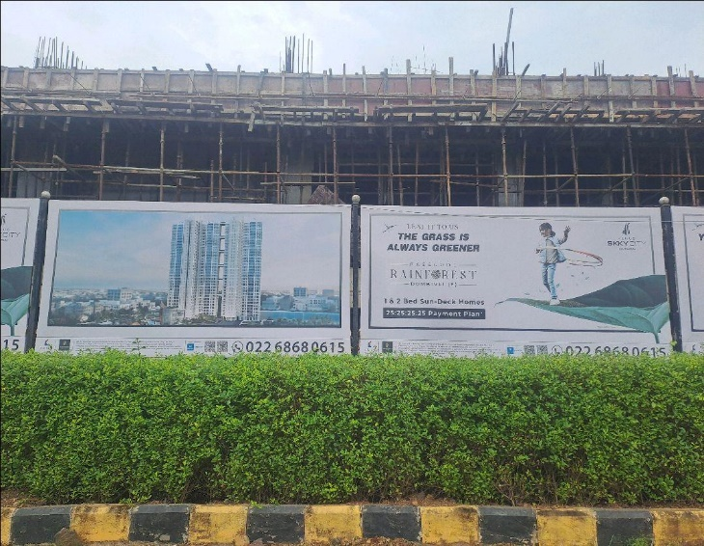
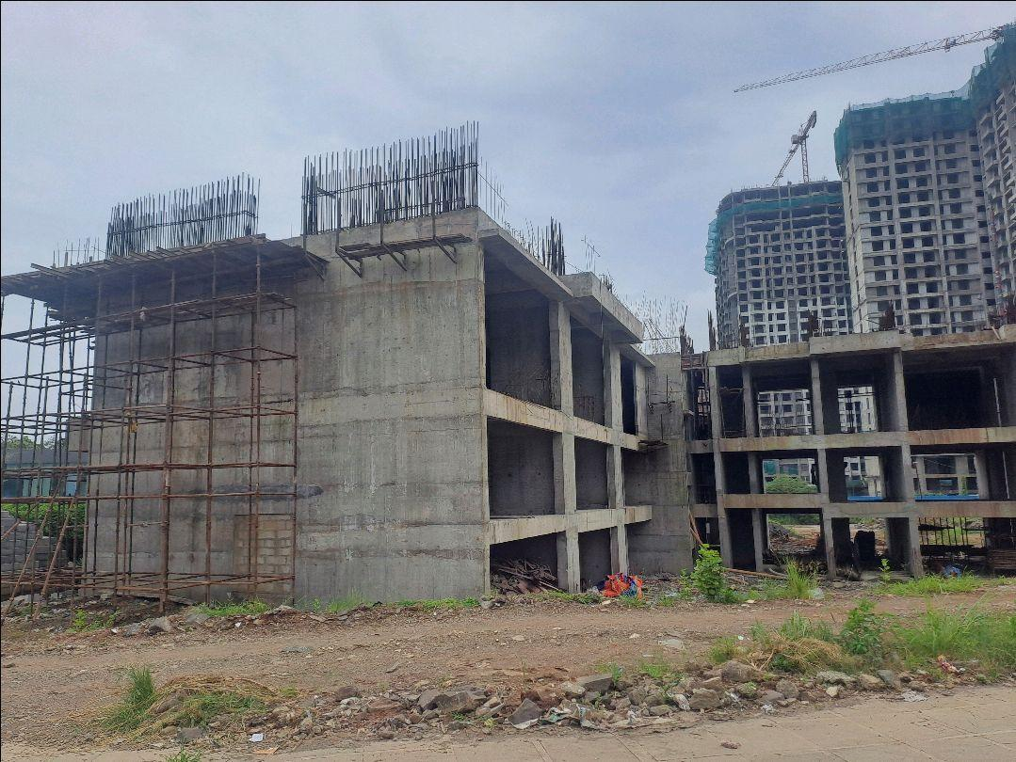
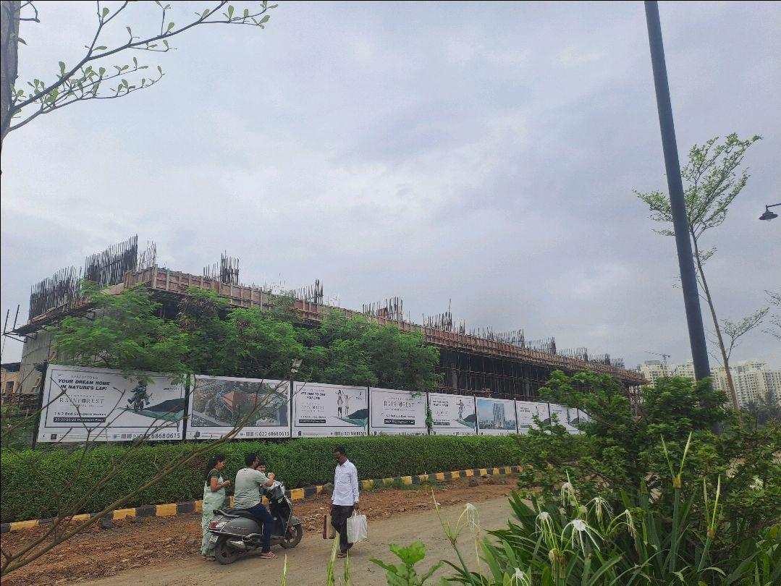

V.S.JADON & CO VALUERS LLP
PHOTOGRAPHS OF PROPERTY OF CUSTOMER: DHARMENDRA VINOD DUBEY
VSJCVNM-RBL-RTL-AUG25-16742 Page 6

Slide 2
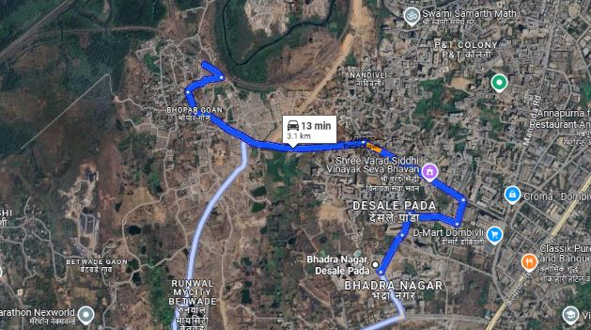
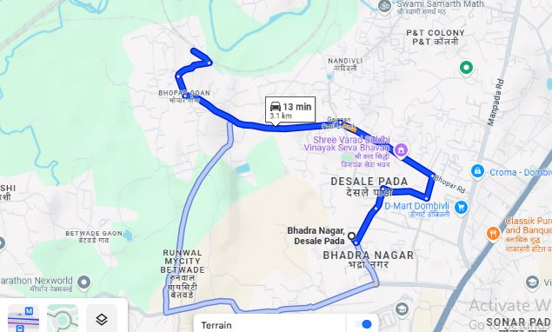
V.S.JADON & CO VALUERS LLP
PHOTOGRAPHS OF PROPERTY OF CUSTOMER : DHARMENDRA VINOD DUBEY
Google Map
VSJCVNM-RBL-RTL-AUG25-16742 Page 7

Slide 3
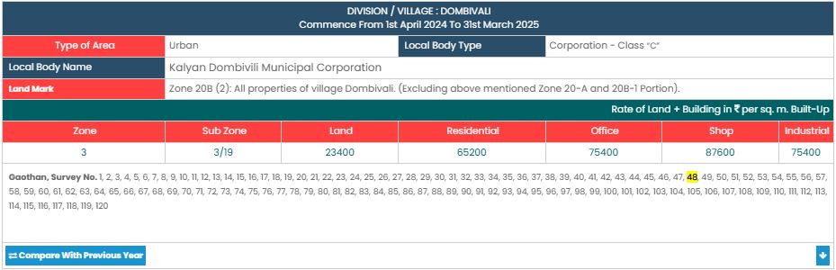
V.S.JADON & CO VALUERS LLP
PHOTOGRAPHS OF PROPERTY OF CUSTOMER: DHARMENDRA VINOD DUBEY
Gov Rate
VSJCVNM-RBL-RTL-AUG25-16742 Page 8

