Slide 1
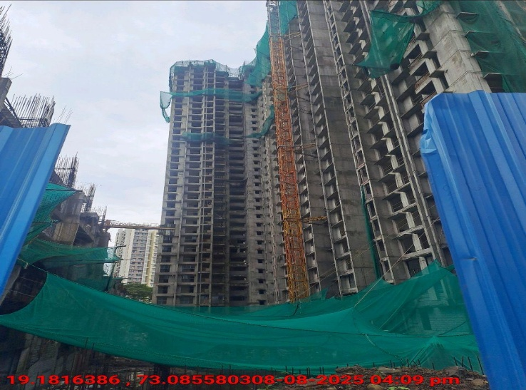

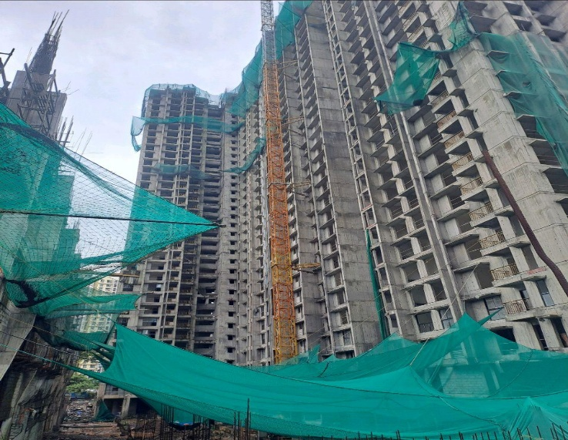
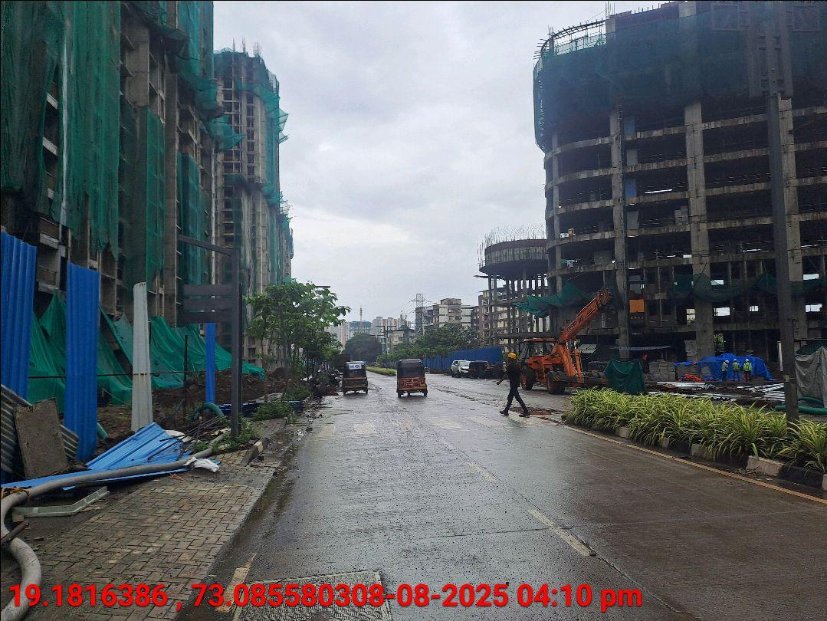
V.S.JADON & CO VALUERS LLP
PHOTOGRAPHS OF PROPERTY OF CUSTOMER: Ganesh Madan Ghagare
VSJCVNM-RBL-RTL-AUG25-16838 Page 8

Slide 2
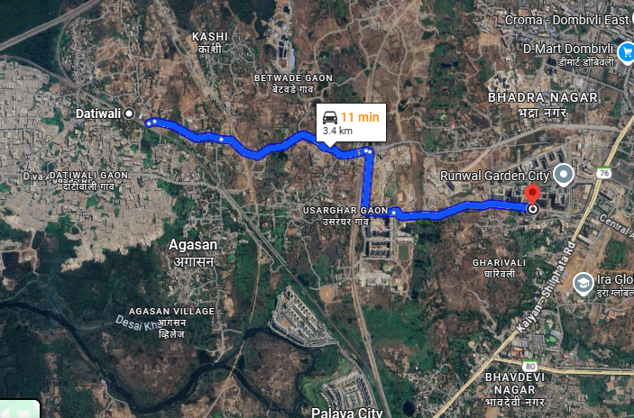
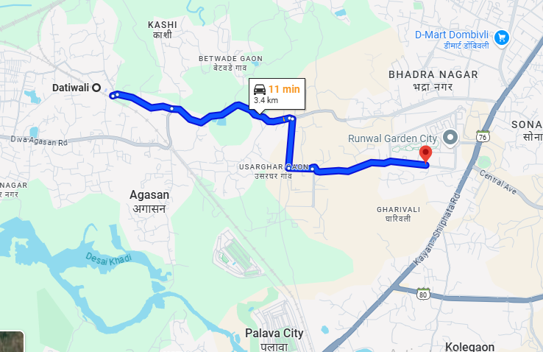
V.S.JADON & CO VALUERS LLP
PHOTOGRAPHS OF PROPERTY OF CUSTOMER: Ganesh Madan Ghagare
VSJCVNM-RBL-RTL-AUG25-16838 Page 2

Slide 3
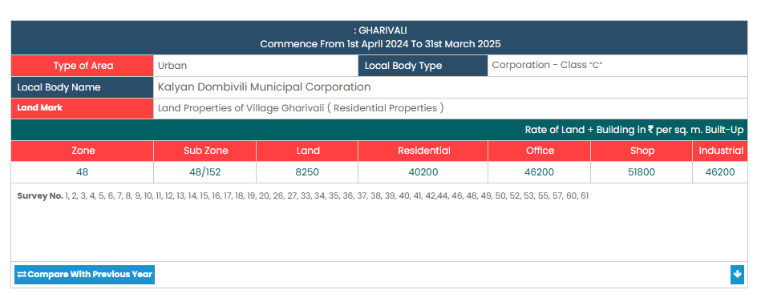
V.S.JADON & CO VALUERS LLP
PHOTOGRAPHS OF PROPERTY OF CUSTOMER: Ganesh Madan Ghagare
Gov Rate
VSJCVNM-RBL-RTL-AUG25-16838 Page 03

