Slide 1
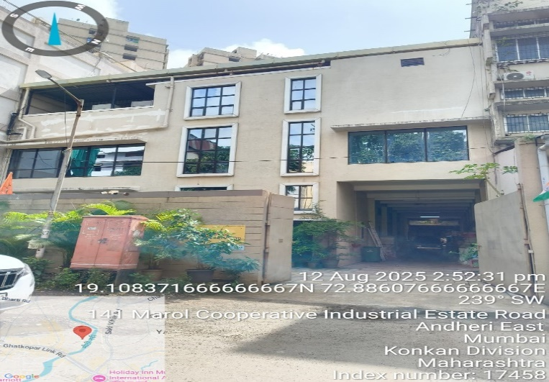
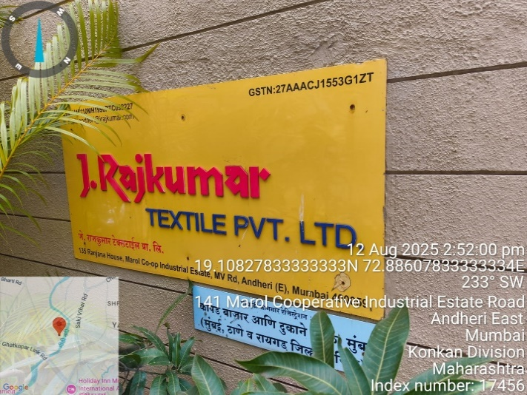
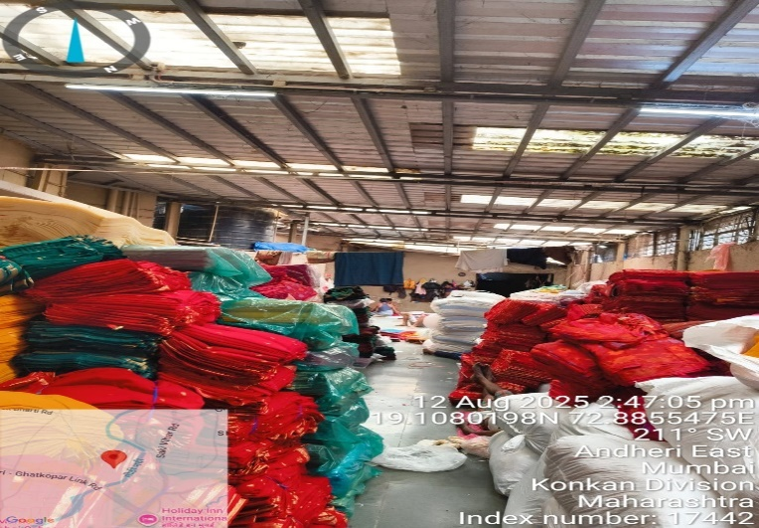
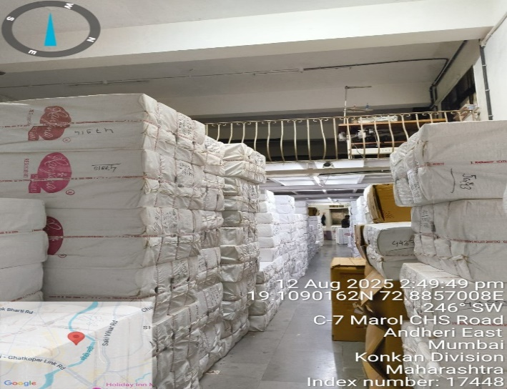
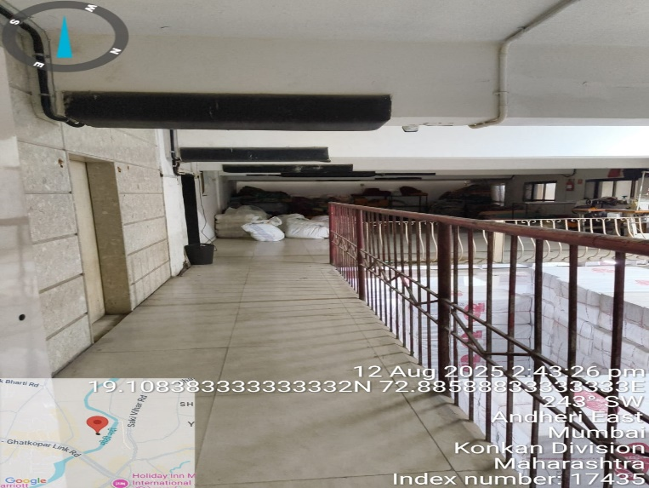
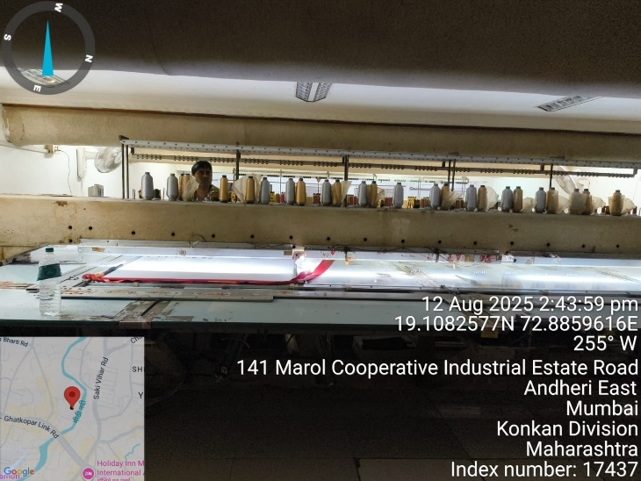
V.S.JADON & CO VALUERS LLP
PHOTOGRAPHS OF PROPERTY OF CUSTOMER Ravi Rajkumar Hissaria
VSJCVNM-AXIS-RTL-AUG25-17195
Page 1

Slide 2
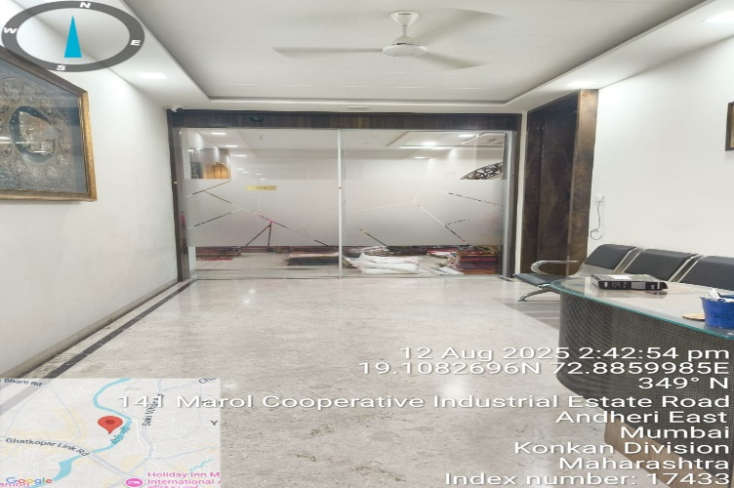
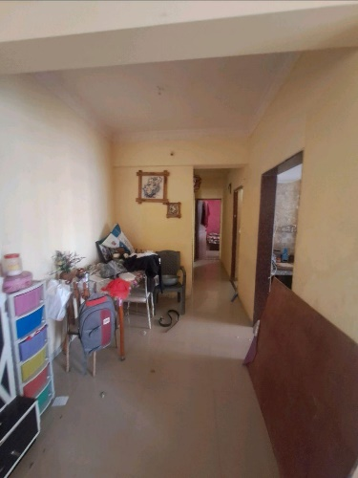
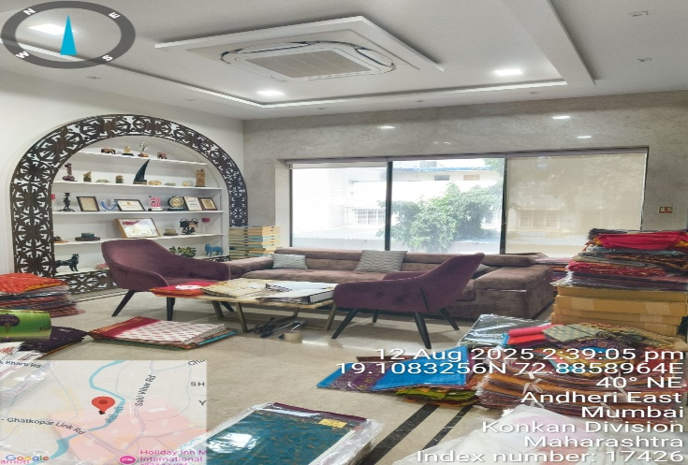
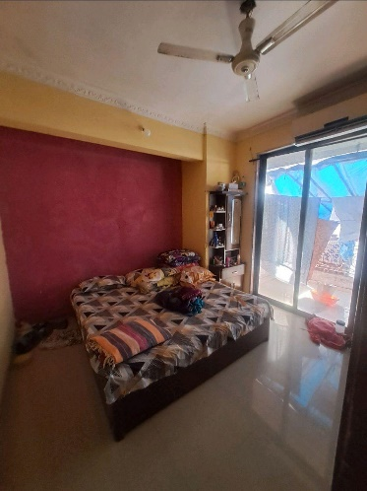
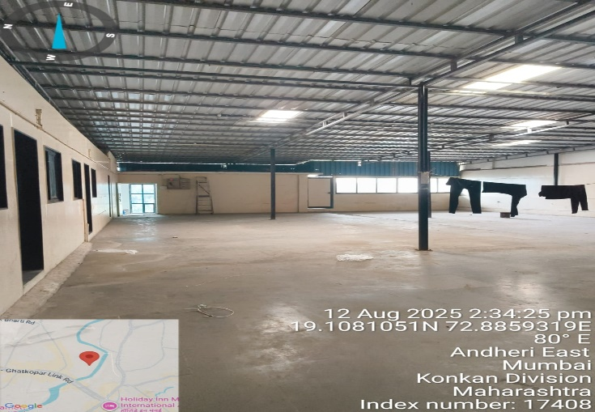
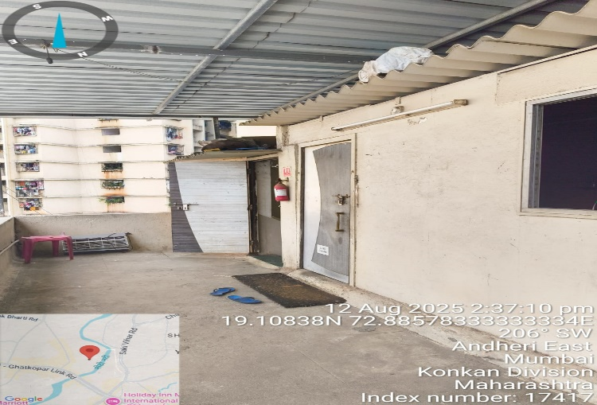
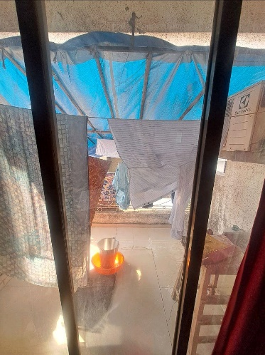
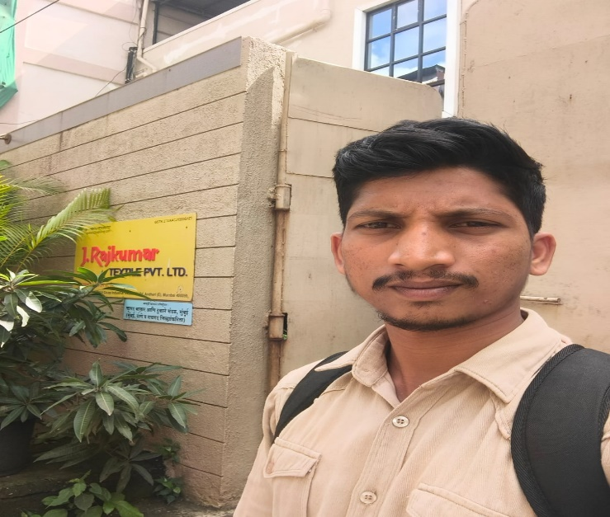
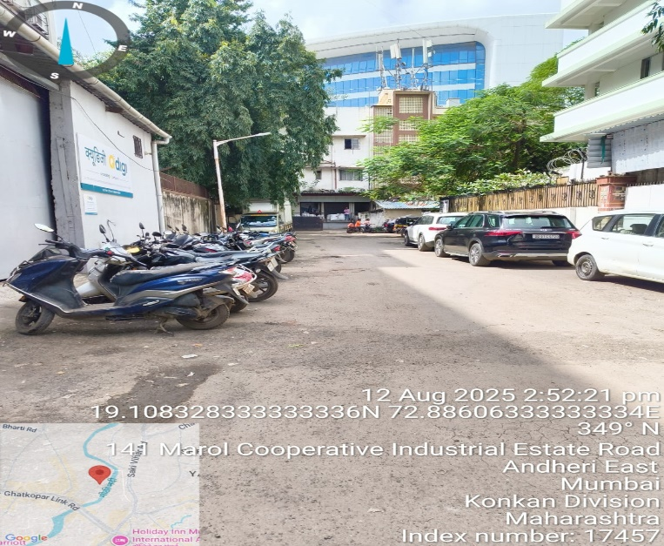
V.S.JADON & CO VALUERS LLP
PHOTOGRAPHS OF PROPERTY OF CUSTOMER Ravi Rajkumar Hissaria
VSJCVNM-AXIS-RTL-AUG25-17195
Page 2

Slide 3
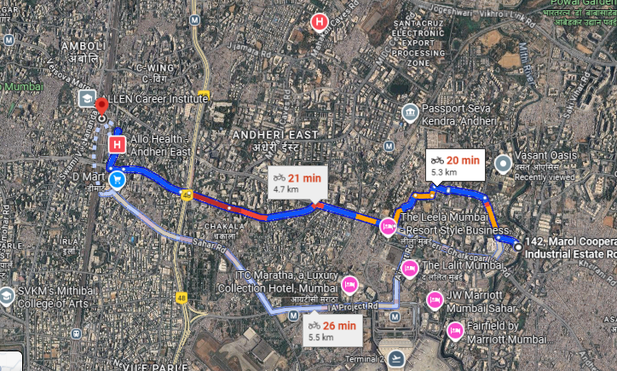
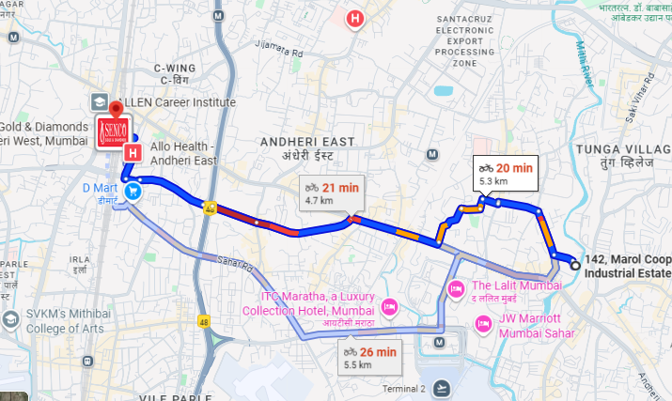
V.S.JADON & CO VALUERS LLP
PHOTOGRAPHS OF PROPERTY OF CUSTOMER : Ravi Rajkumar Hissaria
Google Map
VSJCVNM-AXIS-RTL-AUG25-17195
Page 3

Slide 4
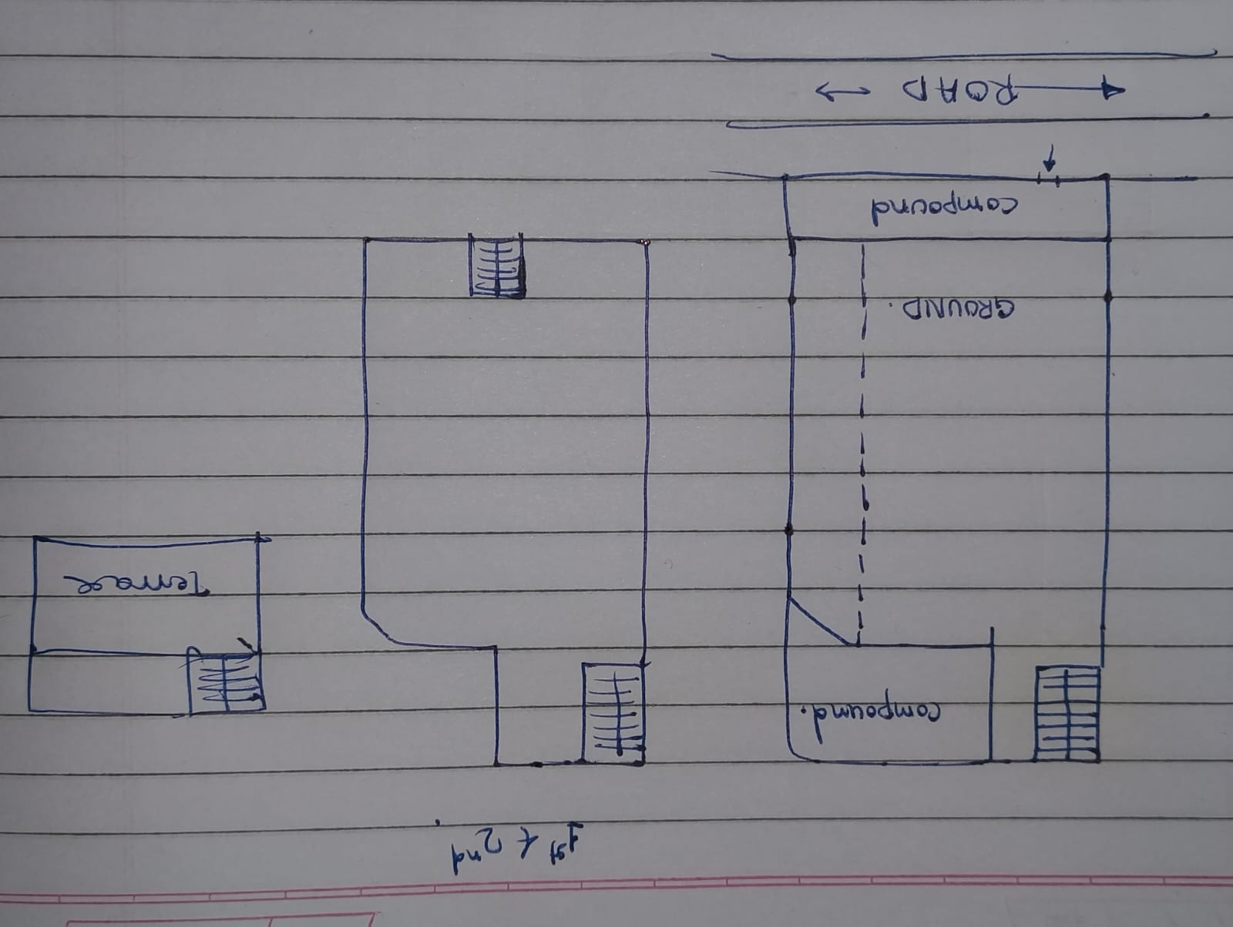
V.S.JADON & CO VALUERS LLP
PHOTOGRAPHS OF PROPERTY OF CUSTOMER: Ravi Rajkumar Hissaria
Site Layout
VSJCVNM-AXIS-RTL-AUG25-17195
Page 4

Slide 5
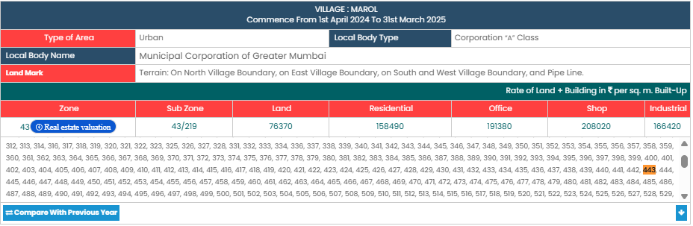
V.S.JADON & CO VALUERS LLP
PHOTOGRAPHS OF PROPERTY OF CUSTOMER Ravi Rajkumar Hissaria
Gov Rate
VSJCVNM-AXIS-RTL-AUG25-17195
Page 5

