Slide 1
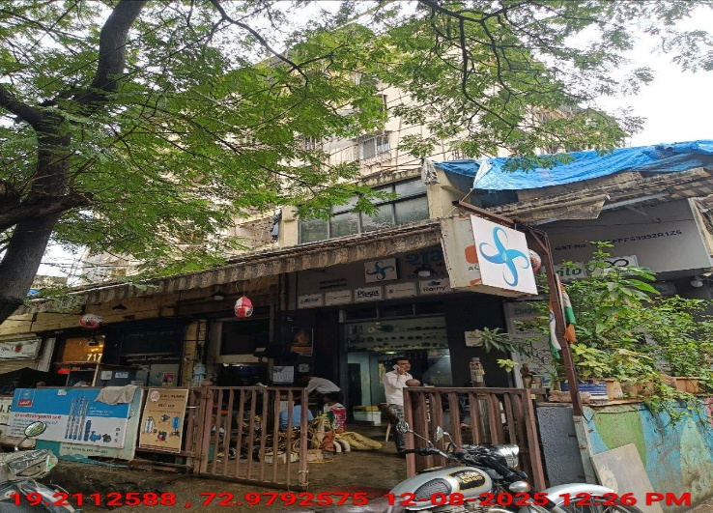
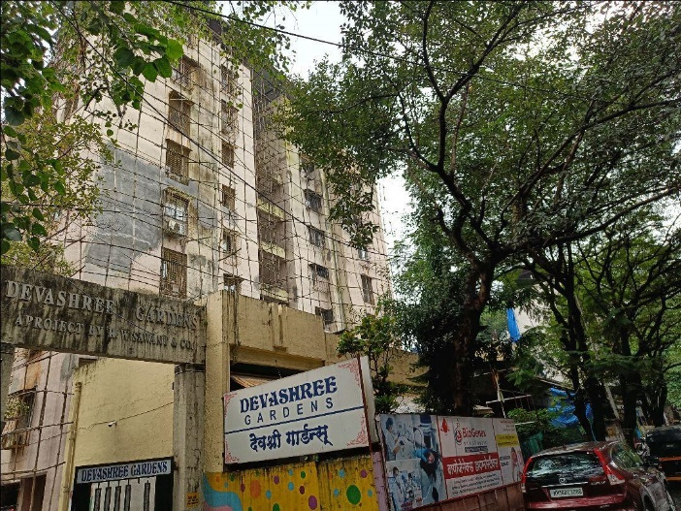
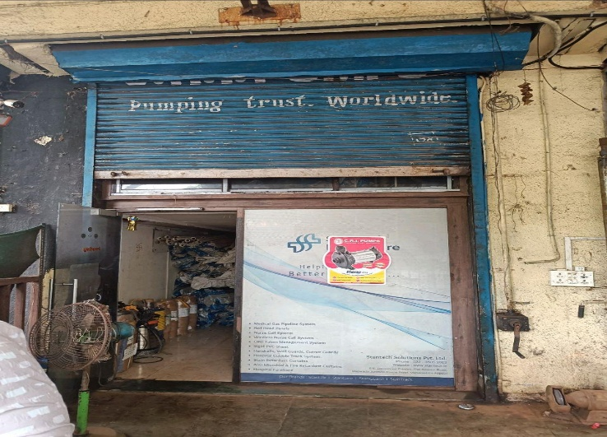
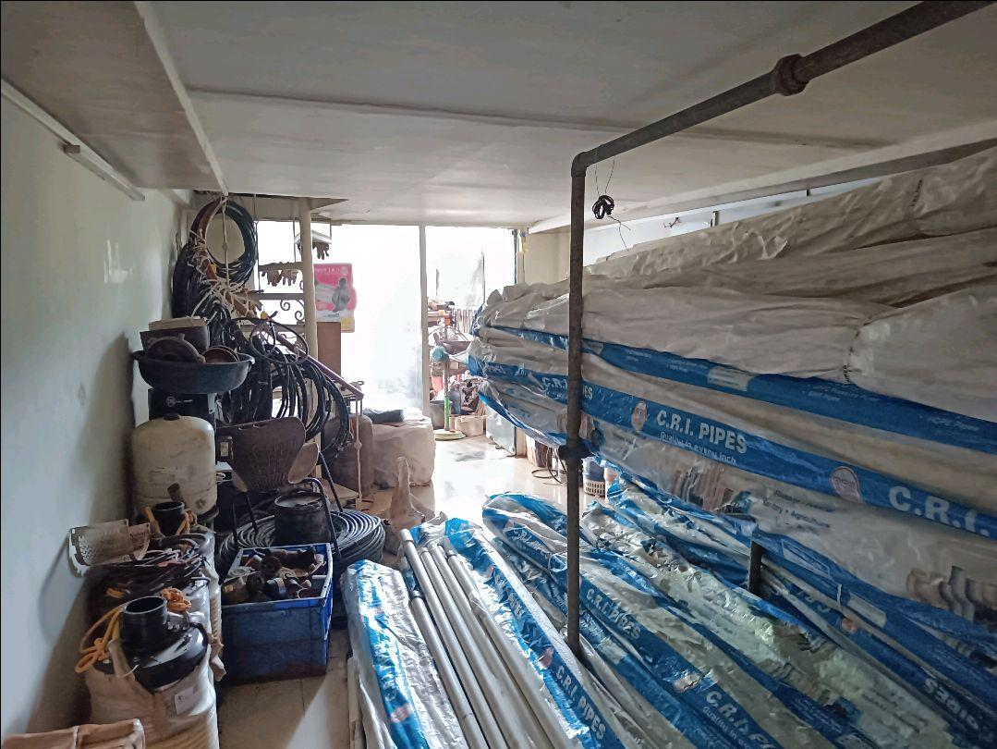
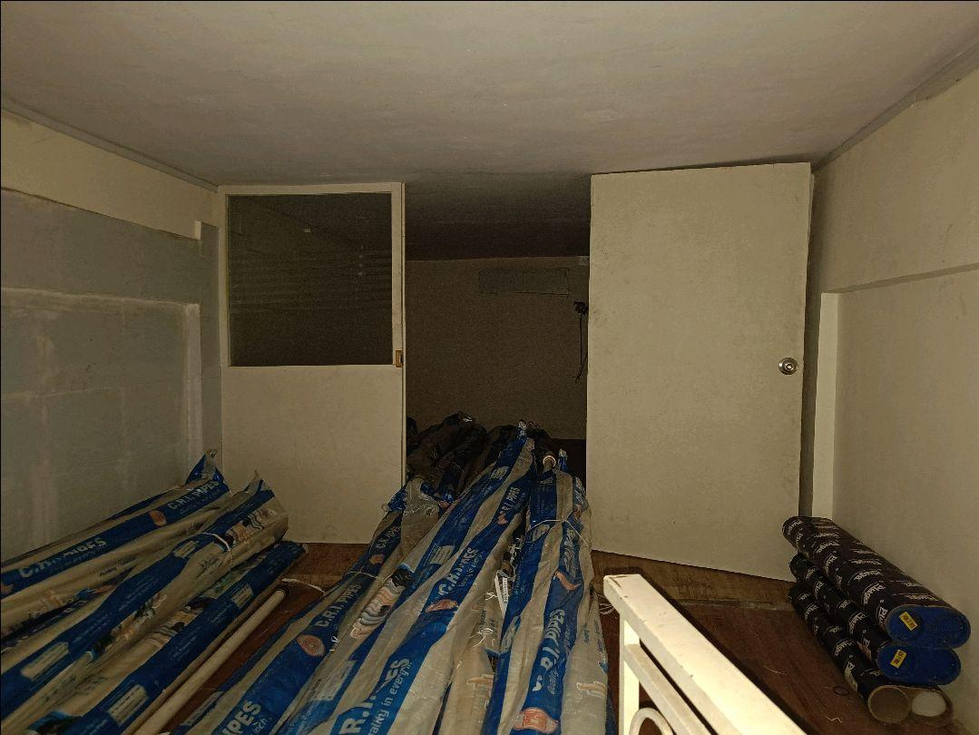
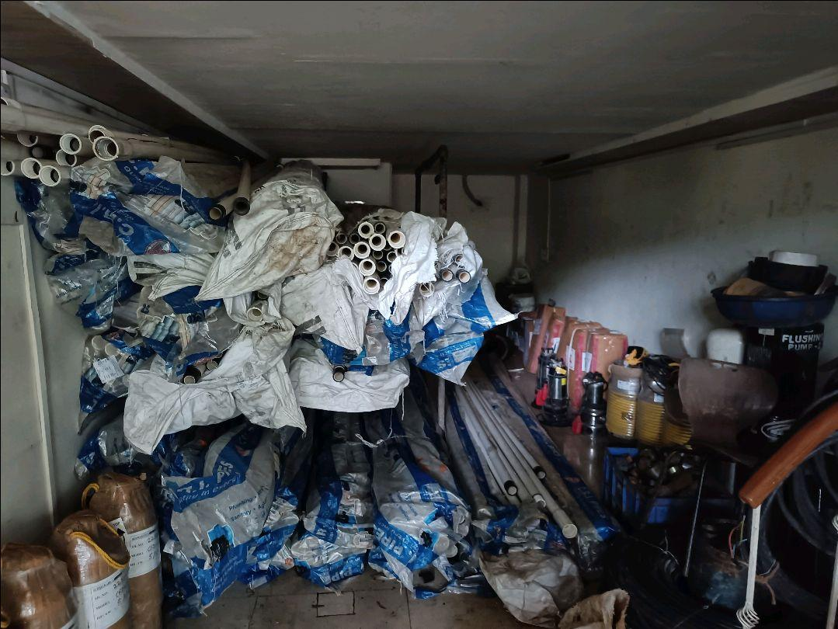
V.S.JADON & CO VALUERS LLP
PHOTOGRAPHS OF PROPERTY OF CUSTOMER : S P Pumps
VSJCVNM-AXIS-RTL-AUG25-17388
Page 1

Slide 2

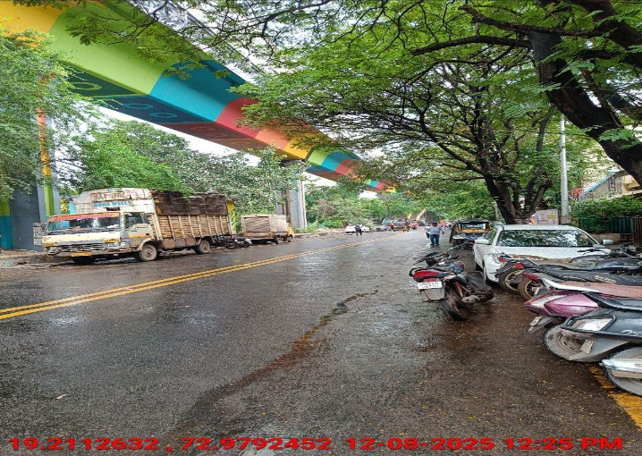
V.S.JADON & CO VALUERS LLP
PHOTOGRAPHS OF PROPERTY OF CUSTOMER : S P Pumps.
VSJCVNM-AXIS-RTL-AUG25-17388
Page 2

Slide 3
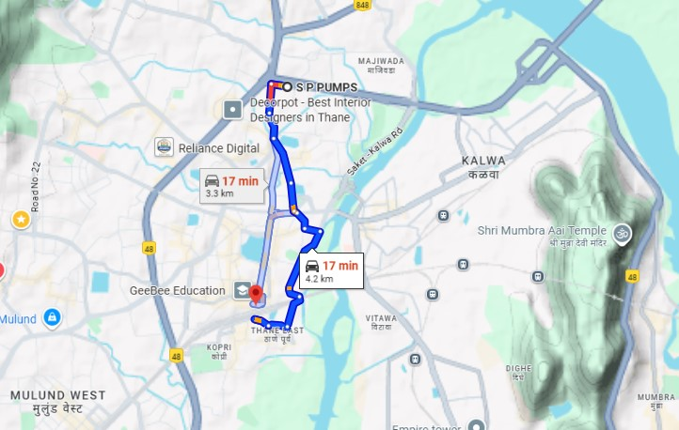
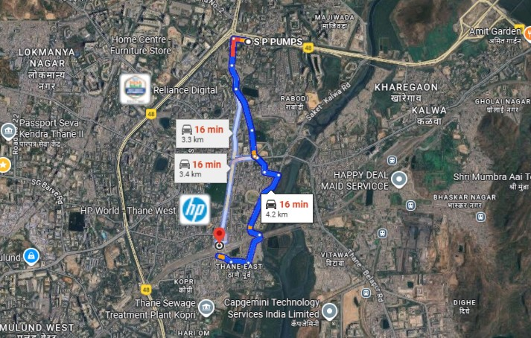
V.S.JADON & CO VALUERS LLP
PHOTOGRAPHS OF PROPERTY OF CUSTOMER: S P Pumps.
Google Map
VSJCVNM-AXIS-RTL-AUG25-17388
Page 3

Slide 4
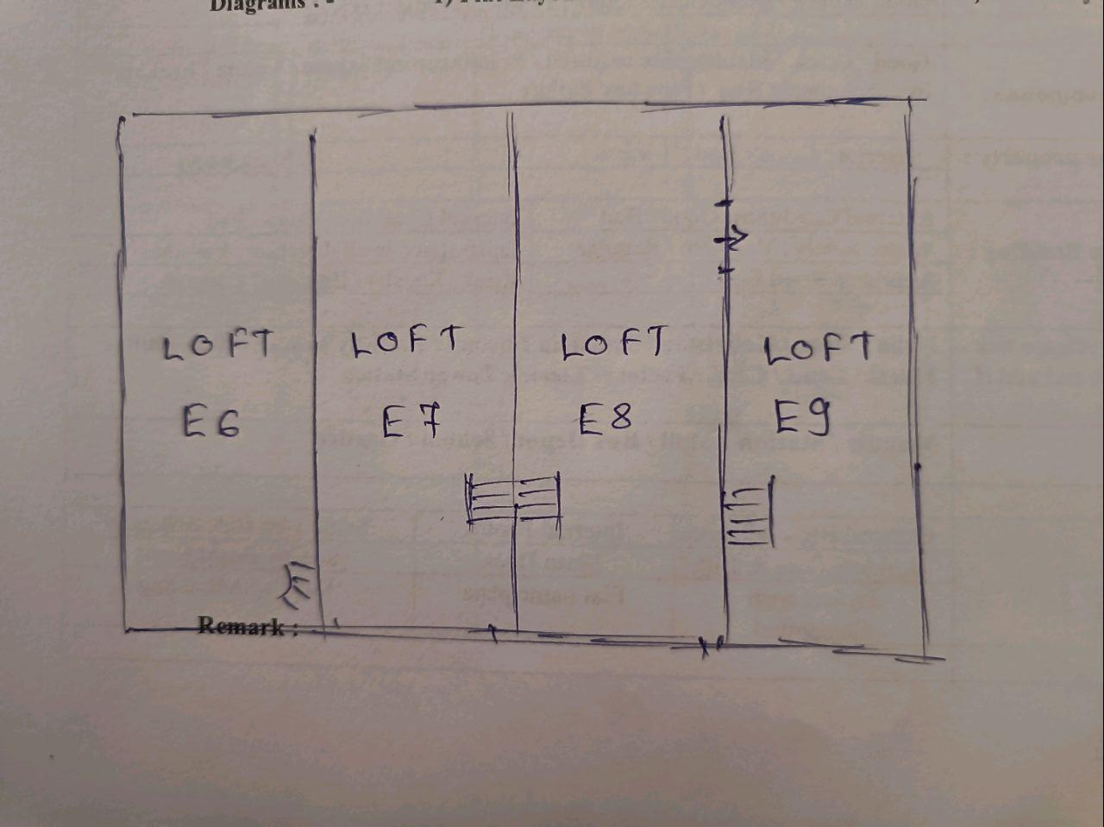
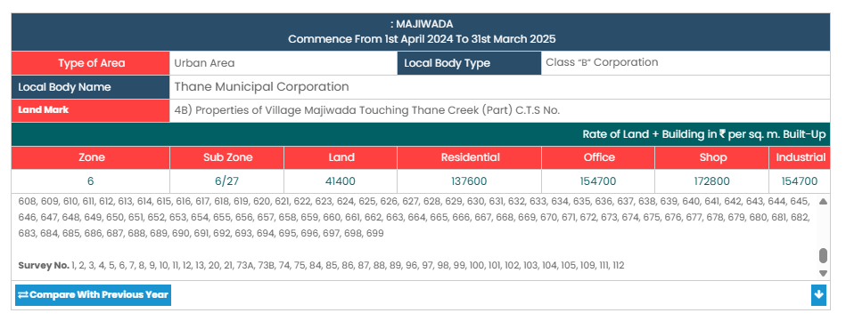
V.S.JADON & CO VALUERS LLP
PHOTOGRAPHS OF PROPERTY OF CUSTOMER: S P Pumps.
Site Layout
Govt. Rate
VSJCVNM-AXIS-RTL-AUG25-17388
Page 4

