Slide 1
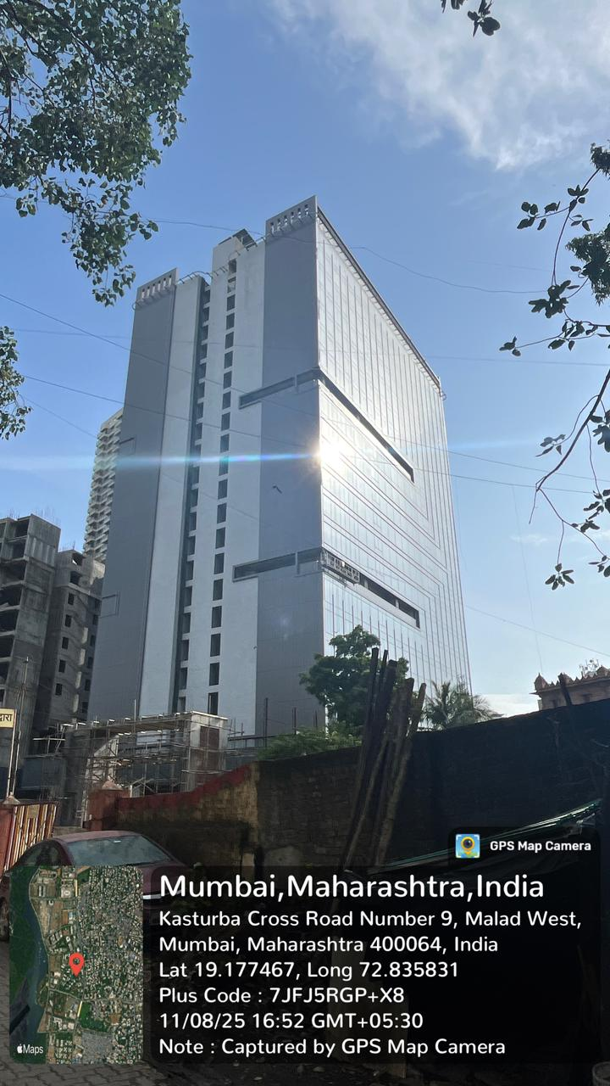
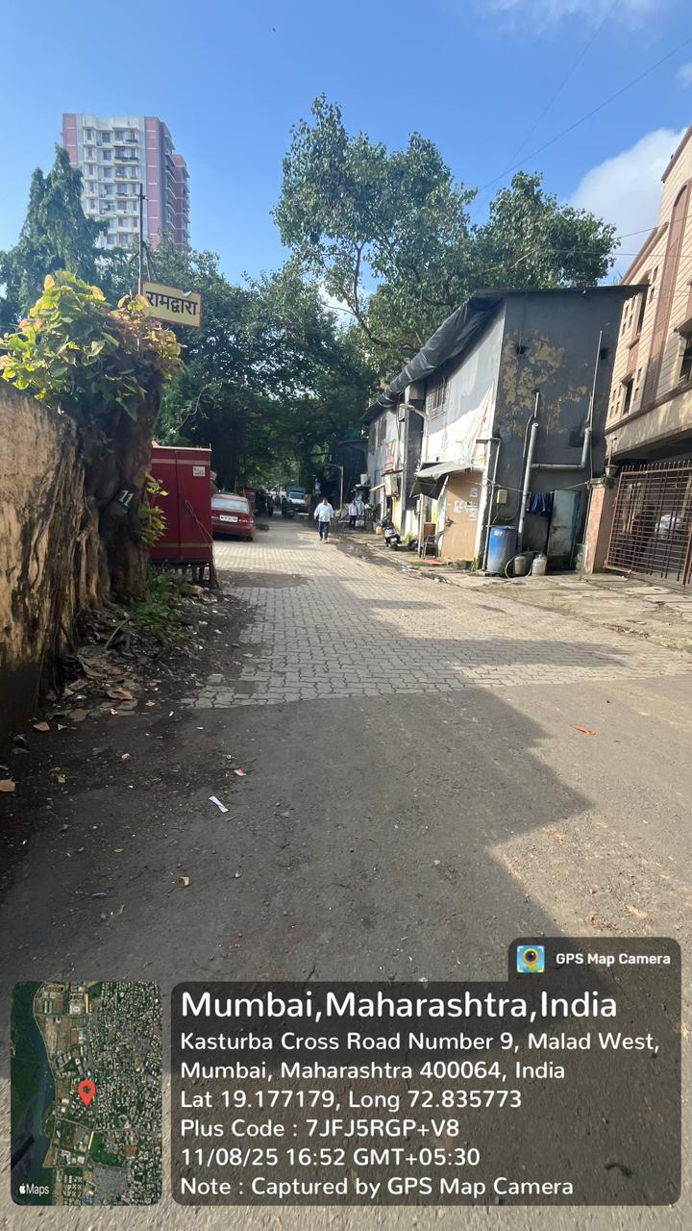
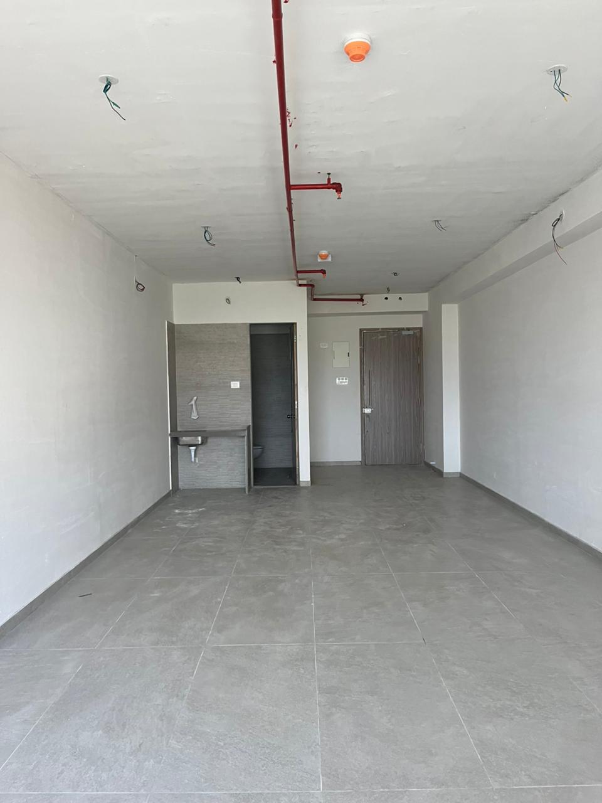
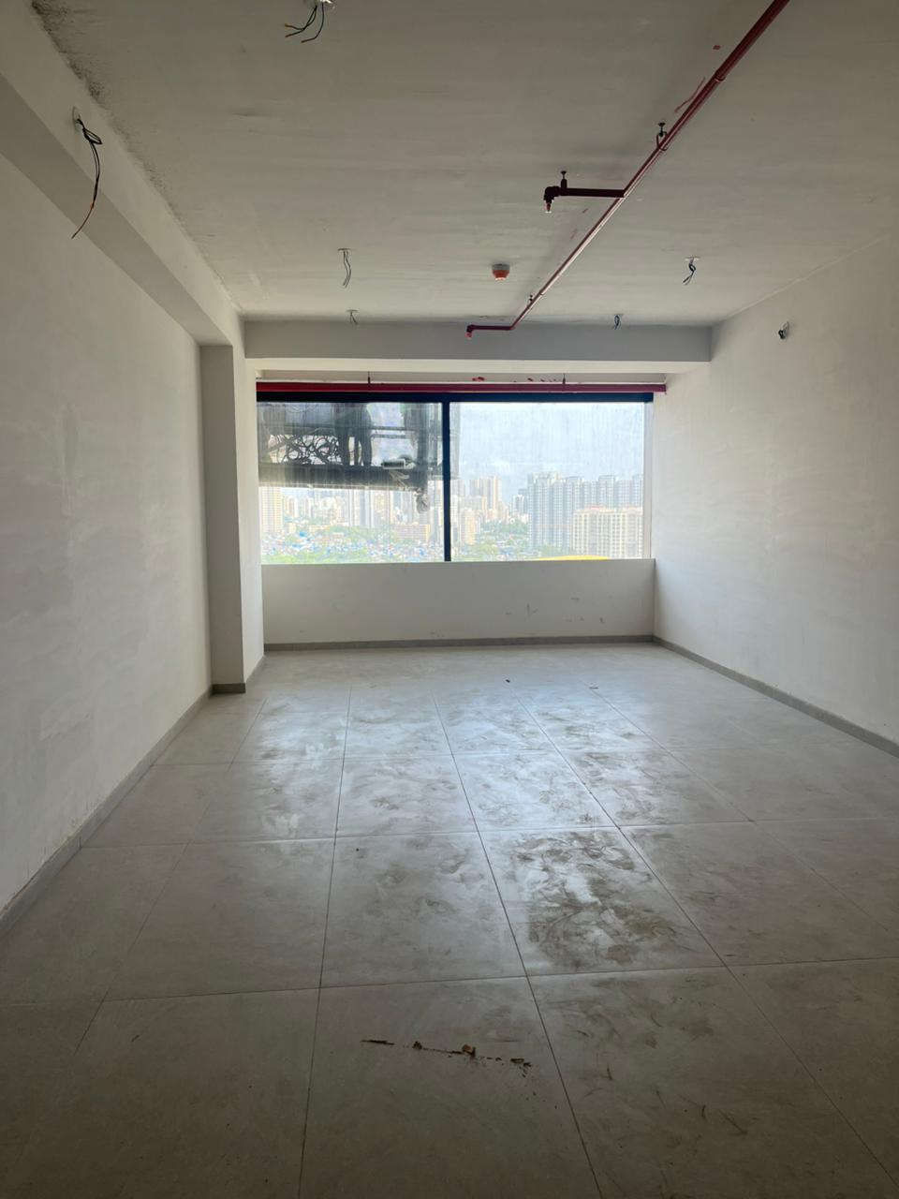
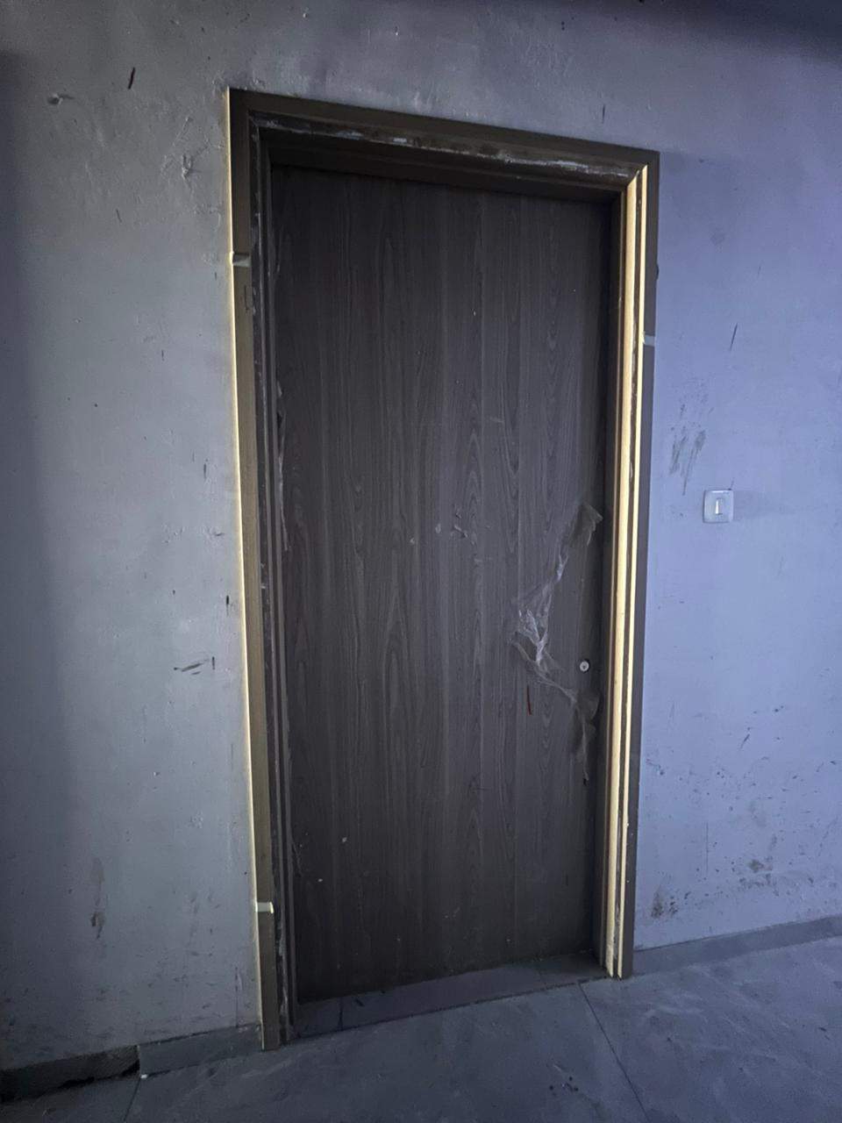
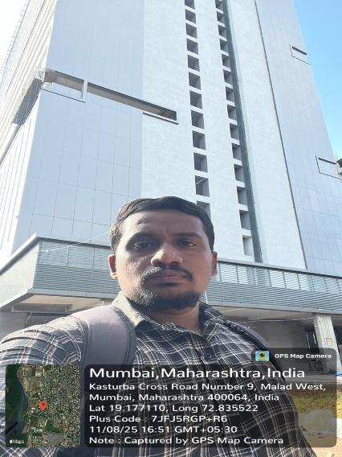
V.S.JADON & CO VALUERS LLP
PHOTOGRAPHS OF PROPERTY OF CUSTOMER ASHWIN SANTKUMAR PANDEY
VSJCVNM-AXI-RTL-AUG25-17570
Page 1

Slide 2
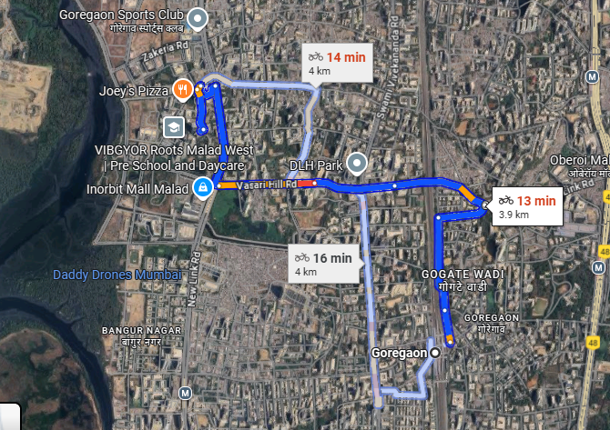
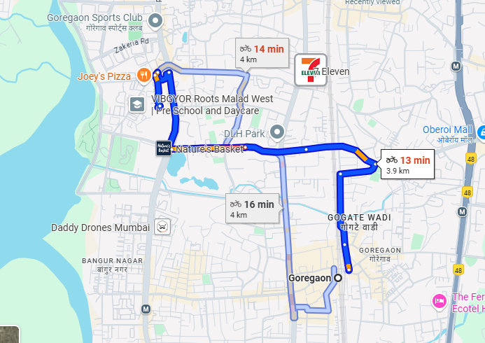
V.S.JADON & CO VALUERS LLP
PHOTOGRAPHS OF PROPERTY OF CUSTOMER : ASHWIN SANTKUMAR PANDEY
VSJCVNM-AXI-RTL-AUG25-17570 Page 3

Slide 3
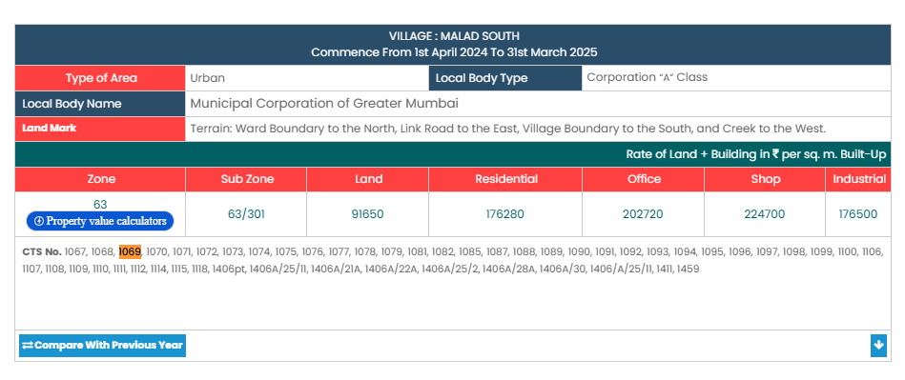
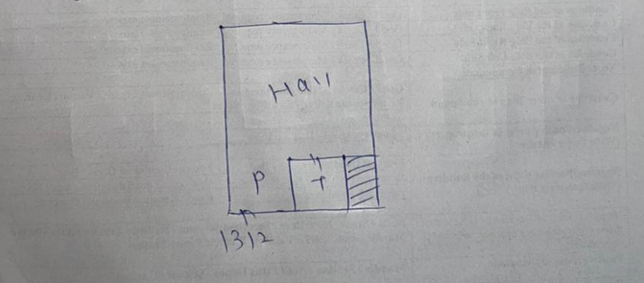
V.S.JADON & CO VALUERS LLP
PHOTOGRAPHS OF PROPERTY OF CUSTOMER- ASHWIN SANTKUMAR PANDEY
Gov Rate
VSJCVNM-AXI-RTL-AUG25-17570 Page 5

