Slide 1
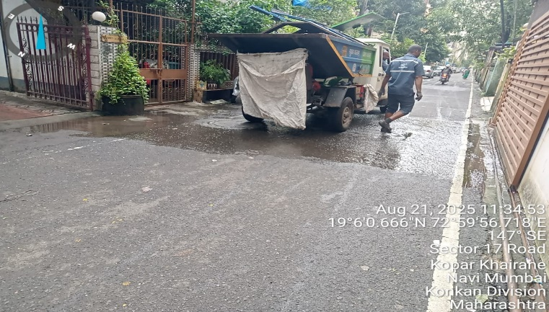
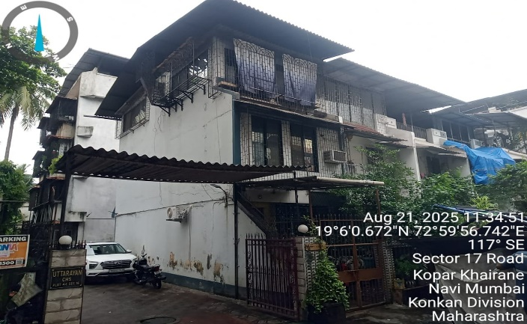
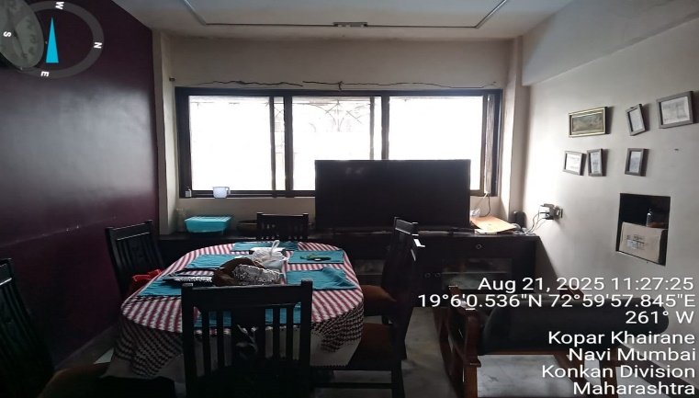
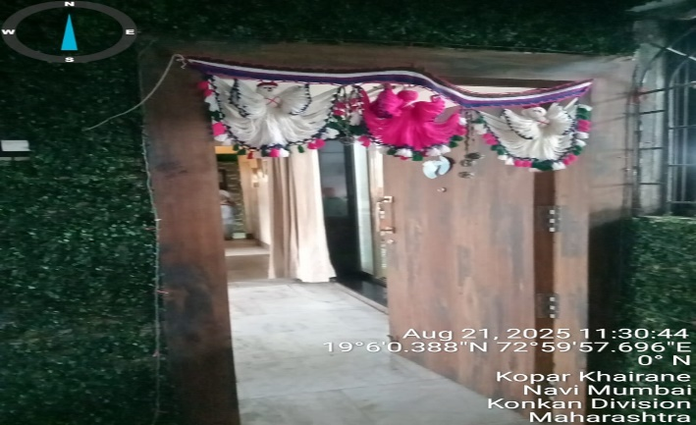
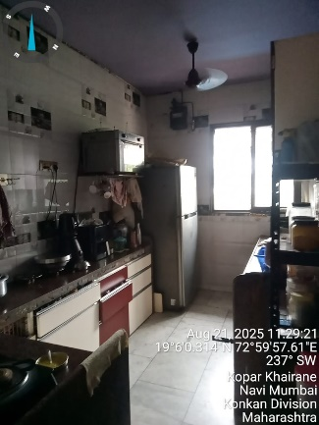
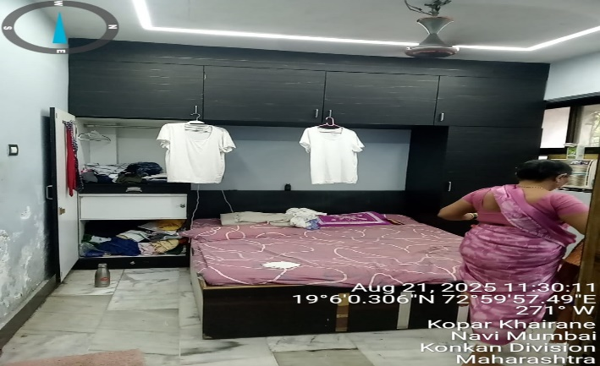
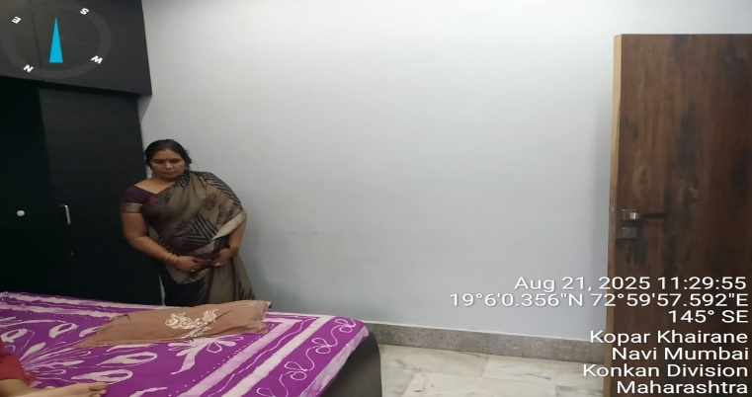
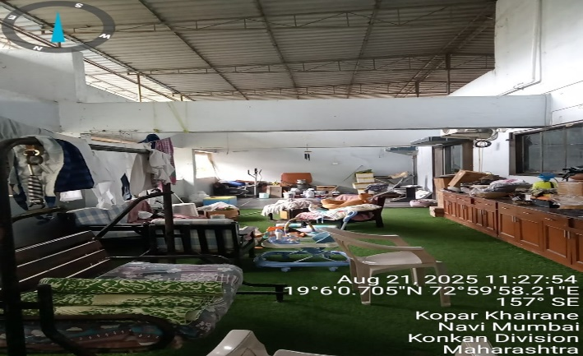
V.S.JADON & CO VALUERS LLP
PHOTOGRAPHS OF PROPERTY OF QUALITY FABRICATOR AND ERECTOR PVT LTD
Site Photo :
VSJCVNM-AXIS-RTL-AUG25-18078 Page 1

Slide 2
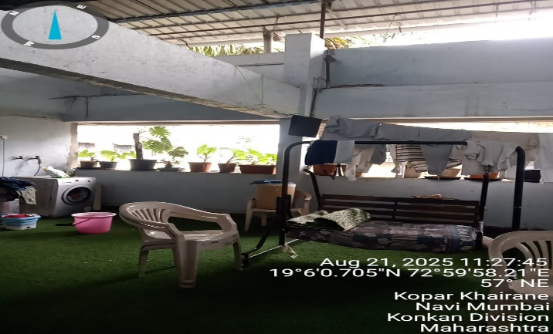
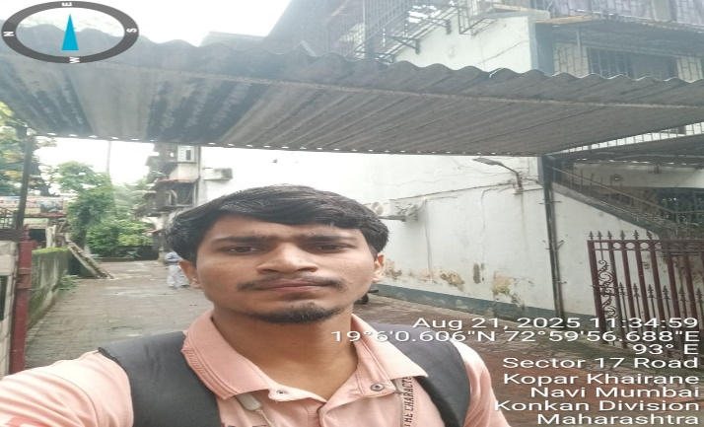
V.S.JADON & CO VALUERS LLP
PHOTOGRAPHS OF PROPERTY OF CUSTOMER QUALITY FABRICATOR AND ERECTOR PVT LTD
Site Photo :
VVSJCVNM-AXIS-RTL-AUG25-18078 Page 2

Slide 3
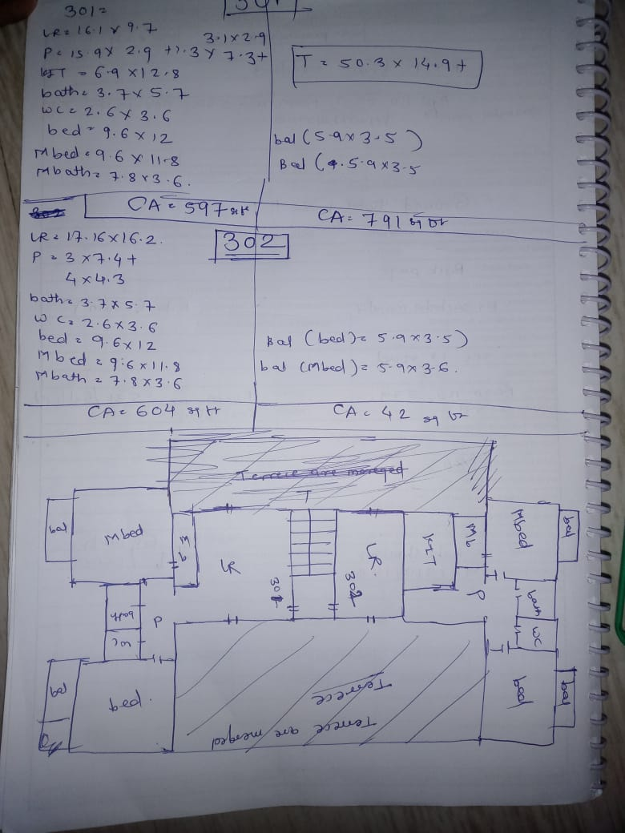
V.S.JADON & CO VALUERS LLP
PHOTOGRAPHS OF PROPERTY OF CUSTOMER QUALITY FABRICATOR AND ERECTOR PVT LTD
Site Layout :
VSJCVNM-AXIS-RTL-AUG25-18078 Page 3

Slide 4
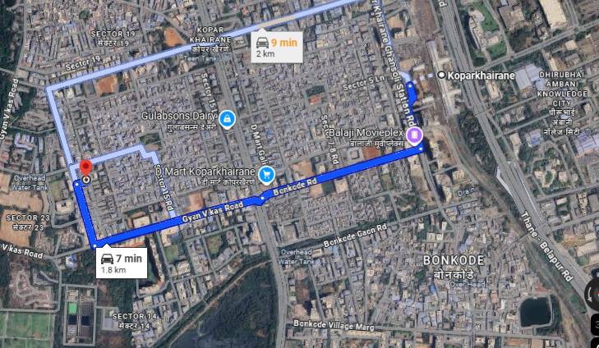
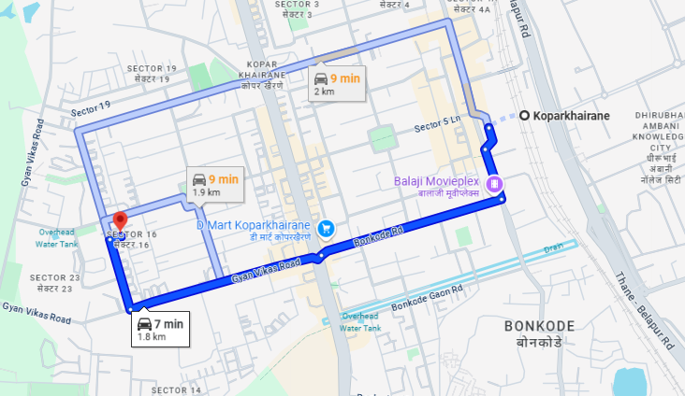
V.S.JADON & CO VALUERS LLP
PHOTOGRAPHS OF PROPERTY OF CUSTOMER QUALITY FABRICATOR AND ERECTOR PVT LTD
Google Maps :
VSJCVNM-AXIS-RTL-AUG25-18078 Page 4

Slide 5
V.S.JADON & CO VALUERS LLP
PHOTOGRAPHS OF PROPERTY OF CUSTOMER QUALITY FABRICATOR AND ERECTOR PVT LTD
Google Maps :
VSJCVNM-AXIS-RTL-AUG25-18078 Page 4

