Slide 1
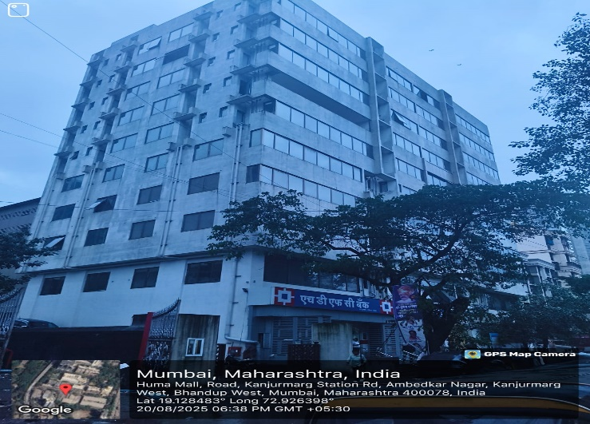
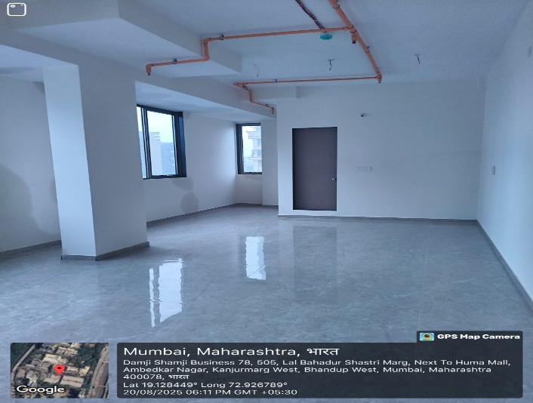
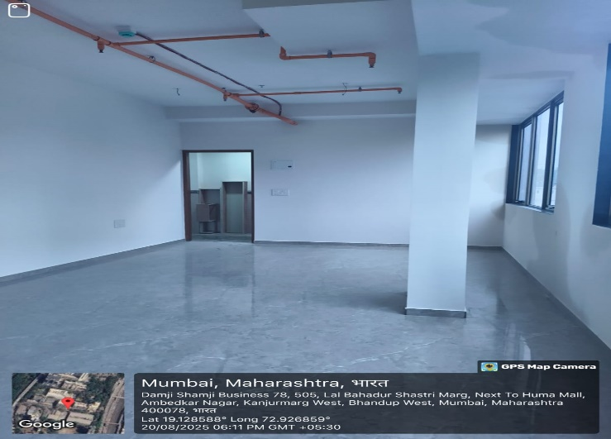
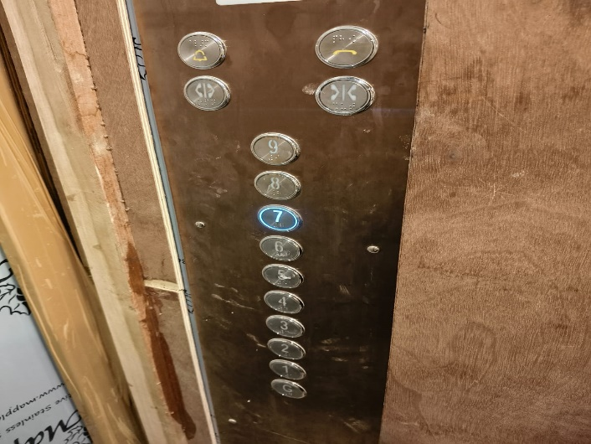

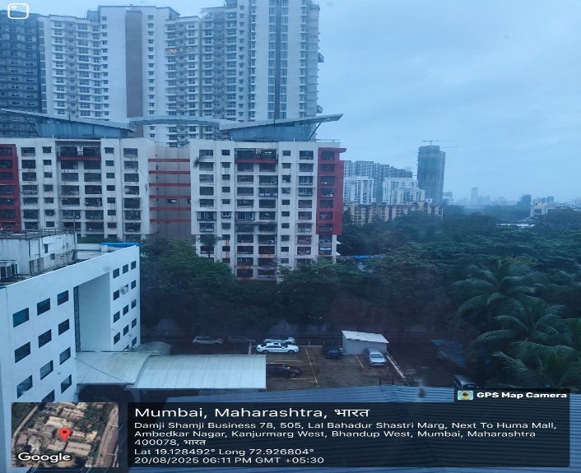
V.S.JADON & CO VALUERS LLP
PHOTOGRAPHS OF PROPERTY OF CUSTOMER : UNILATERAL TECHNOLOGY PVT LTD.
VSJCVNM-AXIS-RTL-AUG25-18172
Page 1

Slide 2
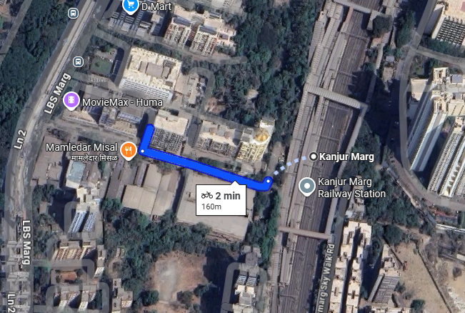
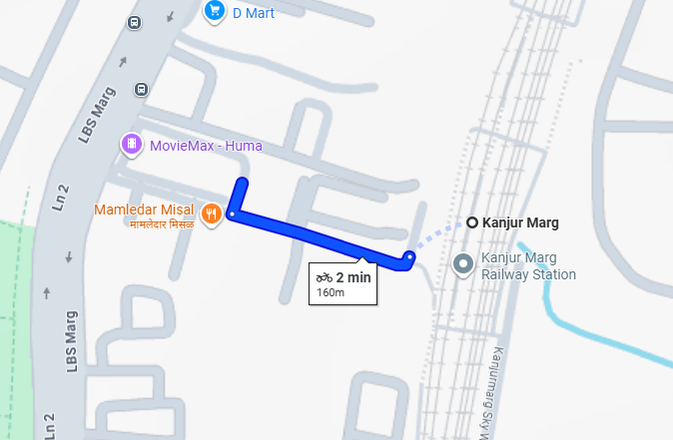
V.S.JADON & CO VALUERS LLP
PHOTOGRAPHS OF PROPERTY OF CUSTOMER UNILATERAL TECHNOLOGY PVT LTD.
Google Map
VSJCVNM-AXIS-RTL-AUG25-18172
Page 3

Slide 3
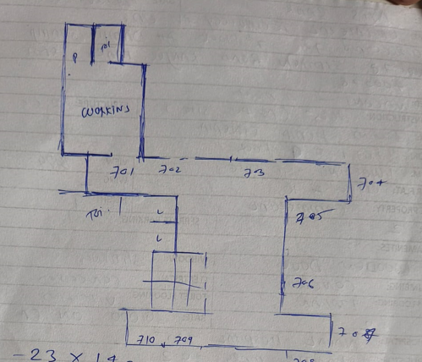
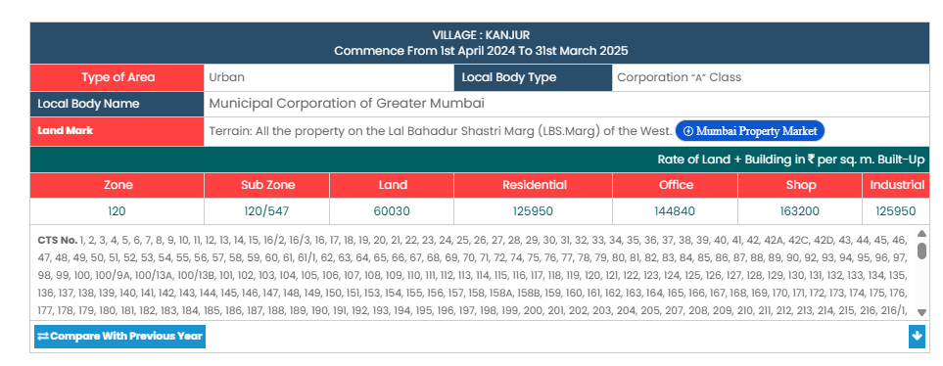
V.S.JADON & CO VALUERS LLP
PHOTOGRAPHS OF PROPERTY OF CUSTOMER -UNILATERAL TECHNOLOGY PVT LTD
Site Layout
Govt. Rate
VSJCVNM-AXIS-RTL-AUG25-18172
Page 4

