Slide 1
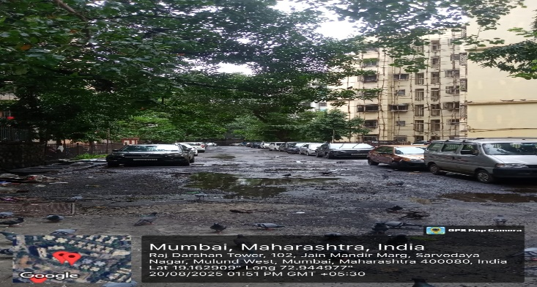
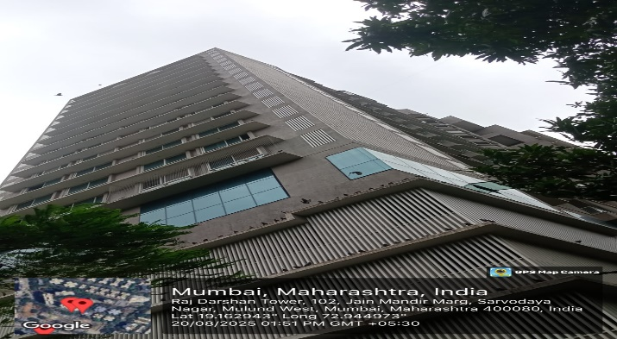
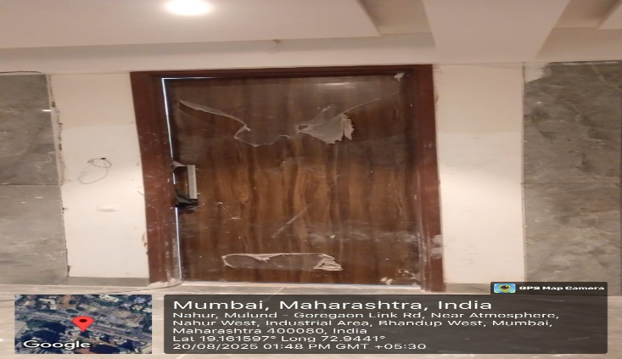
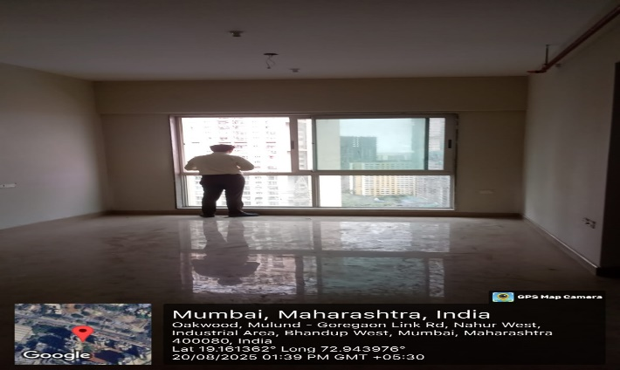
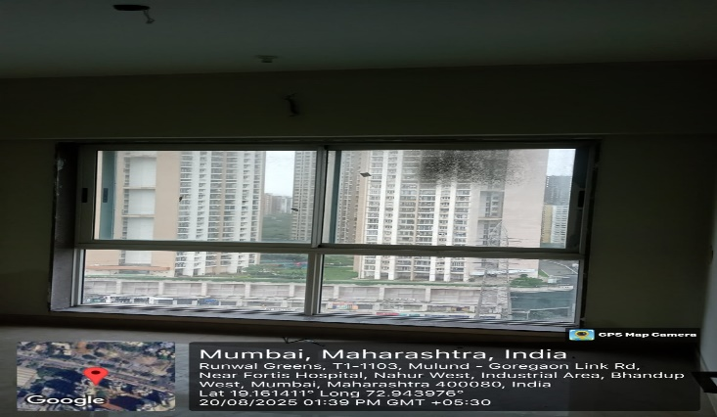
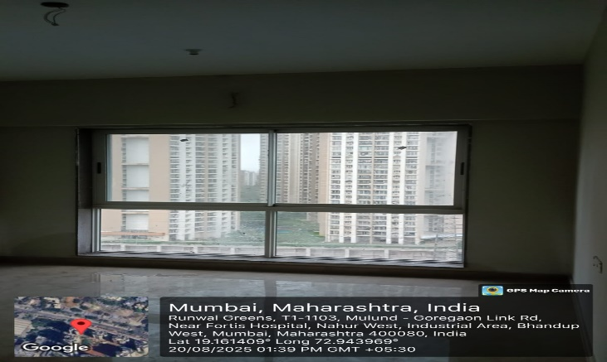
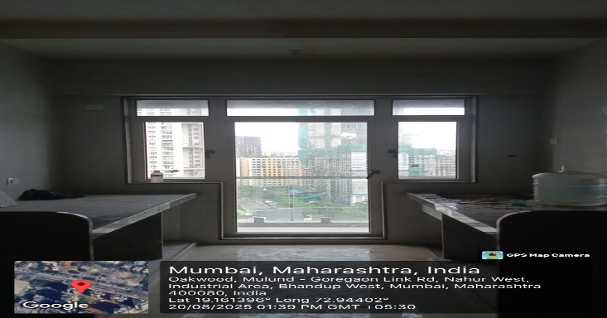
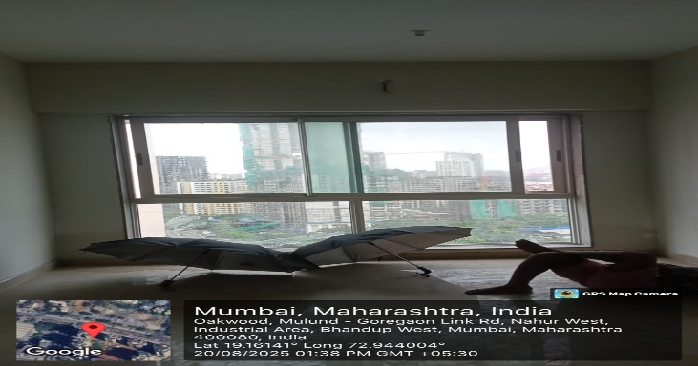
V.S.JADON & CO VALUERS LLP
PHOTOGRAPHS OF PROPERTY OF CUSTOMER: Prince Metkari
Site Photo
VSJCVNM-BOI-RTL-JUL24-12745
Page 1

Slide 2
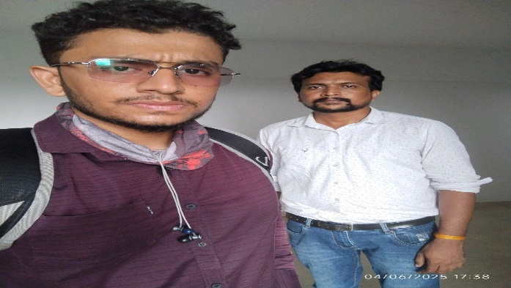
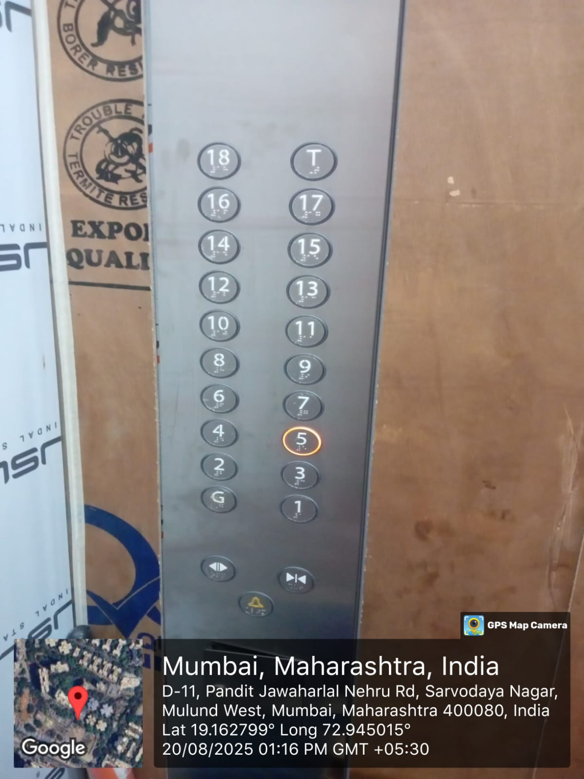
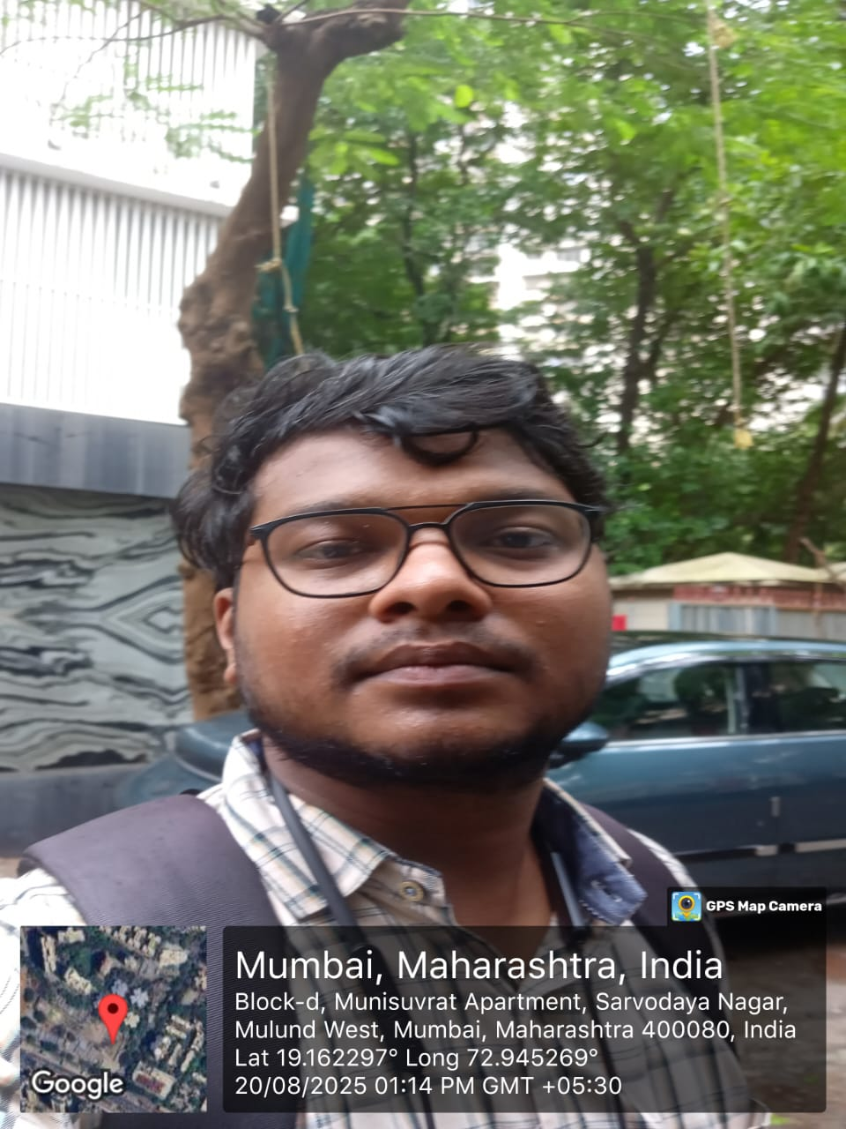
V.S.JADON & CO VALUERS LLP
PHOTOGRAPHS OF PROPERTY OF CUSTOMER: Prince Metkari
Site Photo
VSJCVNM-BOI-RTL-JUL24-12745
Page 1

Slide 3
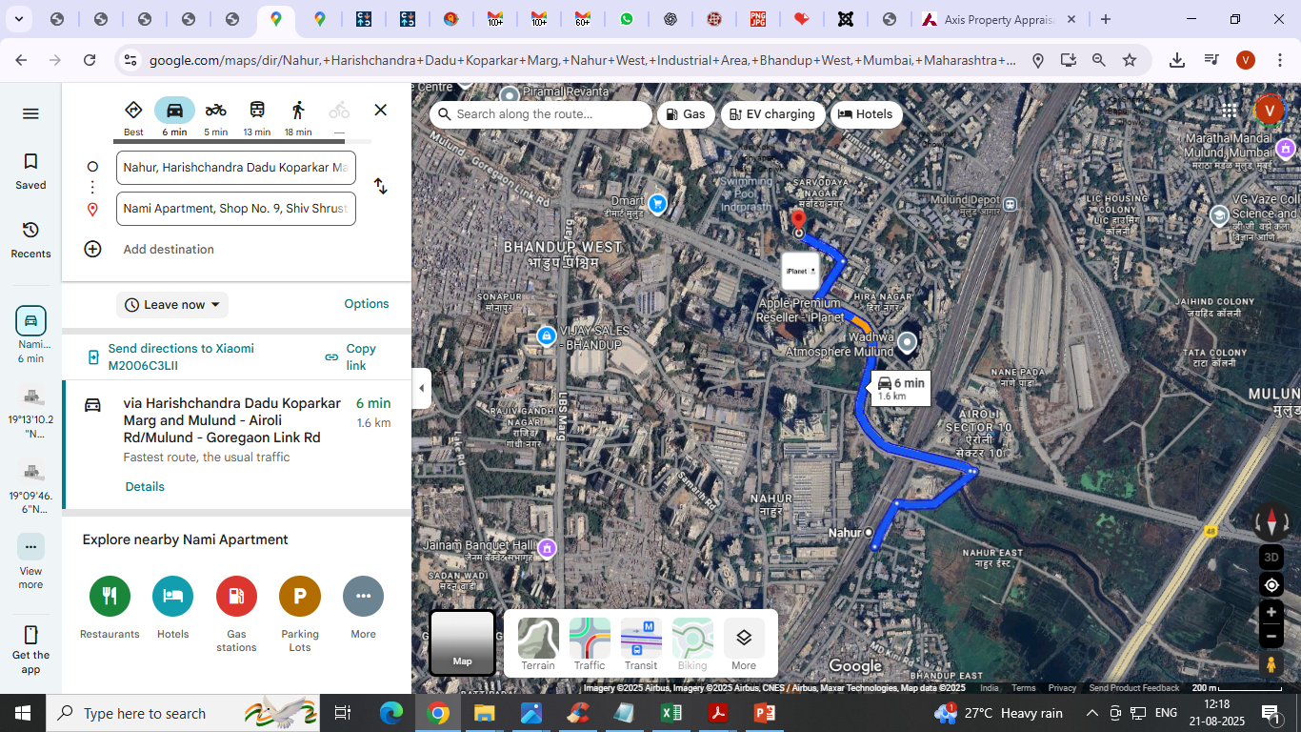
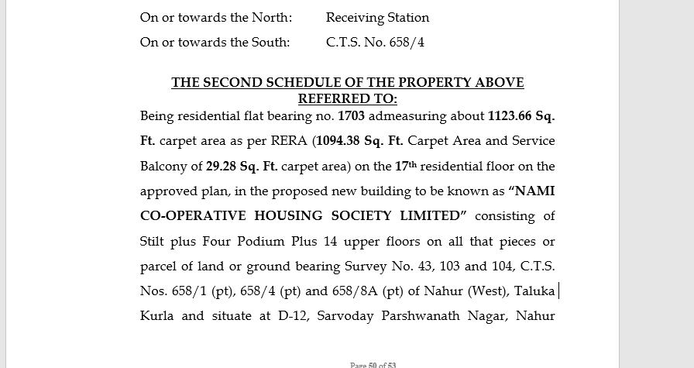
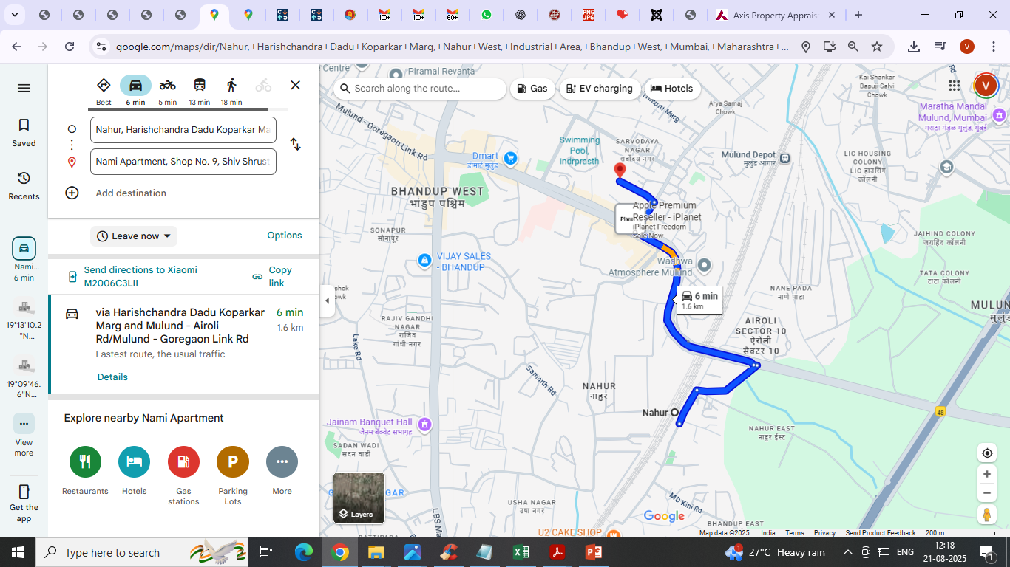
V.S.JADON & CO VALUERS LLP
PHOTOGRAPHS OF PROPERTY OF CUSTOMER: SMT SURINDER MANDER
Google Map :
VSJCVNM-BOI-RTL-JUL24-12745
Page 3

Slide 4
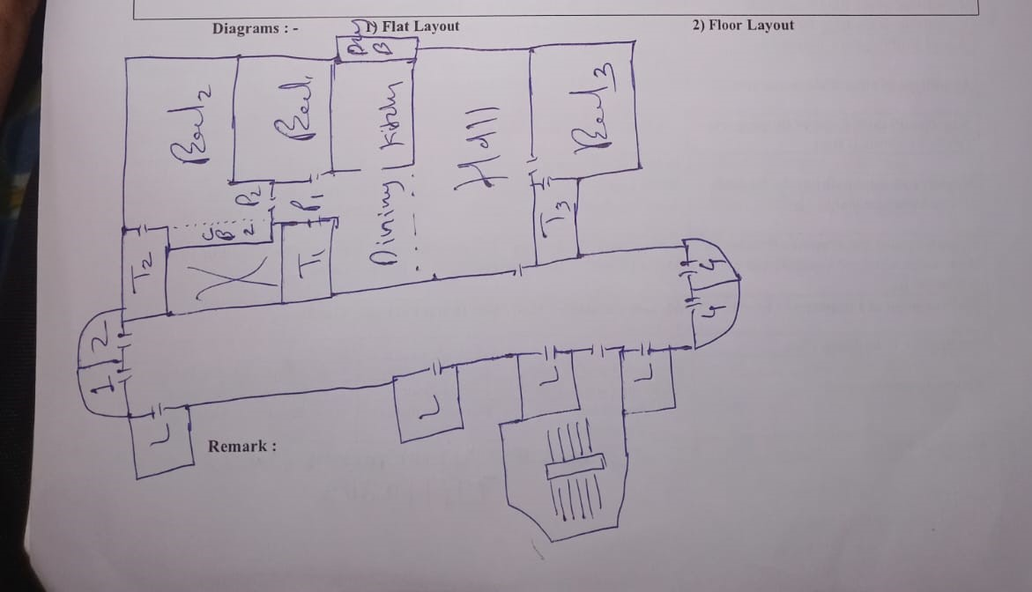
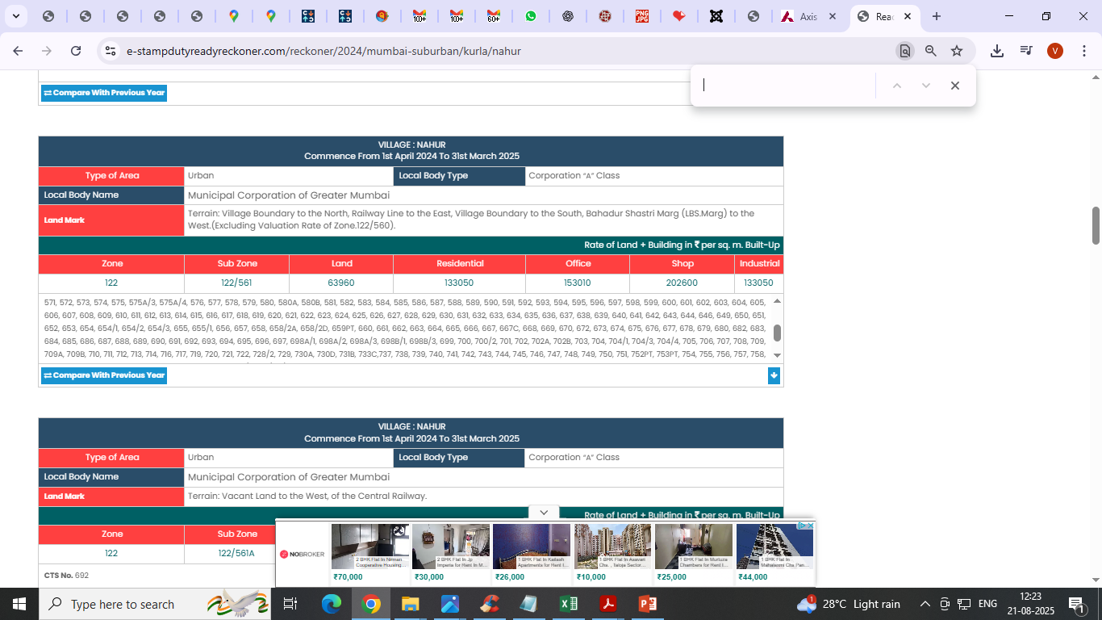
V.S.JADON & CO VALUERS LLP
PHOTOGRAPHS OF PROPERTY OF CUSTOMER SMT SURINDER MANDER
Site layout :
VSJCVNM-BOI-RTL-JUL24-12745
Page 4

Slide 5
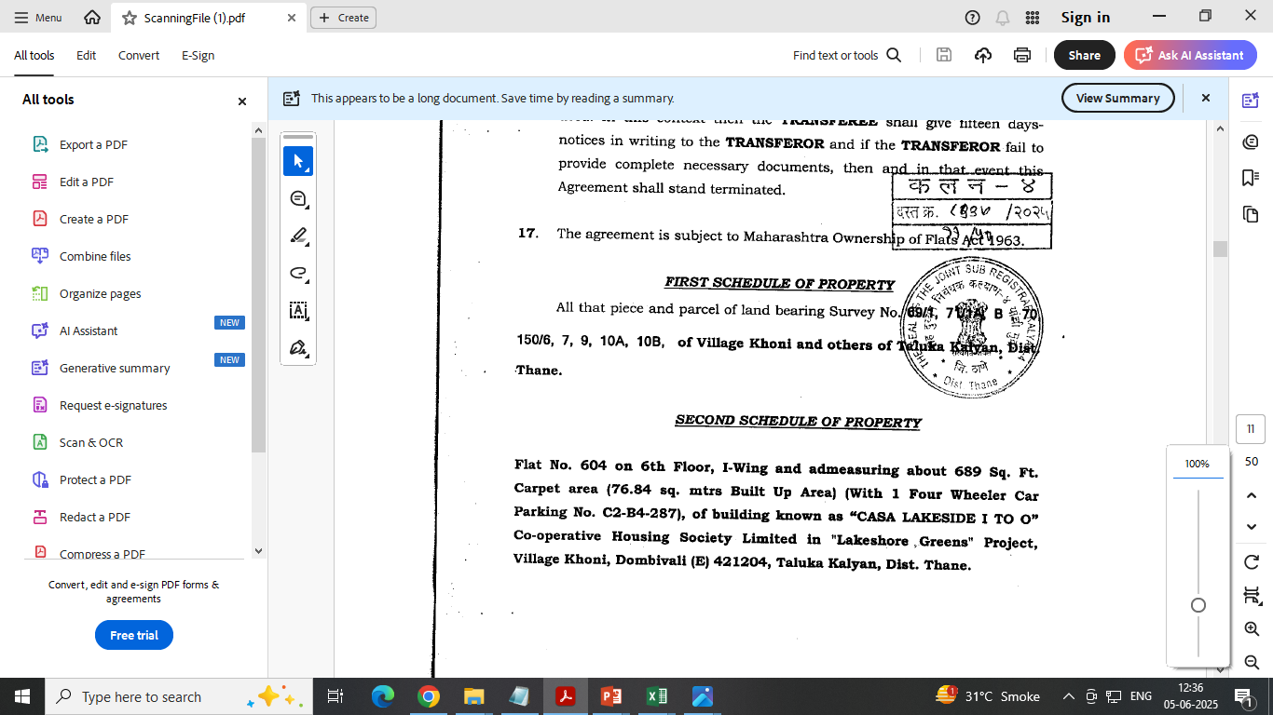
V.S.JADON & CO VALUERS LLP
PHOTOGRAPHS OF PROPERTY OF CUSTOMER SMT SURINDER MANDER
Site layout :
VSJCVNM-BOI-RTL-JUL24-12745
Page 4

