Slide 1
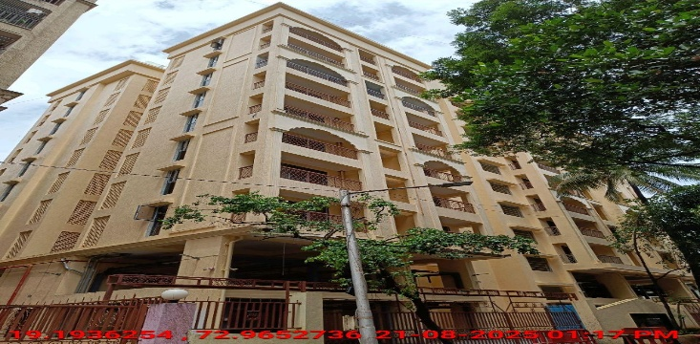
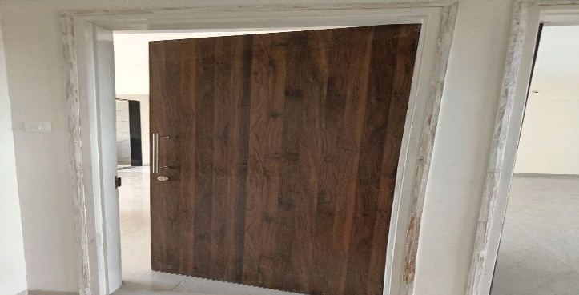
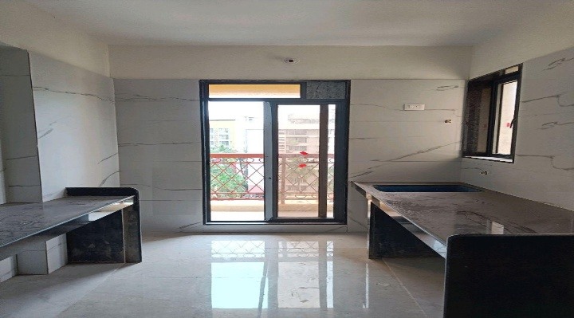
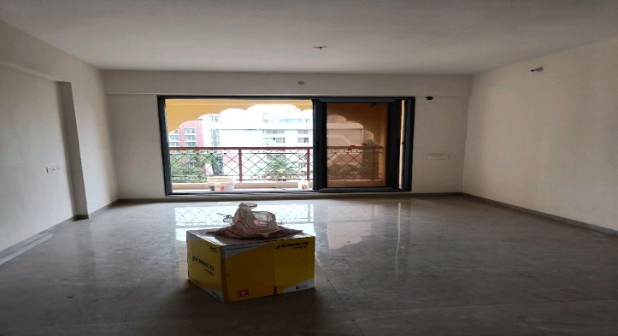
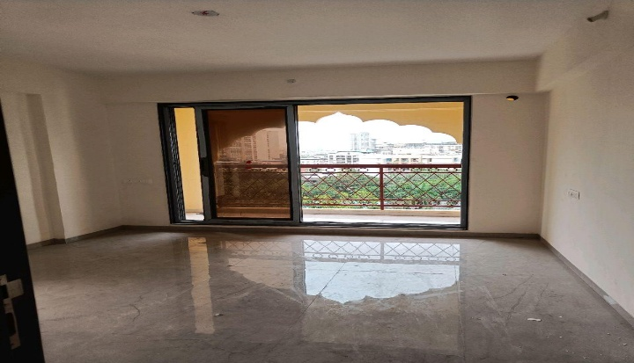
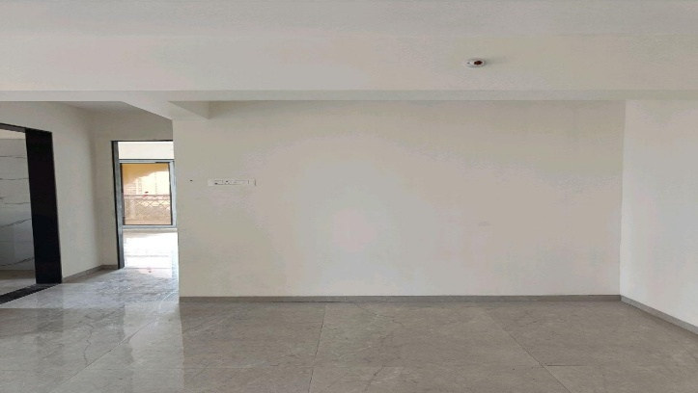
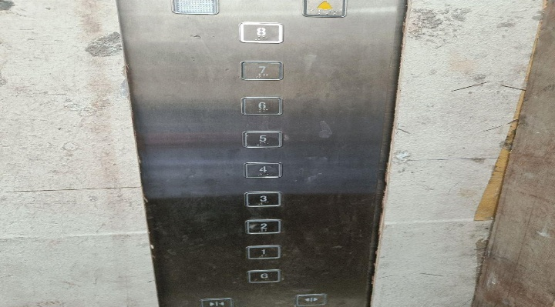
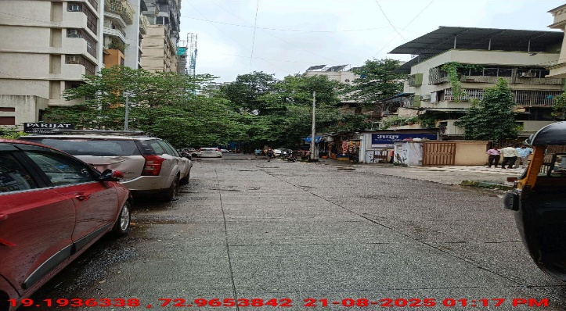
V.S.JADON & CO VALUERS LLP
PHOTOGRAPHS OF PROPERTY OF CUSTOMER: SHARDA VASTU NIRMITEE PRIVATE LIMITED
Site Photo
VSJCVNM-RBL-RTL-AUG25-18489 Page 1

Slide 2
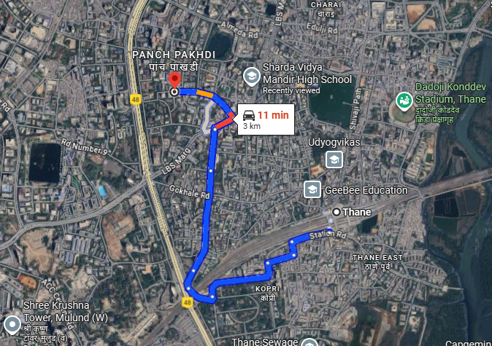
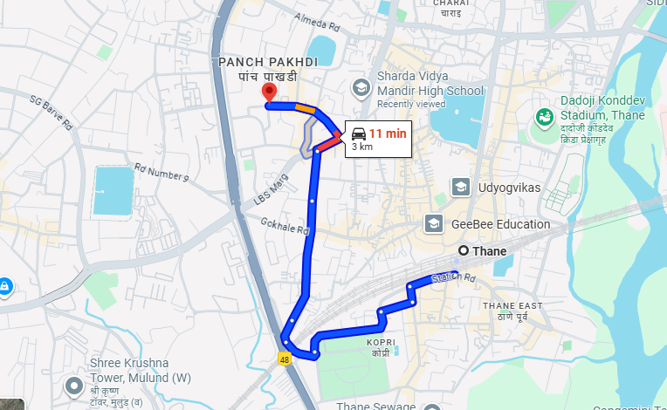
V.S.JADON & CO VALUERS LLP
PHOTOGRAPHS OF PROPERTY OF CUSTOMER: SHARDA VASTU NIRMITEE PRIVATE LIMITED
Google Map :
VSJCVNM-RBL-RTL-AUG25-18489 Page 2

Slide 3
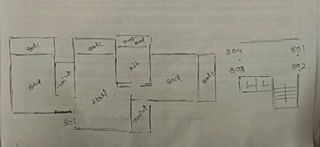
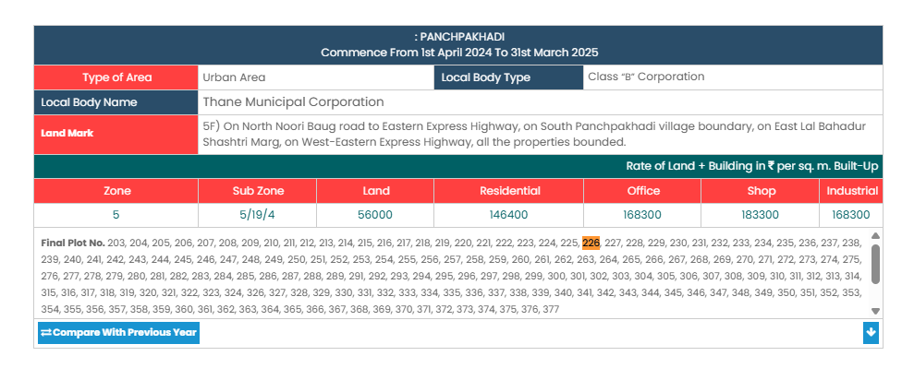
V.S.JADON & CO VALUERS LLP
PHOTOGRAPHS OF PROPERTY OF CUSTOMER: SHARDA VASTU NIRMITEE PRIVATE LIMITED
Site Layout :
VSJCVNM-RBL-RTL-AUG25-18489 Page 3

