Slide 1
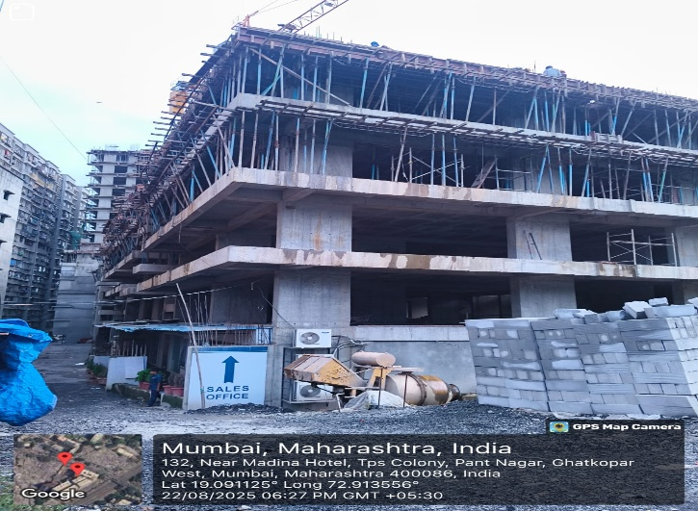
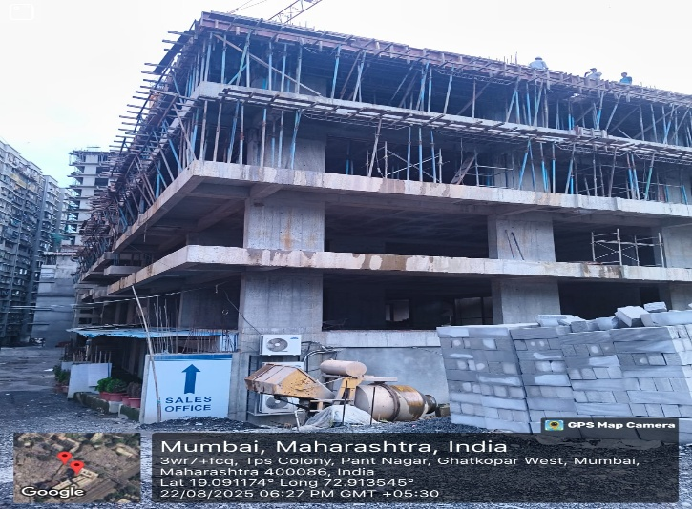
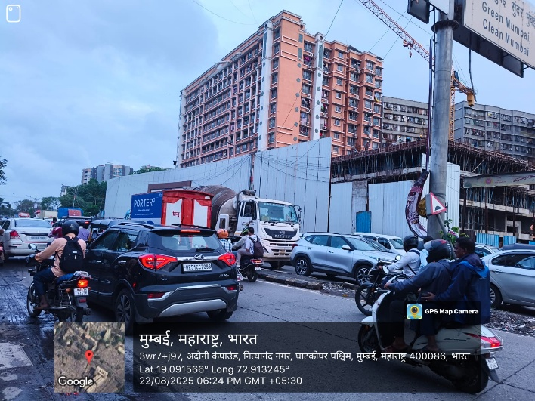
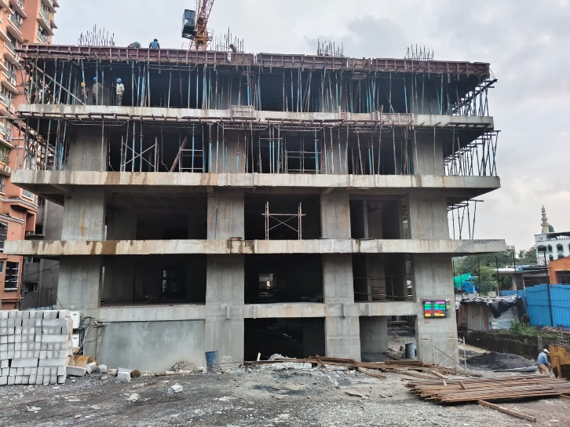
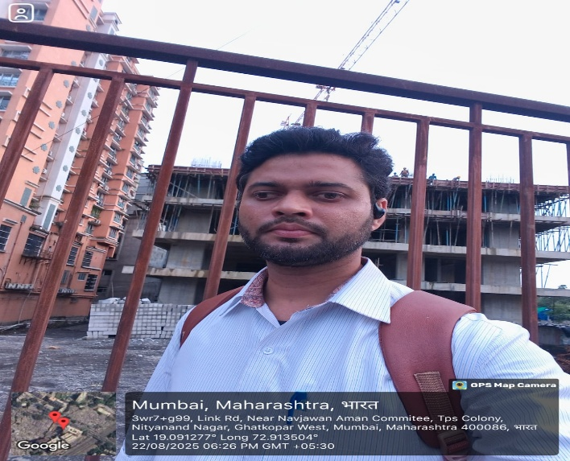
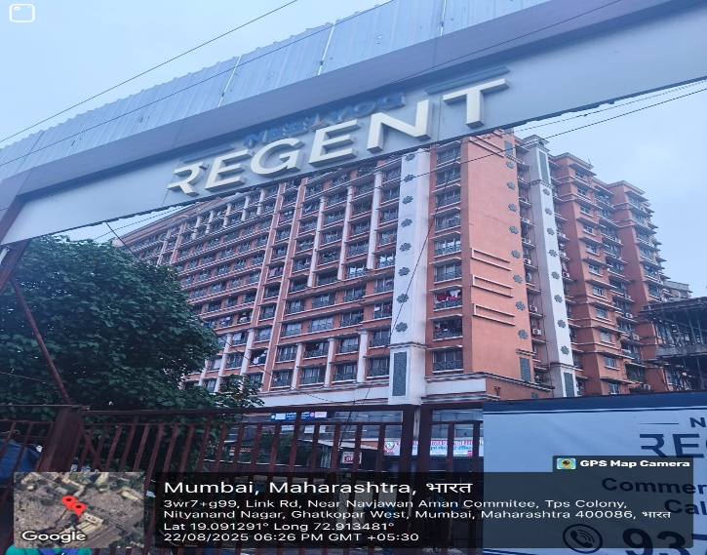
V.S.JADON & CO VALUERS LLP
PHOTOGRAPHS OF PROPERTY OF CUSTOMER SUNIL KUMAR J SINGH
VSJCVNM-PNBHFL-RTL-AUG25-18526
Page 1

Slide 2
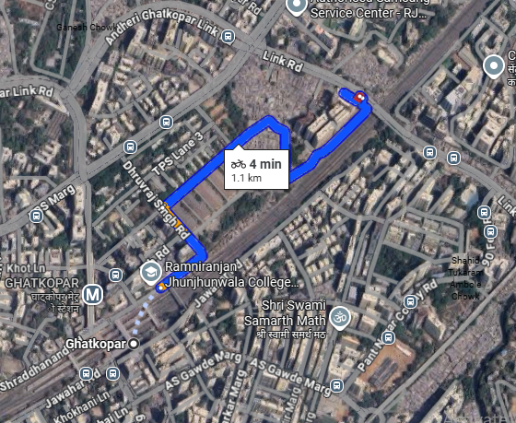
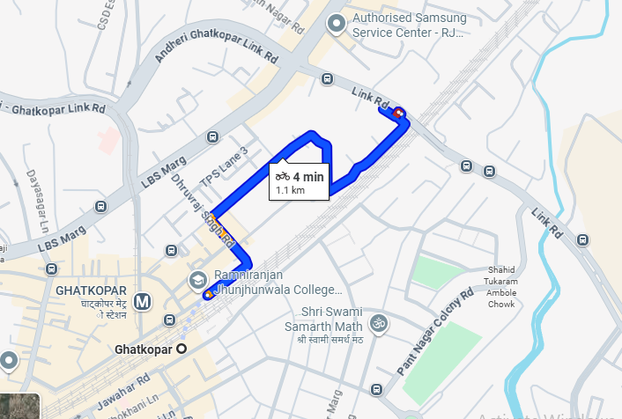
V.S.JADON & CO VALUERS LLP
PHOTOGRAPHS OF PROPERTY OF CUSTOMER : SUNIL KUMAR J SINGH
Google Map
VSJCVNM-PNBHFL-RTL-AUG25-18526
Page 3

Slide 3
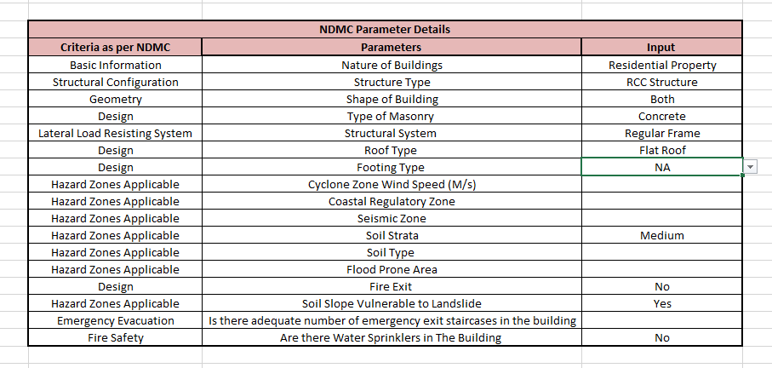
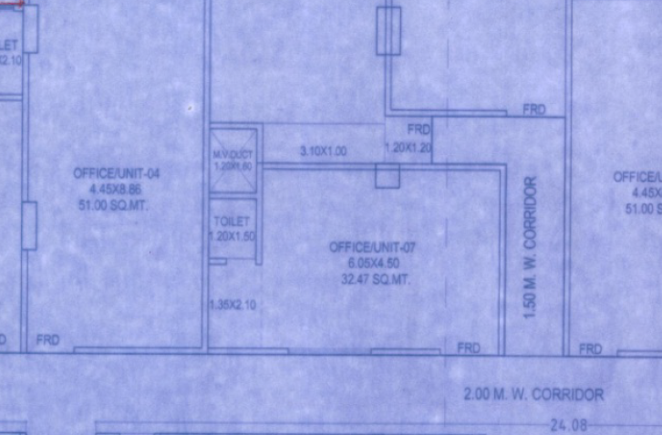
V.S.JADON & CO VALUERS LLP
PHOTOGRAPHS OF PROPERTY OF CUSTOMER Nitesh Kisan Jadhav
VSJCVNM-PNBHFL-RTL-AUG25-18526
Page 3

