Slide 1
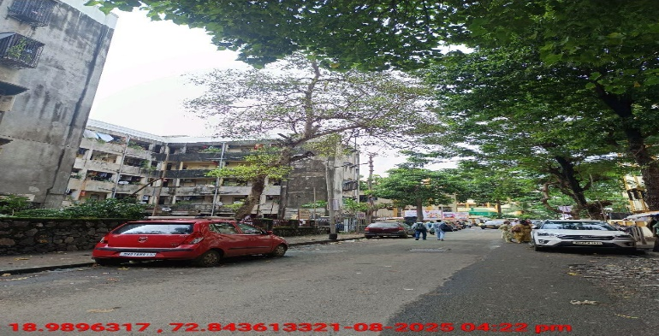
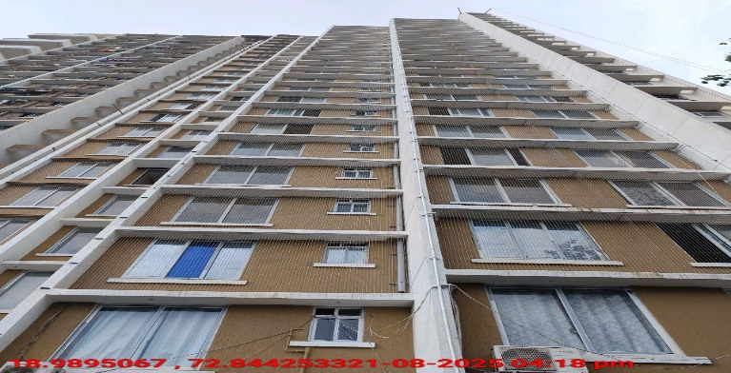
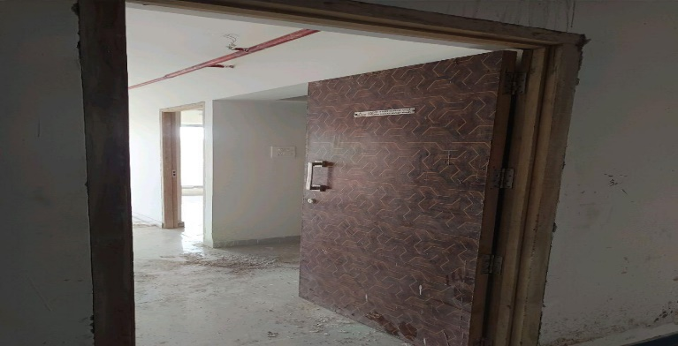
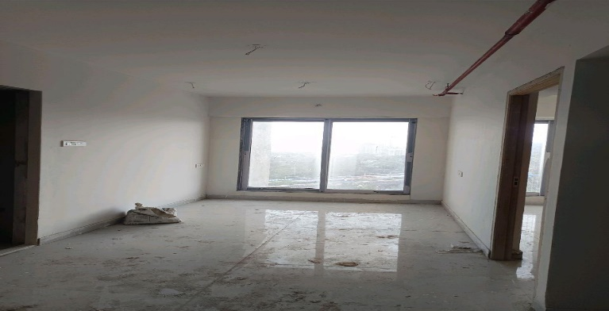
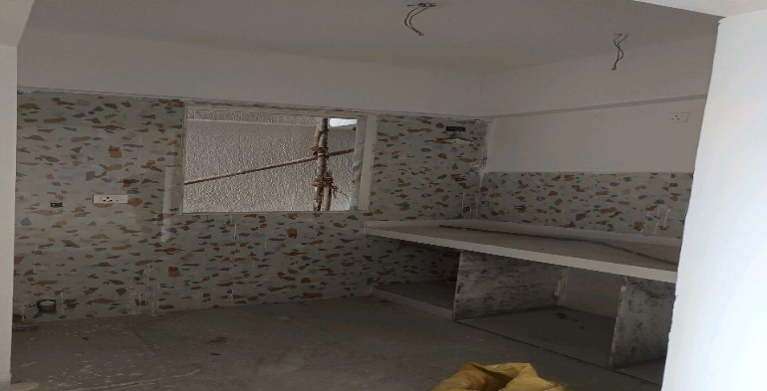
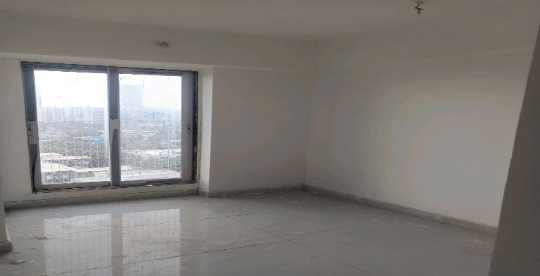
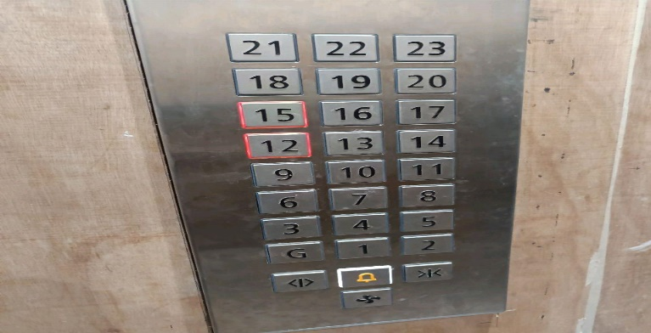
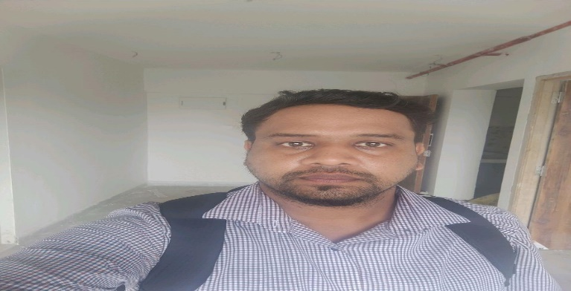
V.S.JADON & CO VALUERS LLP
PHOTOGRAPHS OF PROPERTY OF CUSTOMER:Abhijit Subhash Wagh
Site Photo
VSJCVNM-PNBHFL-RTL-AUG25-18528 Page 1

Slide 2
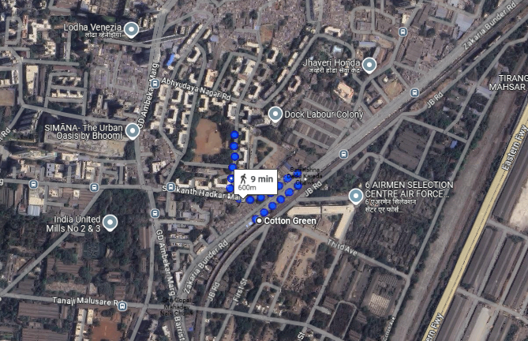
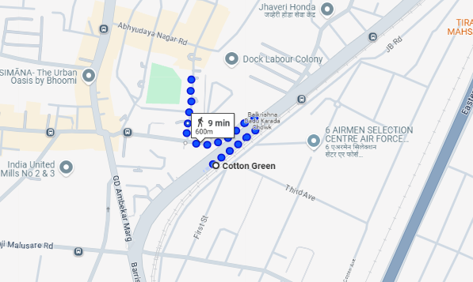
V.S.JADON & CO VALUERS LLP
PHOTOGRAPHS OF PROPERTY OF CUSTOMER: Abhijit Subhash Wagh
Google Map :
VSJCVNM-PNBHFL-RTL-AUG25-18528 Page 3

Slide 3
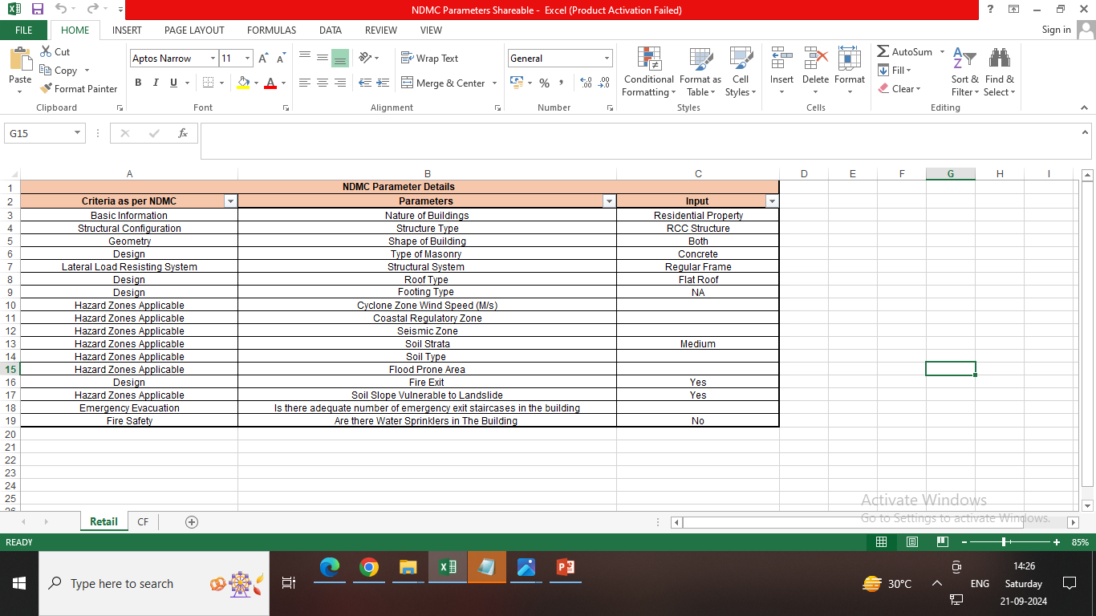
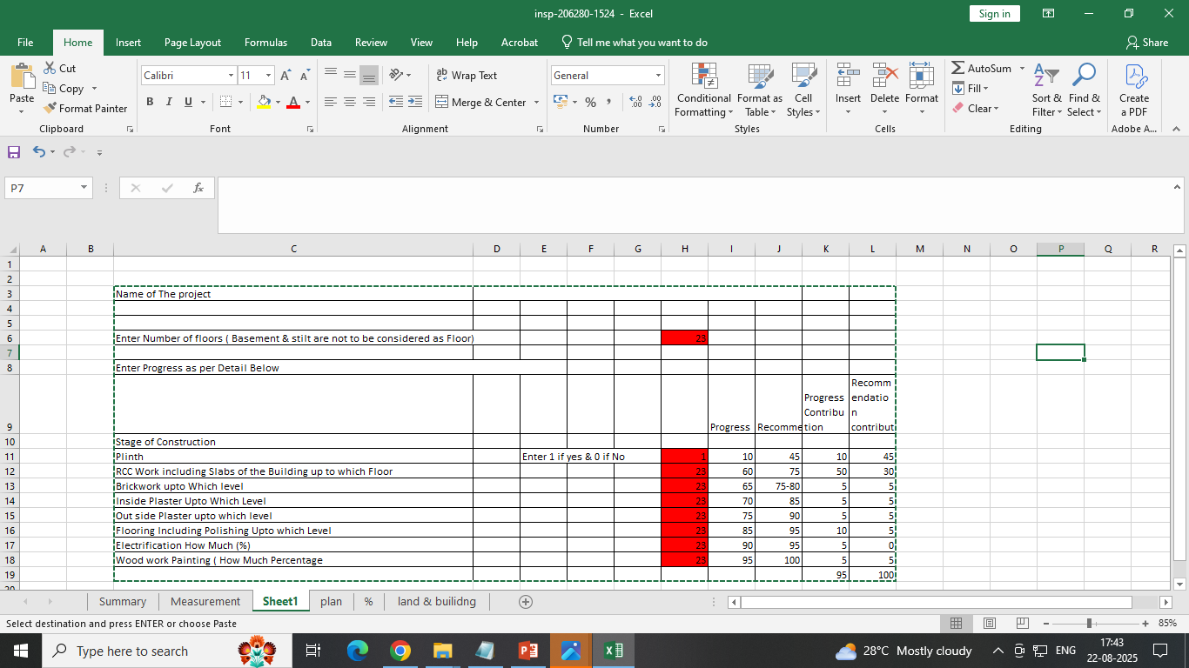
V.S.JADON & CO VALUERS LLP
PHOTOGRAPHS OF PROPERTY OF CUSTOMER Abhijit Subhash Wagh
Site layout :
VSJCVNM-PNBHFL-RTL-AUG25-18528 Page 3

