Slide 1
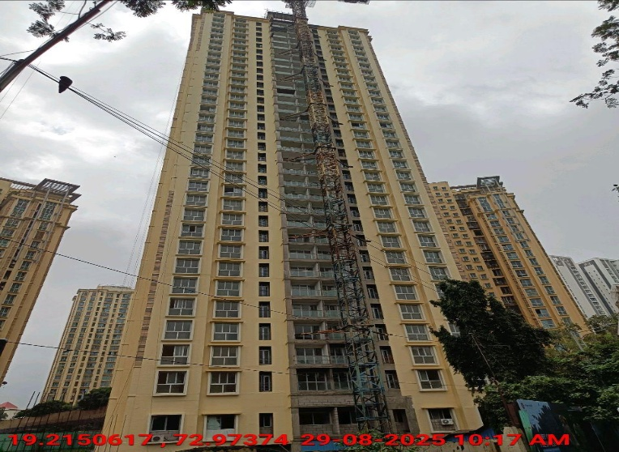
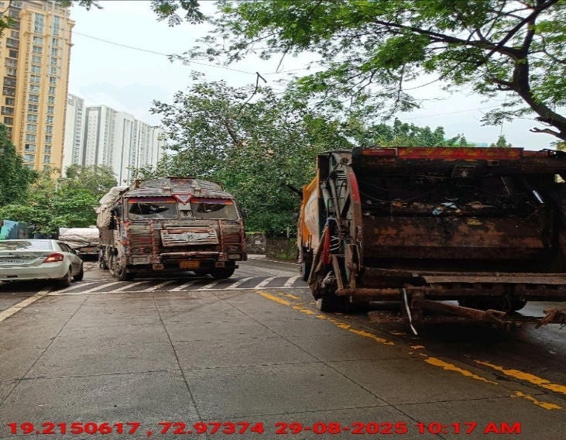
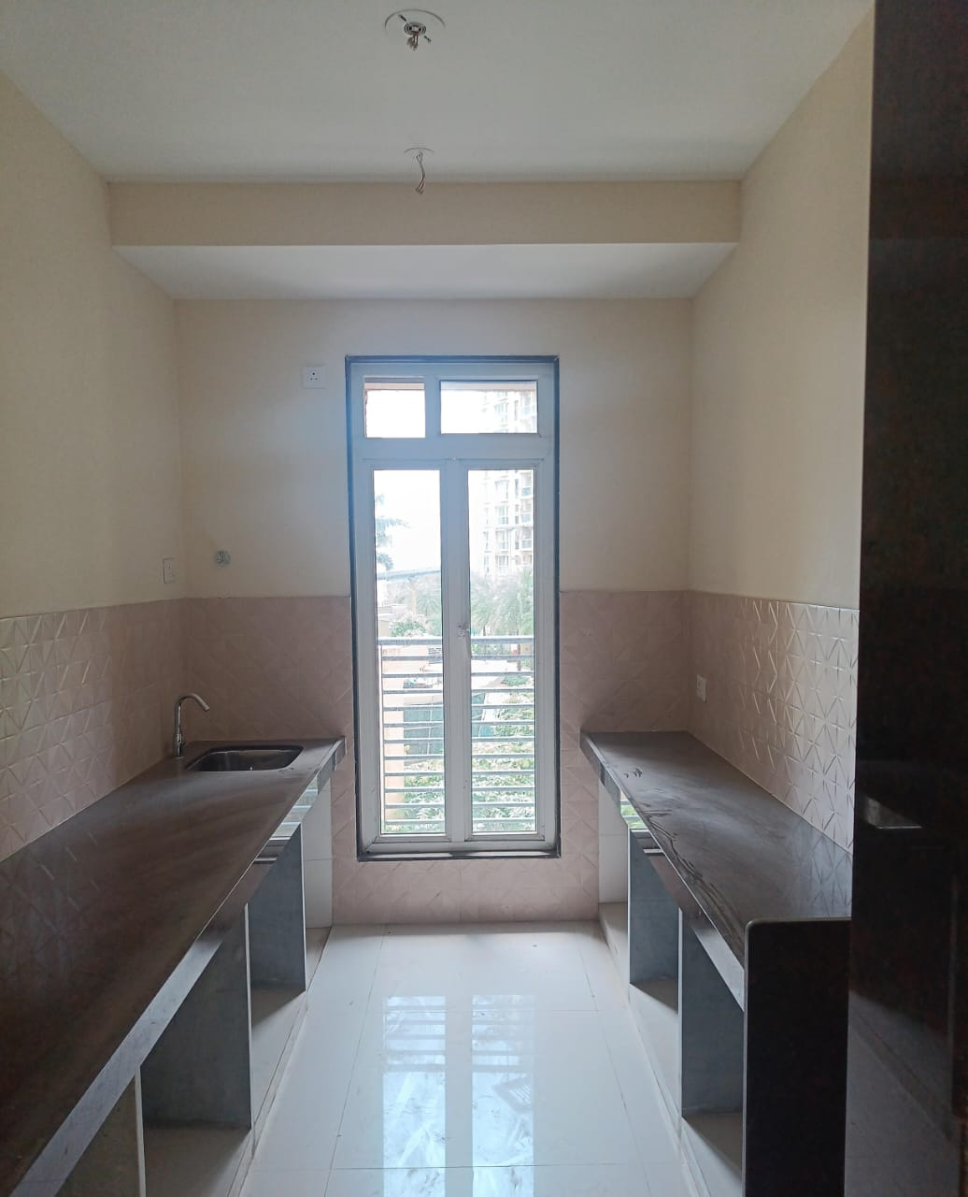
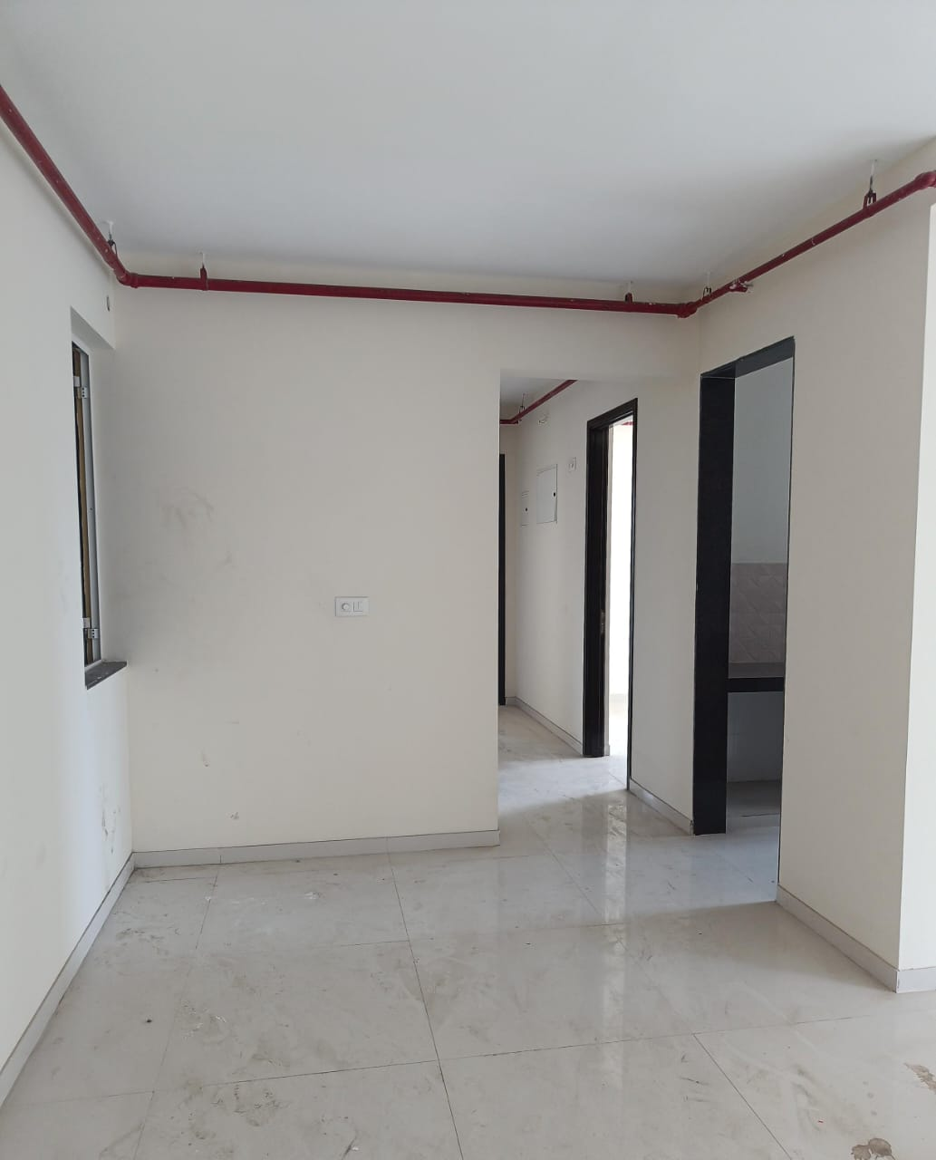
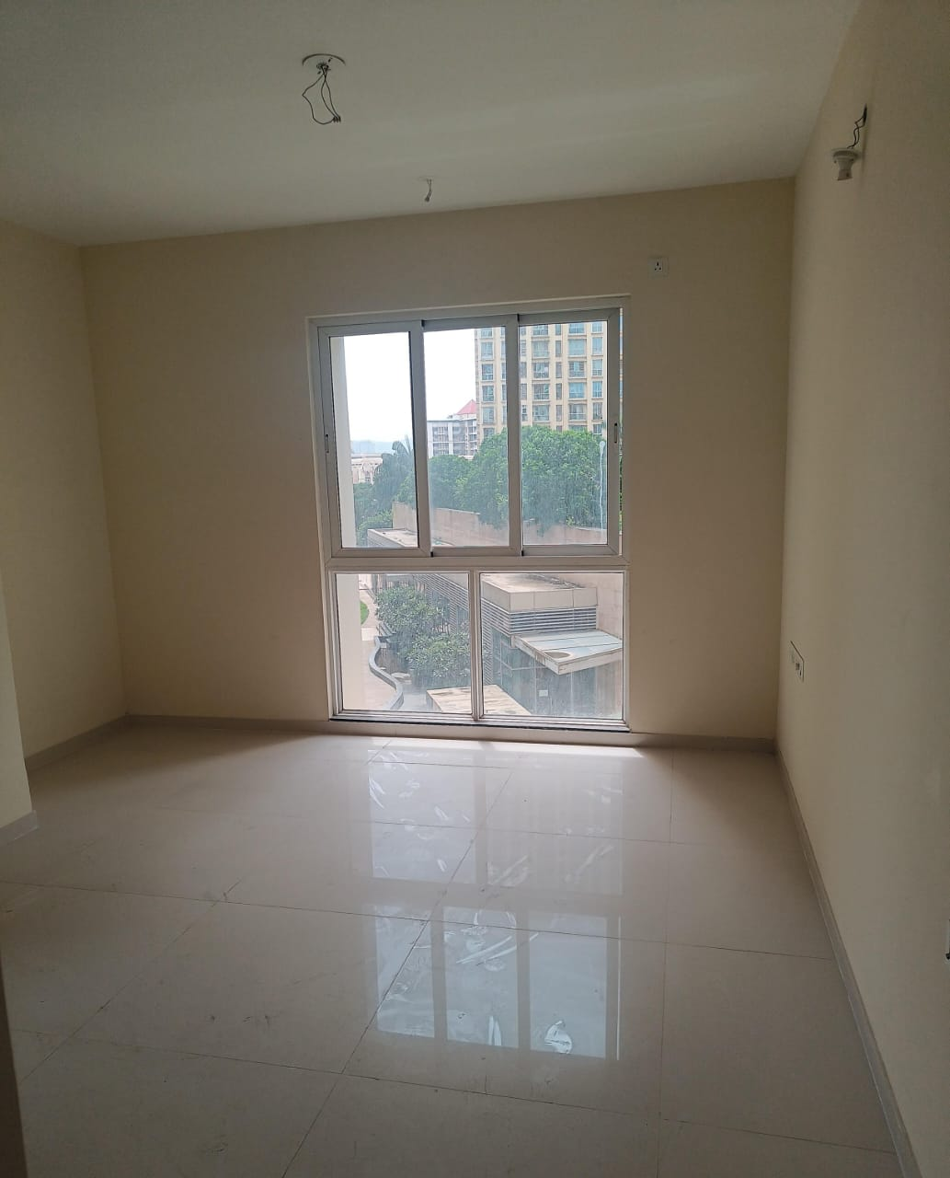
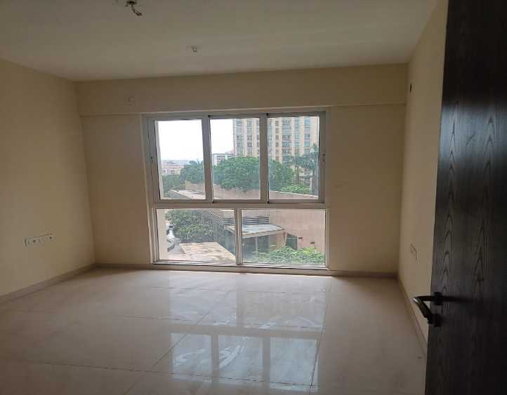
V.S.JADON & CO VALUERS LLP
Site Photo
PHOTOGRAPHS OF PROPERTY OF CUSTOMER Vishal Sudhakar Adawadkar
VSJCVNM-AXIS-RTL-AUG25-19201 Page 1

Slide 2
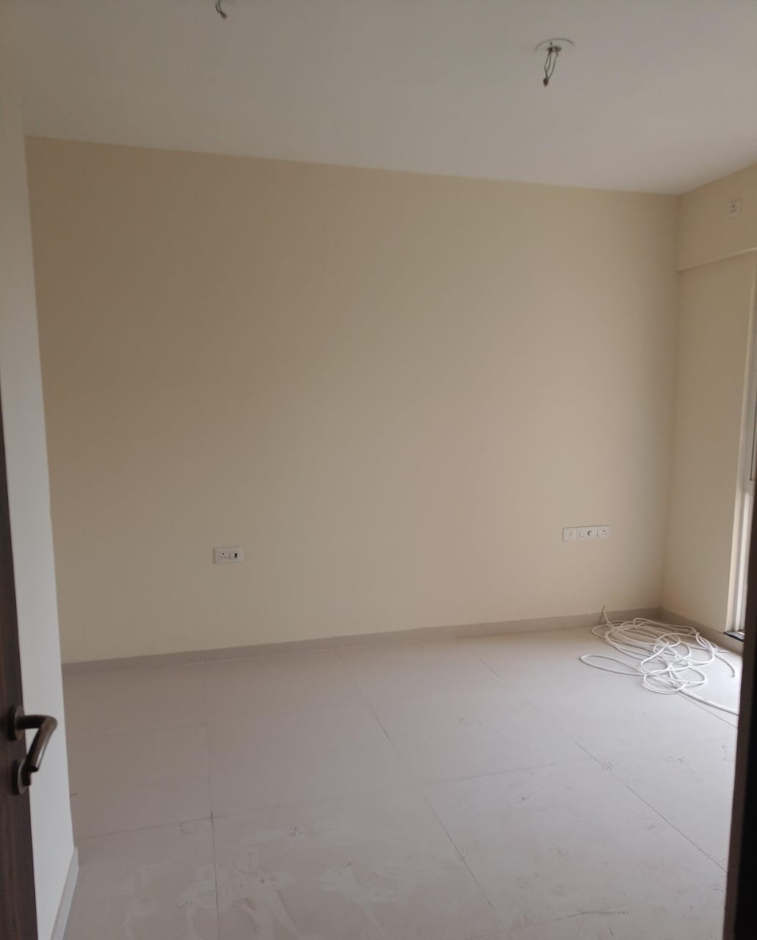
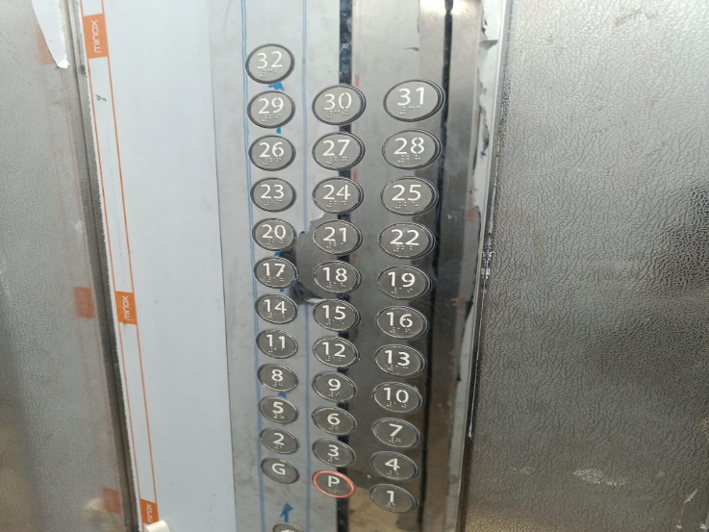

V.S.JADON & CO VALUERS LLP
Site Photo
PHOTOGRAPHS OF PROPERTY OF CUSTOMER Vishal Sudhakar Adawadkar
VSJCVNM-AXIS-RTL-AUG25-19201 Page 2

Slide 3
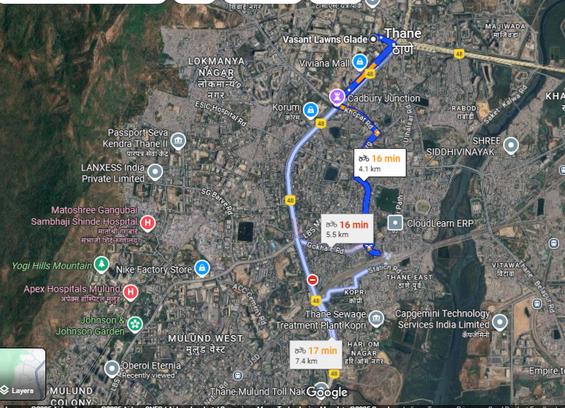
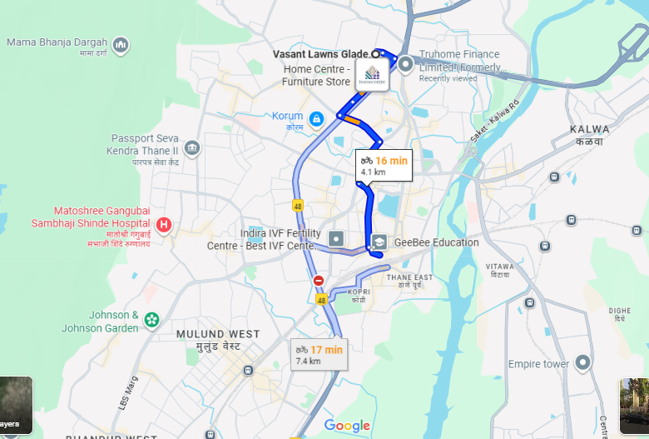
V.S.JADON & CO VALUERS LLP
PHOTOGRAPHS OF PROPERTY OF CUSTOMER: Vishal Sudhakar Adawadkar
Google Maps :
VSJCVNM-AXIS-RTL-AUG25-19201 Page 2

Slide 4
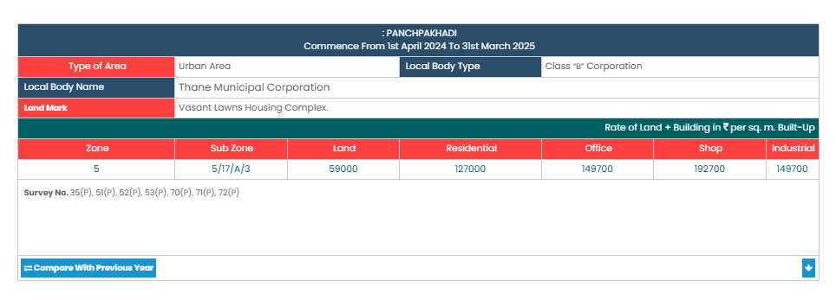
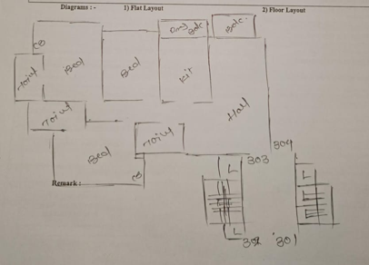
V.S.JADON & CO VALUERS LLP
PHOTOGRAPHS OF PROPERTY OF CUSTOMER: Vishal Sudhakar Adawadkar
Govt rate :
VSJCVNM-AXIS-RTL-AUG25-19201 Page 4

