Slide 1
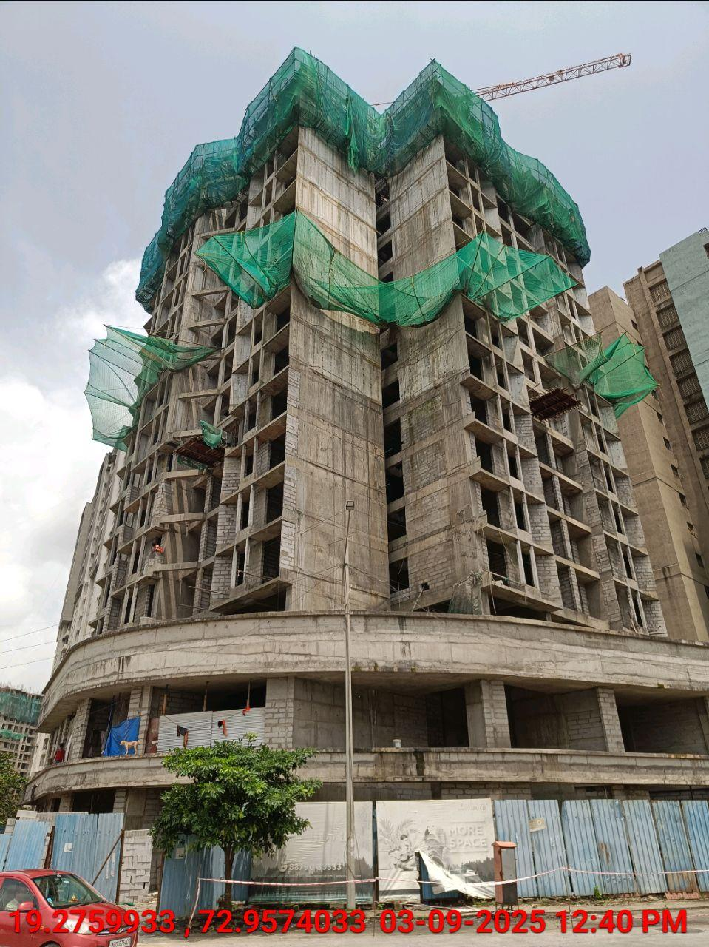
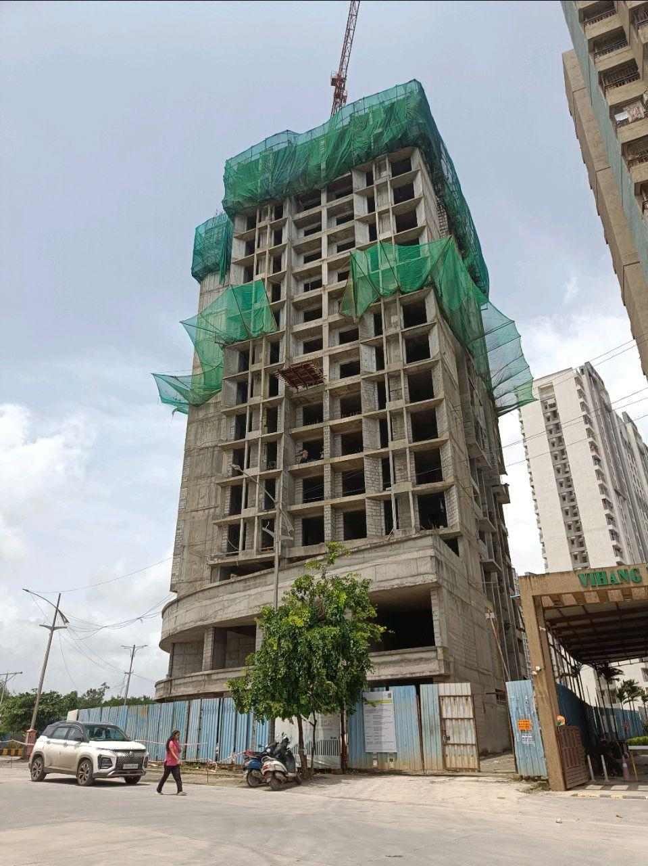
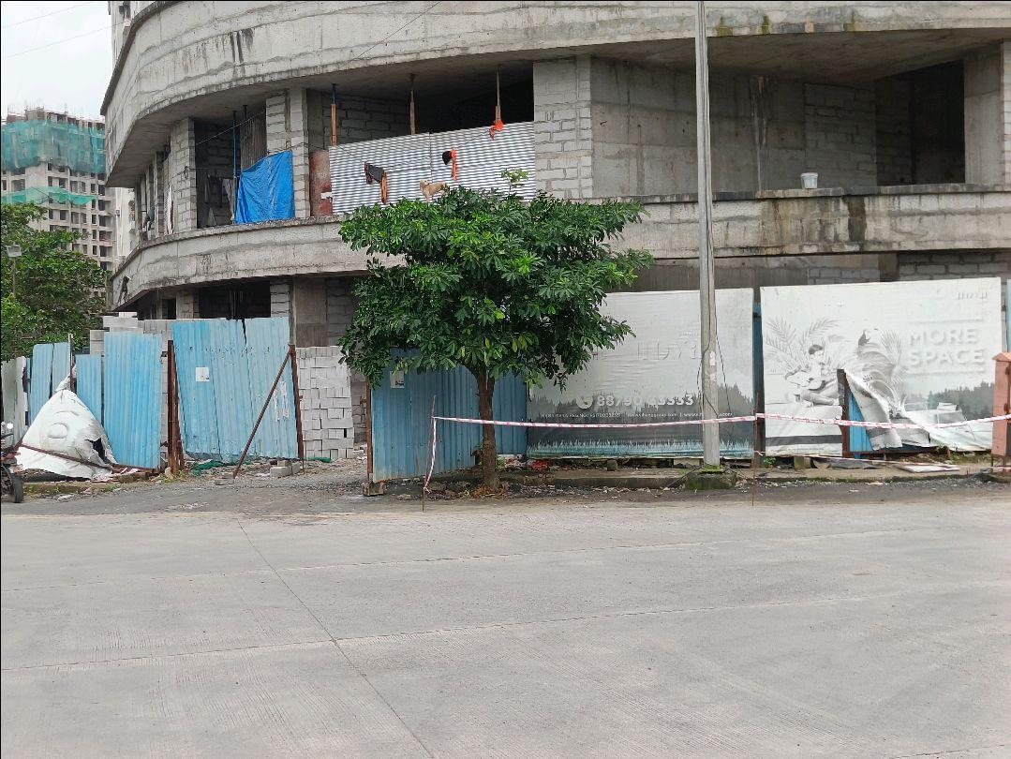
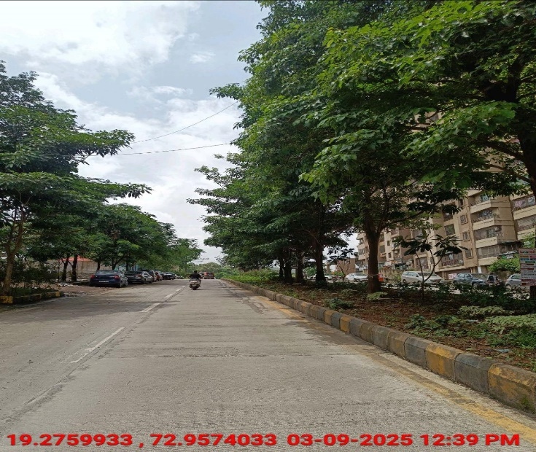
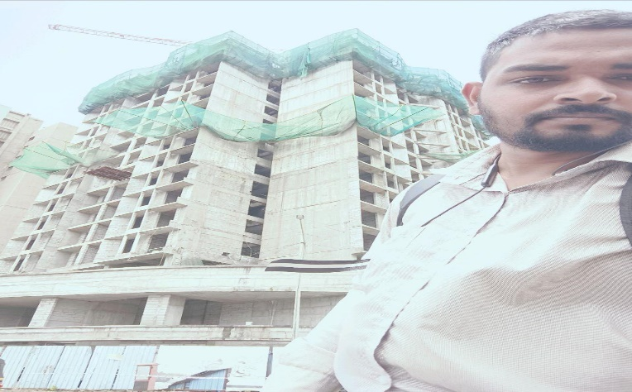
V.S.JADON & CO VALUERS LLP
PHOTOGRAPHS OF PROPERTY OF CUSTOMER: MR. SANDIP GHOSH.
VSJCVNM-RBL-RTL-SEP25-19461 Page 6

Slide 2
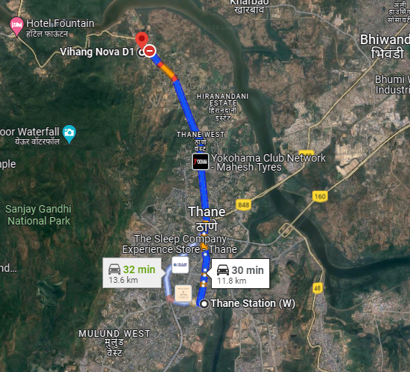
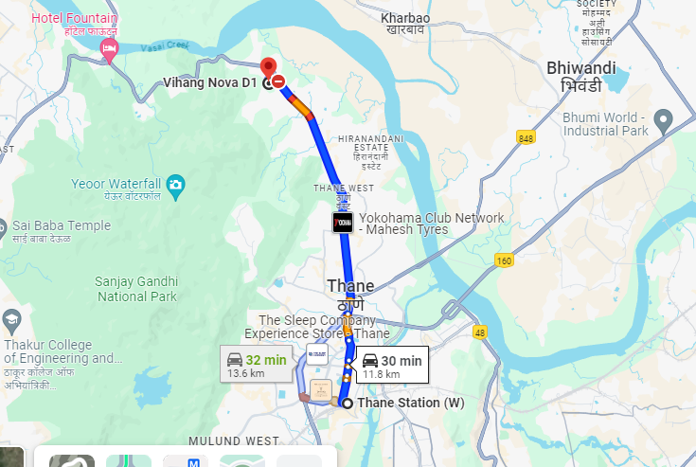
V.S.JADON & CO VALUERS LLP
PHOTOGRAPHS OF PROPERTY OF CUSTOMER MR. SANDIP GHOSH.
Google Map
VSJCVNM-RBL-RTL-SEP25-19461 Page 7

Slide 3
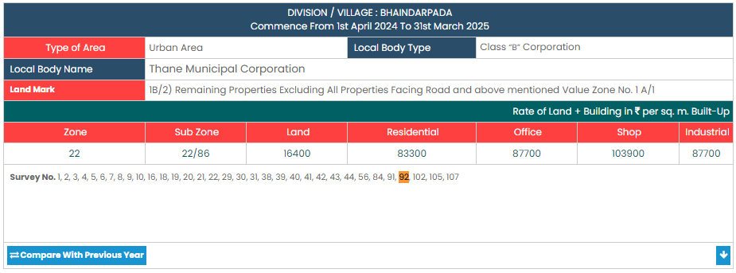
V.S.JADON & CO VALUERS LLP
PHOTOGRAPHS OF PROPERTY OF CUSTOMER MR. SANDIP GHOSH.
Gov Rate
VSJCVNM-RBL-RTL-SEP25-19461 Page 8

