Slide 1
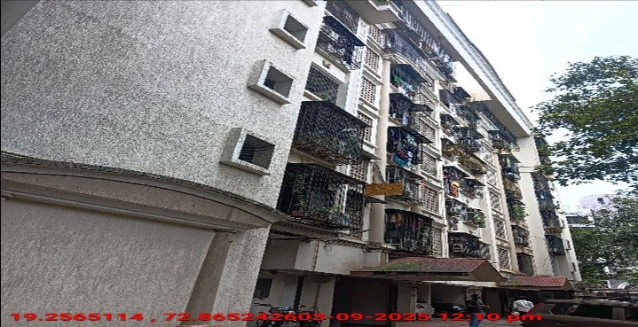
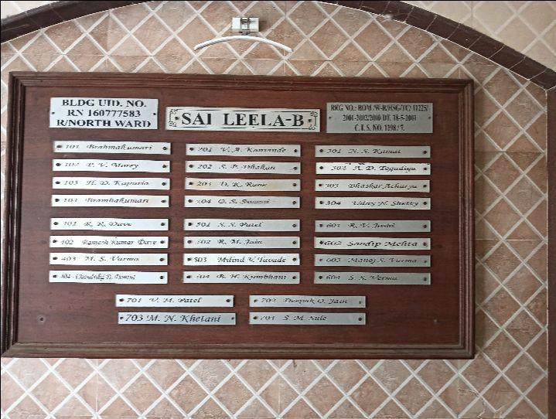
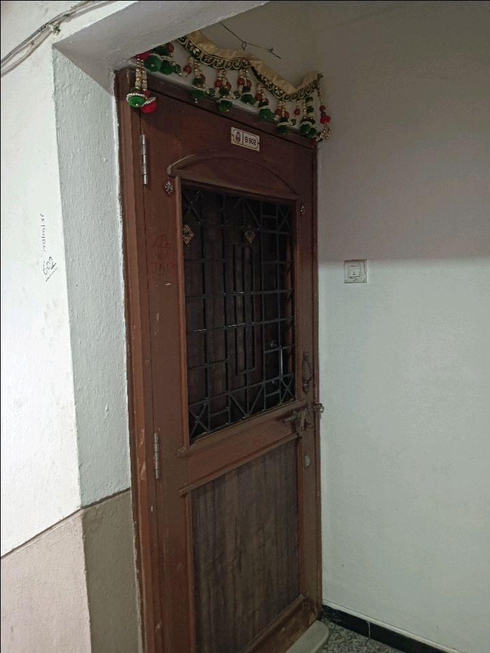
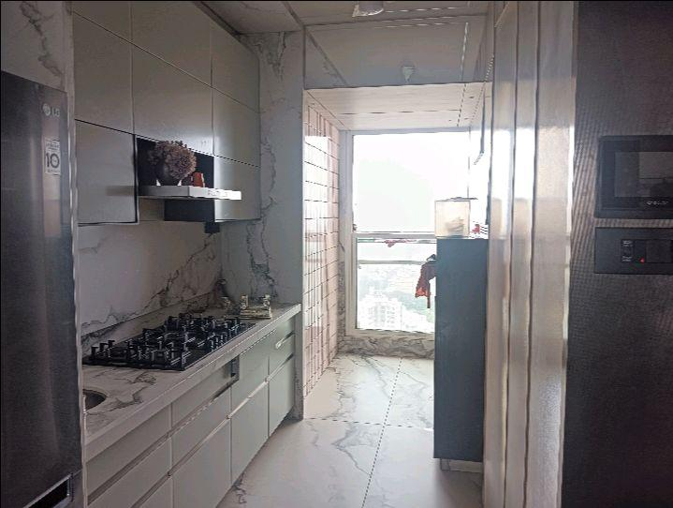
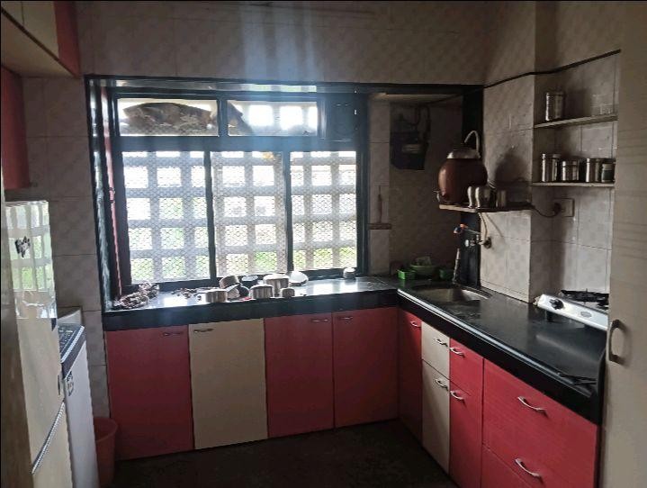
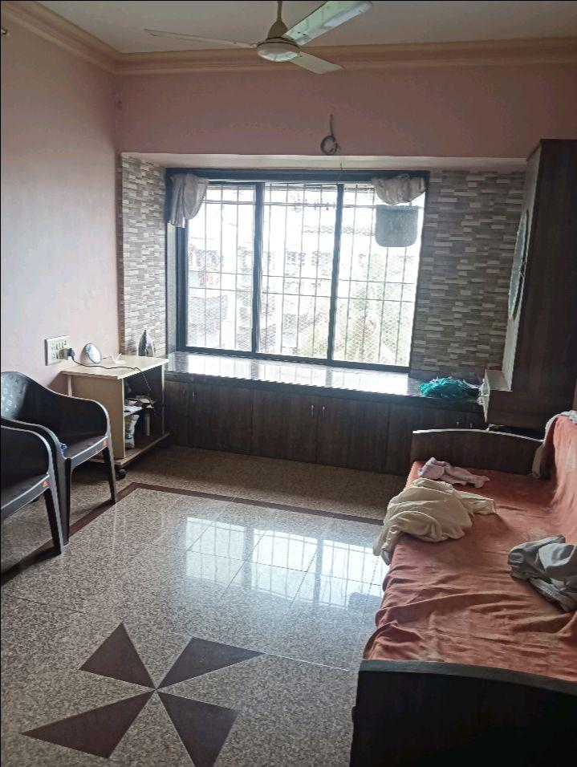
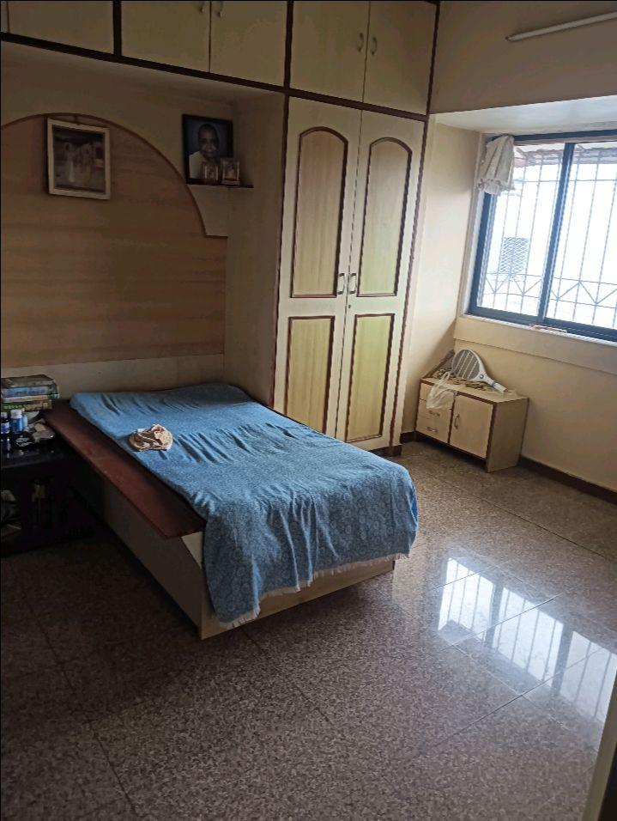
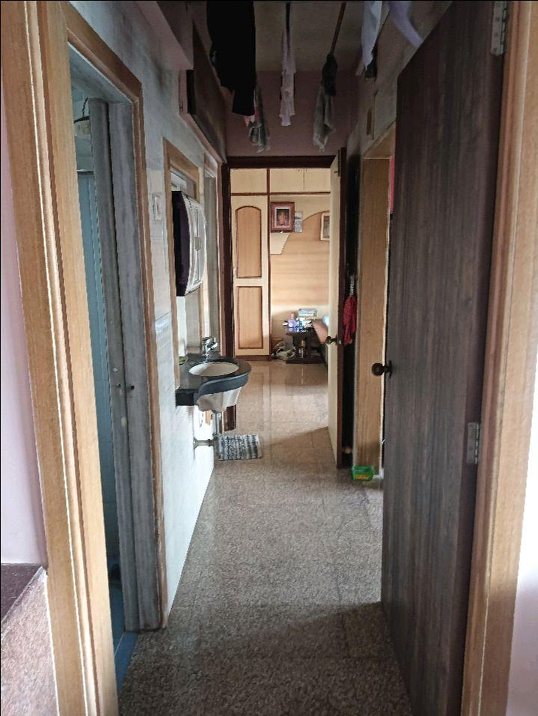
V.S.JADON & CO VALUERS LLP
PHOTOGRAPHS OF PROPERTY OF CUSTOMER: Shagun Chem
Site Photo
VSJCVNM-RBL-RTL-SEP25-19532 Page 1

Slide 2

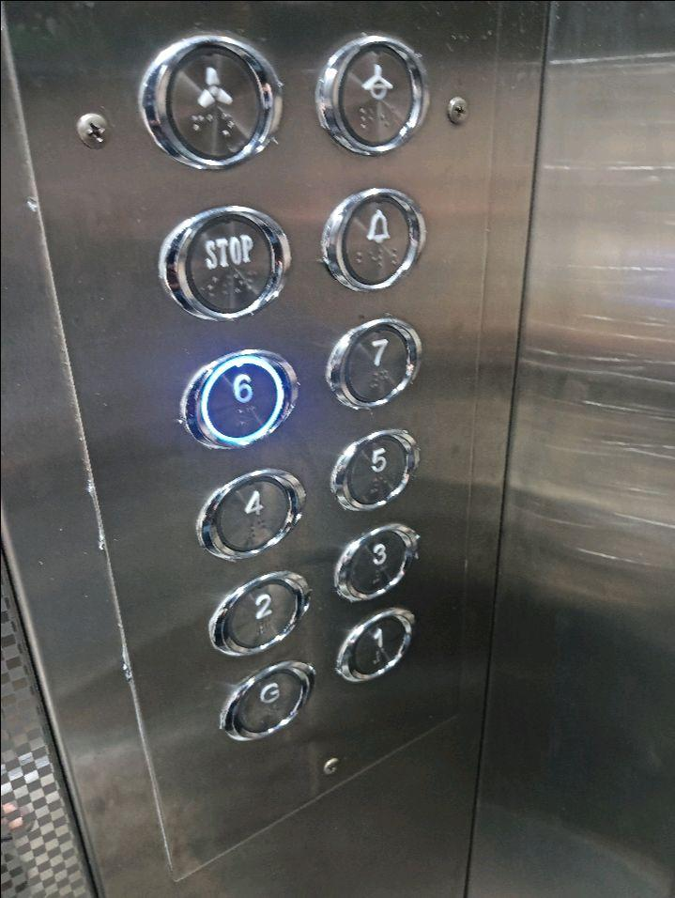
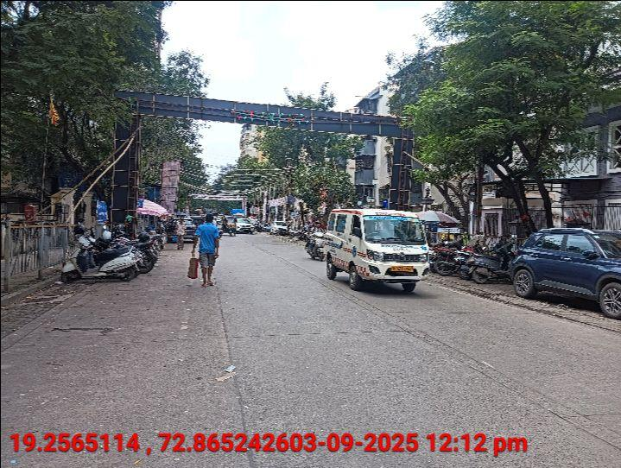
V.S.JADON & CO VALUERS LLP
PHOTOGRAPHS OF PROPERTY OF CUSTOMER: Shagun Chem
Site Photo
VSJCVNM-RBL-RTL-SEP25-19532 Page 2

Slide 3
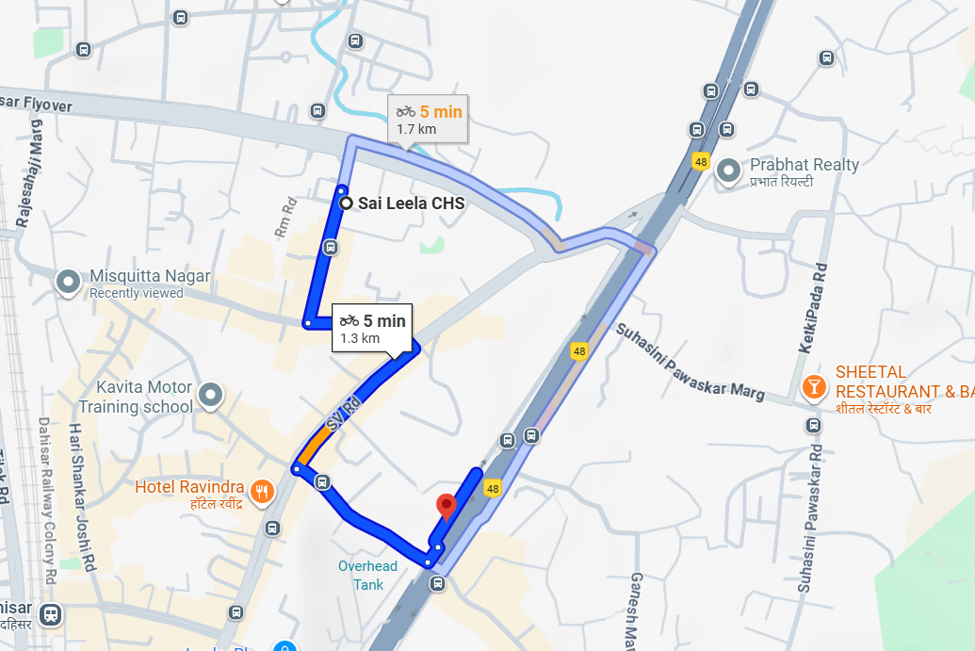
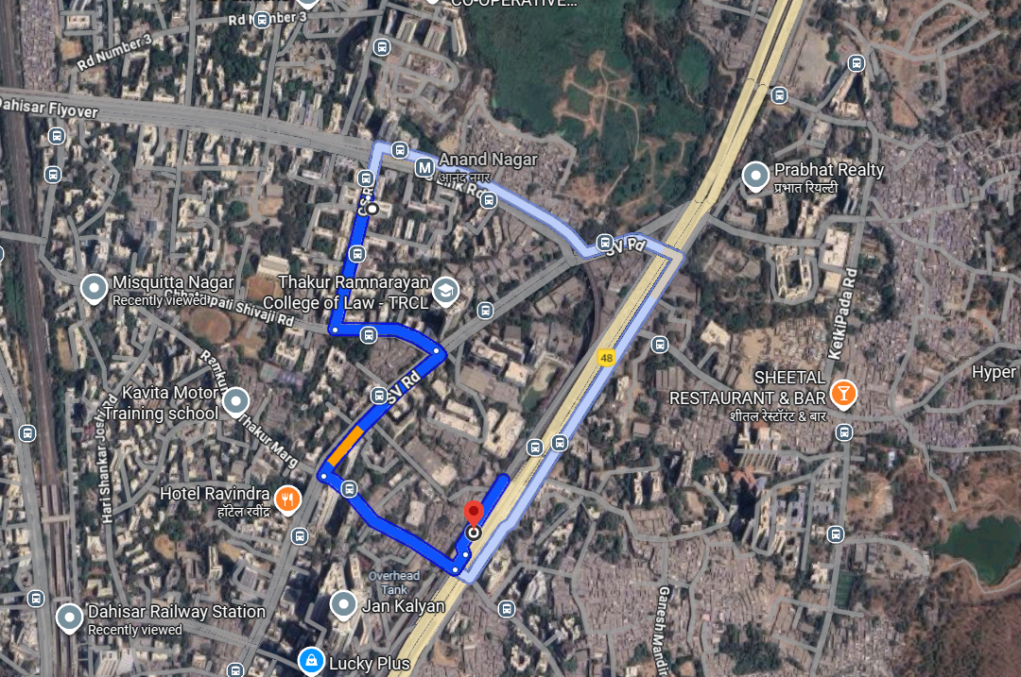
V.S.JADON & CO VALUERS LLP
PHOTOGRAPHS OF PROPERTY OF CUSTOMER: Shagun Chem.
Google Map :
VSJCVNM-RBL-RTL-SEP25-19532 Page 3

Slide 4
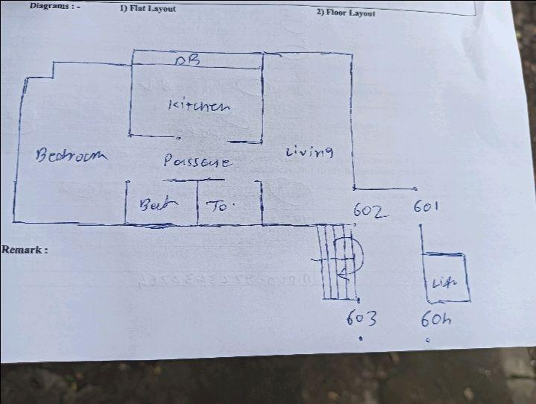
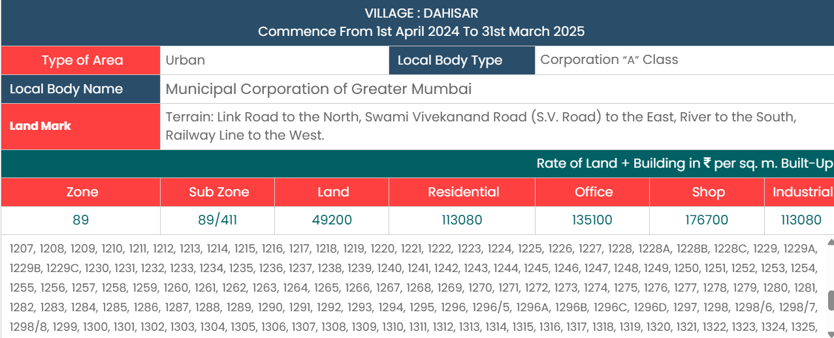
V.S.JADON & CO VALUERS LLP
PHOTOGRAPHS OF PROPERTY OF CUSTOMER: Shagun Chem.
Site Layout :
VSJCVNM-RBL-RTL-SEP25-19532
Page 4

