Slide 1
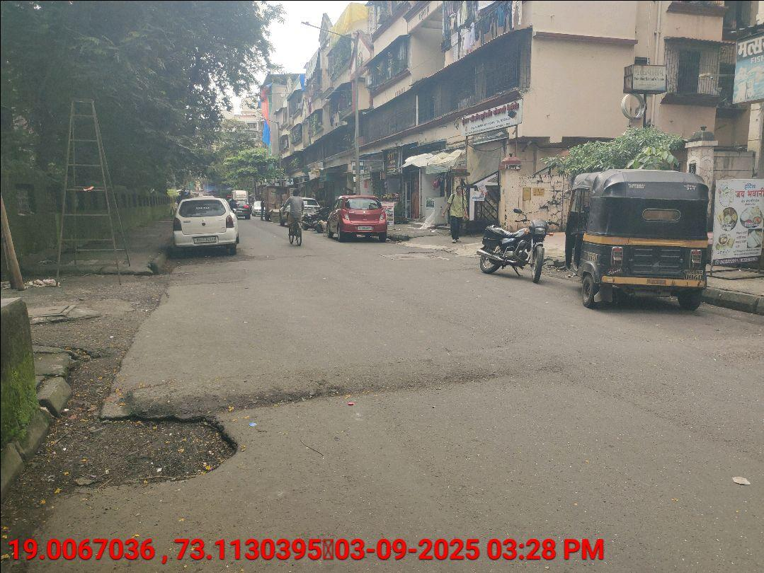
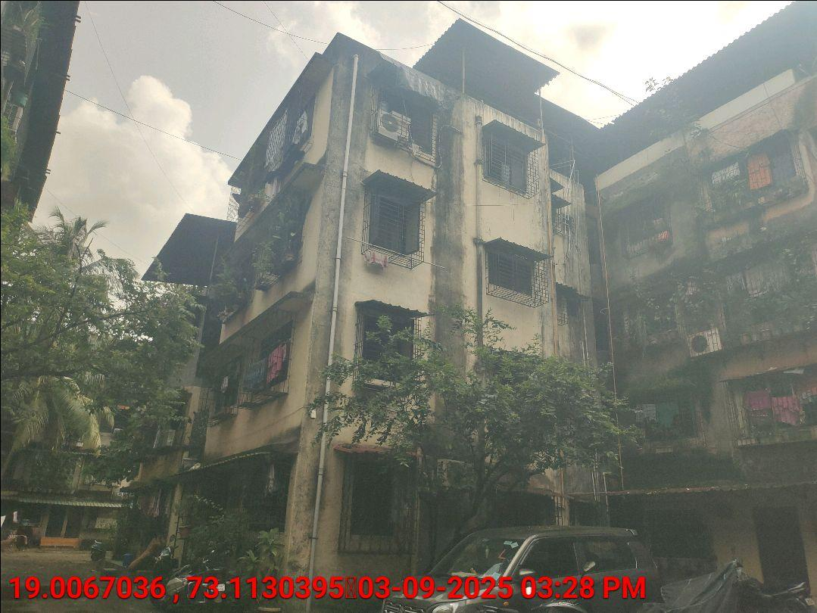
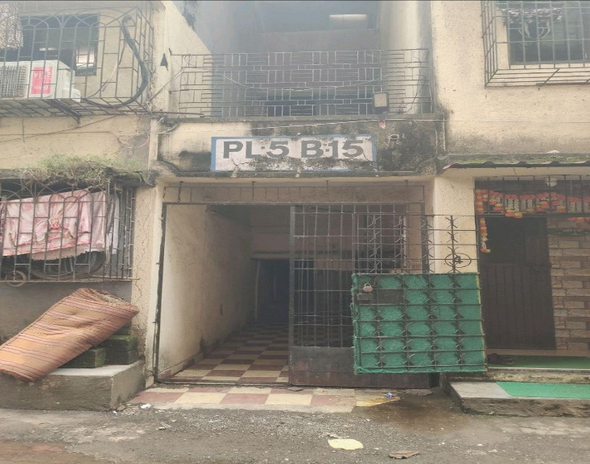
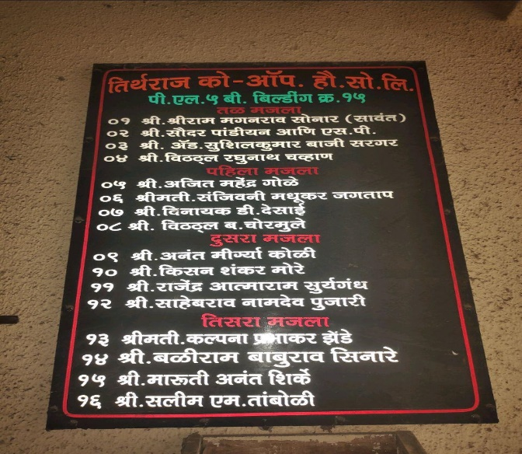
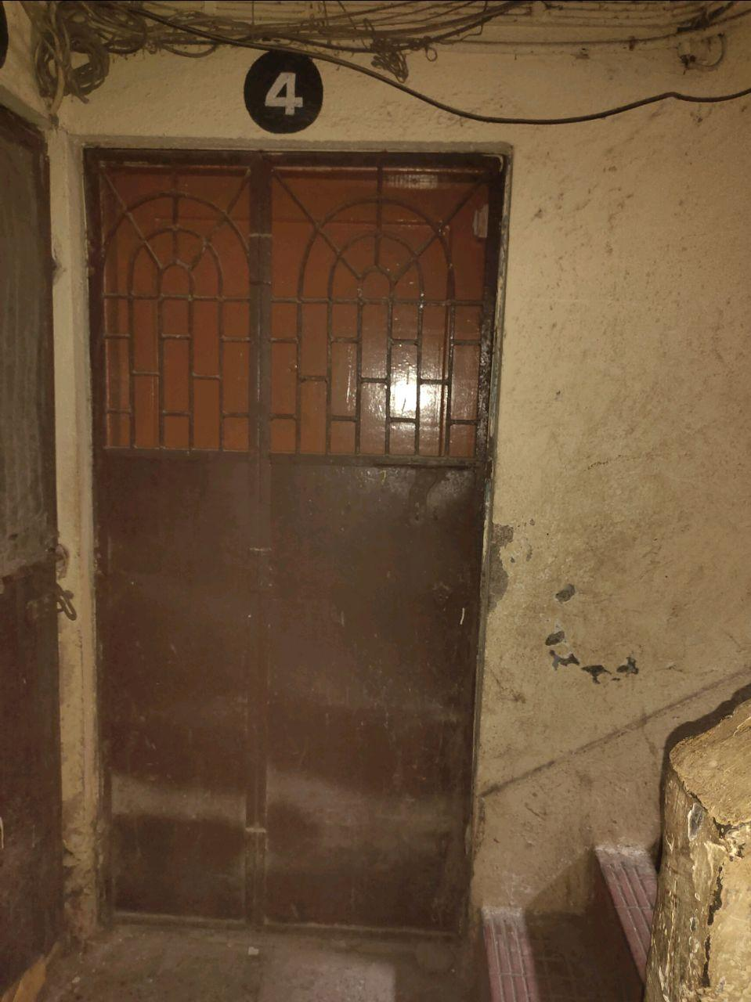
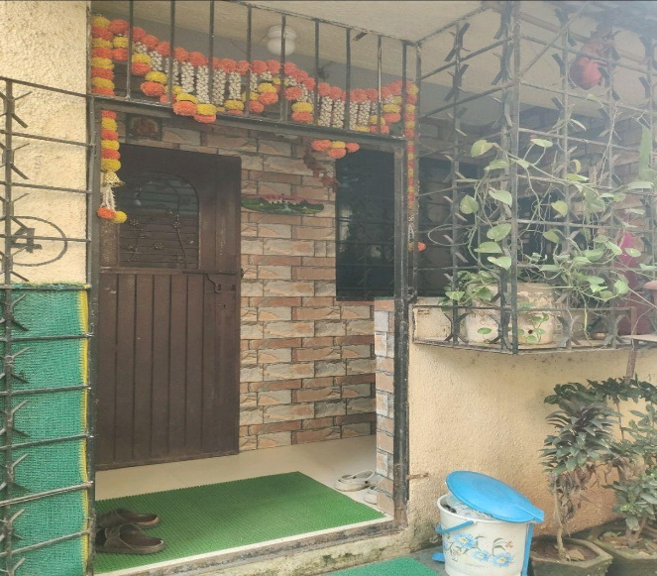
V.S.JADON & CO VALUERS LLP
Site Photo
PHOTOGRAPHS OF PROPERTY OF CUSTOMER: Vitthal Raghunath Chavan
VSJCVNM-PNBHFL-RTL-SEP25-19598 Page 1

Slide 2
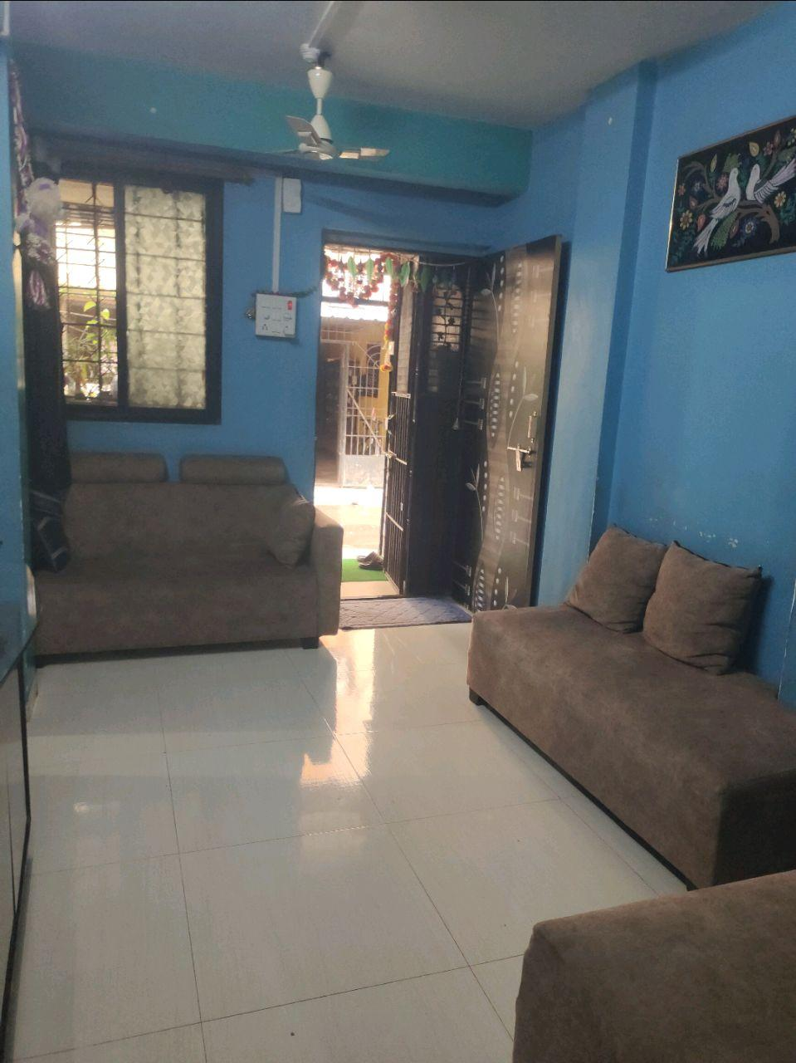
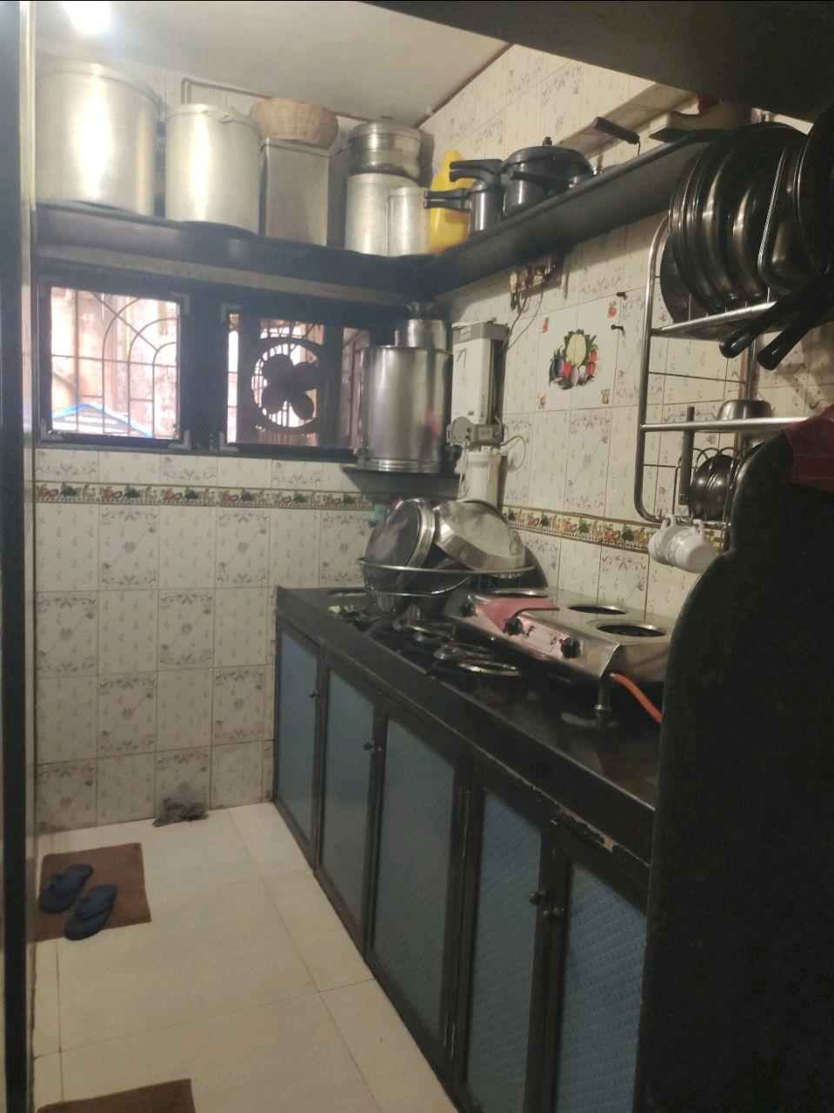
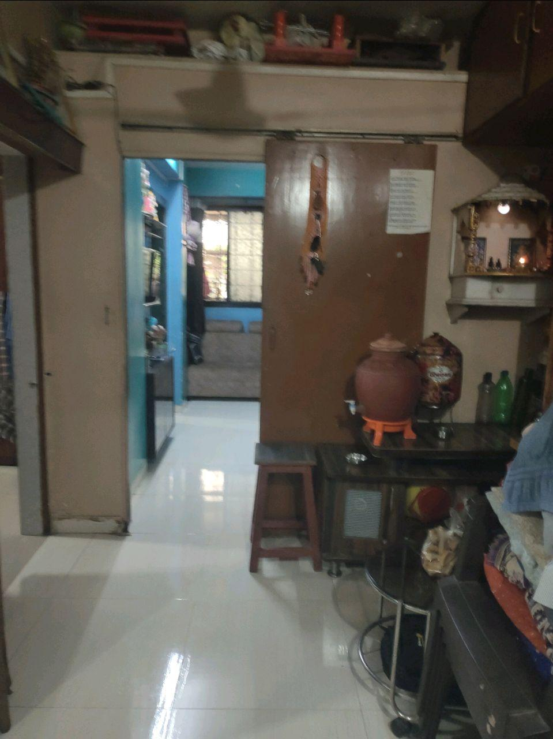
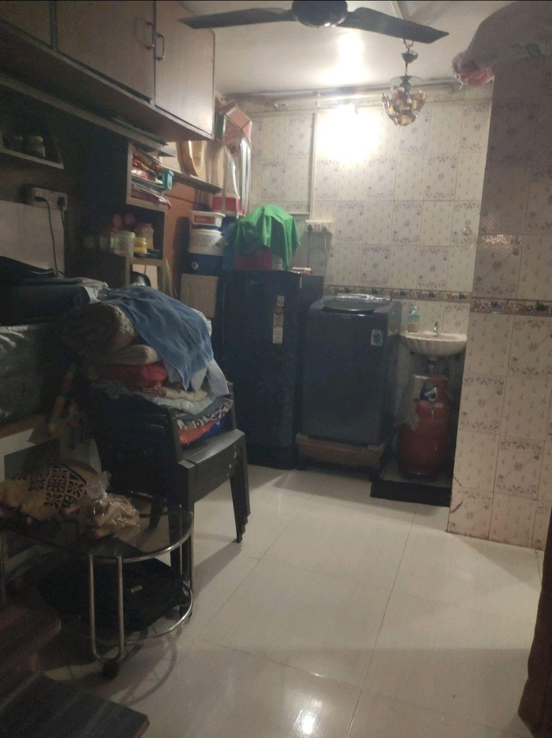
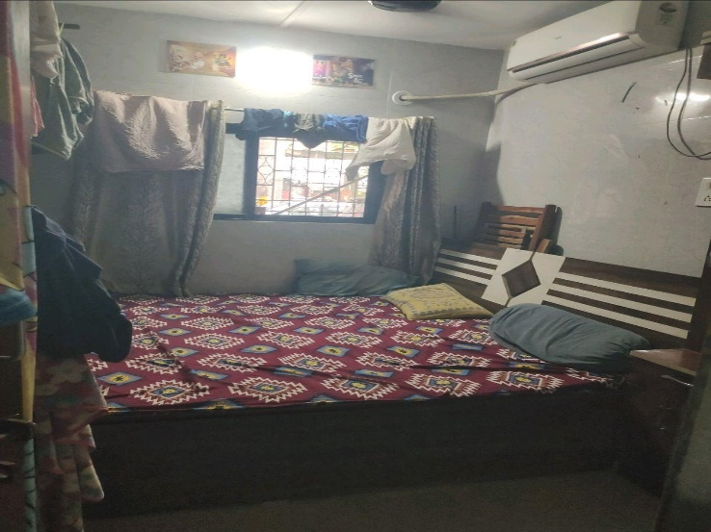
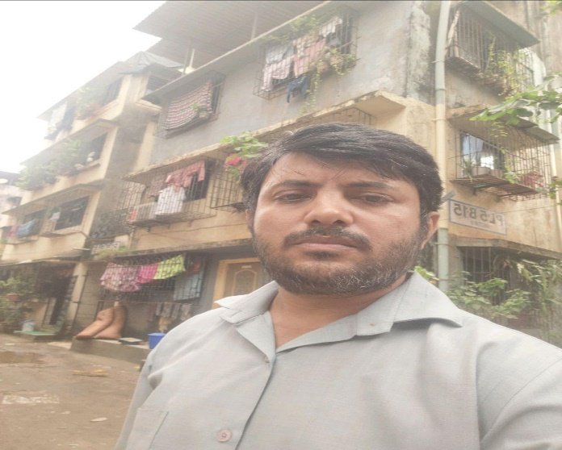
V.S.JADON & CO VALUERS LLP
Site Photo
VSJCVNM-PNBHFL-RTL-SEP25-19598 Page 2

Slide 3
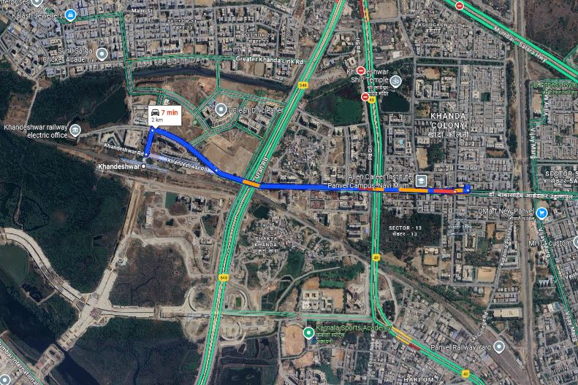
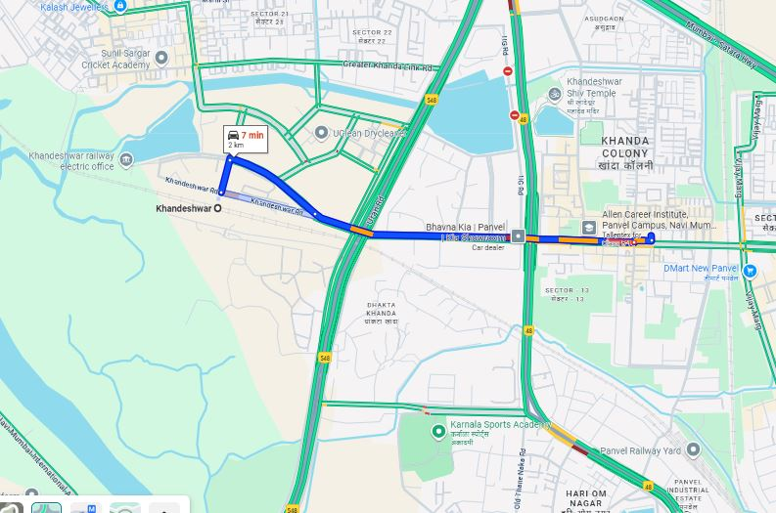
V.S.JADON & CO VALUERS LLP
PHOTOGRAPHS OF PROPERTY OF CUSTOMER: Vitthal Raghunath Chavan
Google Maps :
VSJCVNM-PNBHFL-RTL-SEP25-19598 Page 3

Slide 4
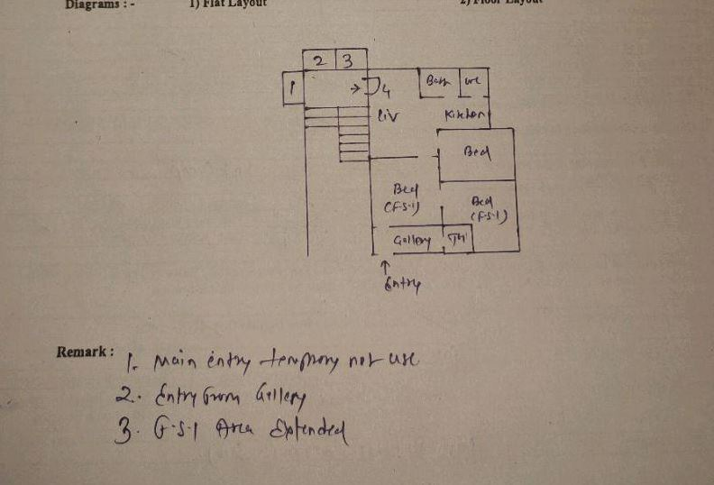
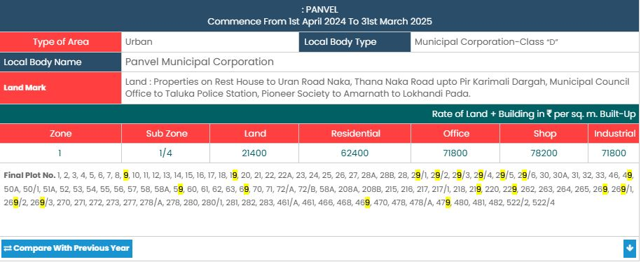
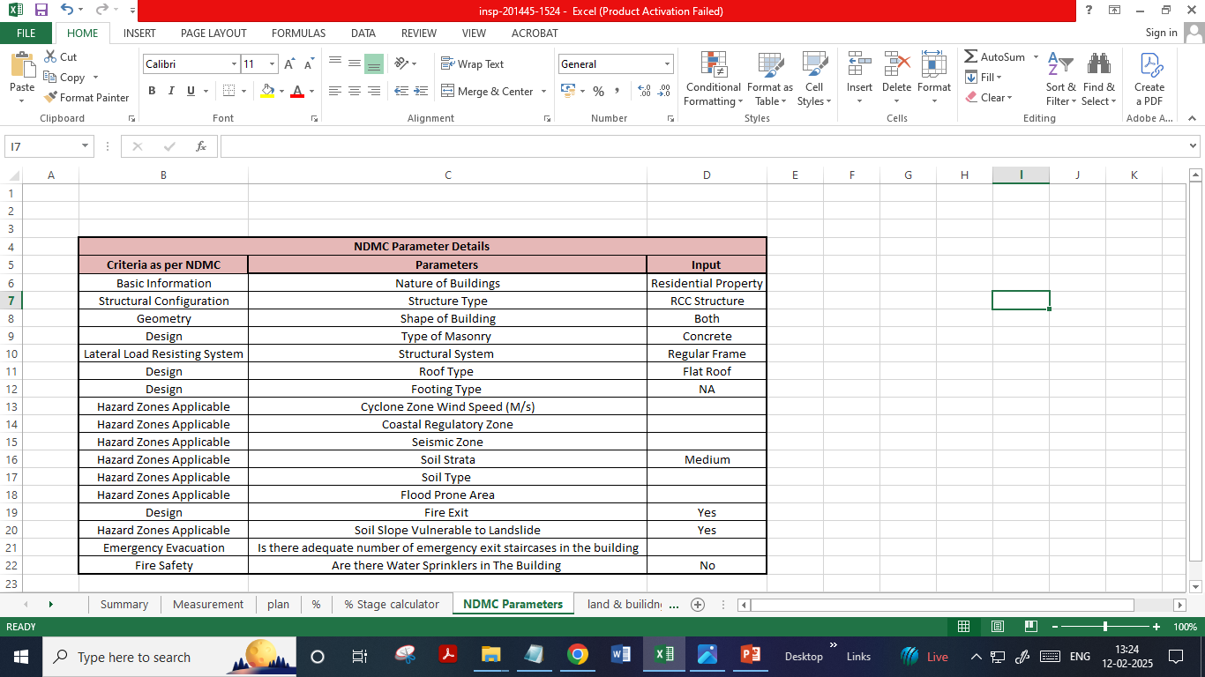
V.S.JADON & CO VALUERS LLP
PHOTOGRAPHS OF PROPERTY OF CUSTOMER: Vitthal Raghunath Chavan
VSJCVNM-PNBHFL-RTL-SEP25-19598 Page 4

