Slide 1
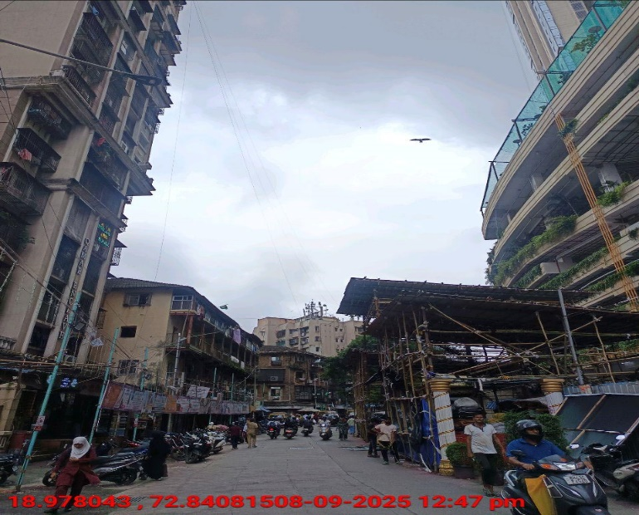
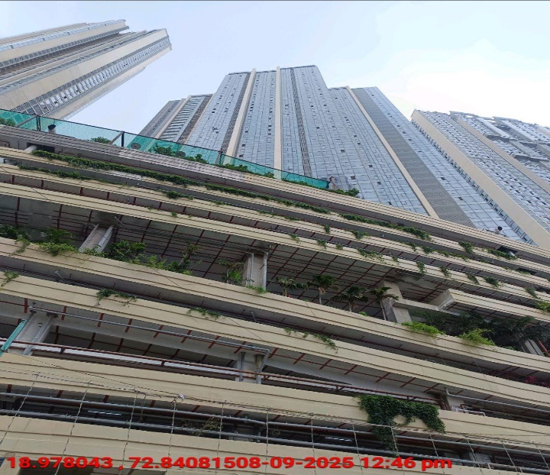
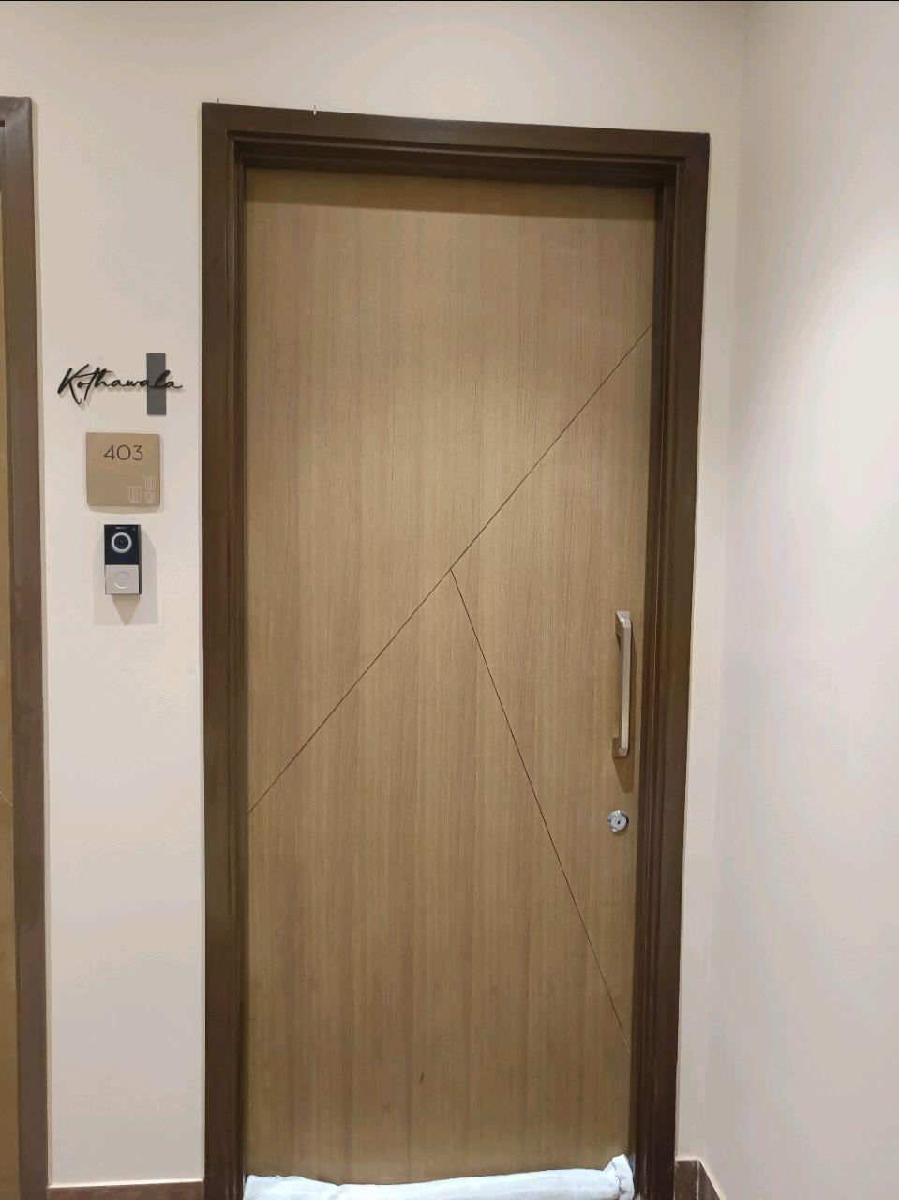
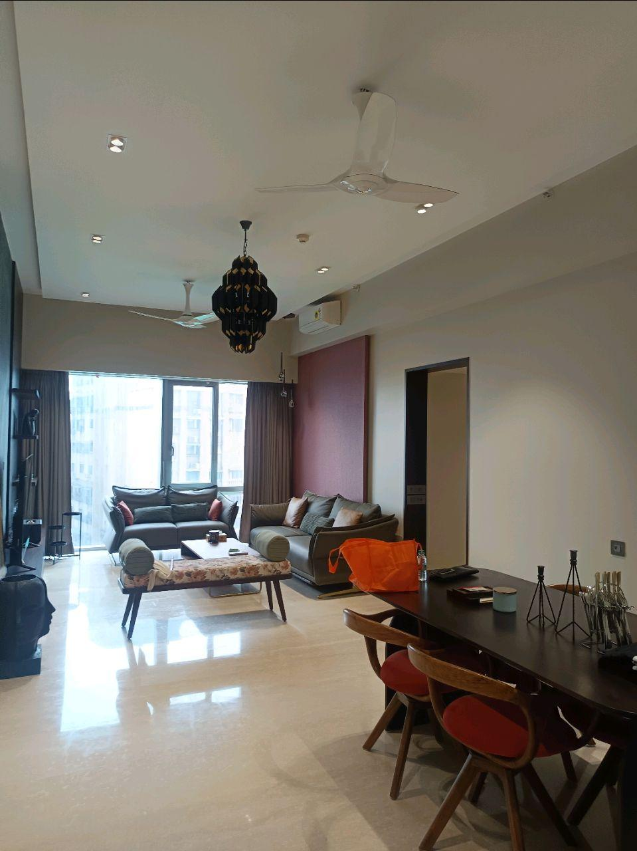
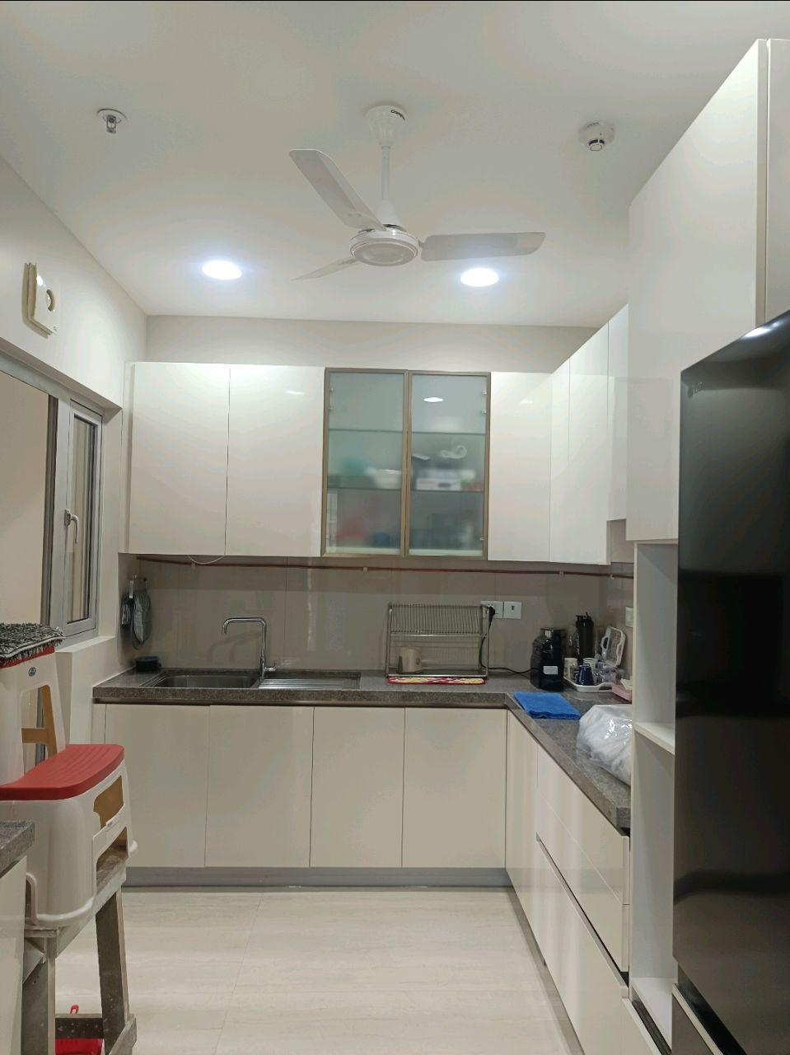
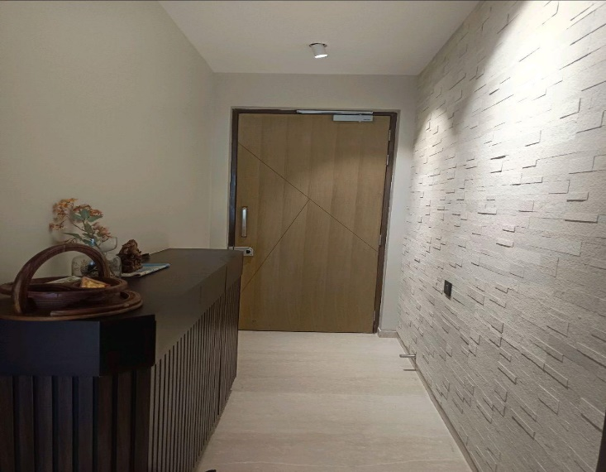
V.S.JADON & CO VALUERS LLP
Site Photo
PHOTOGRAPHS OF PROPERTY OF CUSTOMER: Mr Shabbir Mohammed Kothawala
VSJCVNM-BOI-RTL-SEP25-20195 Page 1

Slide 2
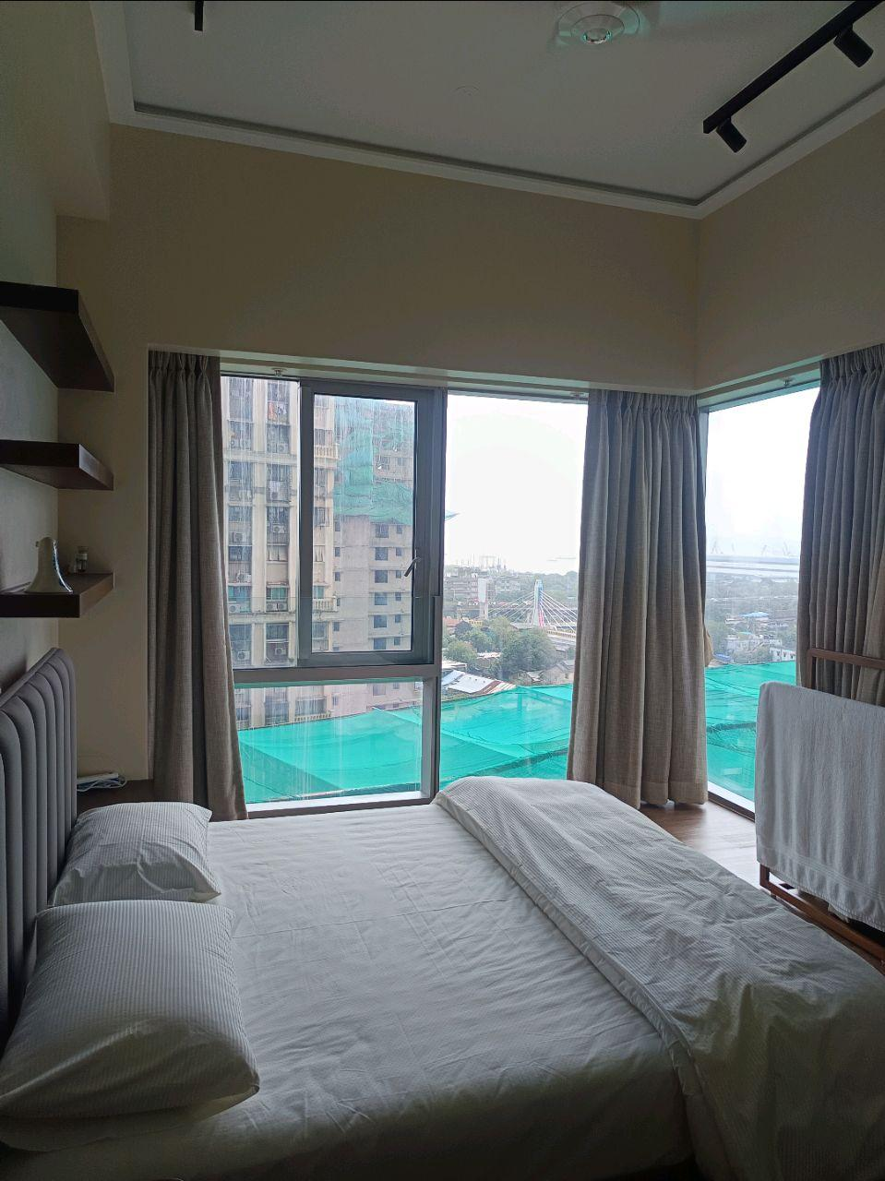
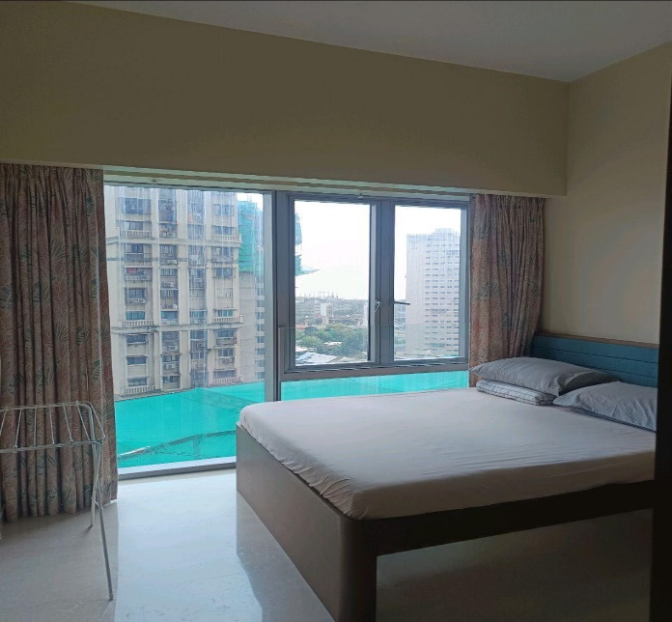
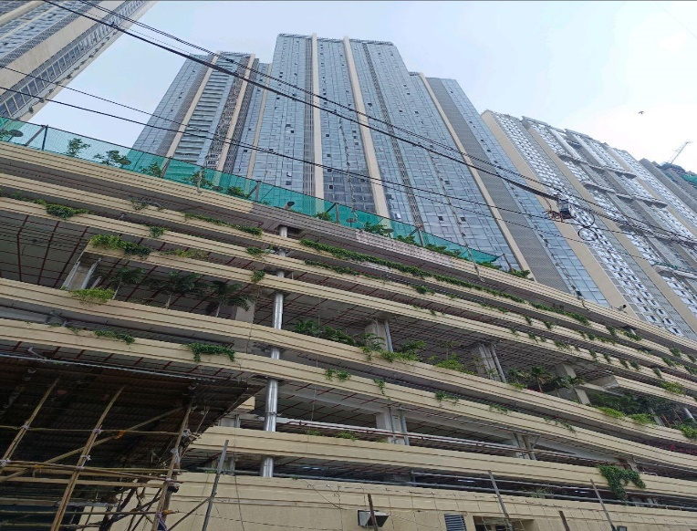
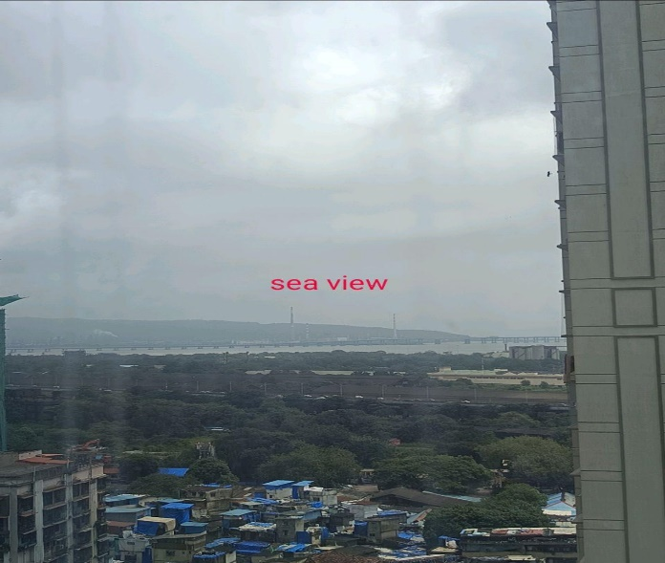
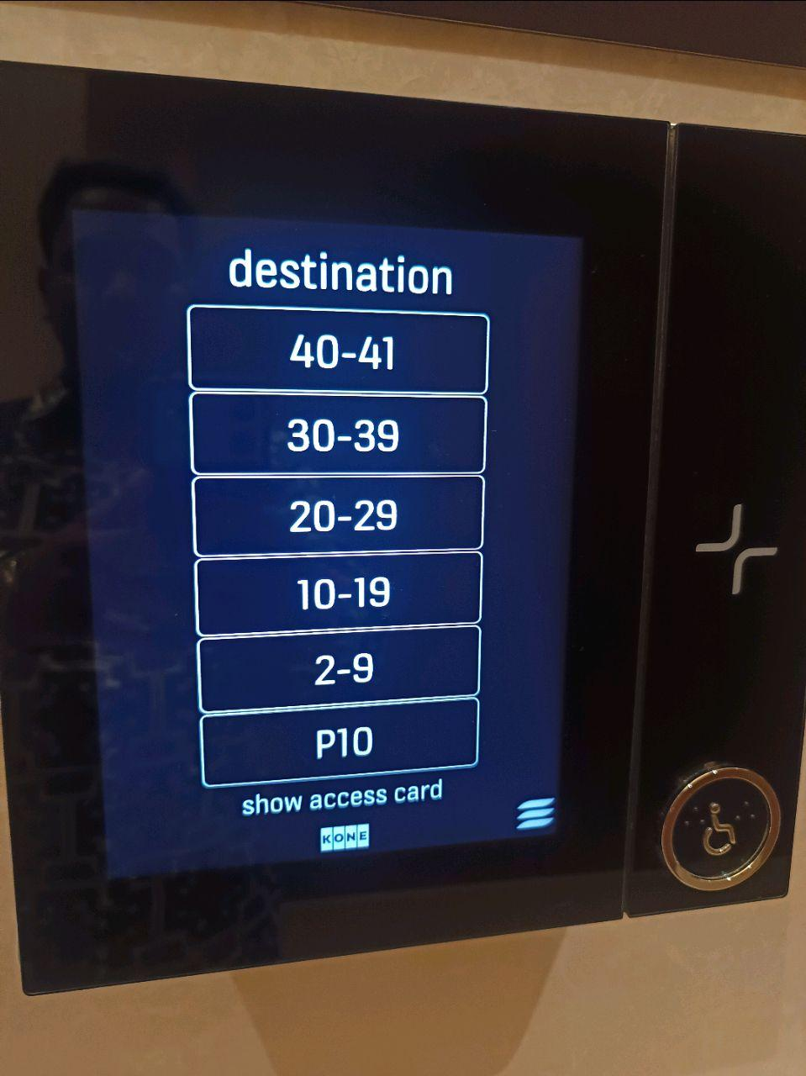
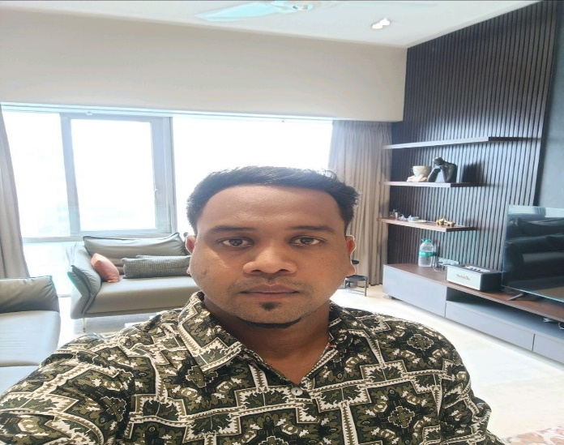
V.S.JADON & CO VALUERS LLP
Site Photo
VSJCVNM-BOI-RTL-SEP25-20195 Page 2

Slide 3
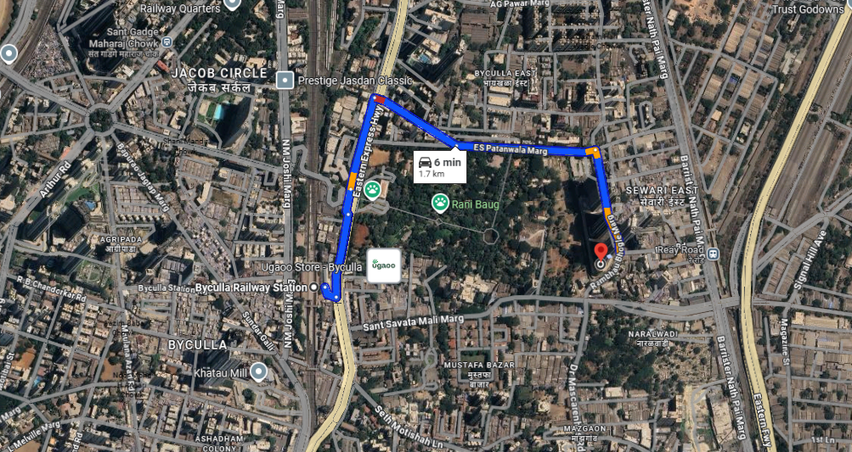
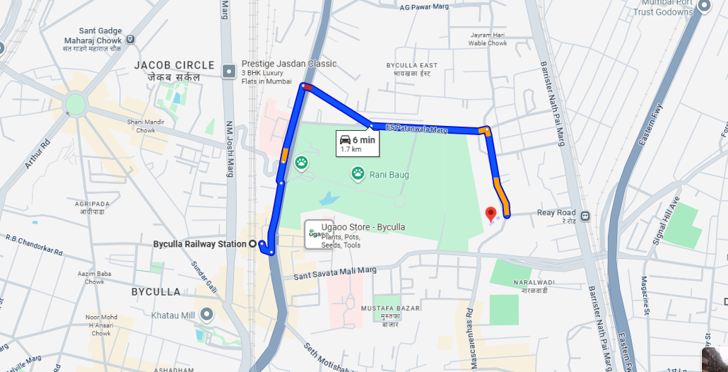
V.S.JADON & CO VALUERS LLP
PHOTOGRAPHS OF PROPERTY OF CUSTOMER: Mr Shabbir Mohammed Kothawala
Google Maps :
VSJCVNM-BOI-RTL-SEP25-20195 Page 3

Slide 4
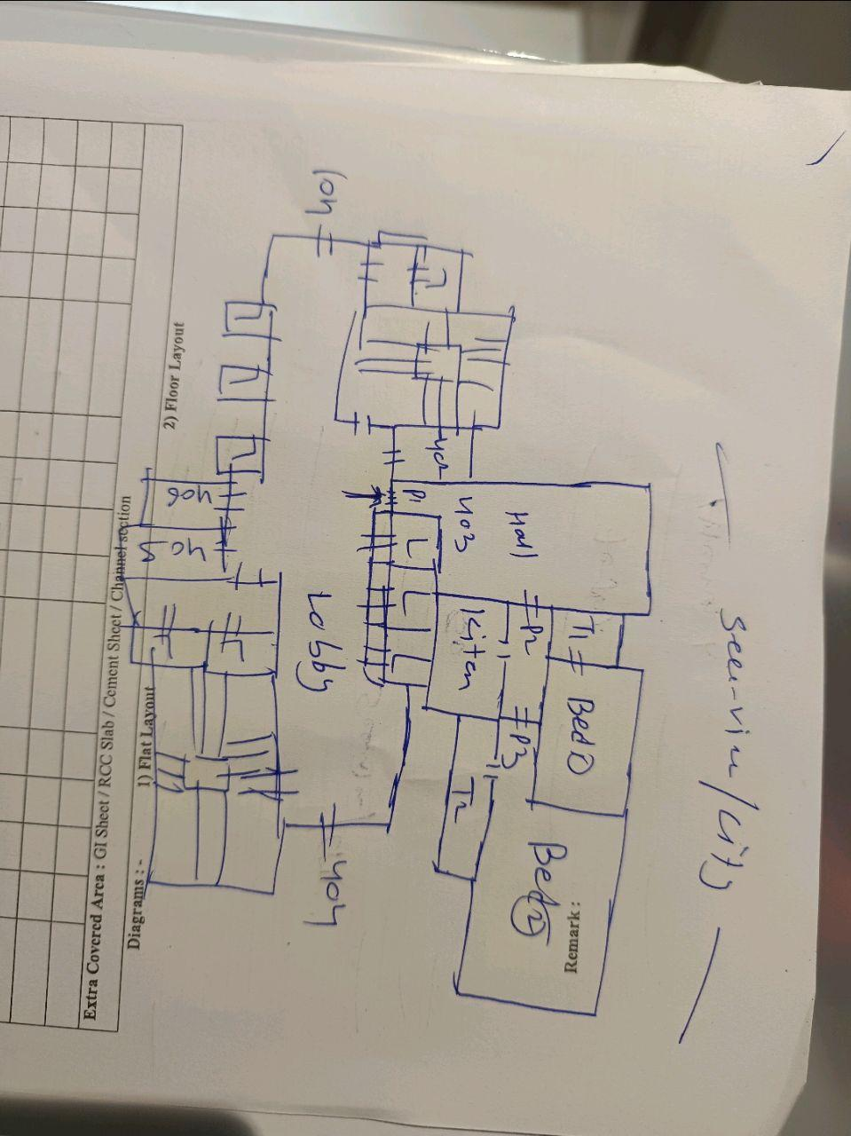
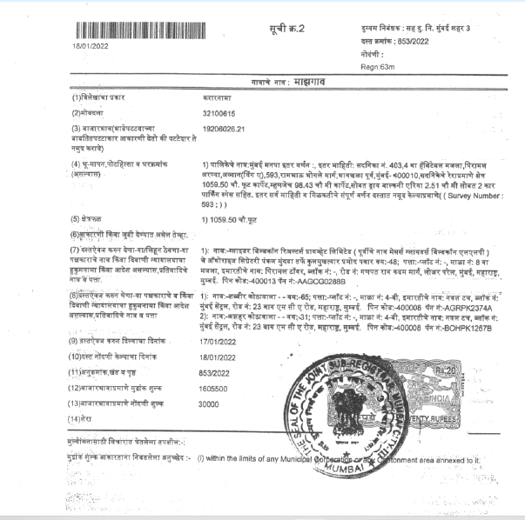
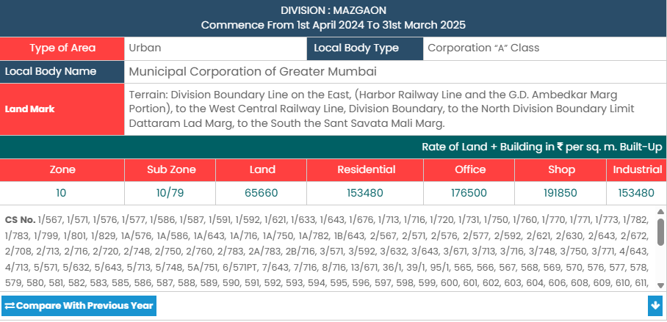
V.S.JADON & CO VALUERS LLP
PHOTOGRAPHS OF PROPERTY OF CUSTOMER: Mr Shabbir Mohammed Kothawala
Site Layout :
VSJCVNM-BOI-RTL-SEP25-20195 Page 4

