Slide 1
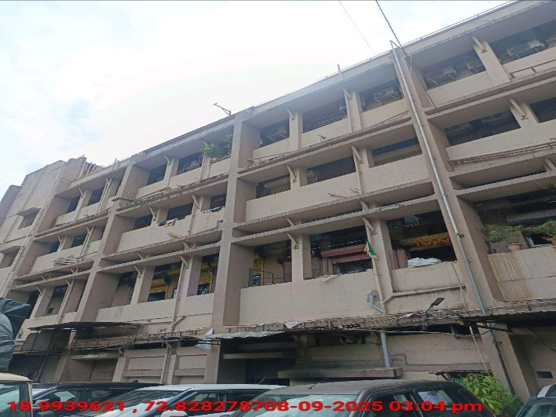
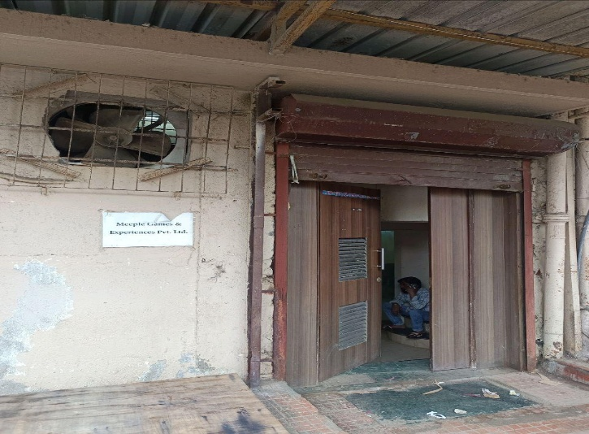
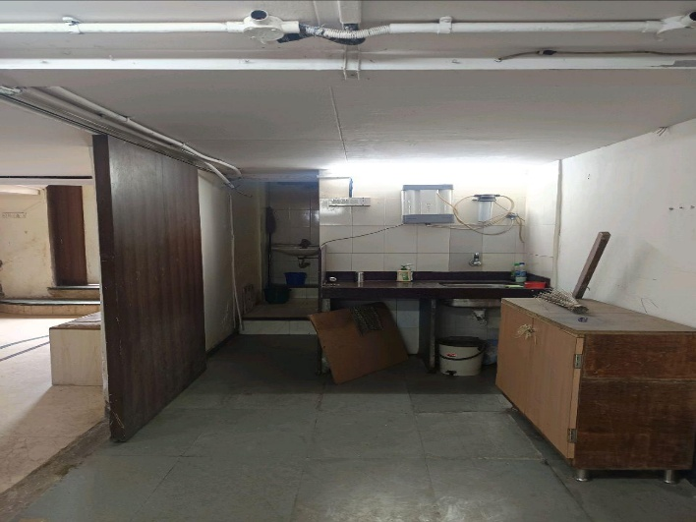
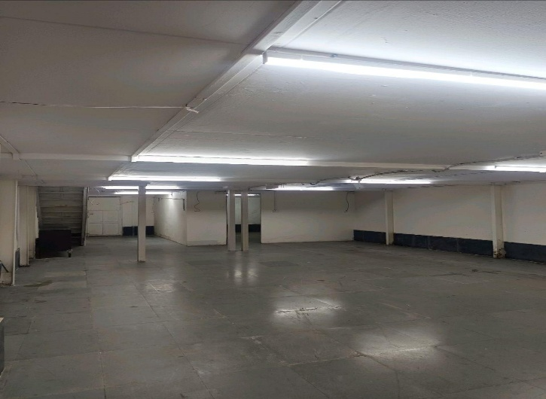
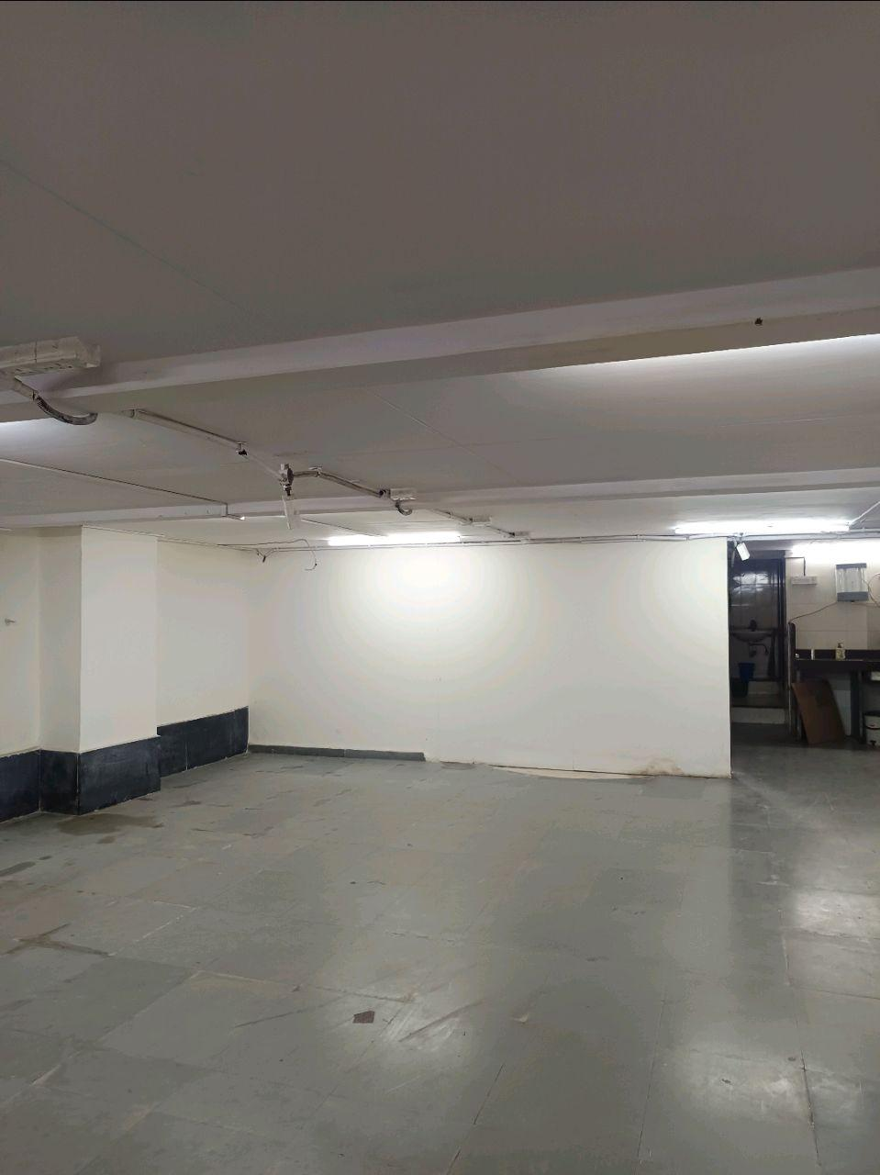
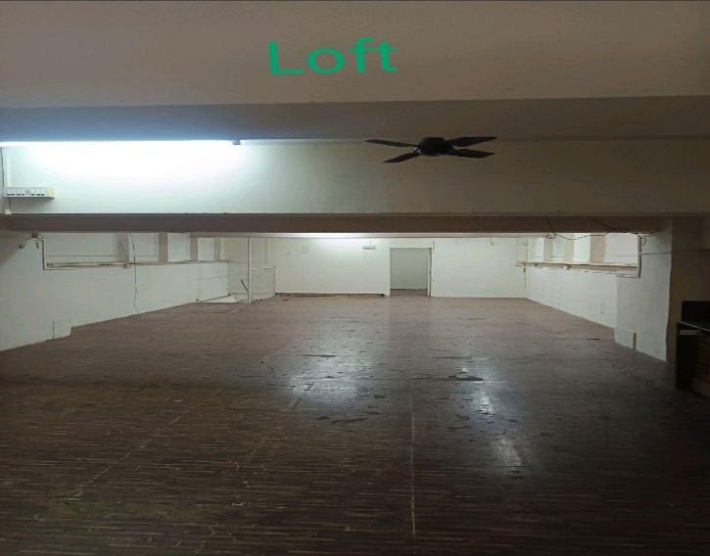
V.S.JADON & CO VALUERS LLP
PHOTOGRAPHS OF PROPERTY OF CUSTOMER -FIRKEE ACCESSORIES PVT LTD
VSJCVNM-AXIS-RTL-SEP25-20314
Page 1

Slide 2
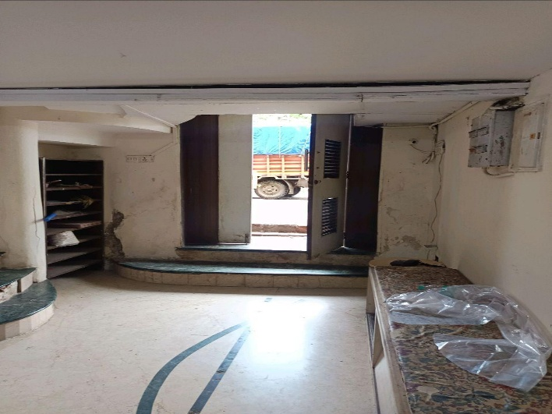
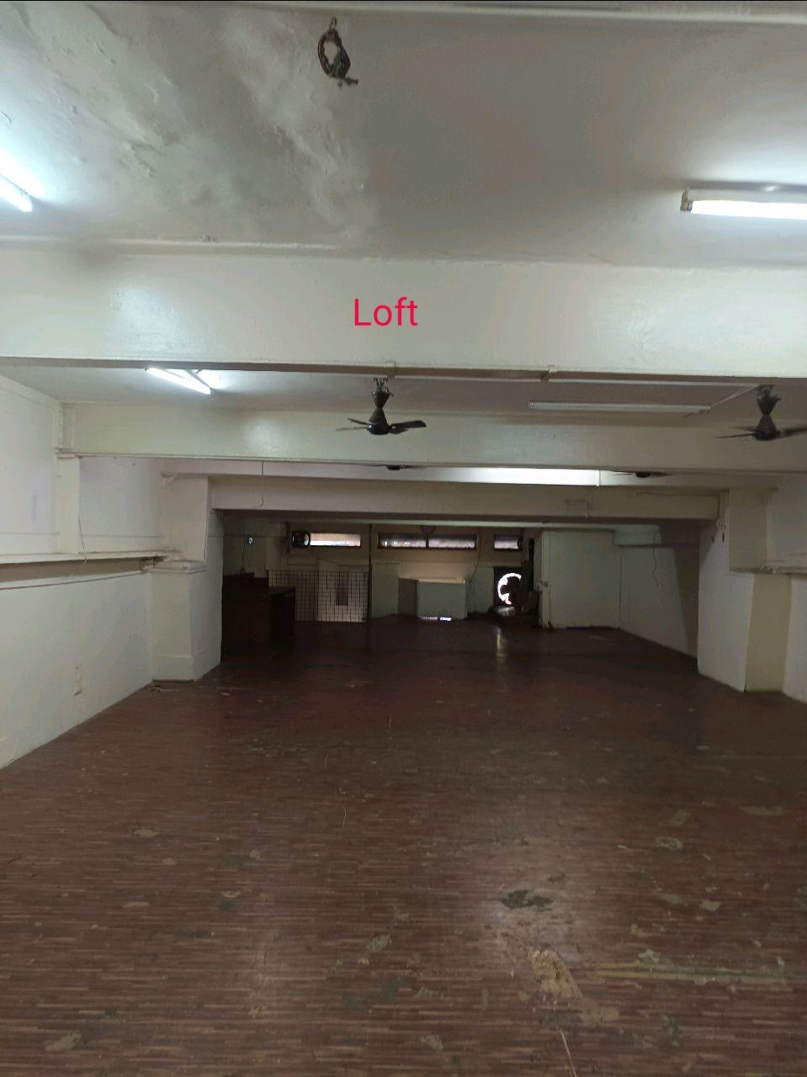
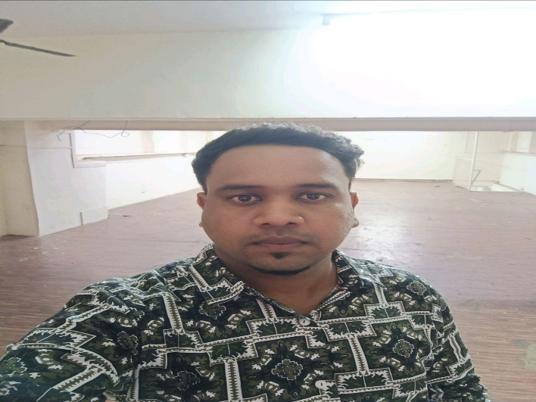
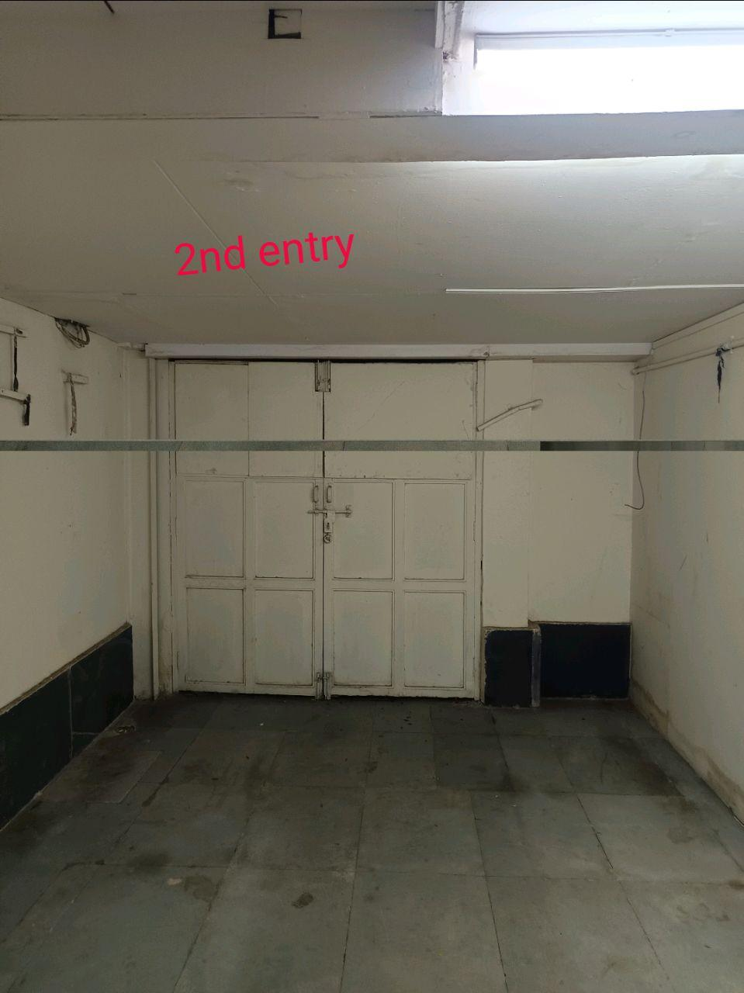
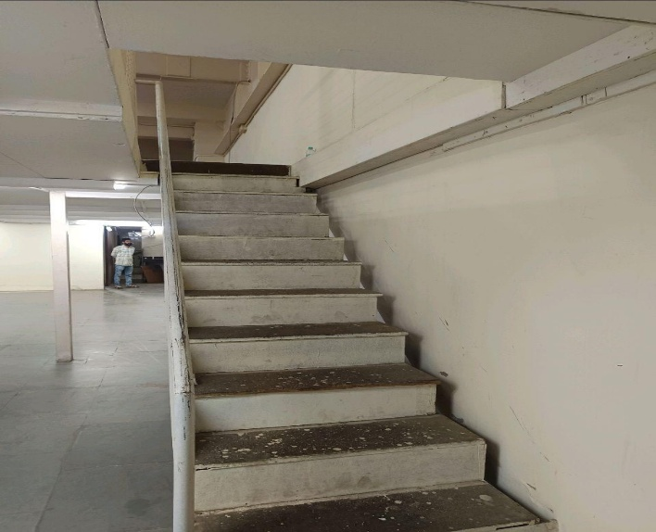
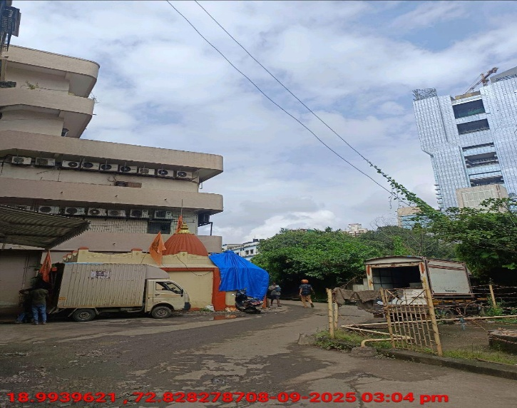
V.S.JADON & CO VALUERS LLP
PHOTOGRAPHS OF PROPERTY OF CUSTOMER FIRKEE ACCESSORIES PVT LTD
VSJCVNM-AXIS-RTL-SEP25-20314
Page 1

Slide 3
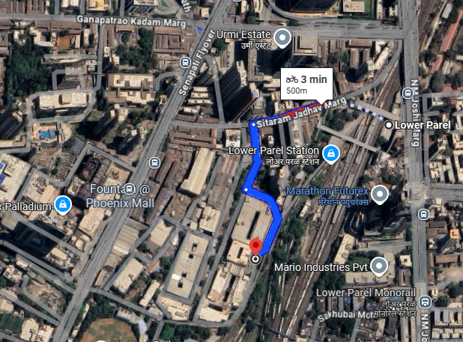
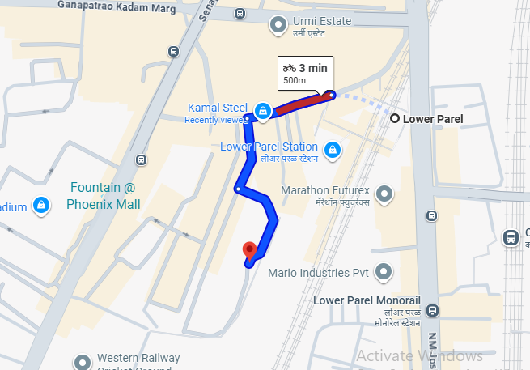
V.S.JADON & CO VALUERS LLP
PHOTOGRAPHS OF PROPERTY OF CUSTOMER : FIRKEE ACCESSORIES PVT LTD
VSJCVNM-AXIS-RTL-SEP25-20314
Page 3

Slide 4
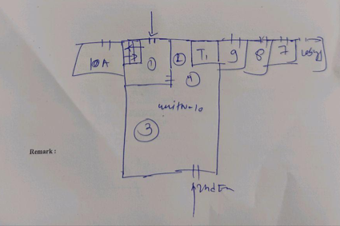
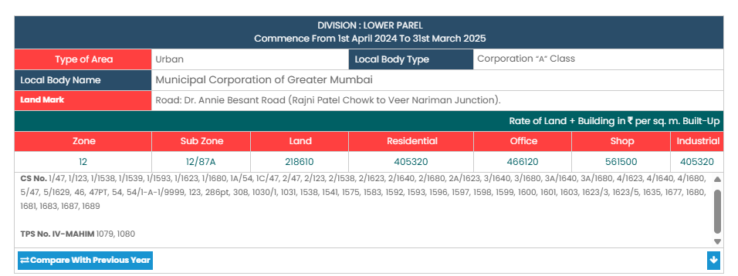
V.S.JADON & CO VALUERS LLP
PHOTOGRAPHS OF PROPERTY OF CUSTOMER -FIRKEE ACCESSORIES PVT LTD
VSJCVNM-AXIS-RTL-SEP25-20314
Page 5

