Slide 1
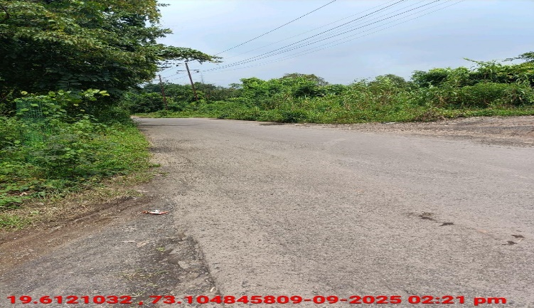
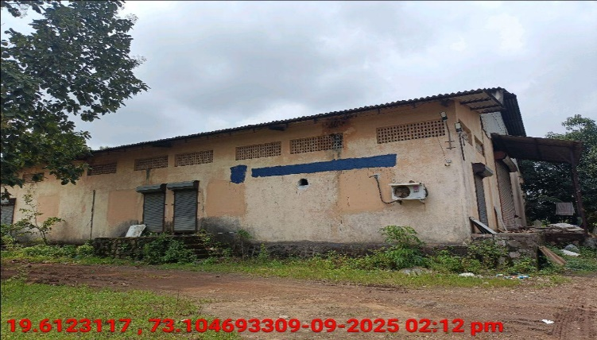
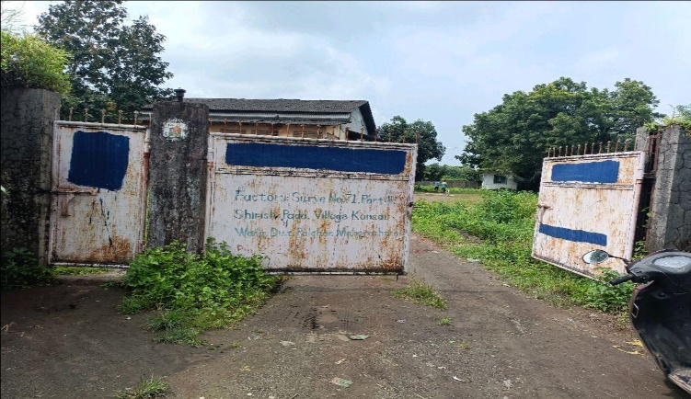
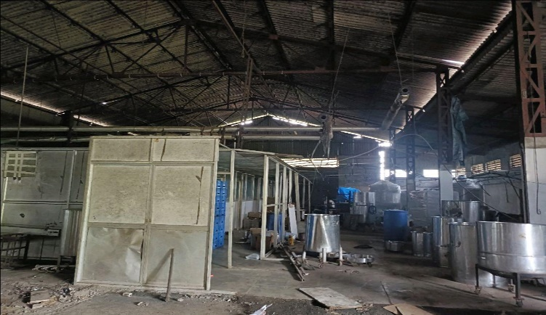
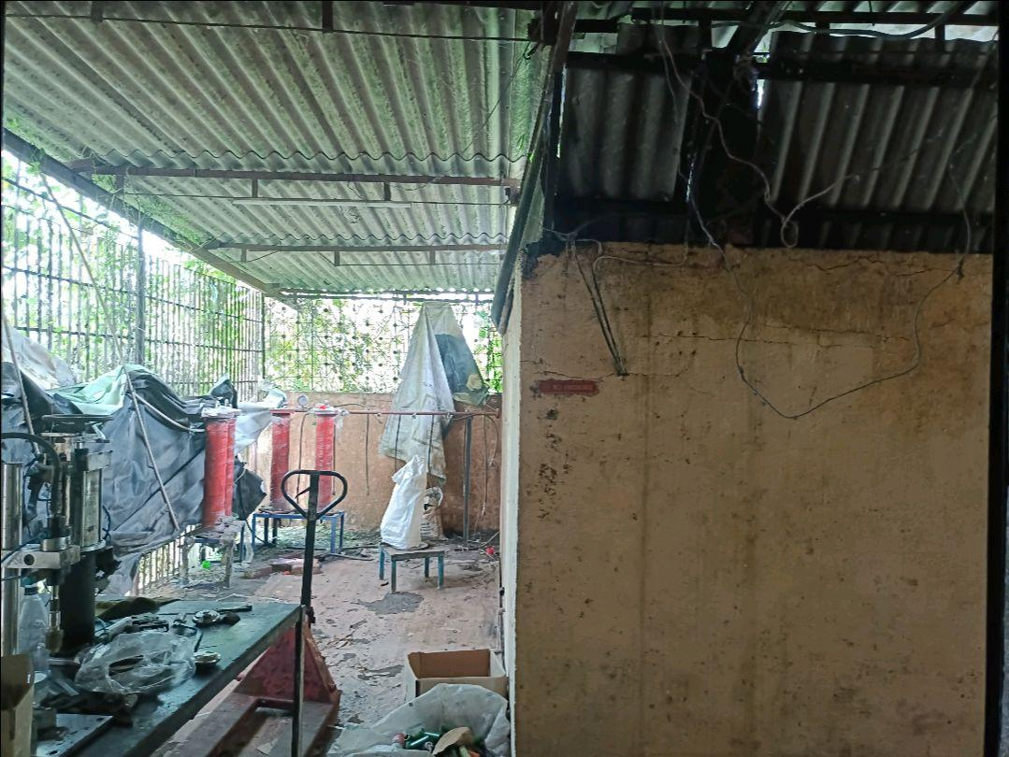
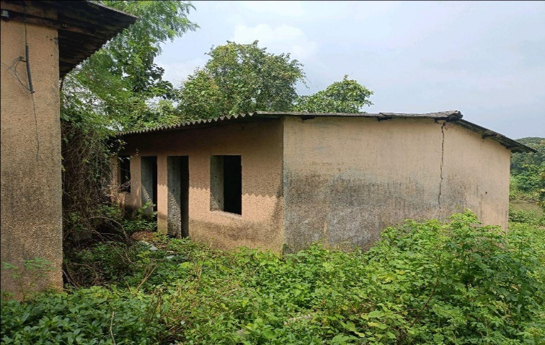
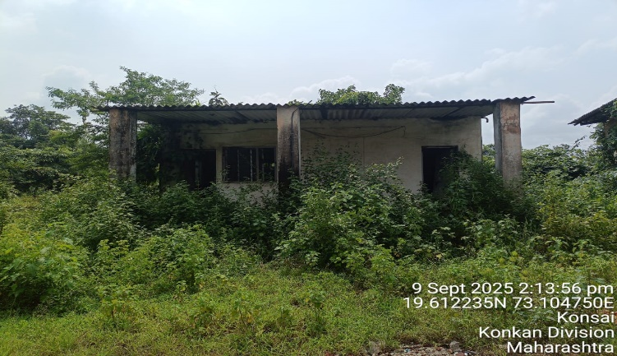
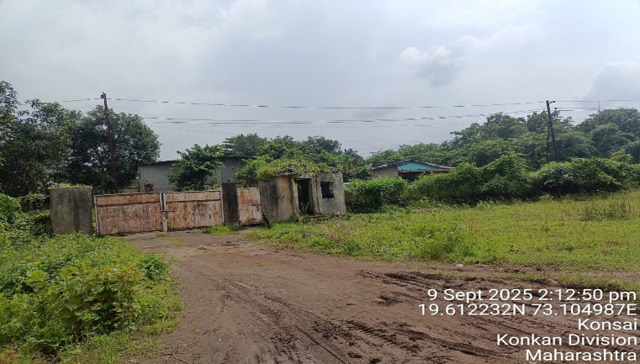
V.S.JADON & CO VALUERS LLP
Site Photo
PHOTOGRAPHS OF PROPERTY OF CUSTOMER:
VSJCVNM-AXIS-RTL-SEP25-20595 Page 1

Slide 2
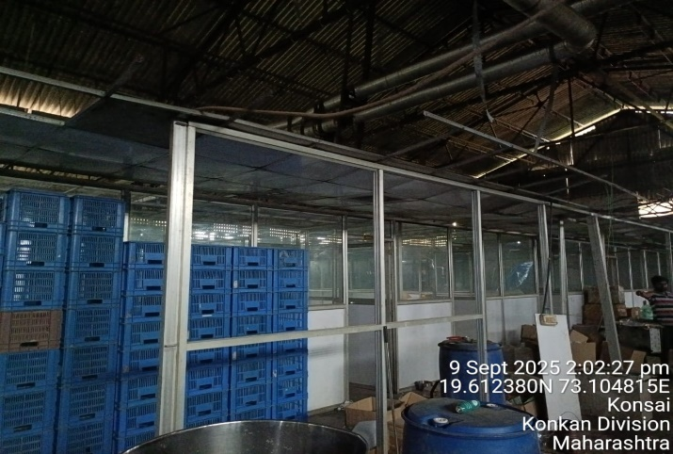
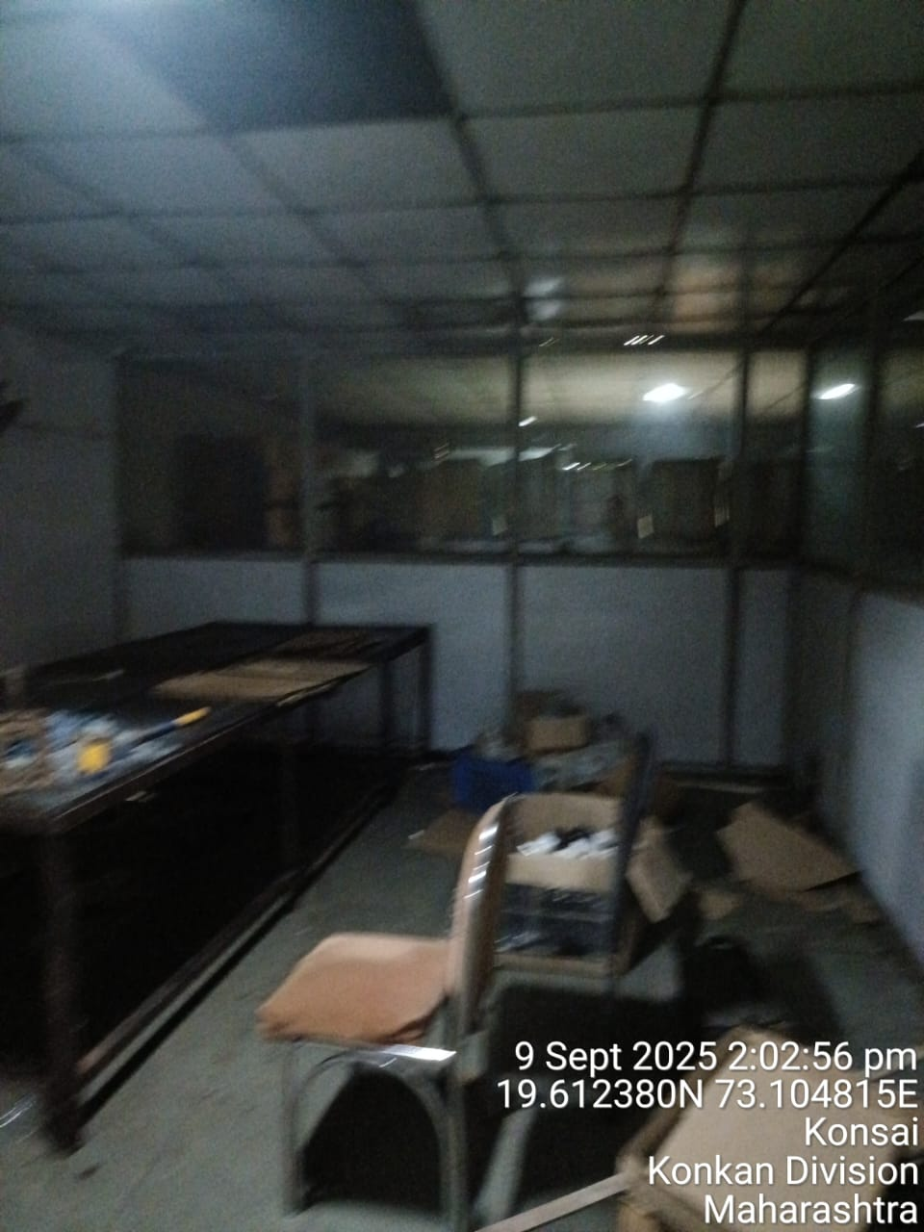
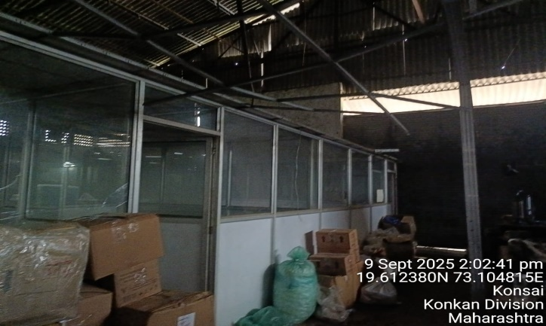
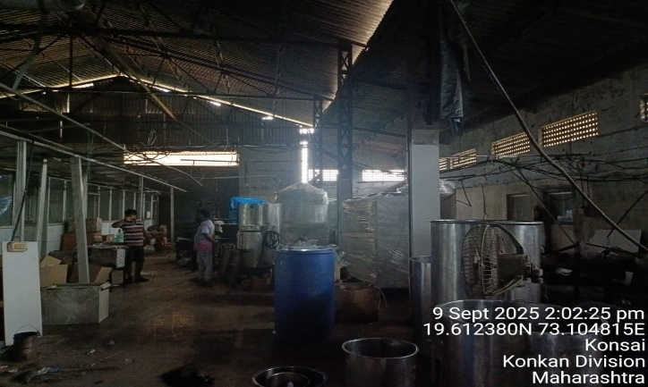
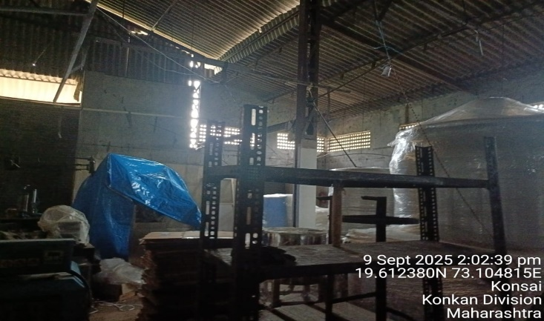
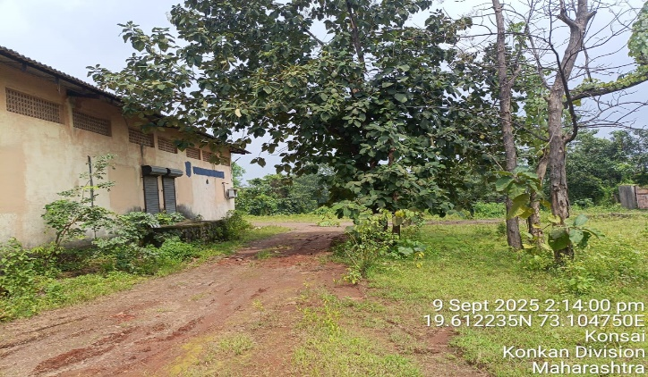
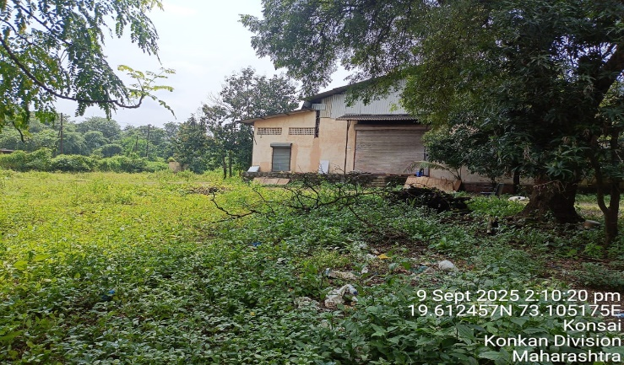

V.S.JADON & CO VALUERS LLP
Site Photo
VSJCVNM-AXIS-RTL-SEP25-20595 Page 2

Slide 3
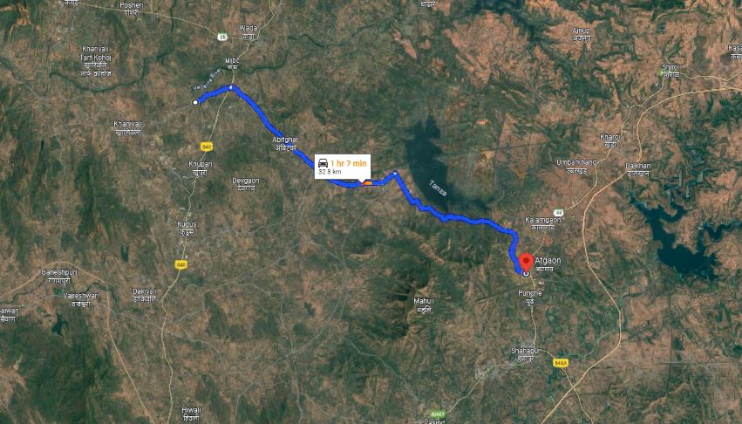
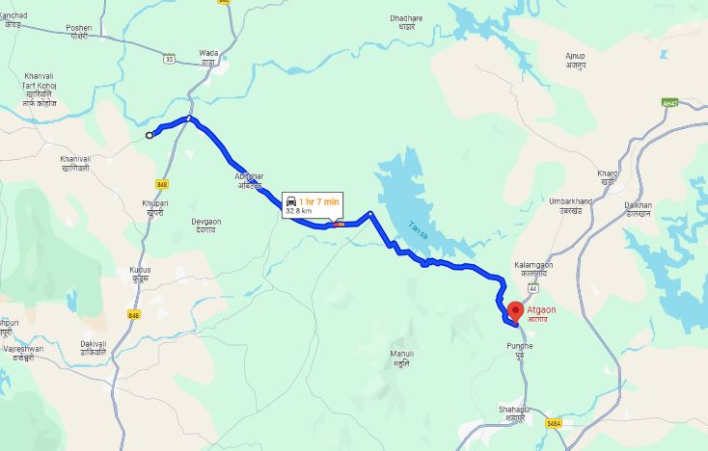
V.S.JADON & CO VALUERS LLP
PHOTOGRAPHS OF PROPERTY OF CUSTOMER:
Google Maps :
VSJCVNM-AXIS-RTL-SEP25-20595 Page 3

Slide 4
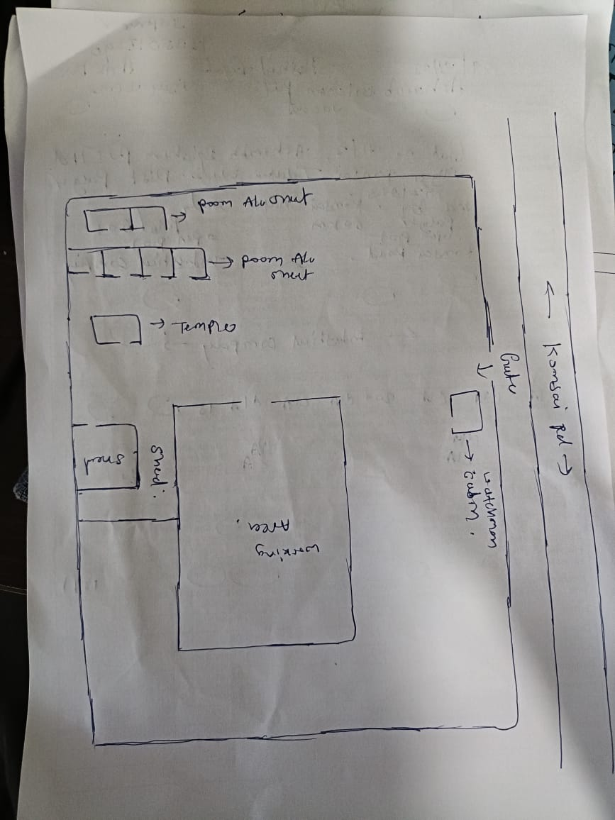
V.S.JADON & CO VALUERS LLP
PHOTOGRAPHS OF PROPERTY OF CUSTOMER:
Site Layout :
VSJCVNM-AXIS-RTL-SEP25-20595 Page 4

