Slide 1
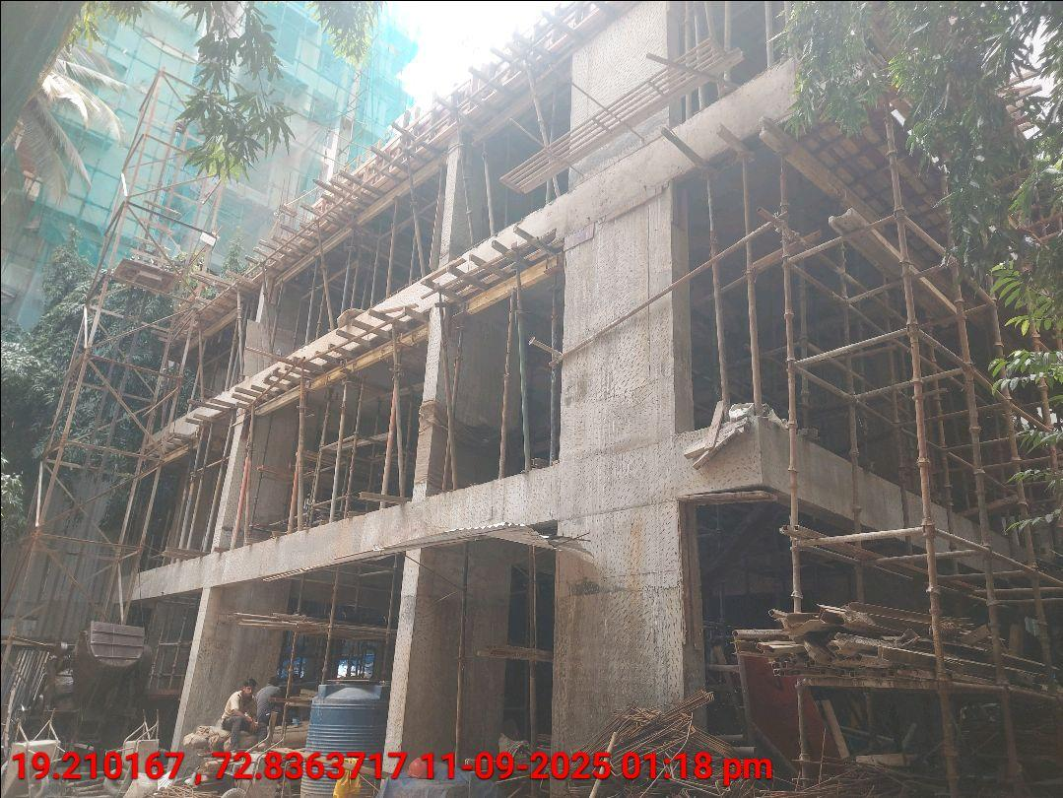
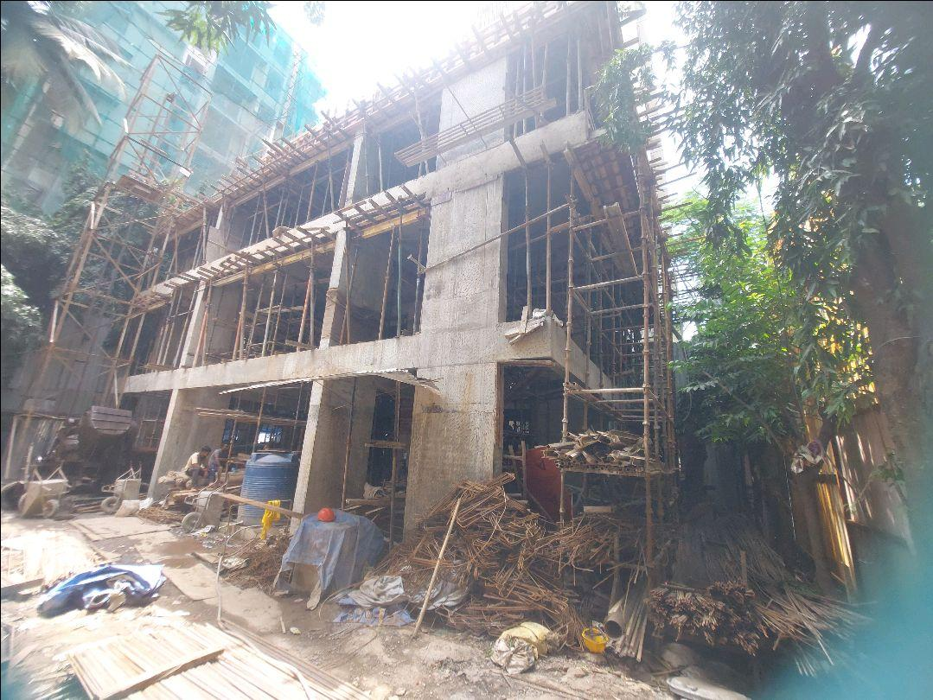
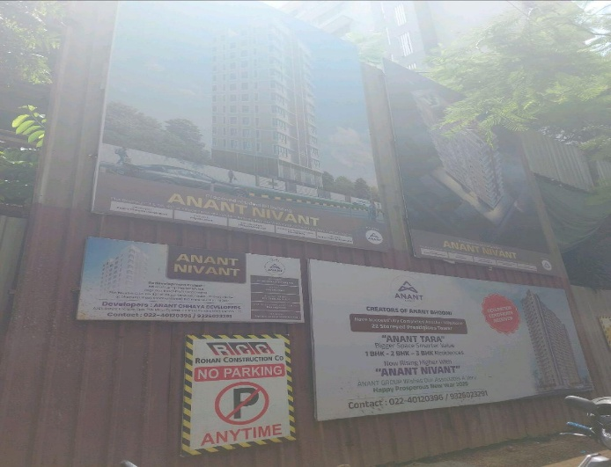
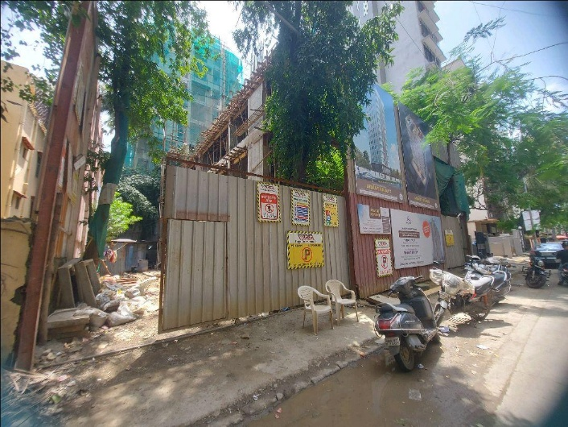
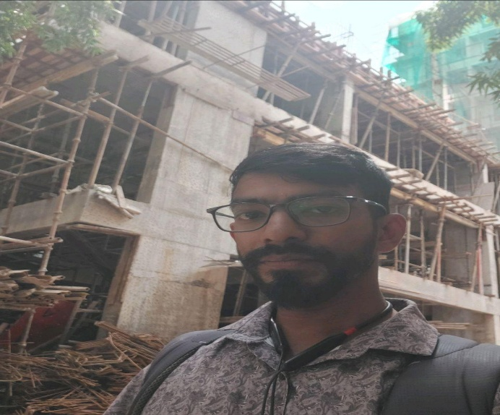
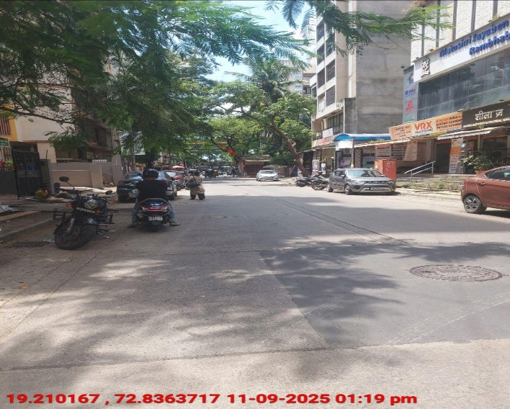
V.S.JADON & CO VALUERS LLP
PHOTOGRAPHS OF PROPERTY OF CUSTOMER - : : Vijay Kamalakar Samant
VSJCVNM-RBL-RTL-SEP25-20723
Page 1

Slide 2
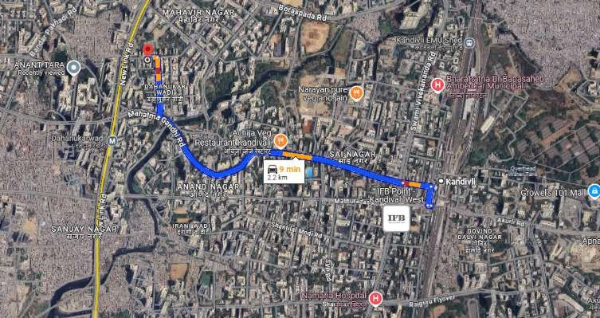
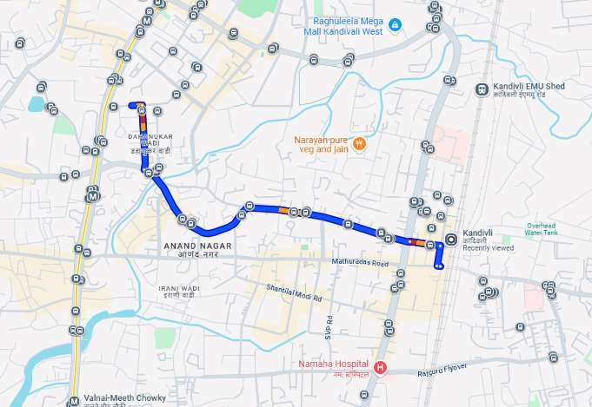
V.S.JADON & CO VALUERS LLP
PHOTOGRAPHS OF PROPERTY OF CUSTOMER : : Vijay Kamalakar Samant
VSJCVNM-RBL-RTL-SEP25-20723
Page 2

Slide 3
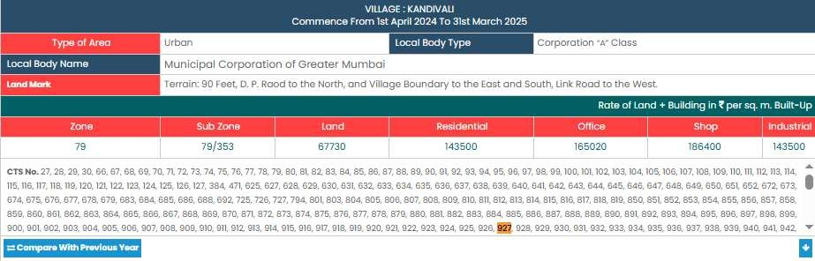
V.S.JADON & CO VALUERS LLP
PHOTOGRAPHS OF PROPERTY OF CUSTOMER - : Vijay Kamalakar Samant
VSJCVNM-RBL-RTL-SEP25-20723
Page 3

