Slide 1
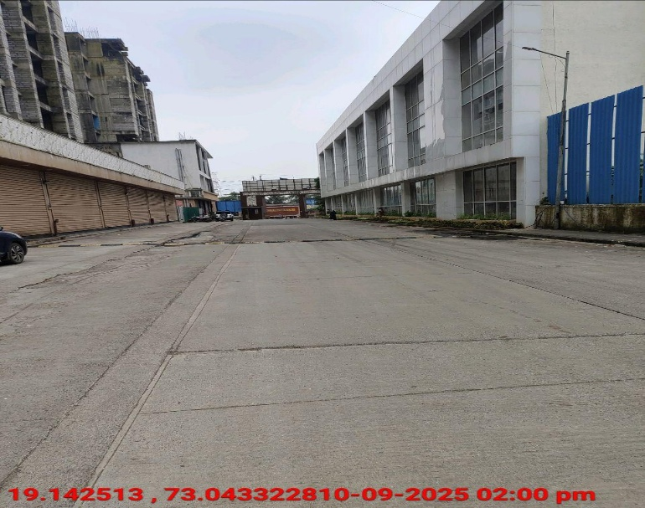
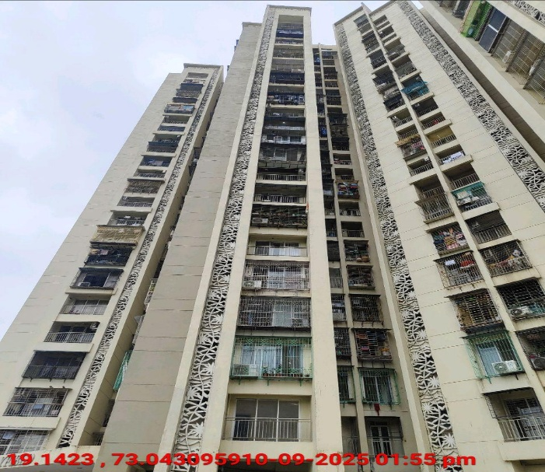
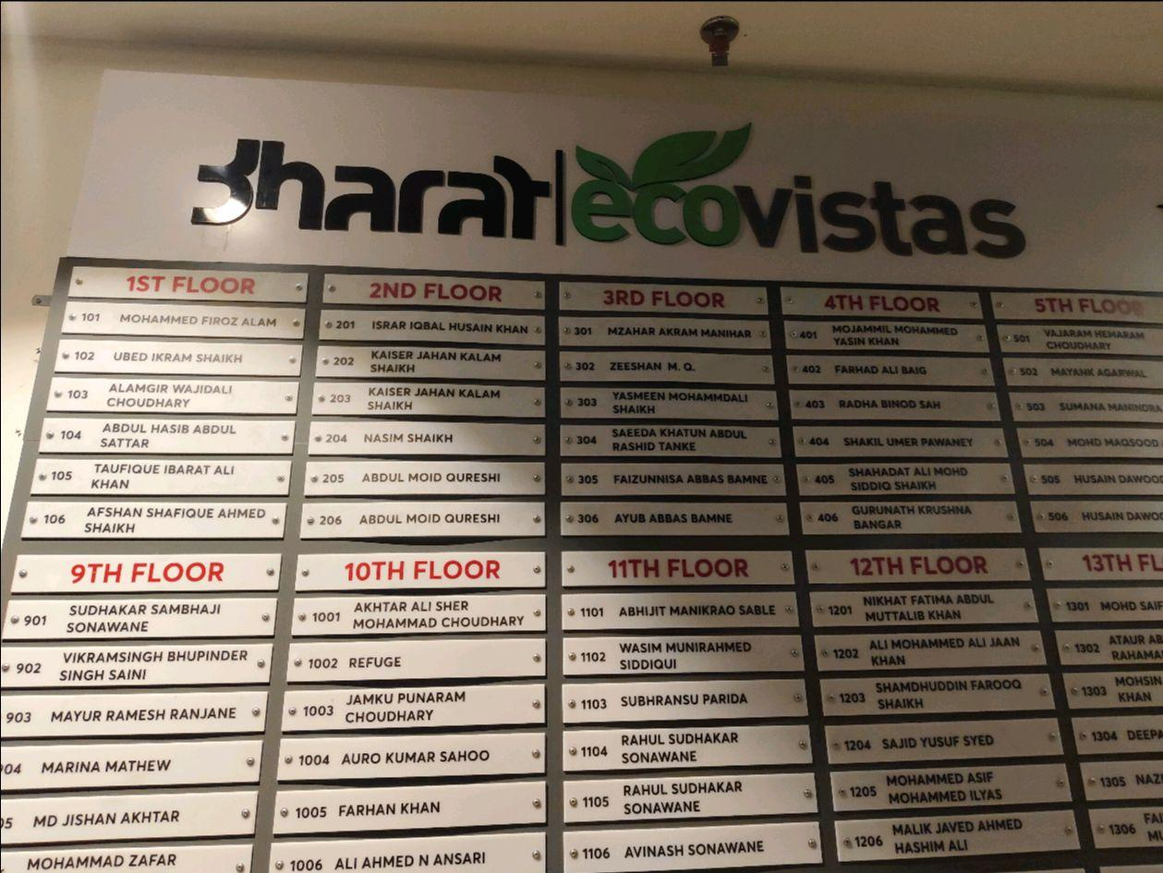
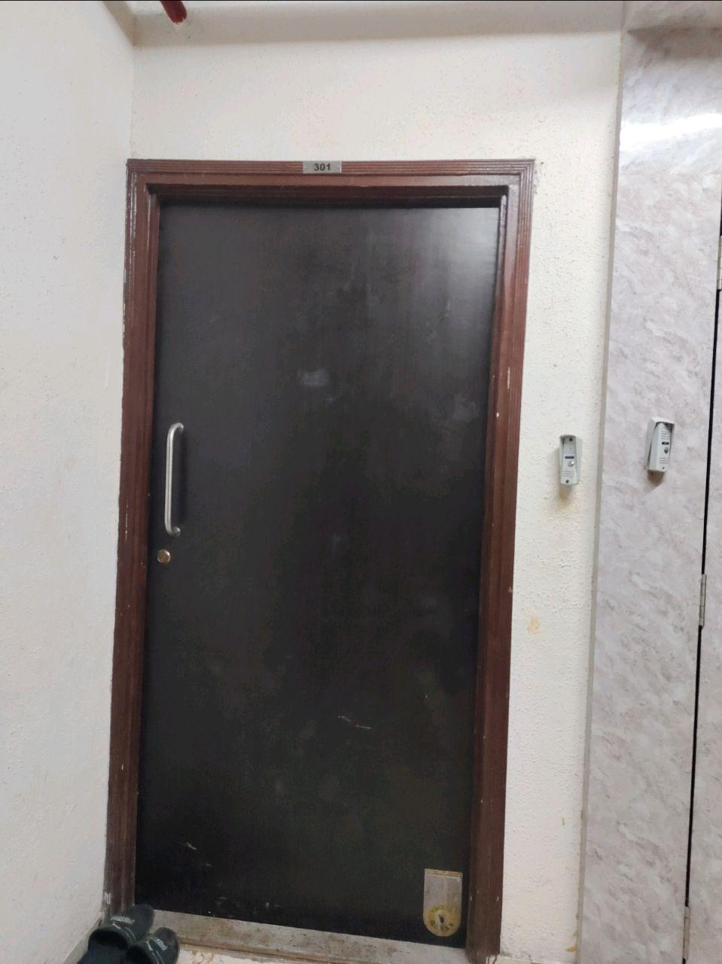
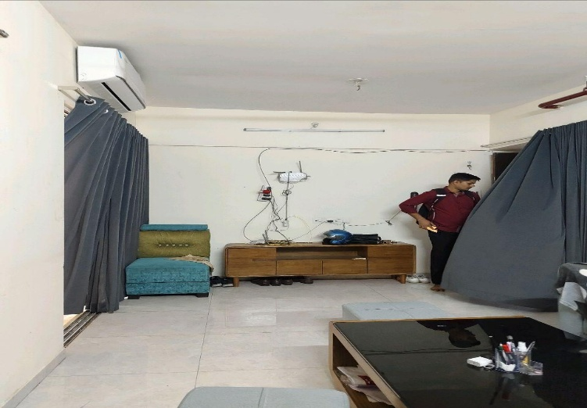
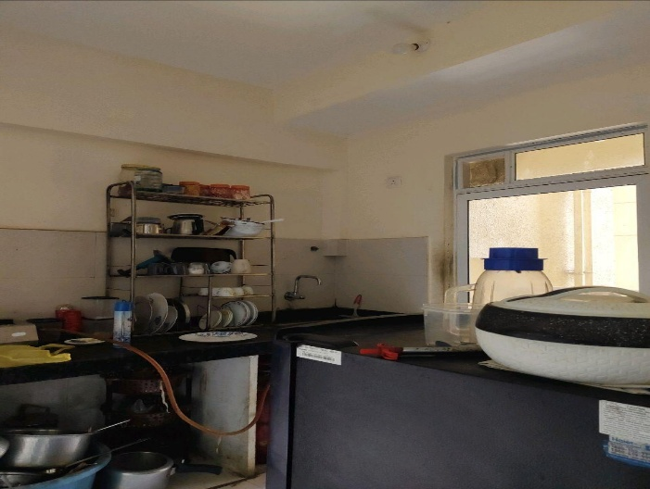
V.S.JADON & CO VALUERS LLP
PHOTOGRAPHS OF PROPERTY OF CUSTOMER : Maharashtra Steel Corporation
Photographs :
VSJCVNM-AXIS-RTL-SEP25-20740 Page 6

Slide 2
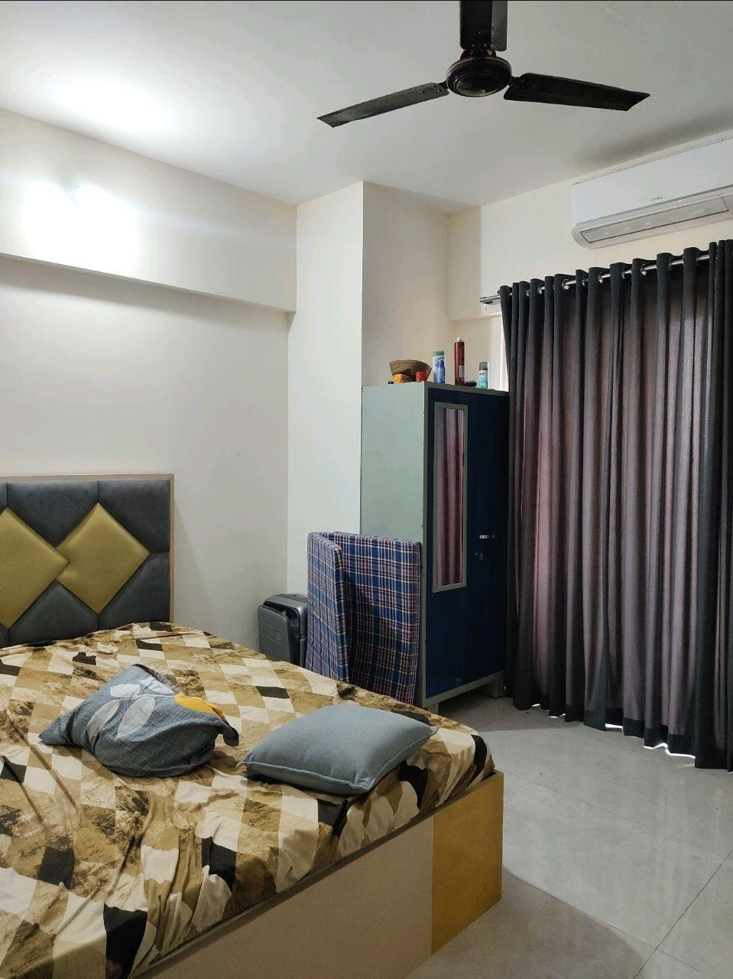
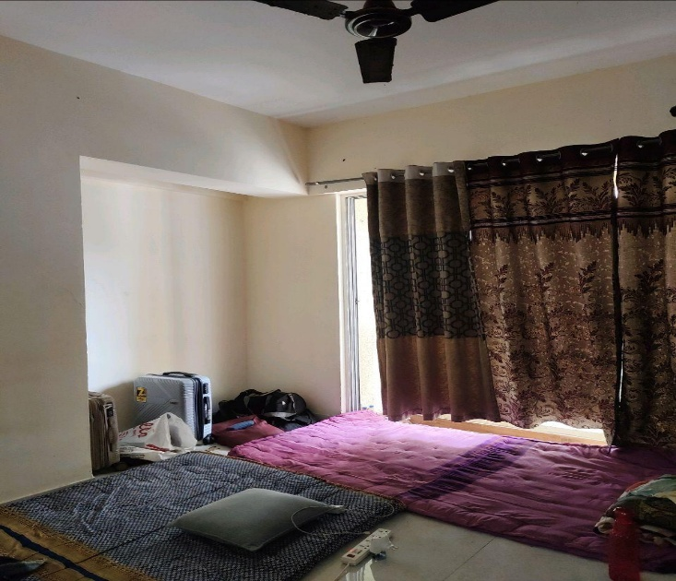
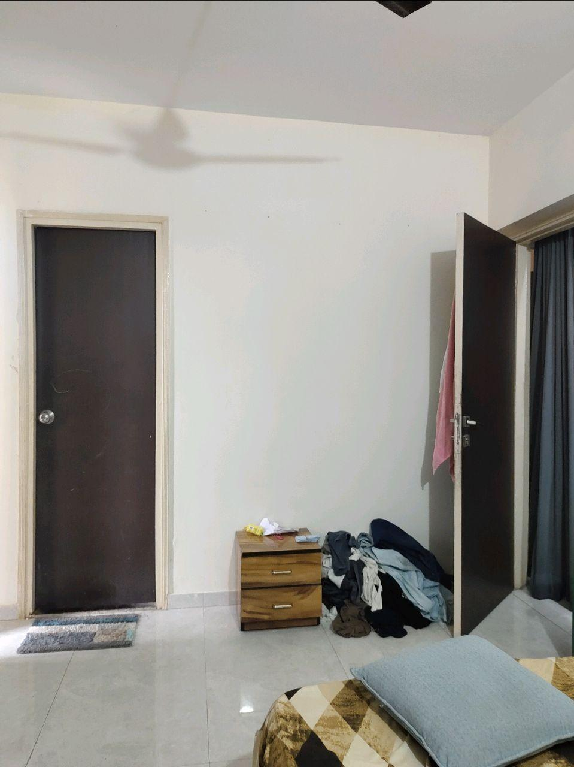
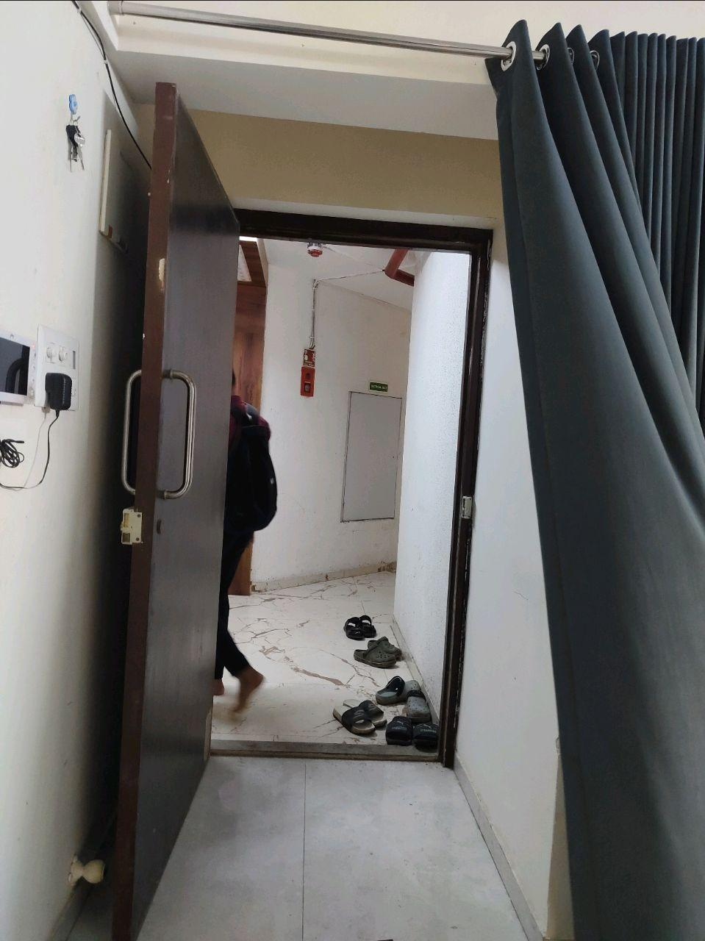
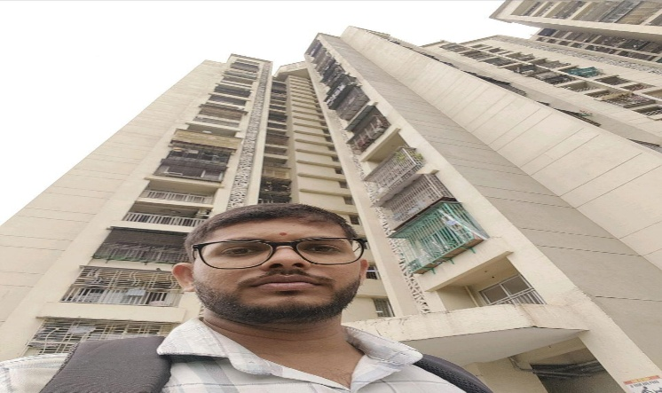
V.S.JADON & CO VALUERS LLP
PHOTOGRAPHS OF PROPERTY OF CUSTOMER : Maharashtra Steel Corporation
Photographs :
VSJCVNM-AXIS-RTL-SEP25-20740 Page 7

Slide 3
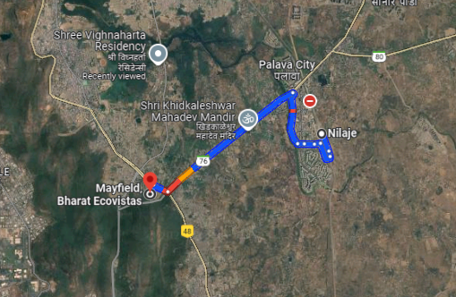
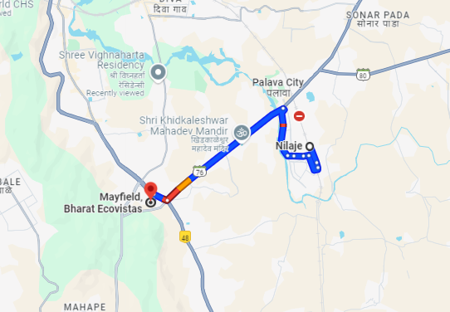
V.S.JADON & CO VALUERS LLP
PHOTOGRAPHS OF PROPERTY OF CUSTOMER : Maharashtra Steel Corporation
Google Map :
VSJCVNM-AXIS-RTL-SEP25-20740 Page 8

Slide 4
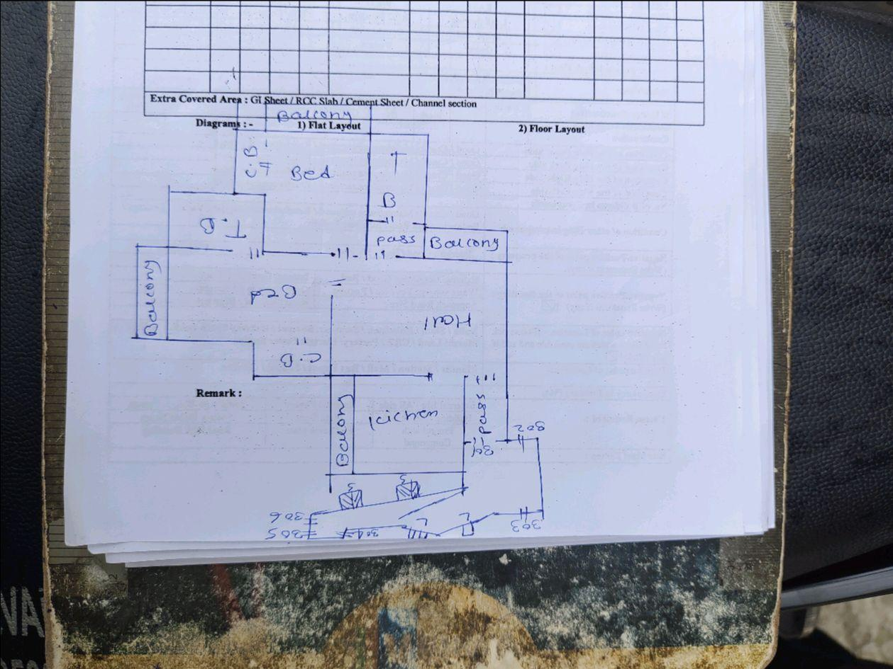
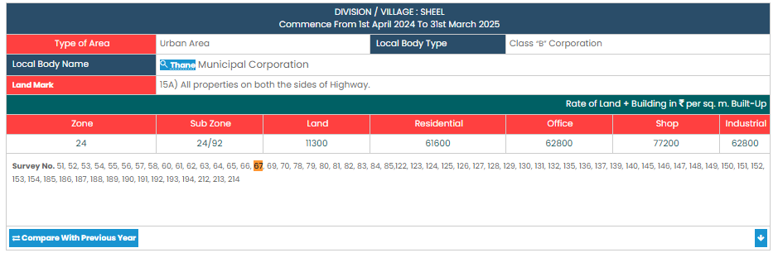
V.S.JADON & CO VALUERS LLP
PHOTOGRAPHS OF PROPERTY OF CUSTOMER : Maharashtra Steel Corporation
Government Rate :
VSJCVNM-AXIS-RTL-SEP25-20740 Page 9

