Slide 1
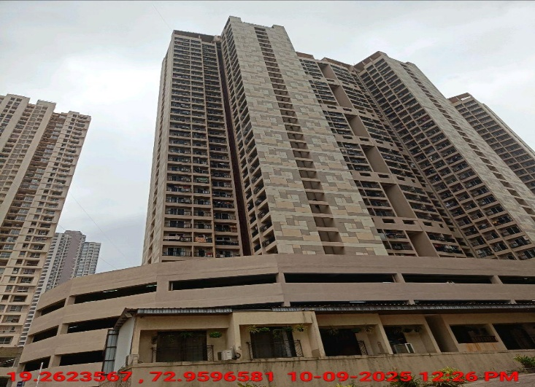
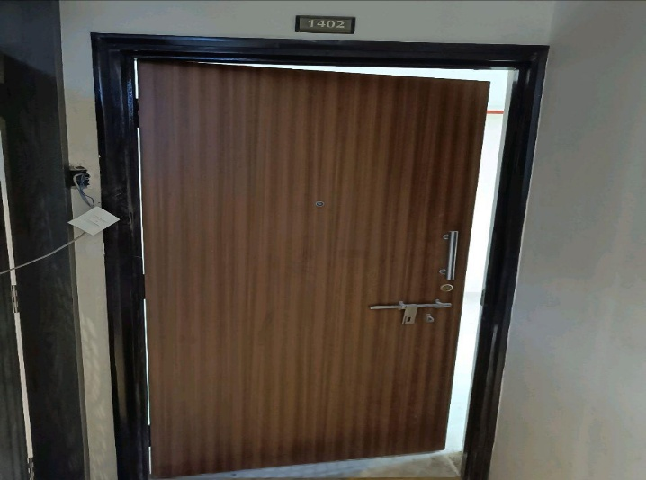
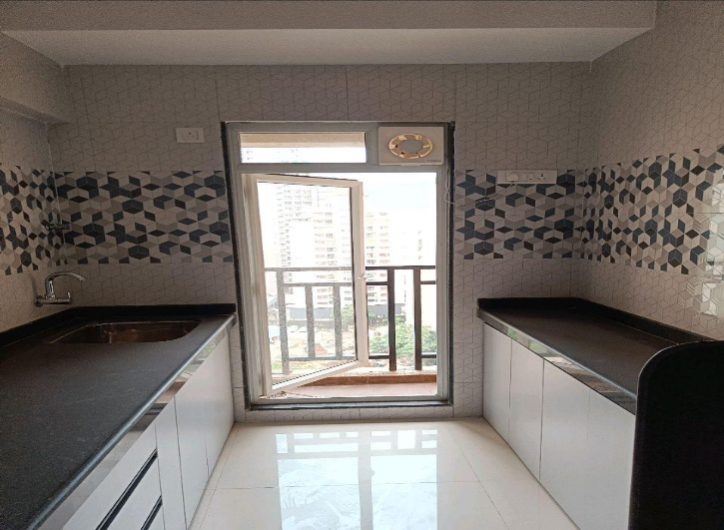
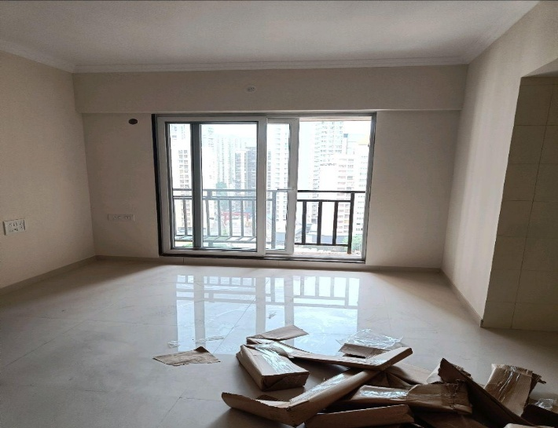
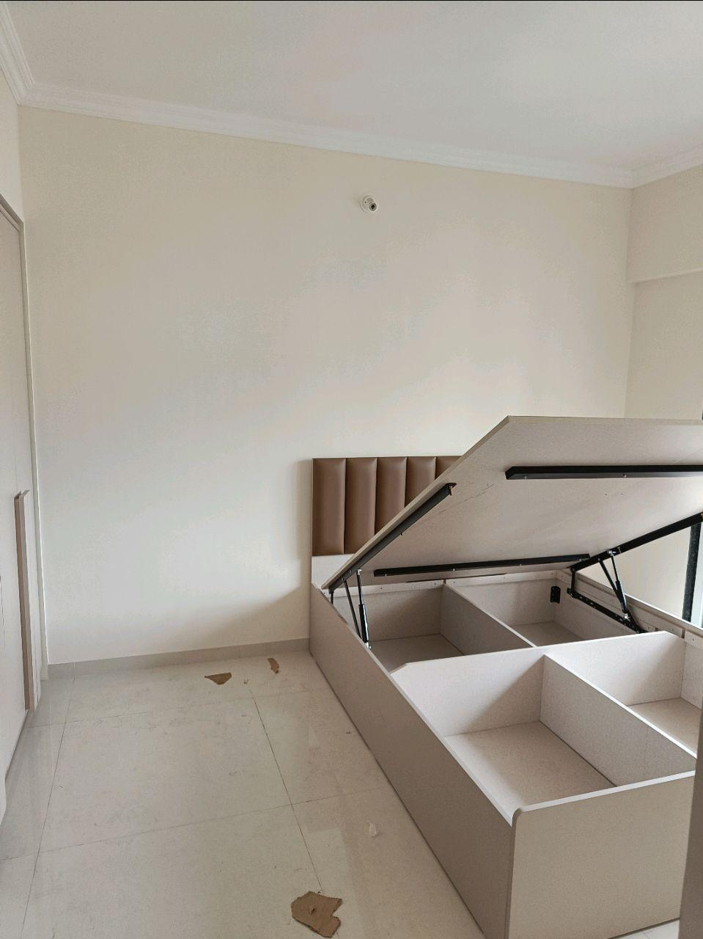
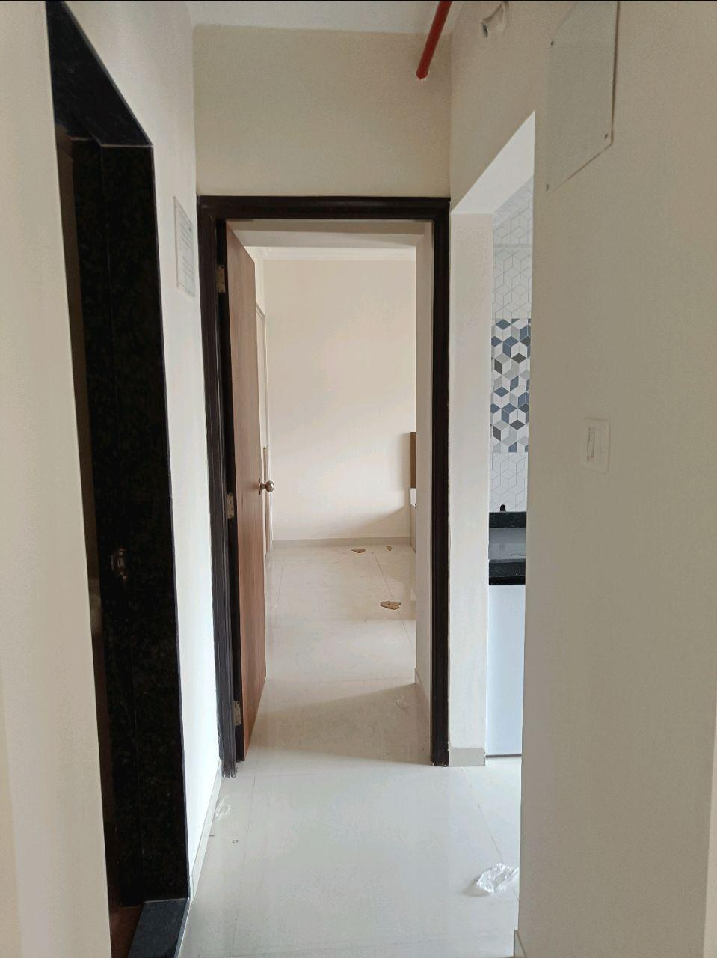
V.S.JADON & CO VALUERS LLP
PHOTOGRAPHS OF PROPERTY OF CUSTOMER Shrikant Gole
VSJCVNM-PNBHFL-RTL-SEP25-20749
Page 1

Slide 2
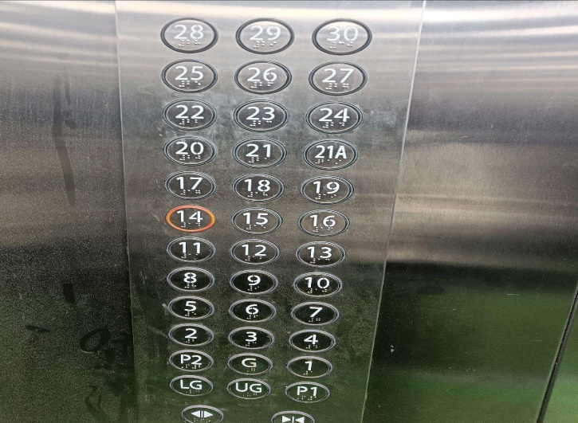

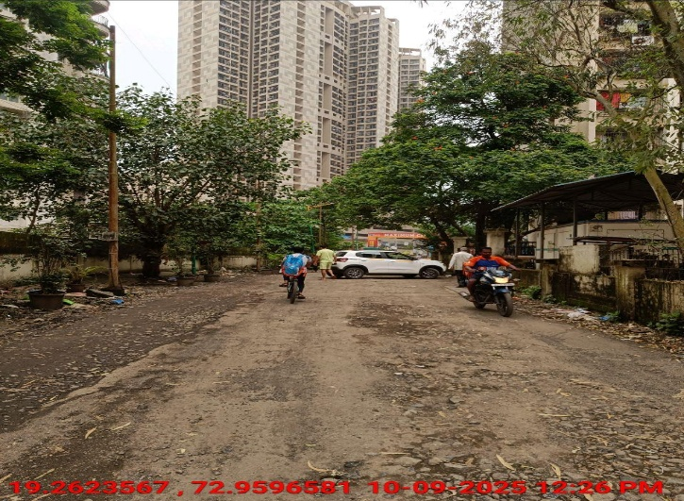
V.S.JADON & CO VALUERS LLP
PHOTOGRAPHS OF PROPERTY OF CUSTOMER Shrikant Gole
VSJCVNM-PNBHFL-RTL-SEP25-20749
Page 2

Slide 3
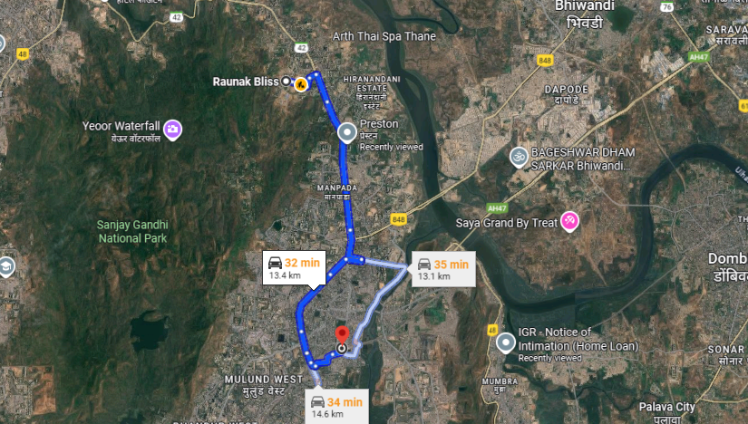
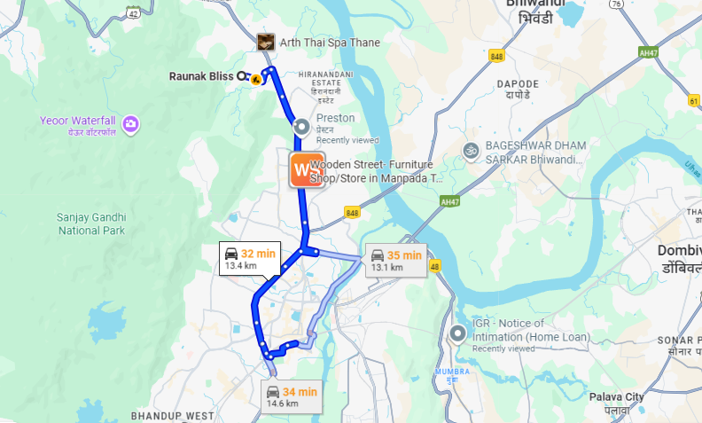
V.S.JADON & CO VALUERS LLP
PHOTOGRAPHS OF PROPERTY OF CUSTOMER Shrikant Gole
Google Map
VSJCVNM-PNBHFL-RTL-SEP25-20749
Page 3

Slide 4
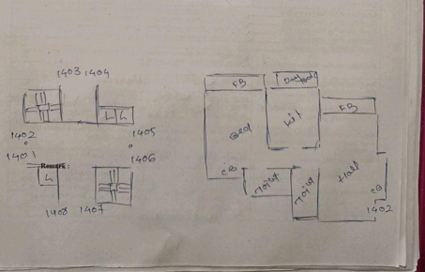
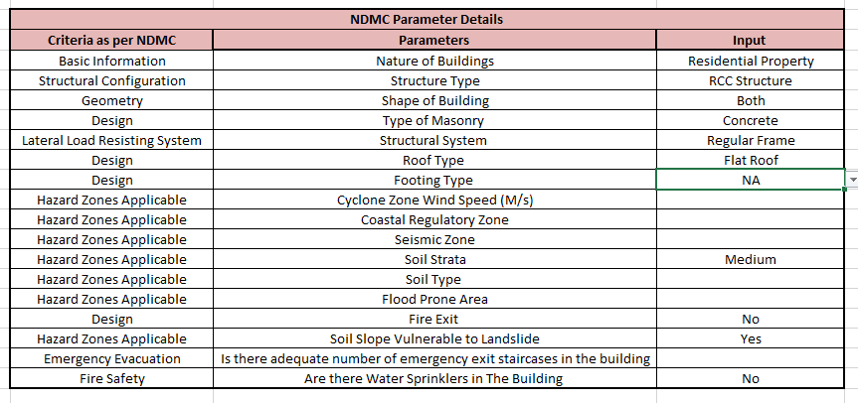
V.S.JADON & CO VALUERS LLP
PHOTOGRAPHS OF PROPERTY OF CUSTOMER Shrikant Gole
Plan
VSJCVNM-PNBHFL-RTL-SEP25-20749
Page 4

