Slide 1
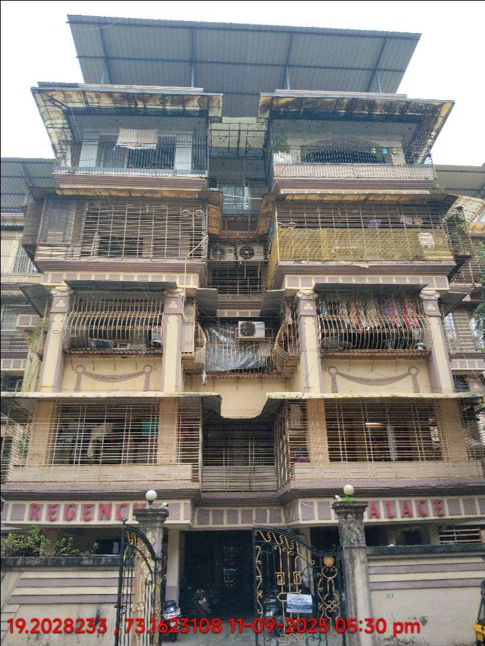
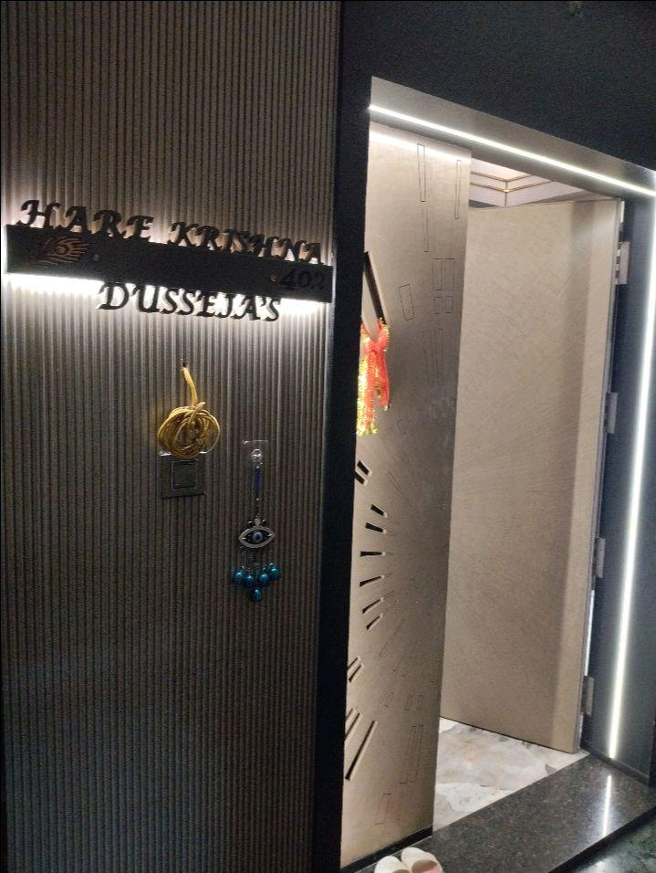
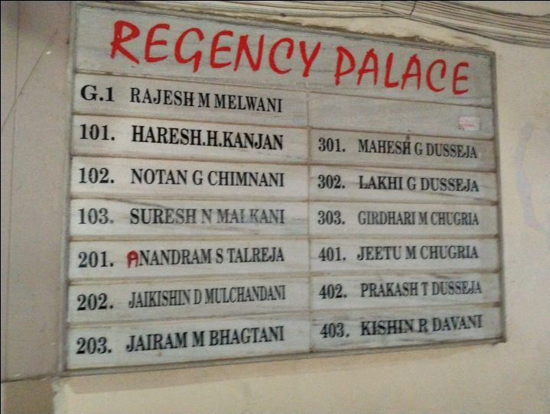
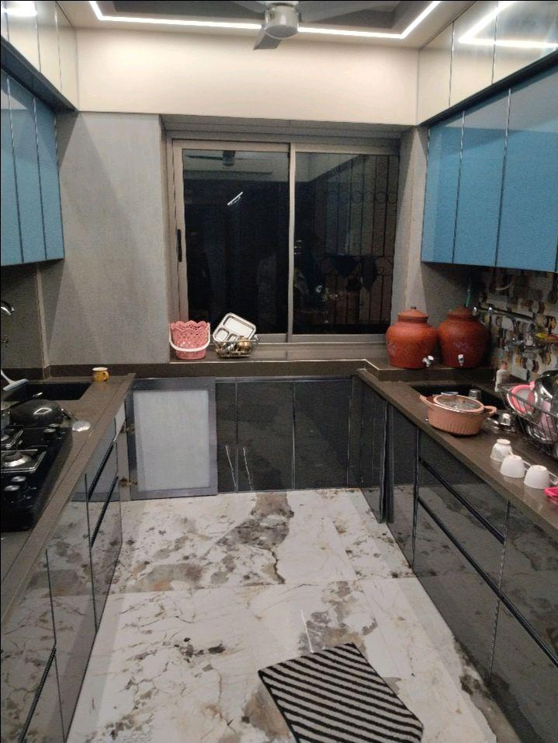
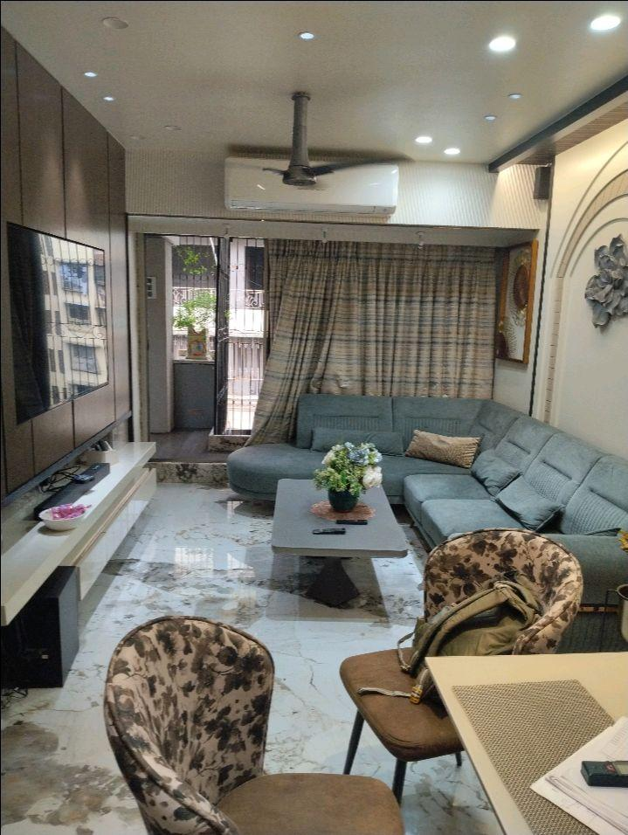
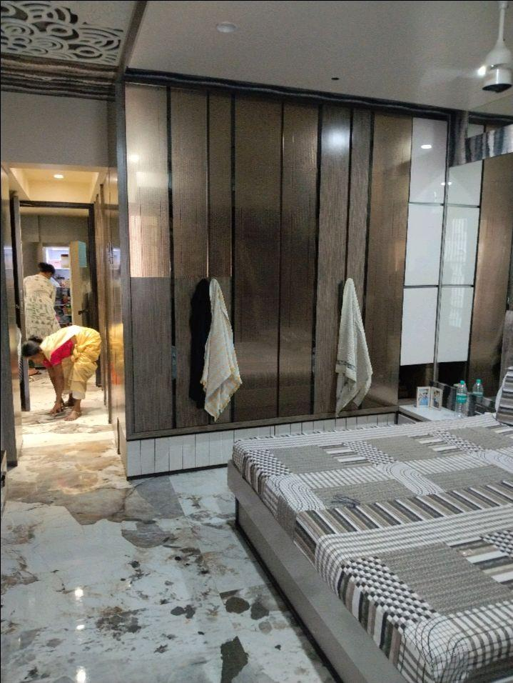
V.S.JADON & CO VALUERS LLP
PHOTOGRAPHS OF PROPERTY OF CUSTOMER -Kanya Garments
VSJCVNM-AXIS-RTL-SEP25-20815
Page 1

Slide 2
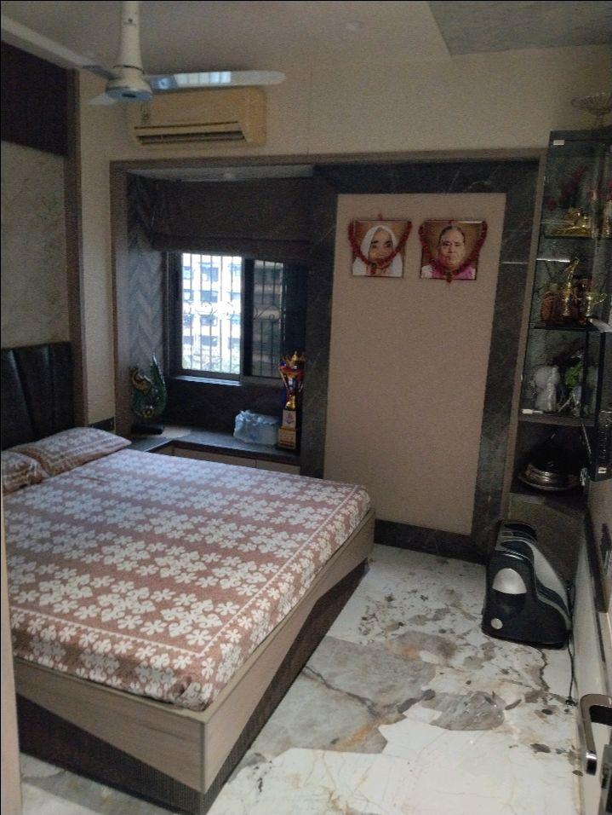
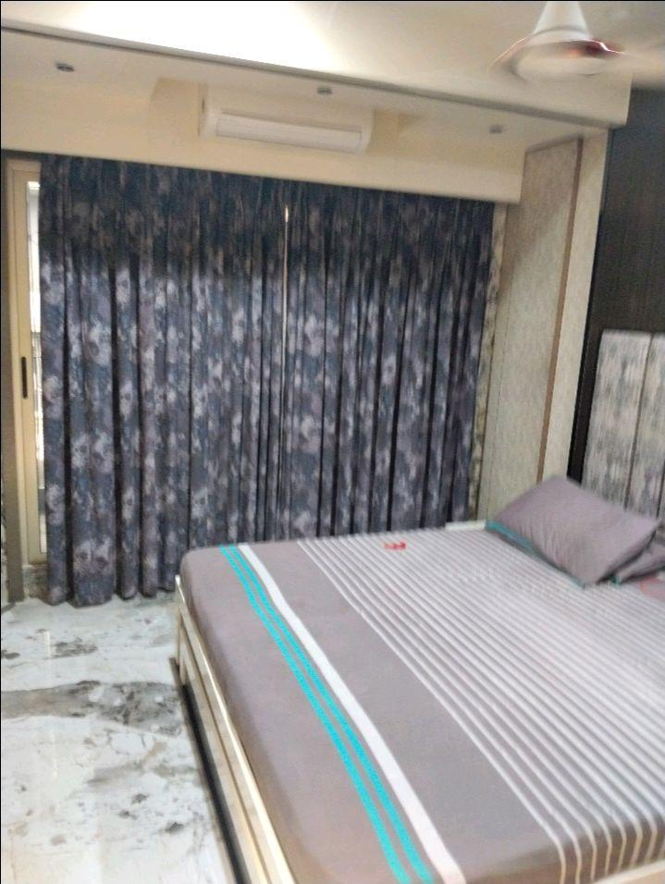
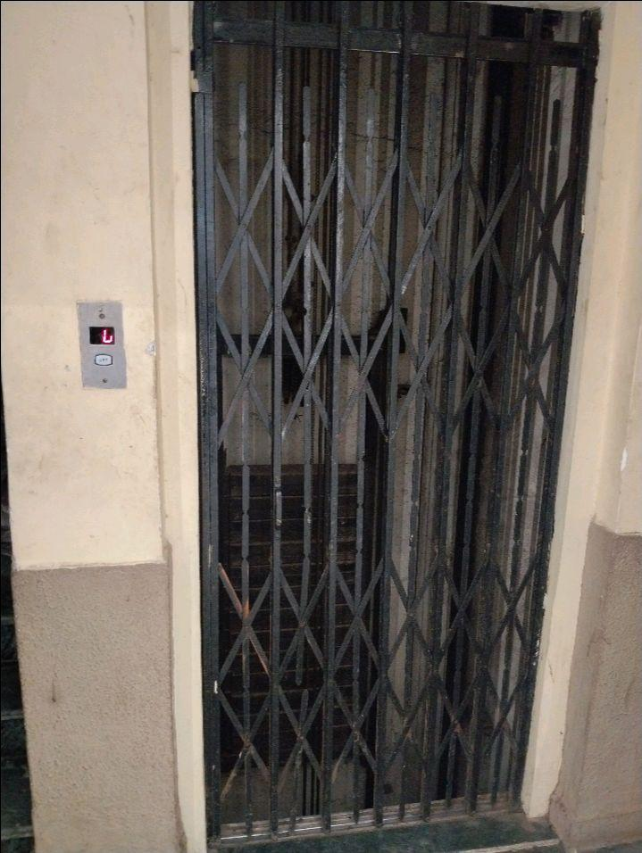
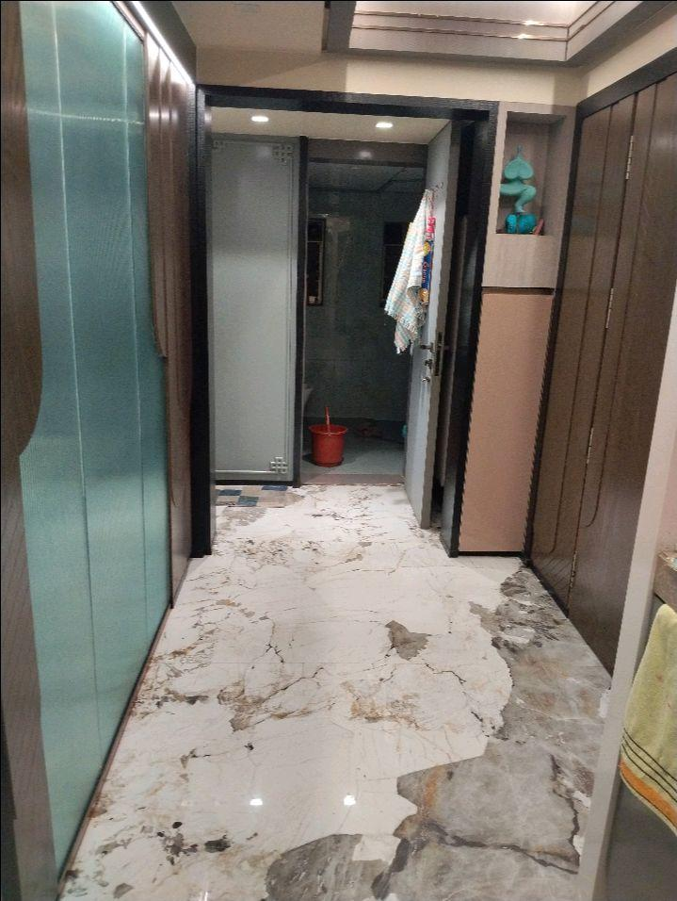
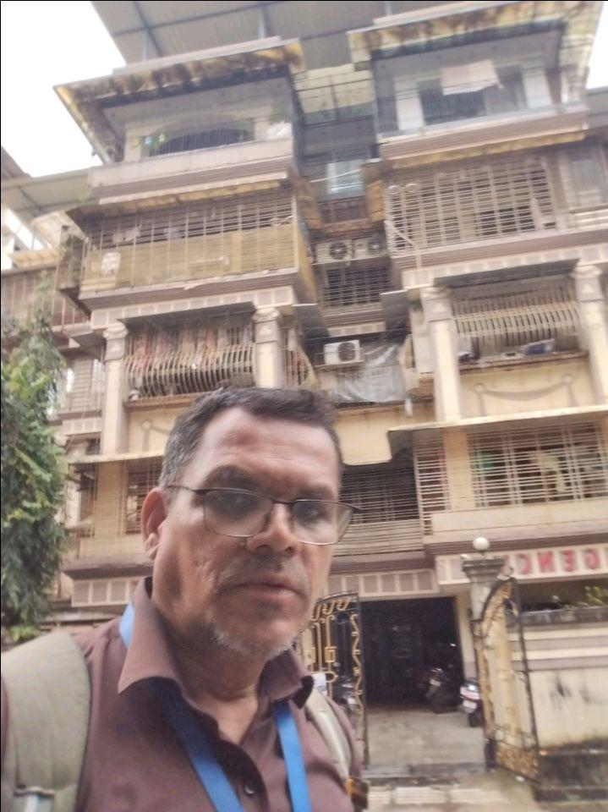
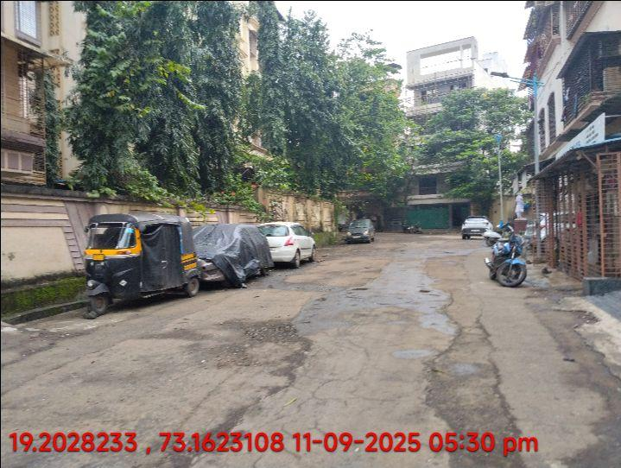
V.S.JADON & CO VALUERS LLP
PHOTOGRAPHS OF PROPERTY OF CUSTOMER Kanya Garments
VSJCVNM-AXIS-RTL-SEP25-20815
Page 2

Slide 3
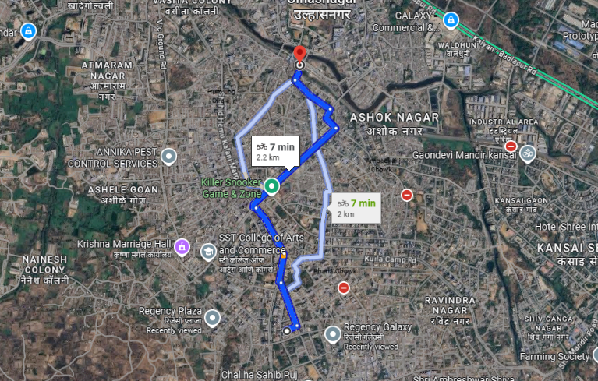
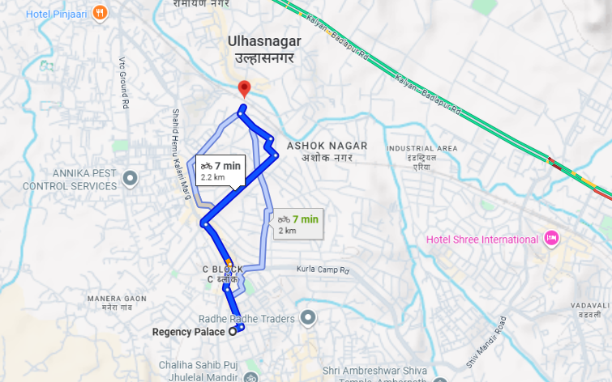
V.S.JADON & CO VALUERS LLP
PHOTOGRAPHS OF PROPERTY OF CUSTOMER : Kanya Garments
Google Map
VSJCVNM-AXIS-RTL-SEP25-20815
Page 3

Slide 4
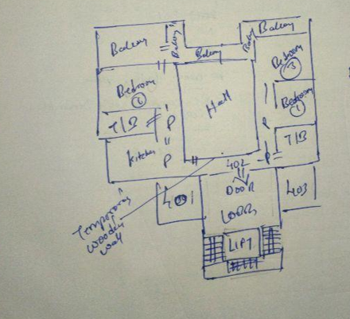
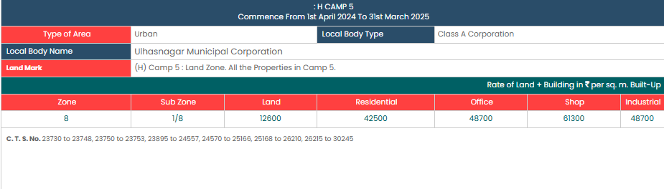
V.S.JADON & CO VALUERS LLP
PHOTOGRAPHS OF PROPERTY OF CUSTOMER Kanya Garments
Site Layout & Gov Rate
VSJCVNM-AXIS-RTL-SEP25-20815 Page 4

