Slide 1
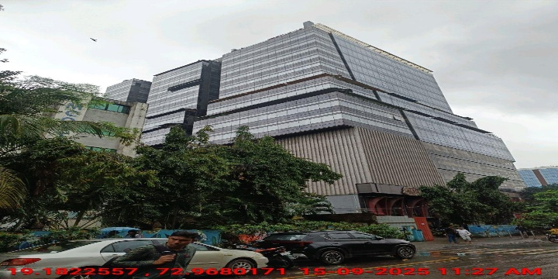
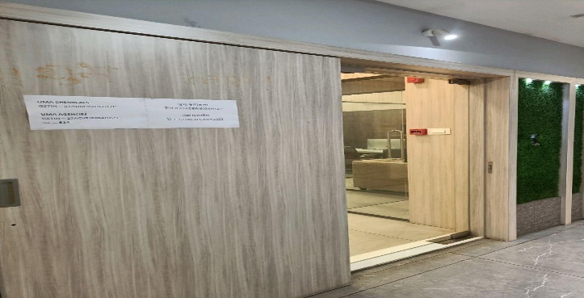
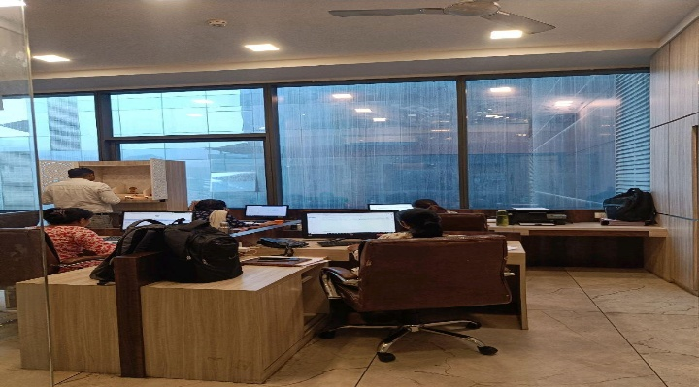
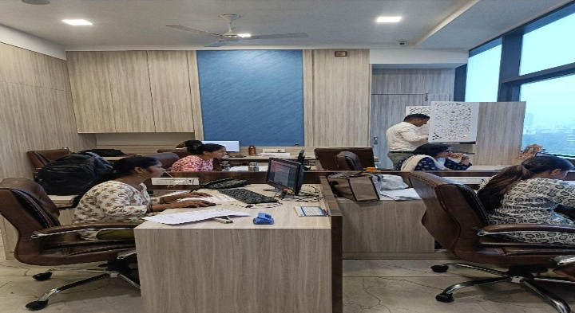
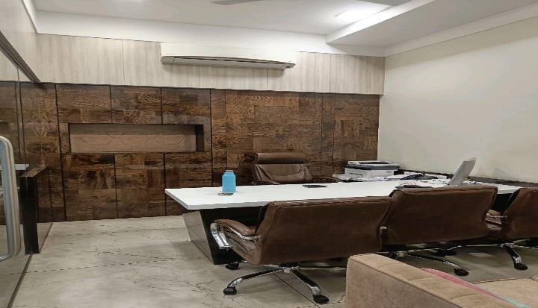
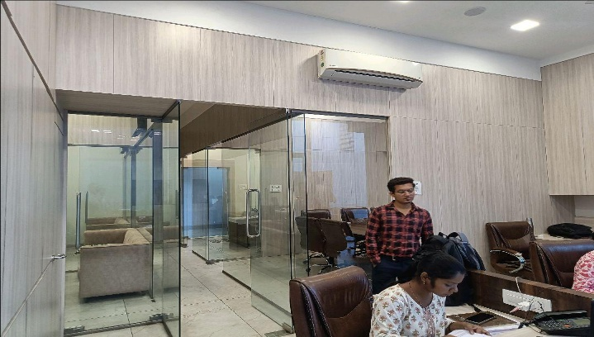
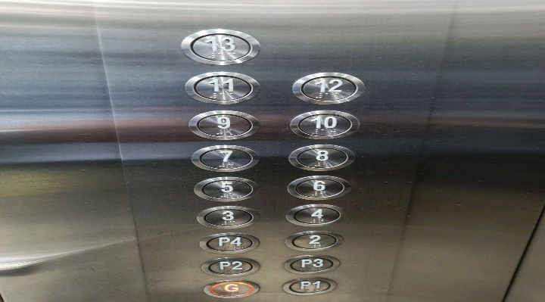
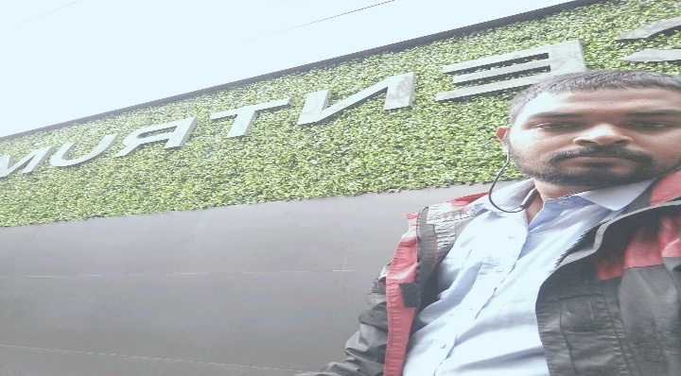
V.S.JADON & CO VALUERS LLP
PHOTOGRAPHS OF PROPERTY OF CUSTOMER: Uma Chemicals
Site Photo
VSJCVNM-RBL-RTL-AUG25-21318 Page 6

Slide 2
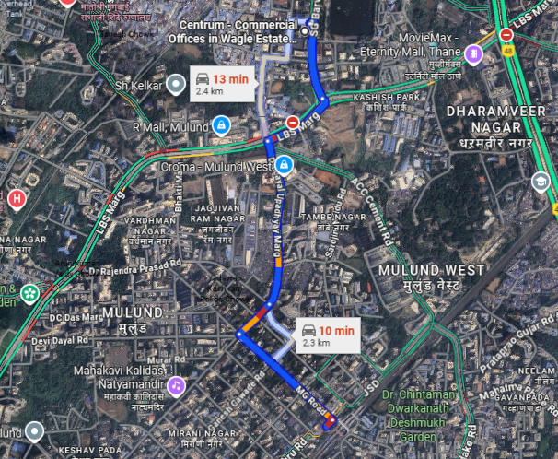
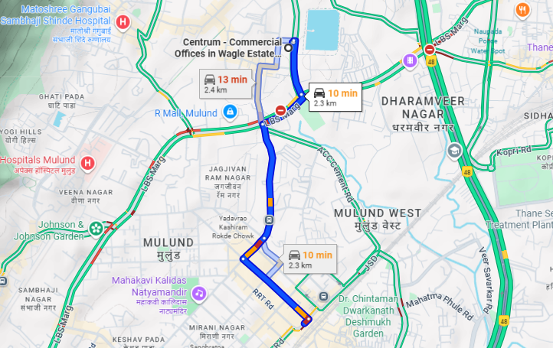
V.S.JADON & CO VALUERS LLP
PHOTOGRAPHS OF PROPERTY OF CUSTOMER: Uma Chemicals
Google Map :
VSJCVNM-RBL-RTL-AUG25-21318 Page 7

Slide 3
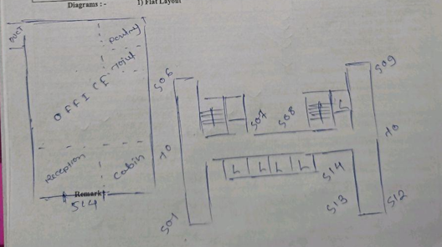
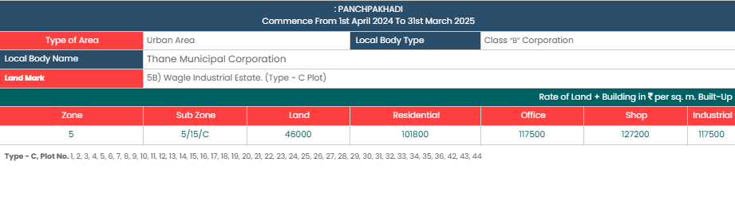
V.S.JADON & CO VALUERS LLP
PHOTOGRAPHS OF PROPERTY OF CUSTOMER: Uma Chemicals
Site Layout :
VSJCVNM-RBL-RTL-AUG25-21318 Page 8

