Slide 1
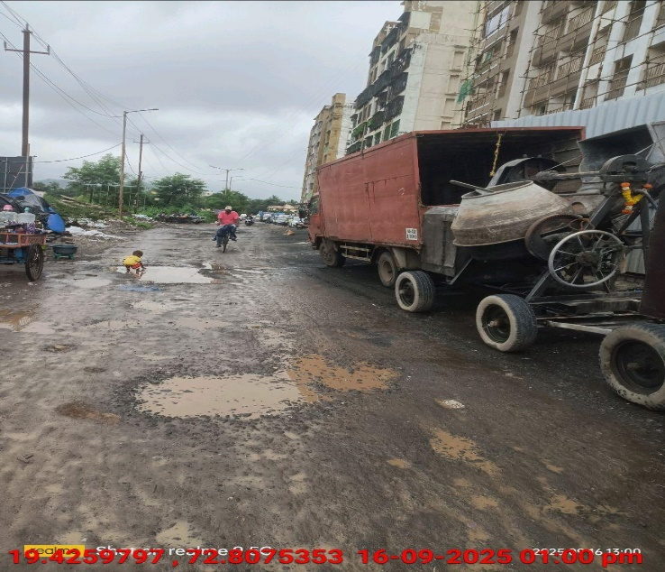
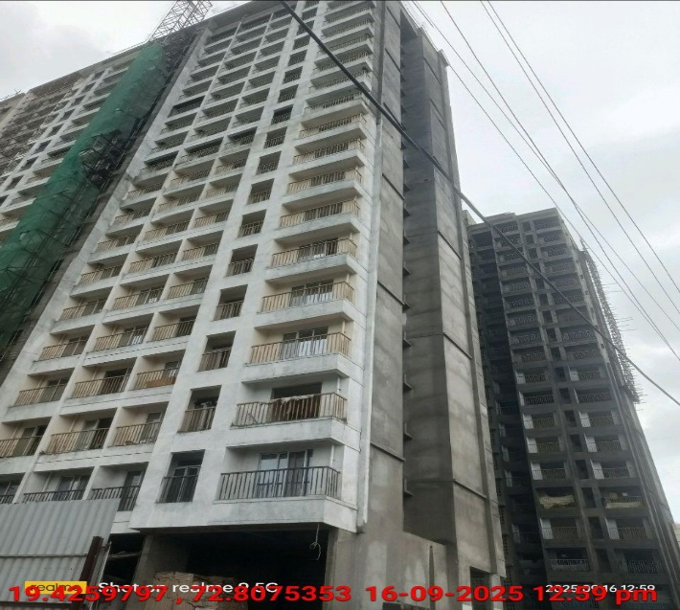
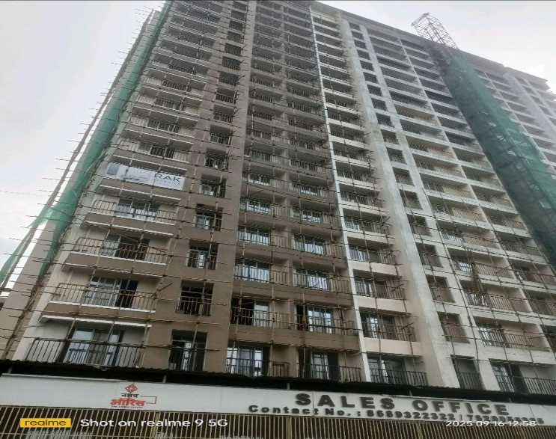
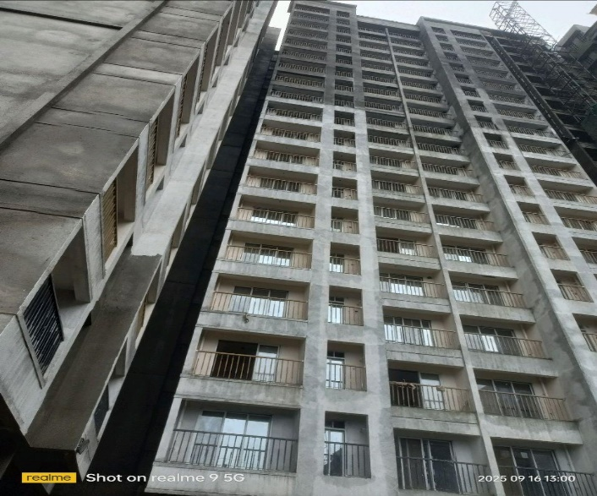
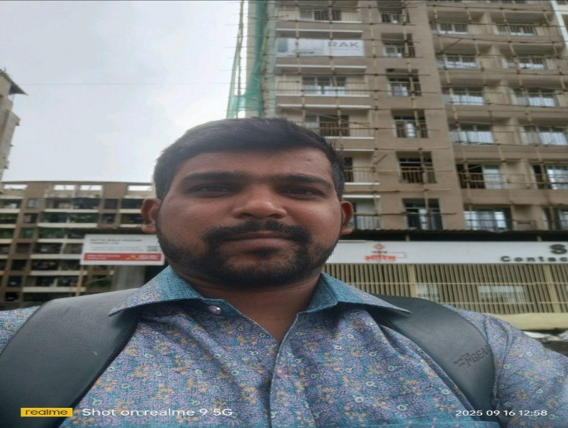
V.S.JADON & CO VALUERS LLP
Site Photo
PHOTOGRAPHS OF PROPERTY OF CUSTOMER: Mrs. Charlotte Ami Correia
VSJCVNM-PNBHFL-RTL-SEP25-21477 Page 5

Slide 2
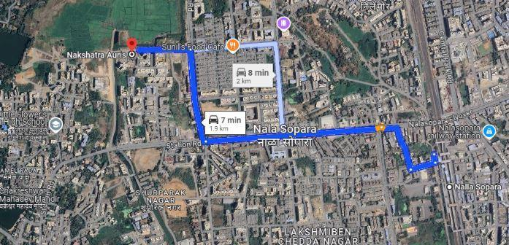
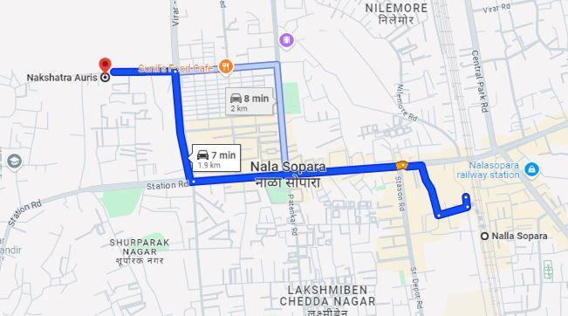
V.S.JADON & CO VALUERS LLP
PHOTOGRAPHS OF PROPERTY OF CUSTOMER: Mrs. Charlotte Ami Correia
Google Maps :
VSJCVNM-PNBHFL-RTL-SEP25-21477 Page 6

Slide 3
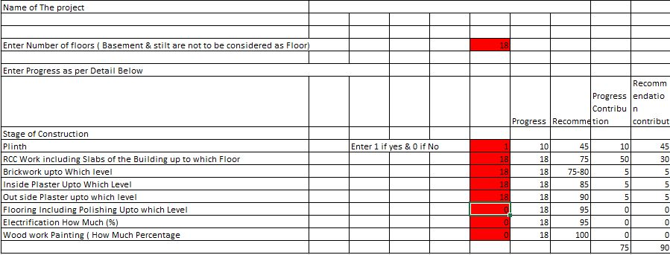
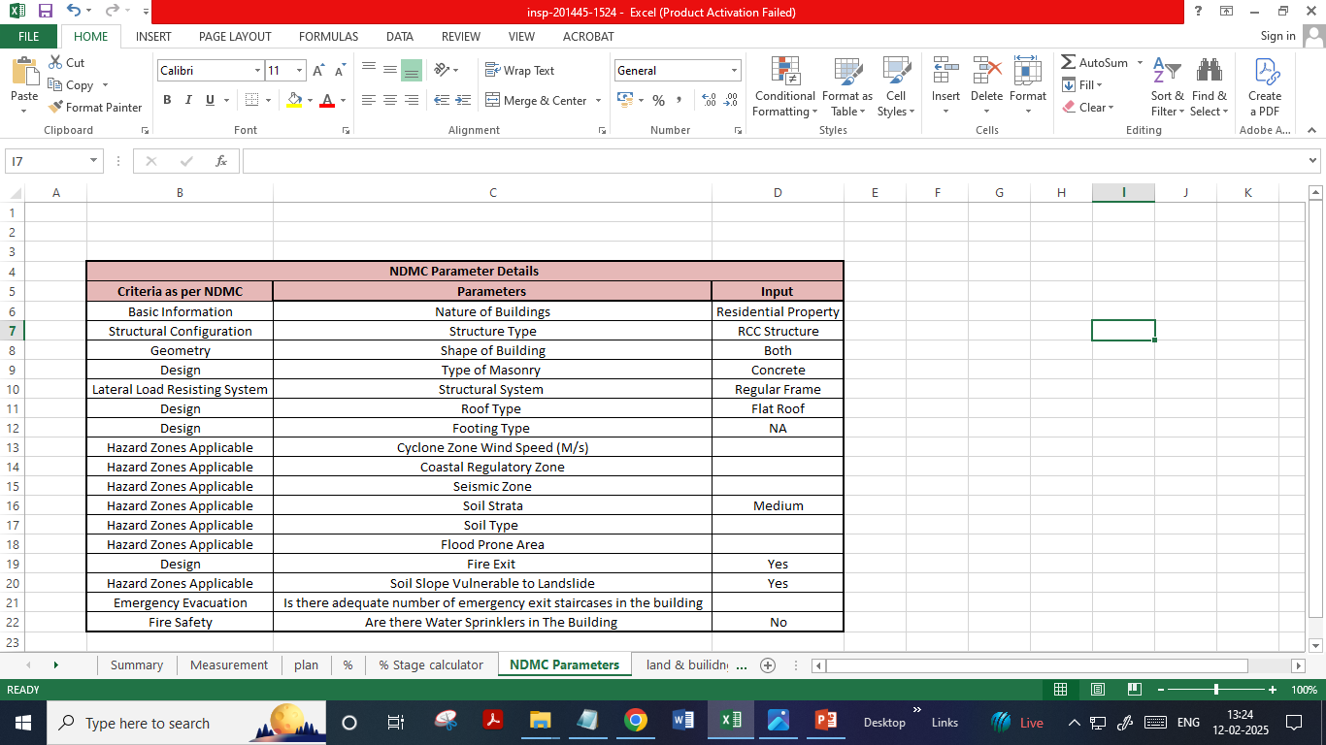
V.S.JADON & CO VALUERS LLP
PHOTOGRAPHS OF PROPERTY OF CUSTOMER: Mrs. Charlotte Ami Correia
Construction percentage & NDMC parameter:
VSJCVNM-PNBHFL-RTL-SEP25-21477 Page 7

