Slide 1
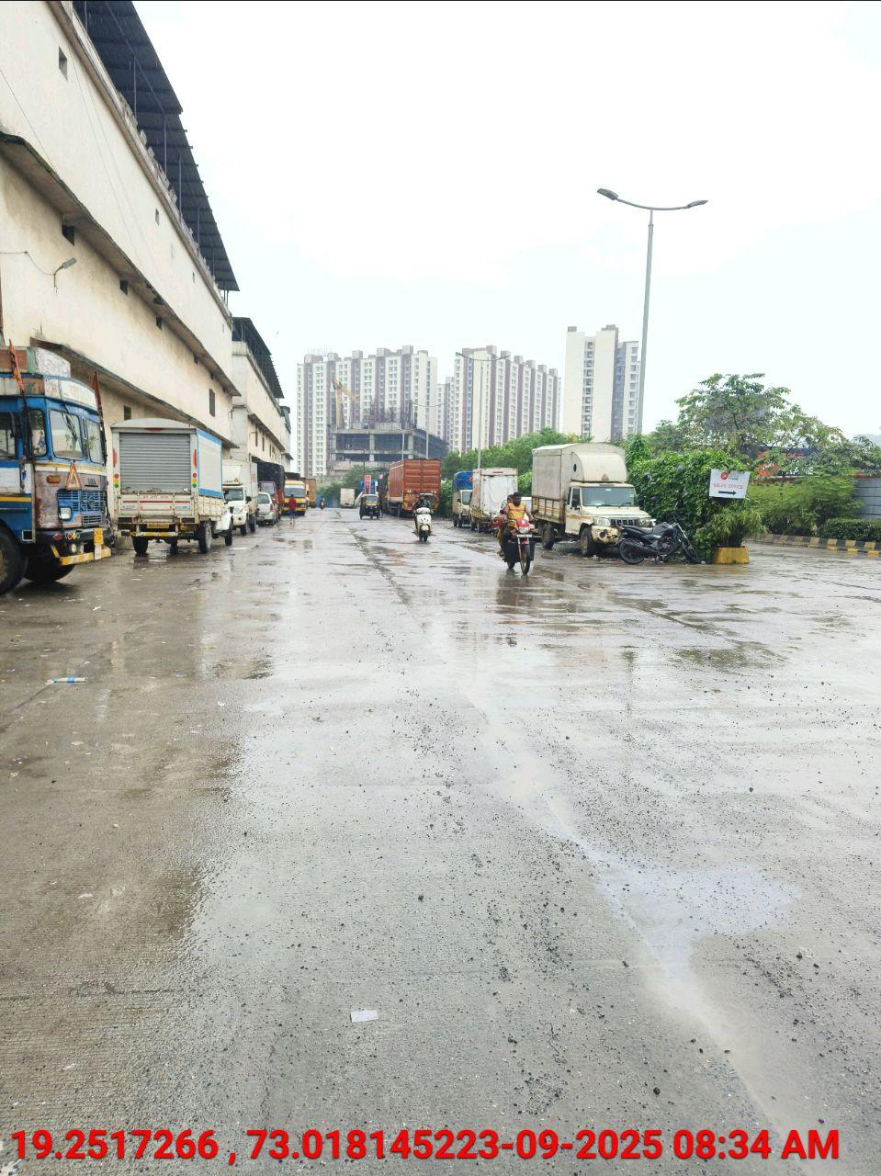
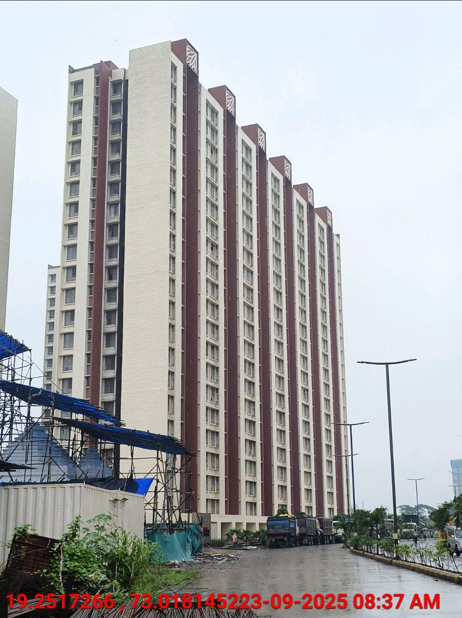
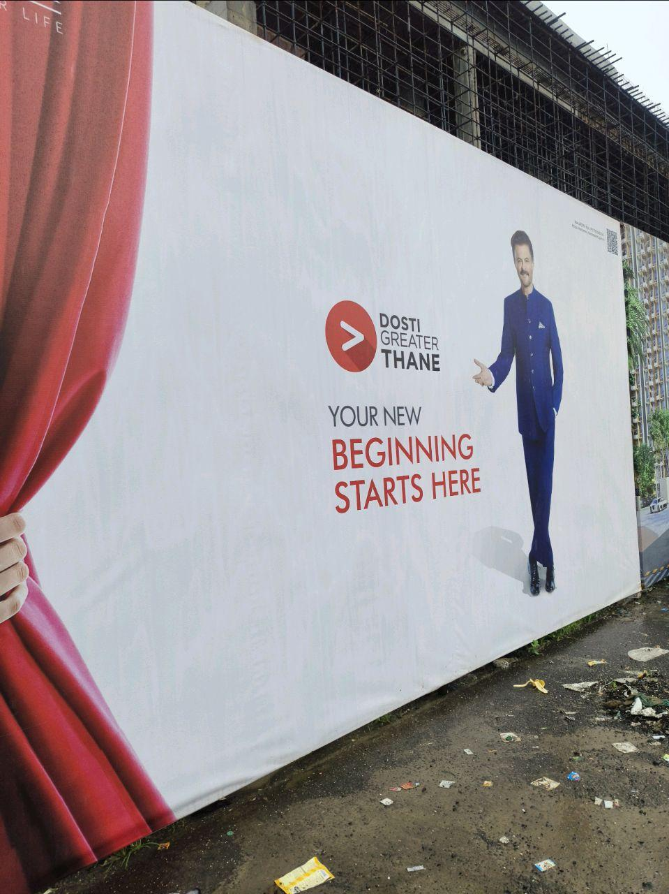
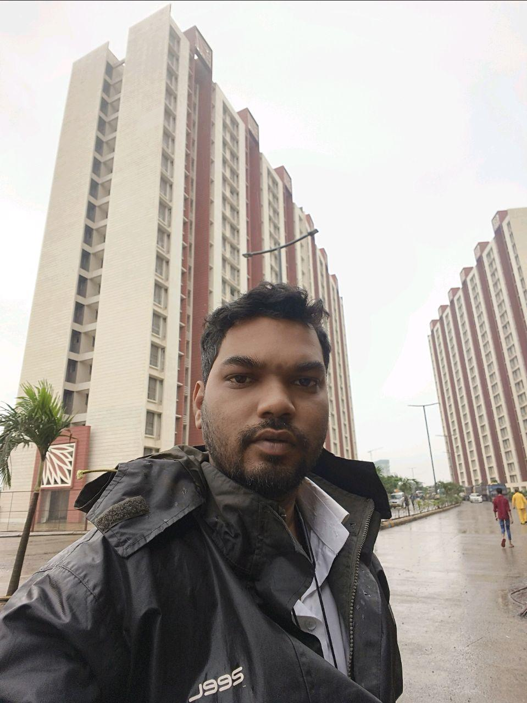
V.S.JADON & CO VALUERS LLP
Site Photo
PHOTOGRAPHS OF PROPERTY OF CUSTOMER: Dadaso Suraj Mane
VSJCVNM-PNBHFL-RTL-SEP25-21559 Page 1

Slide 2
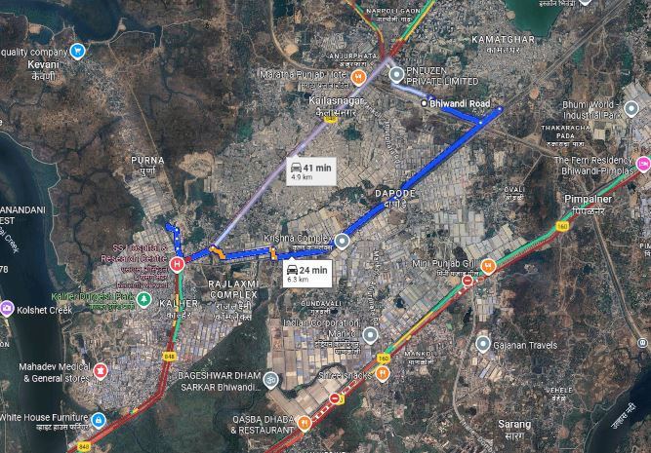
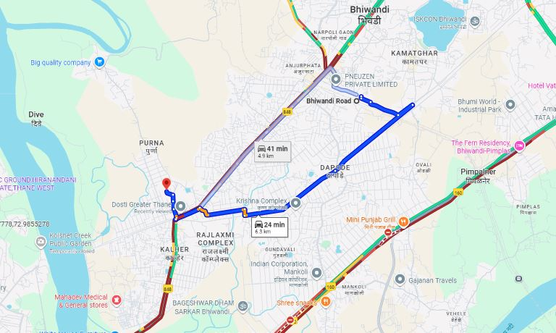
V.S.JADON & CO VALUERS LLP
PHOTOGRAPHS OF PROPERTY OF CUSTOMER: Dadaso Suraj Mane
Google Maps :
VSJCVNM-PNBHFL-RTL-SEP25-21559 Page 3

Slide 3
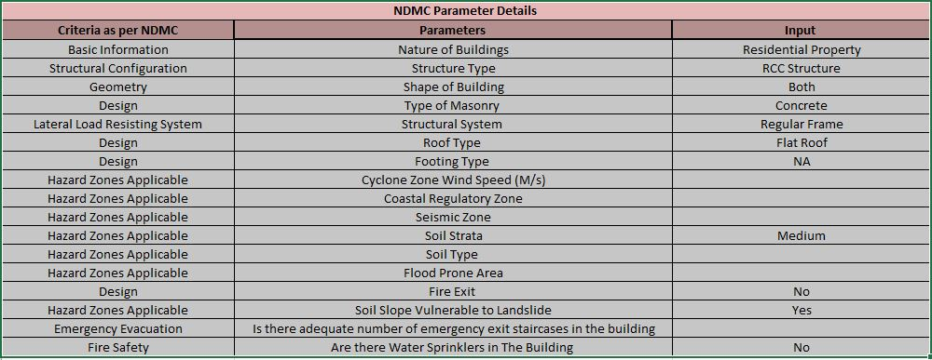
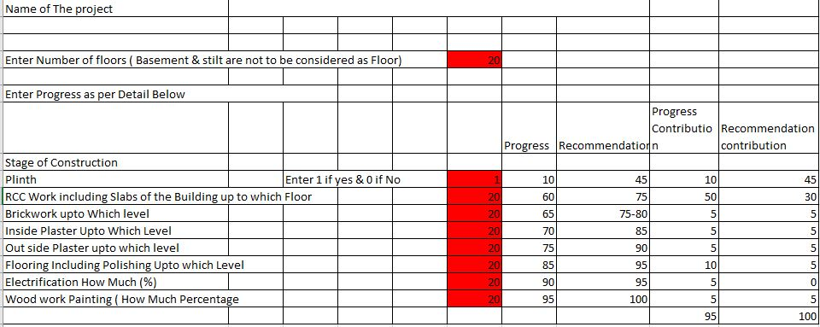
V.S.JADON & CO VALUERS LLP
PHOTOGRAPHS OF PROPERTY OF CUSTOMER: Dadaso Suraj Mane
VSJCVNM-PNBHFL-RTL-SEP25-21559 Page 3

