Slide 1
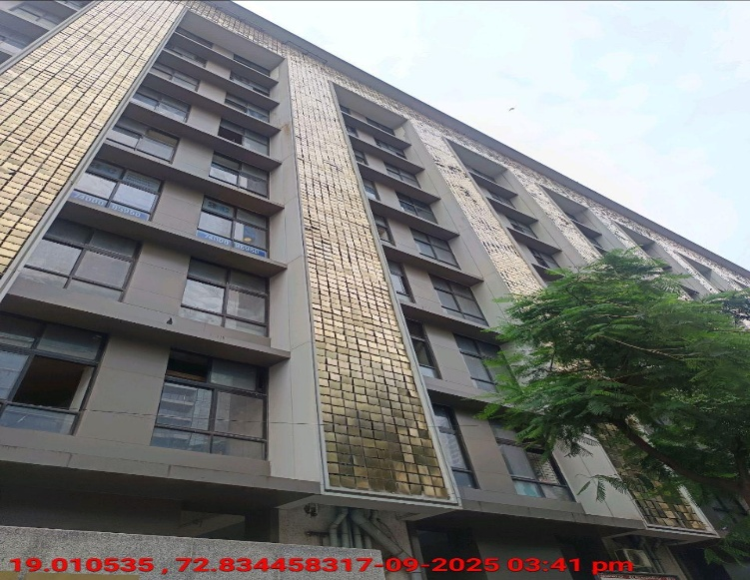
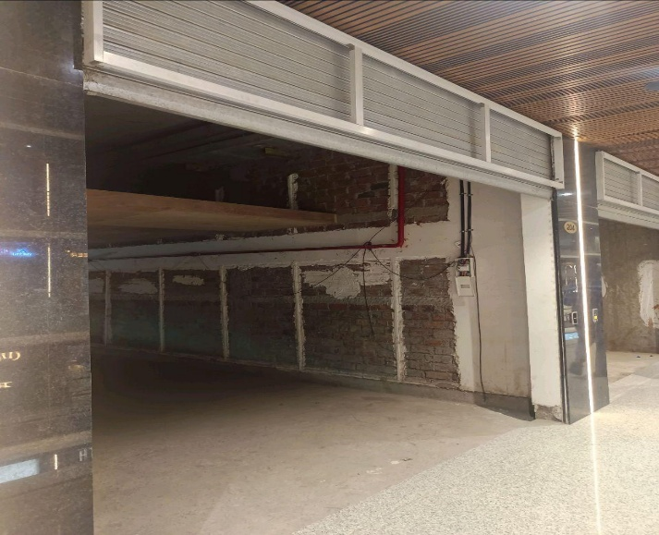
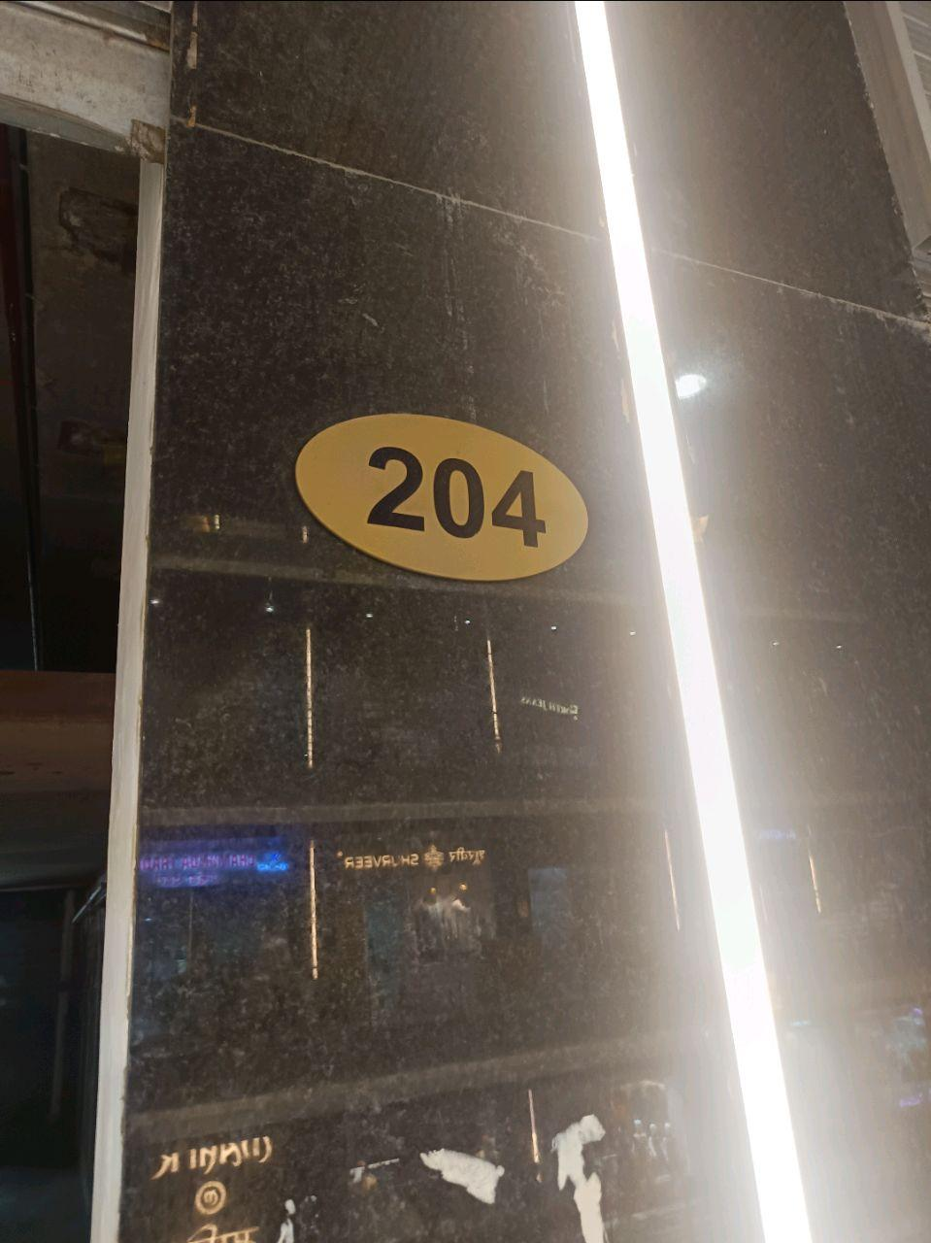
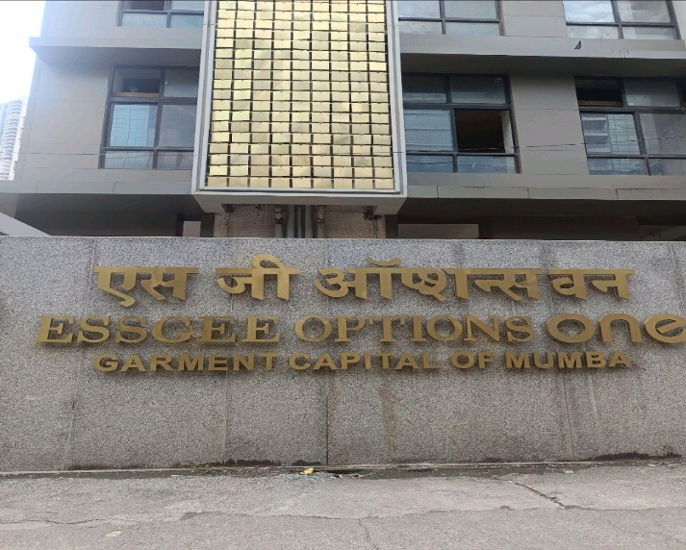
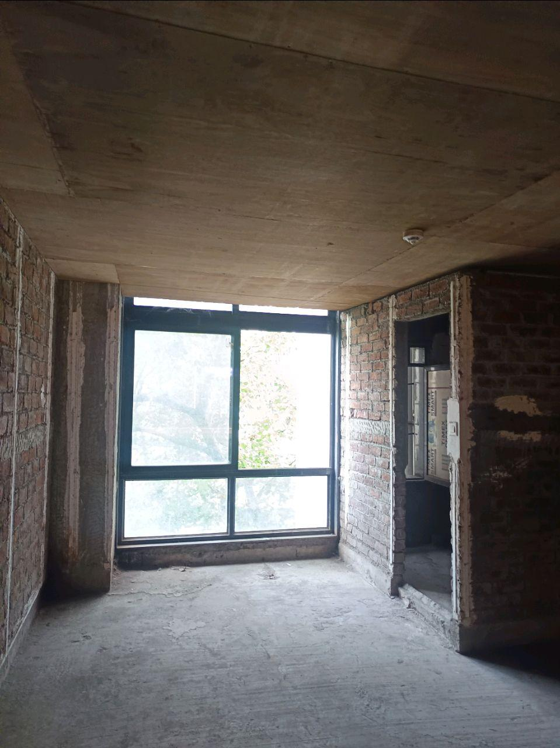
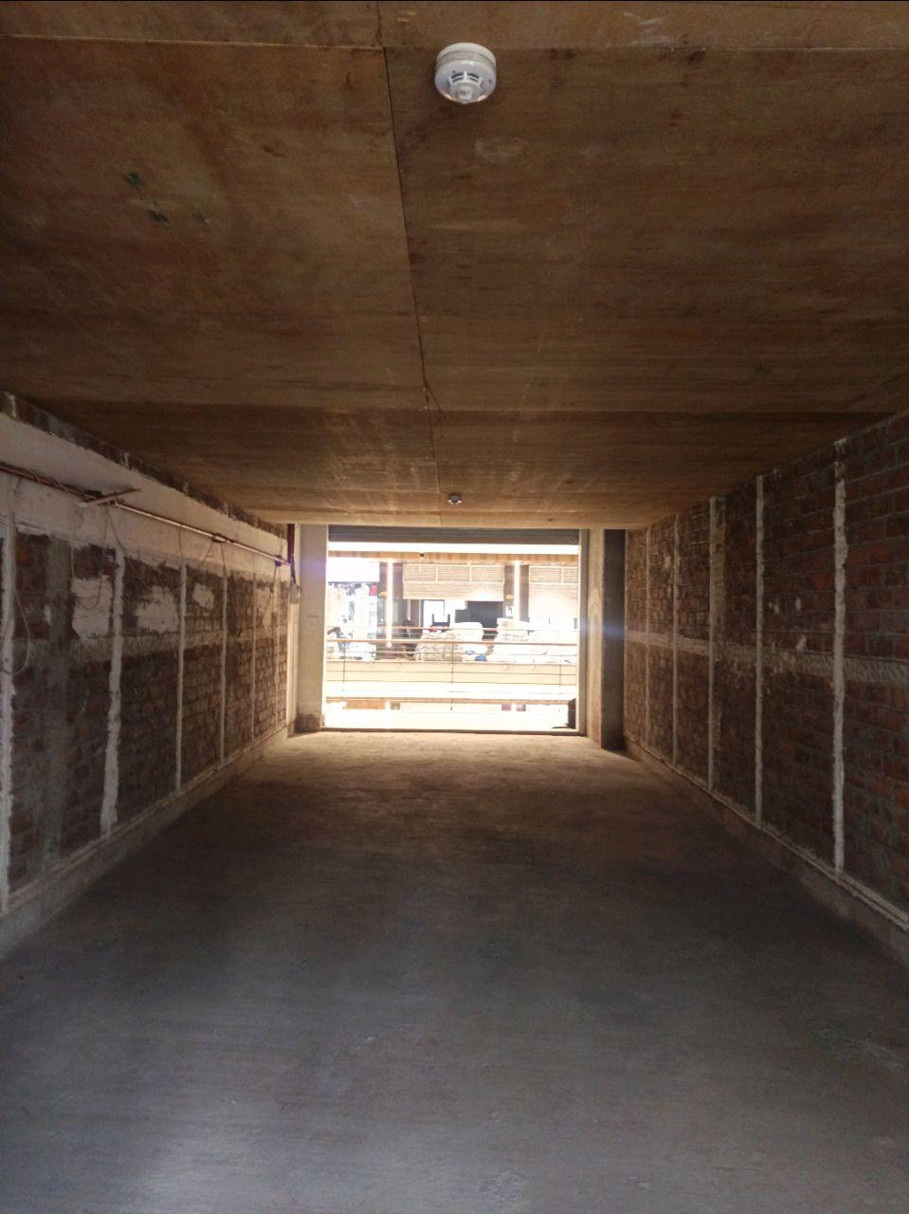
V.S.JADON & CO VALUERS LLP
Site Photo
PHOTOGRAPHS OF PROPERTY OF CUSTOMER: HARISH JOTWANI
VSJCVNM-AXIS-RTL-SEP25-21833 Page 6

Slide 2
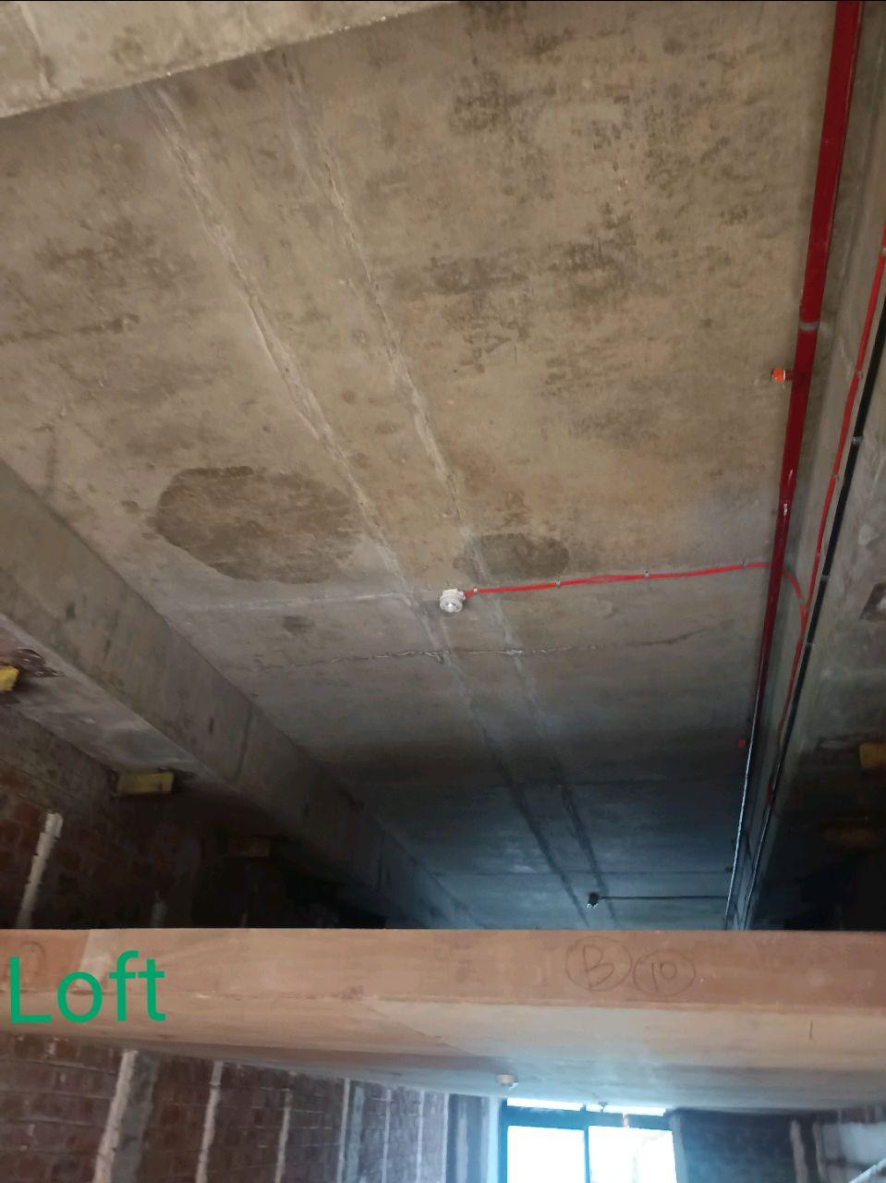
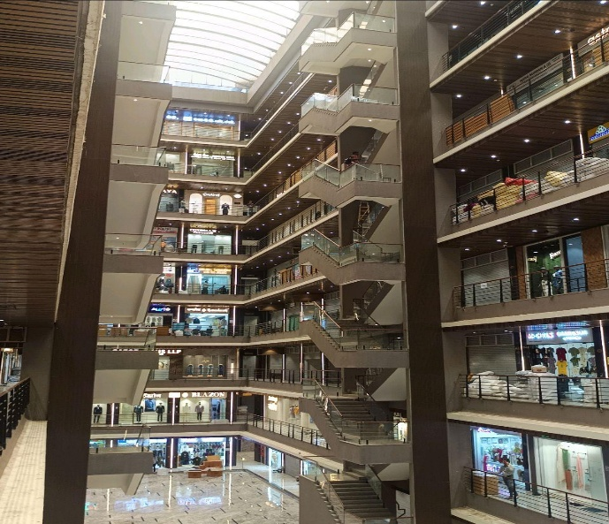
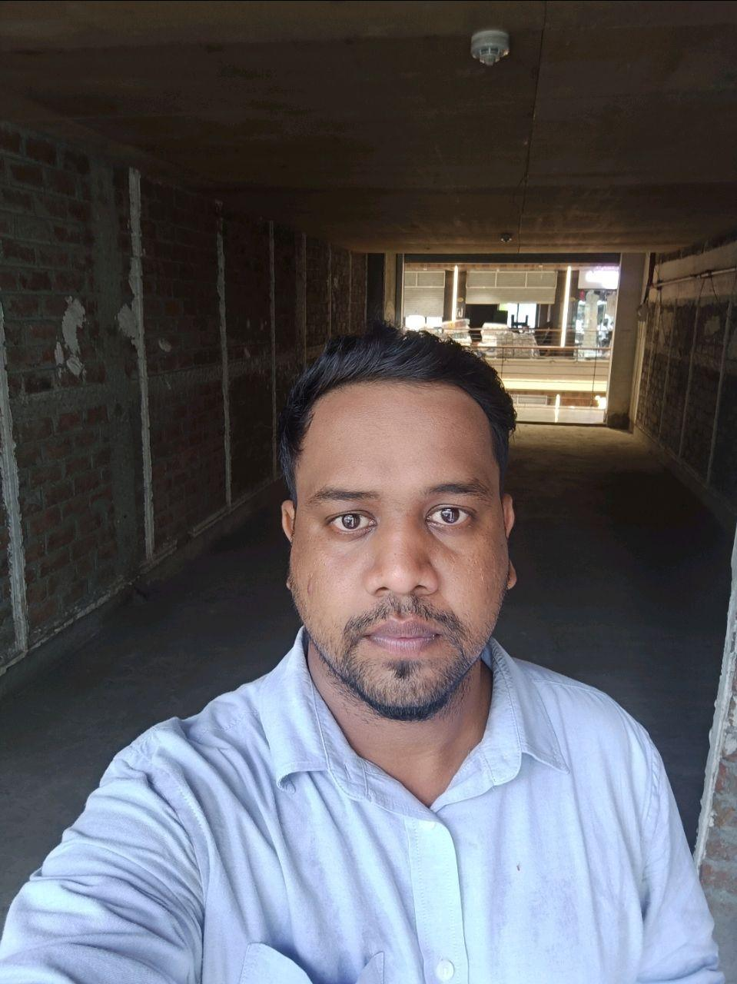
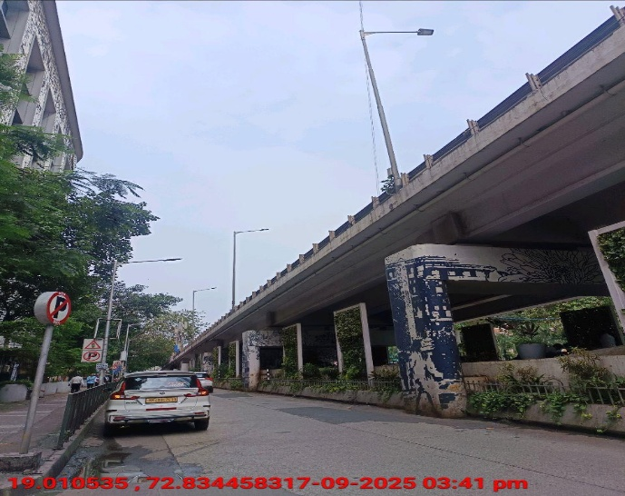
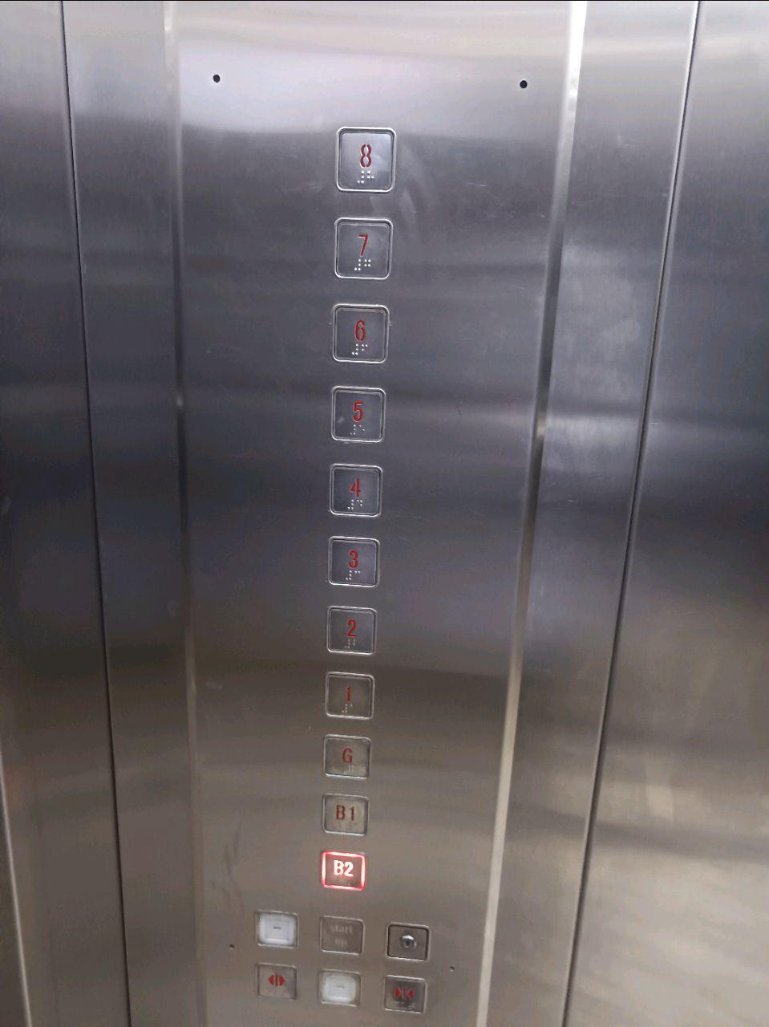
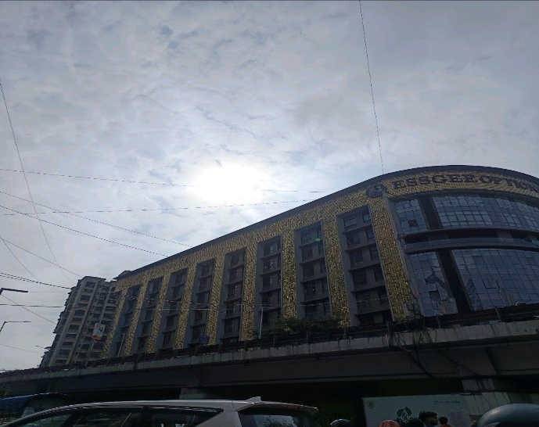
V.S.JADON & CO VALUERS LLP
Site Photo
VSJCVNM-AXIS-RTL-SEP25-21833 Page 7

Slide 3
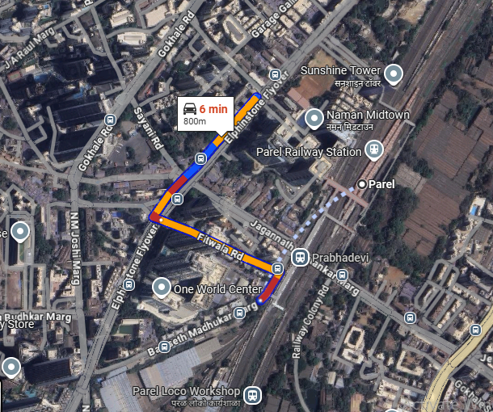
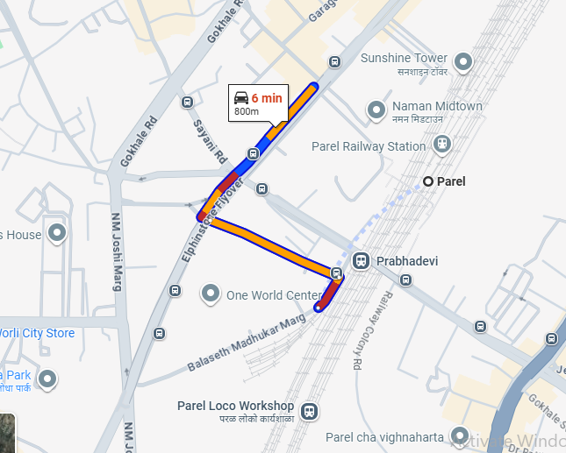
V.S.JADON & CO VALUERS LLP
PHOTOGRAPHS OF PROPERTY OF CUSTOMER: HARISH JOTWANI
Google Maps :
VSJCVNM-AXIS-RTL-SEP25-21833 Page 8

Slide 4
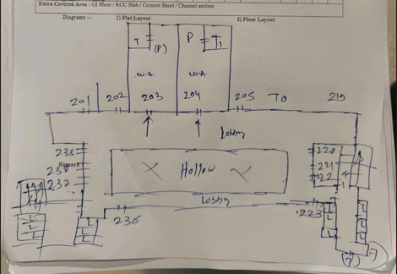
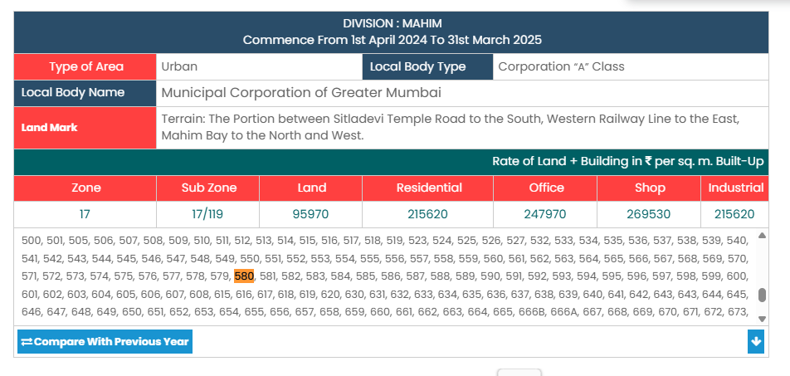
V.S.JADON & CO VALUERS LLP
PHOTOGRAPHS OF PROPERTY OF CUSTOMER: HARISH JOTWANI
Site Layout :
VSJCVNM-AXIS-RTL-SEP25-21833 Page 9

