Slide 1
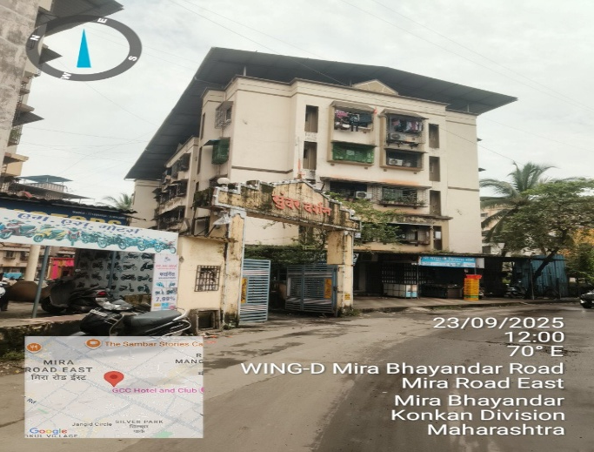
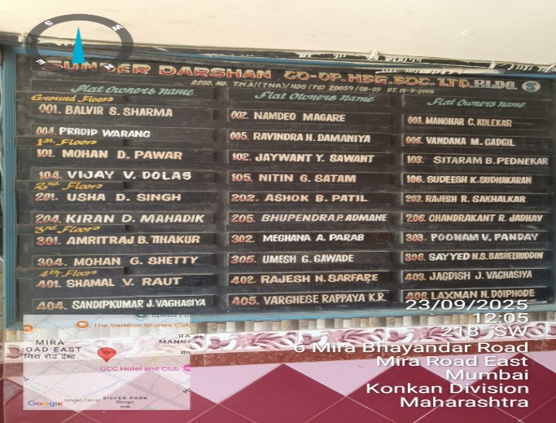
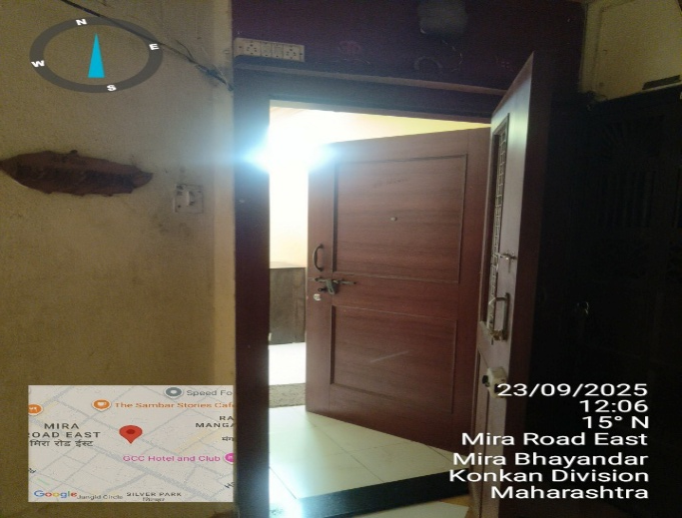
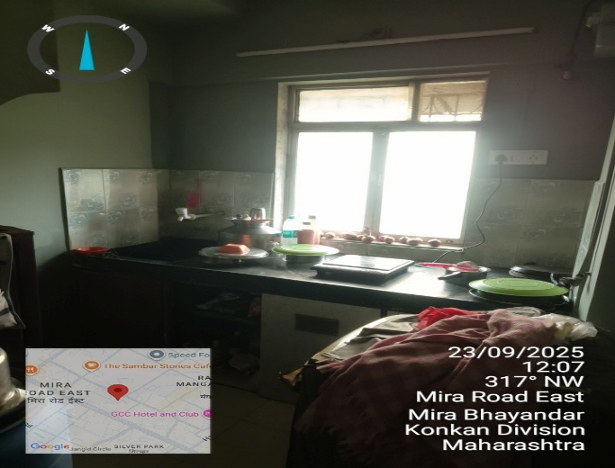
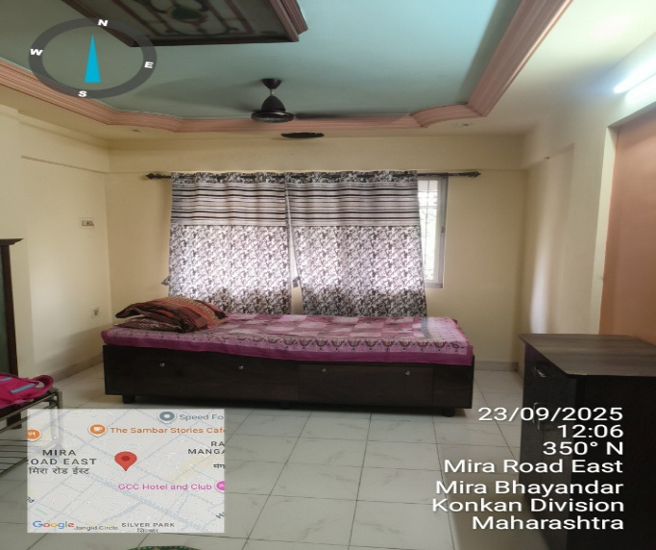
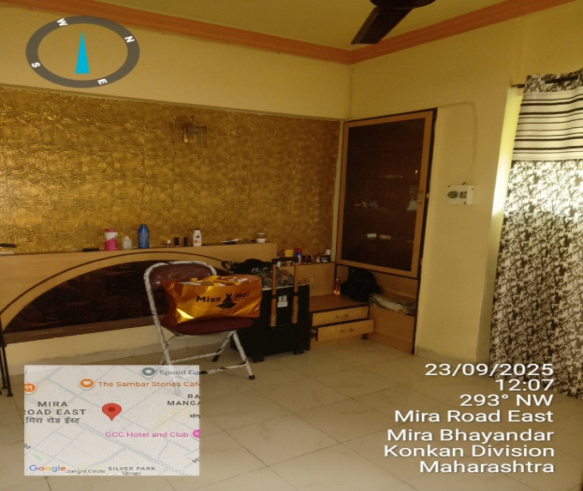
V.S.JADON & CO VALUERS LLP
Customer Name :- Impluse Branding Solution
VSJCVNM-AXIS-RTL-SEP25-21896 Page 1

Slide 2
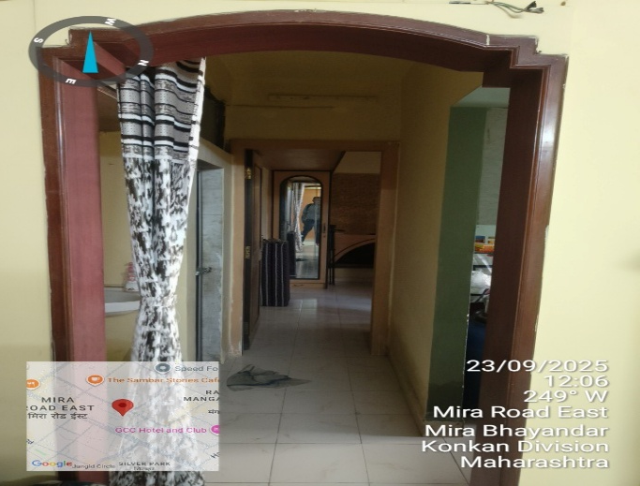
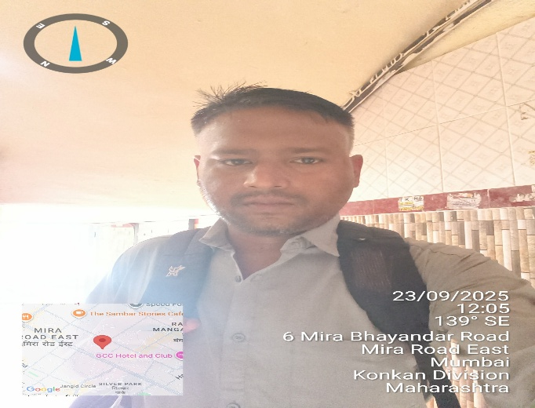
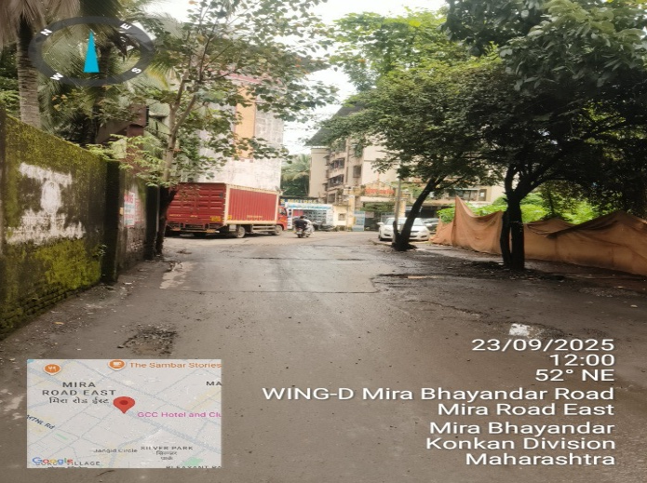
V.S.JADON & CO VALUERS LLP
Customer Name :- Impluse Branding Solution
VSJCVNM-AXIS-RTL-SEP25-21896 Page2

Slide 3
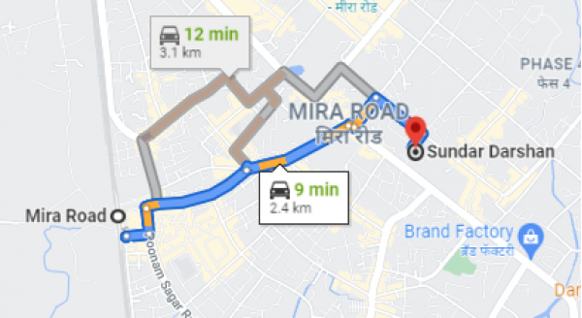
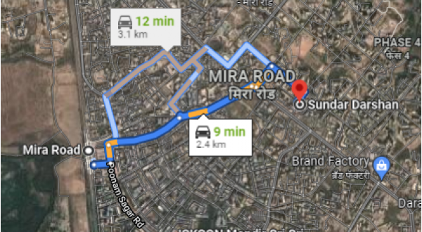
V.S.JADON & CO VALUERS LLP
PHOTOGRAPHS OF PROPERTY OF CUSTOMER Impluse Branding Solution
Google Maps :
VSJCVNM-AXIS-RTL-SEP25-21896 Page 3

Slide 4
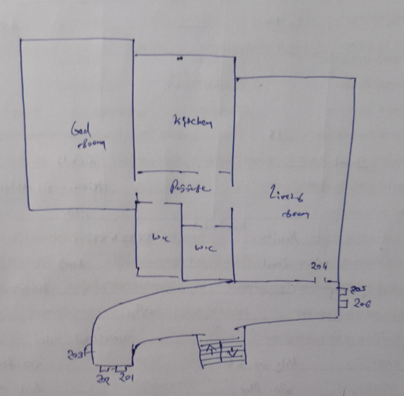
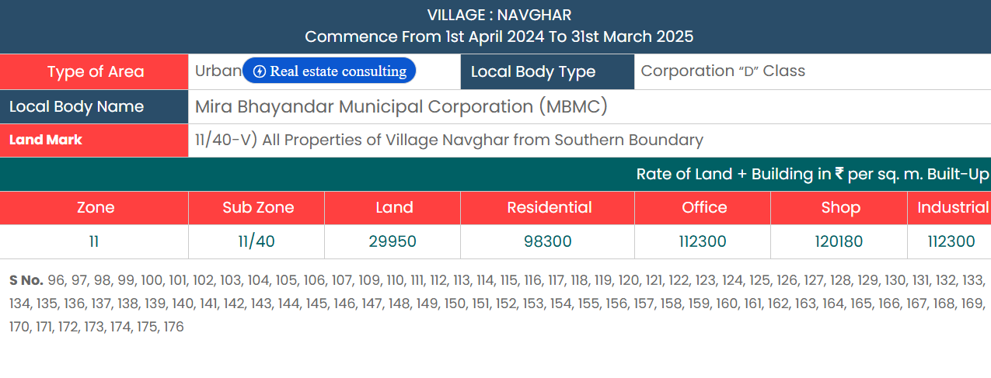
V.S.JADON & CO VALUERS LLP
PHOTOGRAPHS OF PROPERTY OF CUSTOMER Impluse Branding Solution
VSJCVNM-AXIS-RTL-SEP25-21896 Page 4

