Slide 1
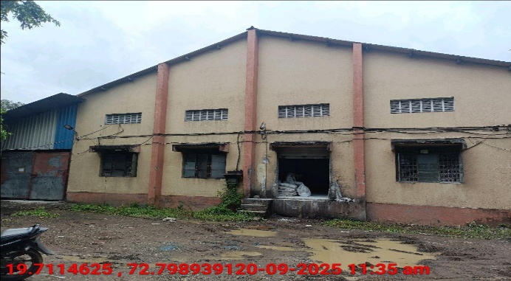
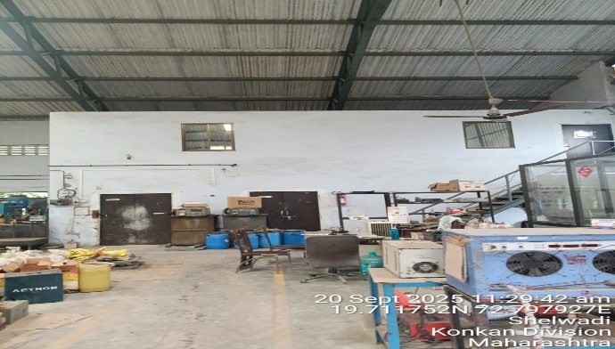
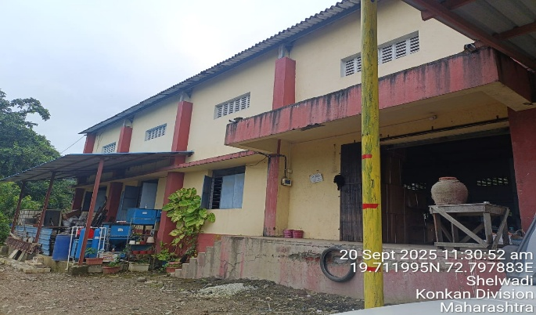
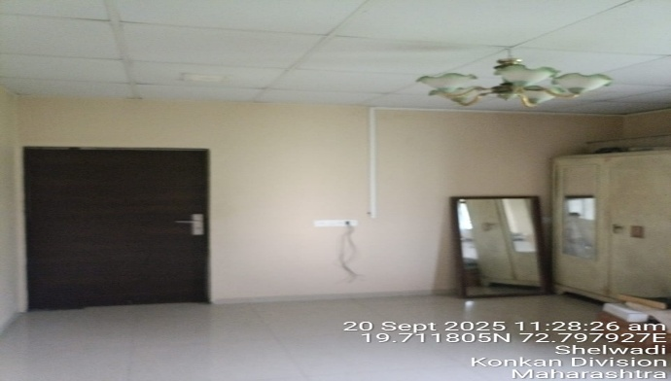
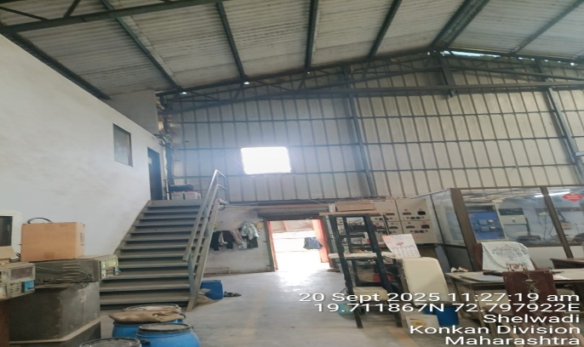
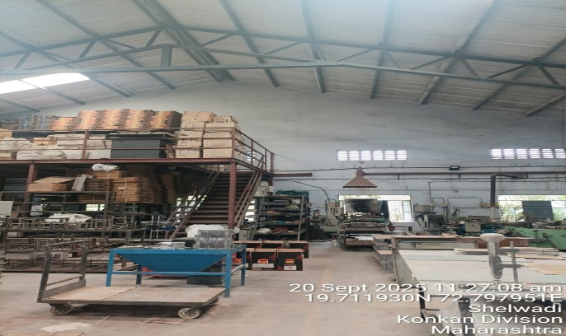
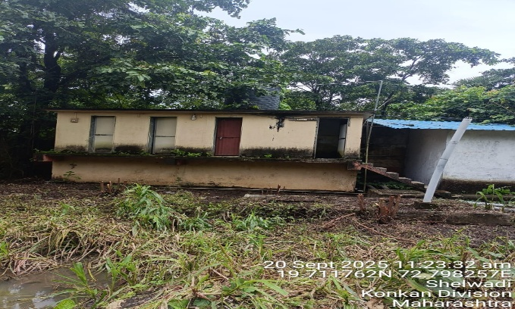
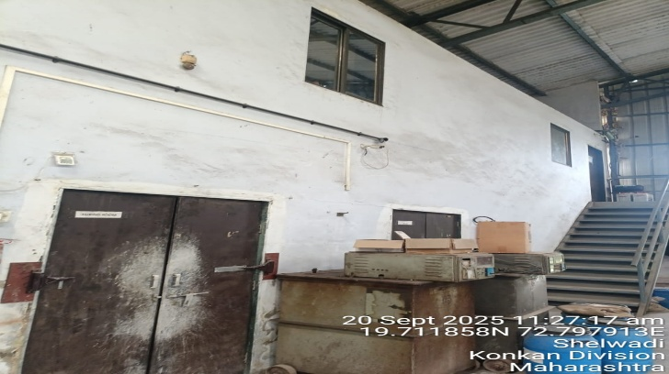
V.S.JADON & CO VALUERS LLP
PHOTOGRAPHS OF PROPERTY OF CUSTOMER: M/S Swastik Industries
Site Photo
VSJCVNM-AXIS-RTL-SEP25-21962 Page 7

Slide 2
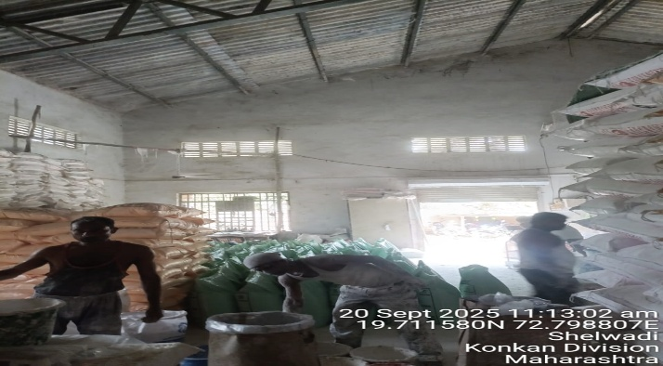
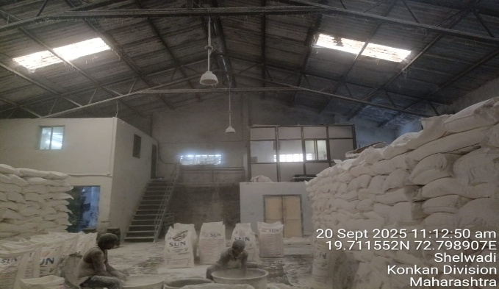
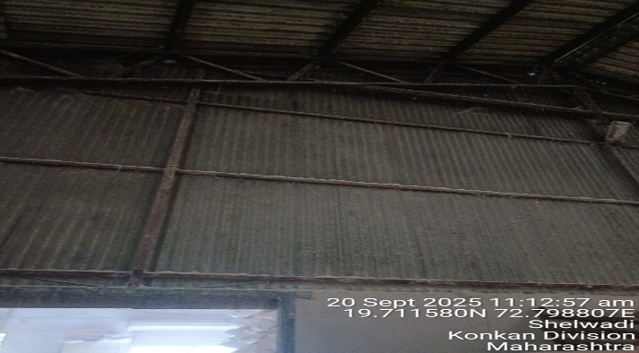
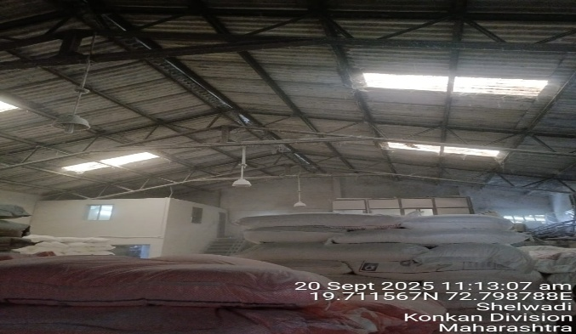
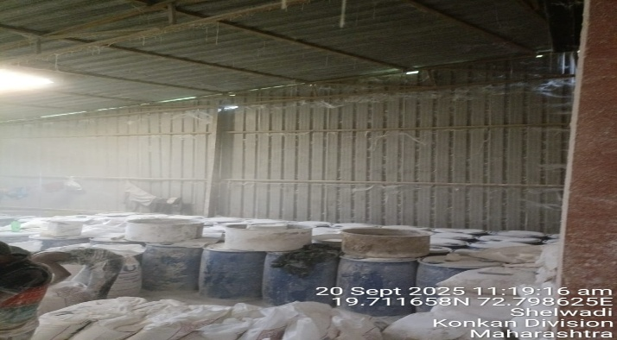

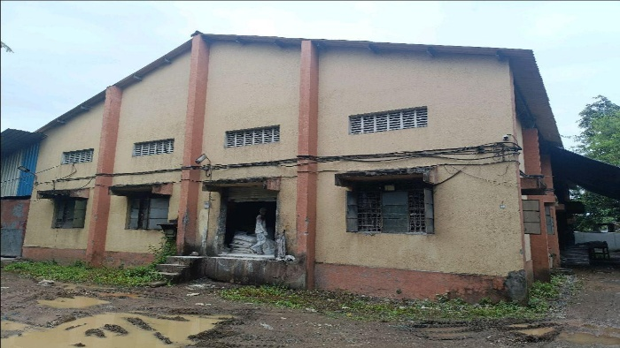
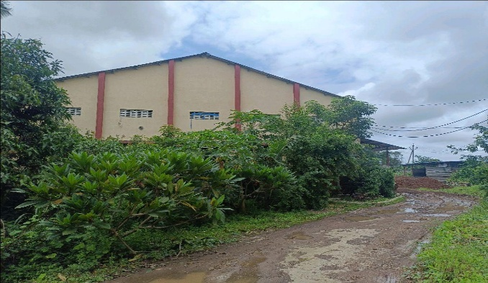
V.S.JADON & CO VALUERS LLP
PHOTOGRAPHS OF PROPERTY OF CUSTOMER: M/S Swastik Industries
Site Photo
VSJCVNM-AXIS-RTL-SEP25-21962 Page 8

Slide 3
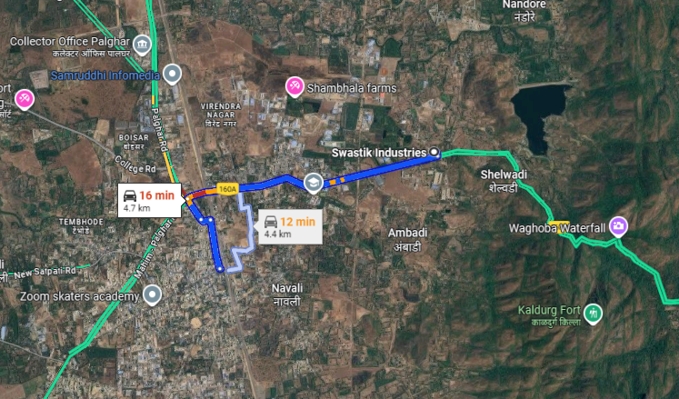
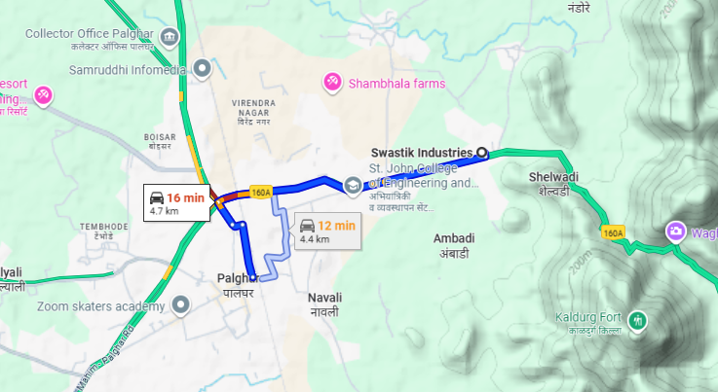
V.S.JADON & CO VALUERS LLP
PHOTOGRAPHS OF PROPERTY OF CUSTOMER: M/S Swastik Industries
Google Map :
VSJCVNM-AXIS-RTL-SEP25-21962 Page 9

Slide 4
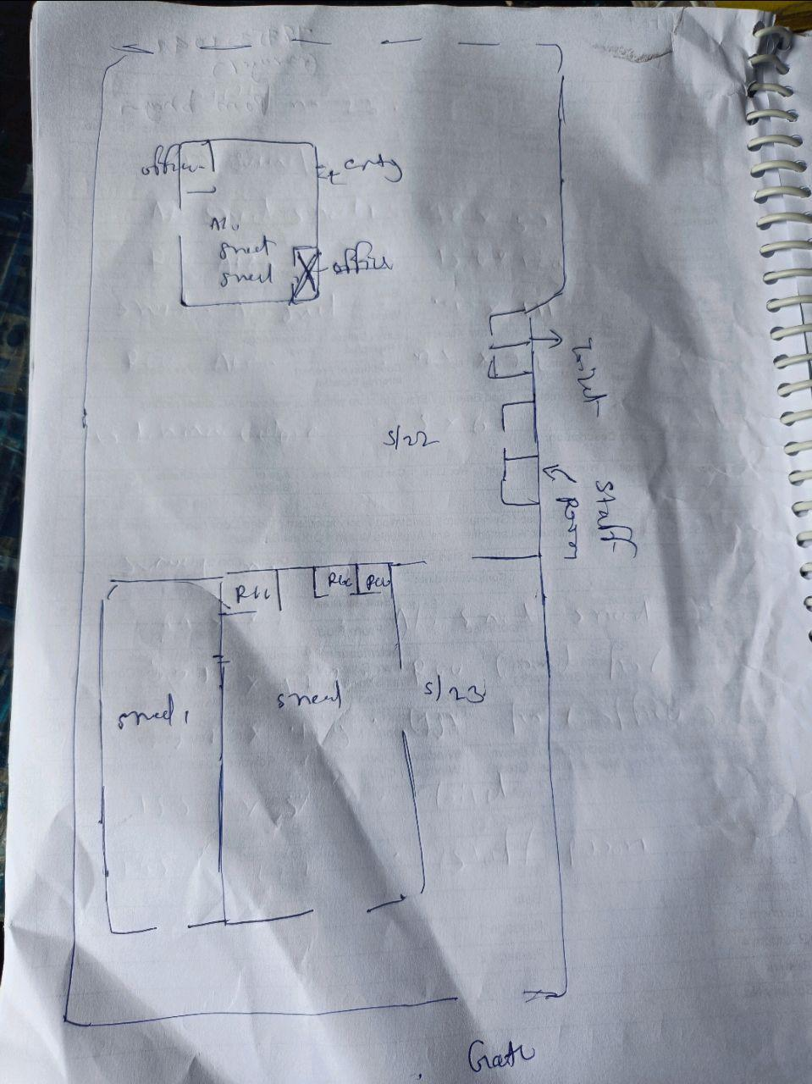
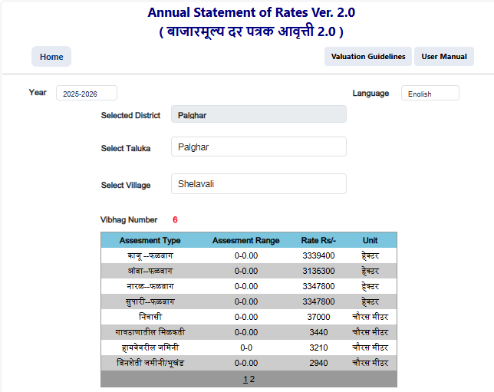
V.S.JADON & CO VALUERS LLP
PHOTOGRAPHS OF PROPERTY OF CUSTOMER M/S Swastik Industries
Site layout & Govt Rate :
VSJCVNM-AXIS-RTL-SEP25-21962 Page 10

